Slide 1





Slide 2

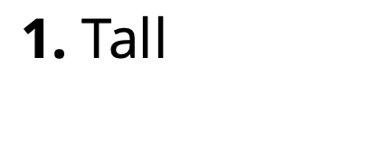
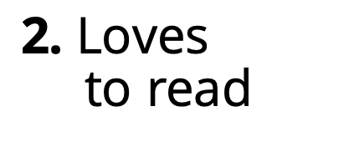
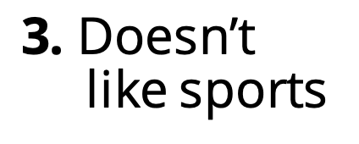
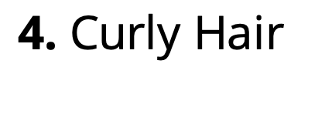
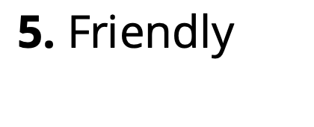
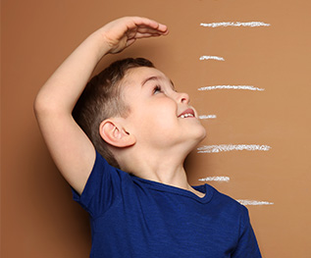

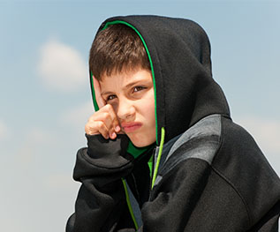
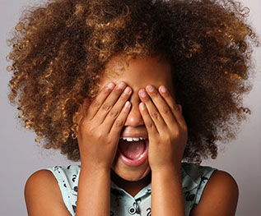
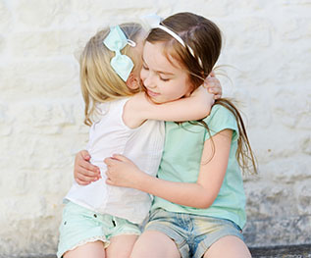



1. Tall
2. Loves
to read
3. Doesn’t like sports
4. Curly Hair
5. Friendly
OUTSIDE
INSIDE
INSIDE
OUTSIDE
INSIDE
Notes:
Instructor Notes:
Instruct the class to sit on the floor in a circle or semi-circle, and join the students by sitting at their level. Then begin the first session by reading the following Wings Words to Live By excerpt aloud: “I soar with wings.
Let me tell you why. I learn lots of skills that help me reach the sky. I love and accept who I am on the inside.”
Repeat the last line: “I love and accept who I am on the inside.”
Click once and ask students: What does “on the inside” mean? Ensure students understand that “on the inside” refers to the way you think, feel and act…not what you look like!
Click again to display a few different traits/qualities. Read them one at a time and have the class help you decide whether these words describe a person on the outside or inside. As students answer, click to reveal the answer next to each word.
Tall [click to reveal “outside”]
Loves to read [click to reveal “inside”]
Doesn’t like sports [click to reveal “inside”]
Curly hair [click to reveal “outside”]
Friendly [click to reveal “inside”]

Slide 3
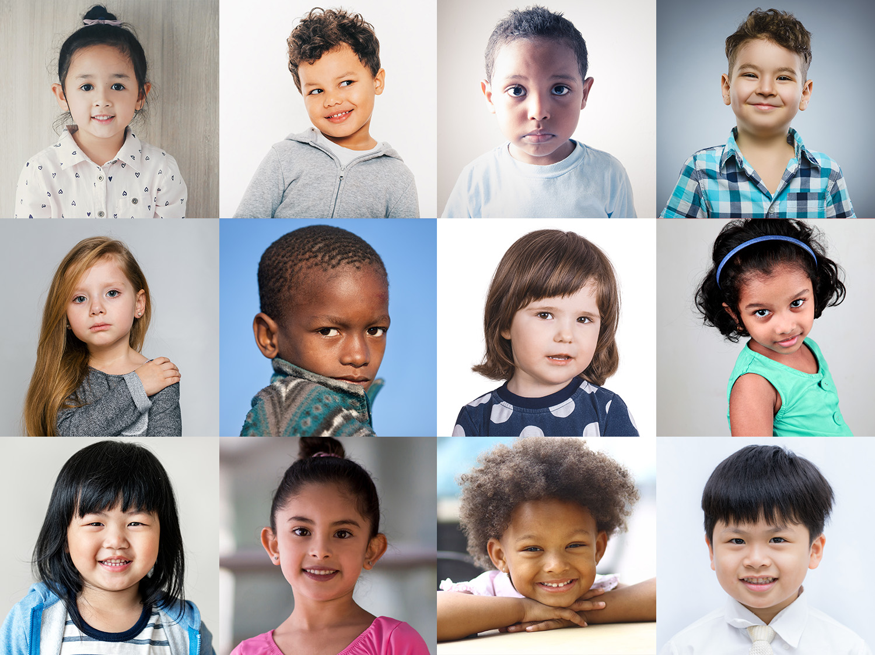

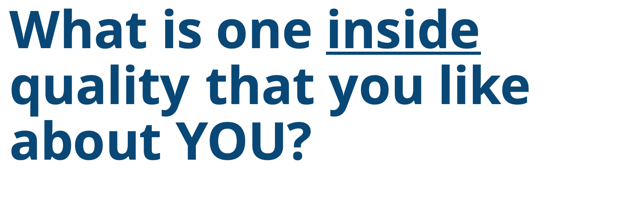
What is one inside quality that you like about YOU?
Notes:
Instructor Notes:
Encourage students to think about one “inside” quality that they like about themselves, and challenge them to come up with a silent hand signal, gesture, or movement that demonstrates this quality.
Explain, for instance, that if someone enjoys drawing, they could pretend one hand is a piece of paper and then use the other hand to pretend to draw on it.
Give students a moment to think of a gesture or movement. Then instruct students to stand up, and silently begin making their gesture. As students make these movements, encourage them to look around and observe what their peers are doing.

Slide 4
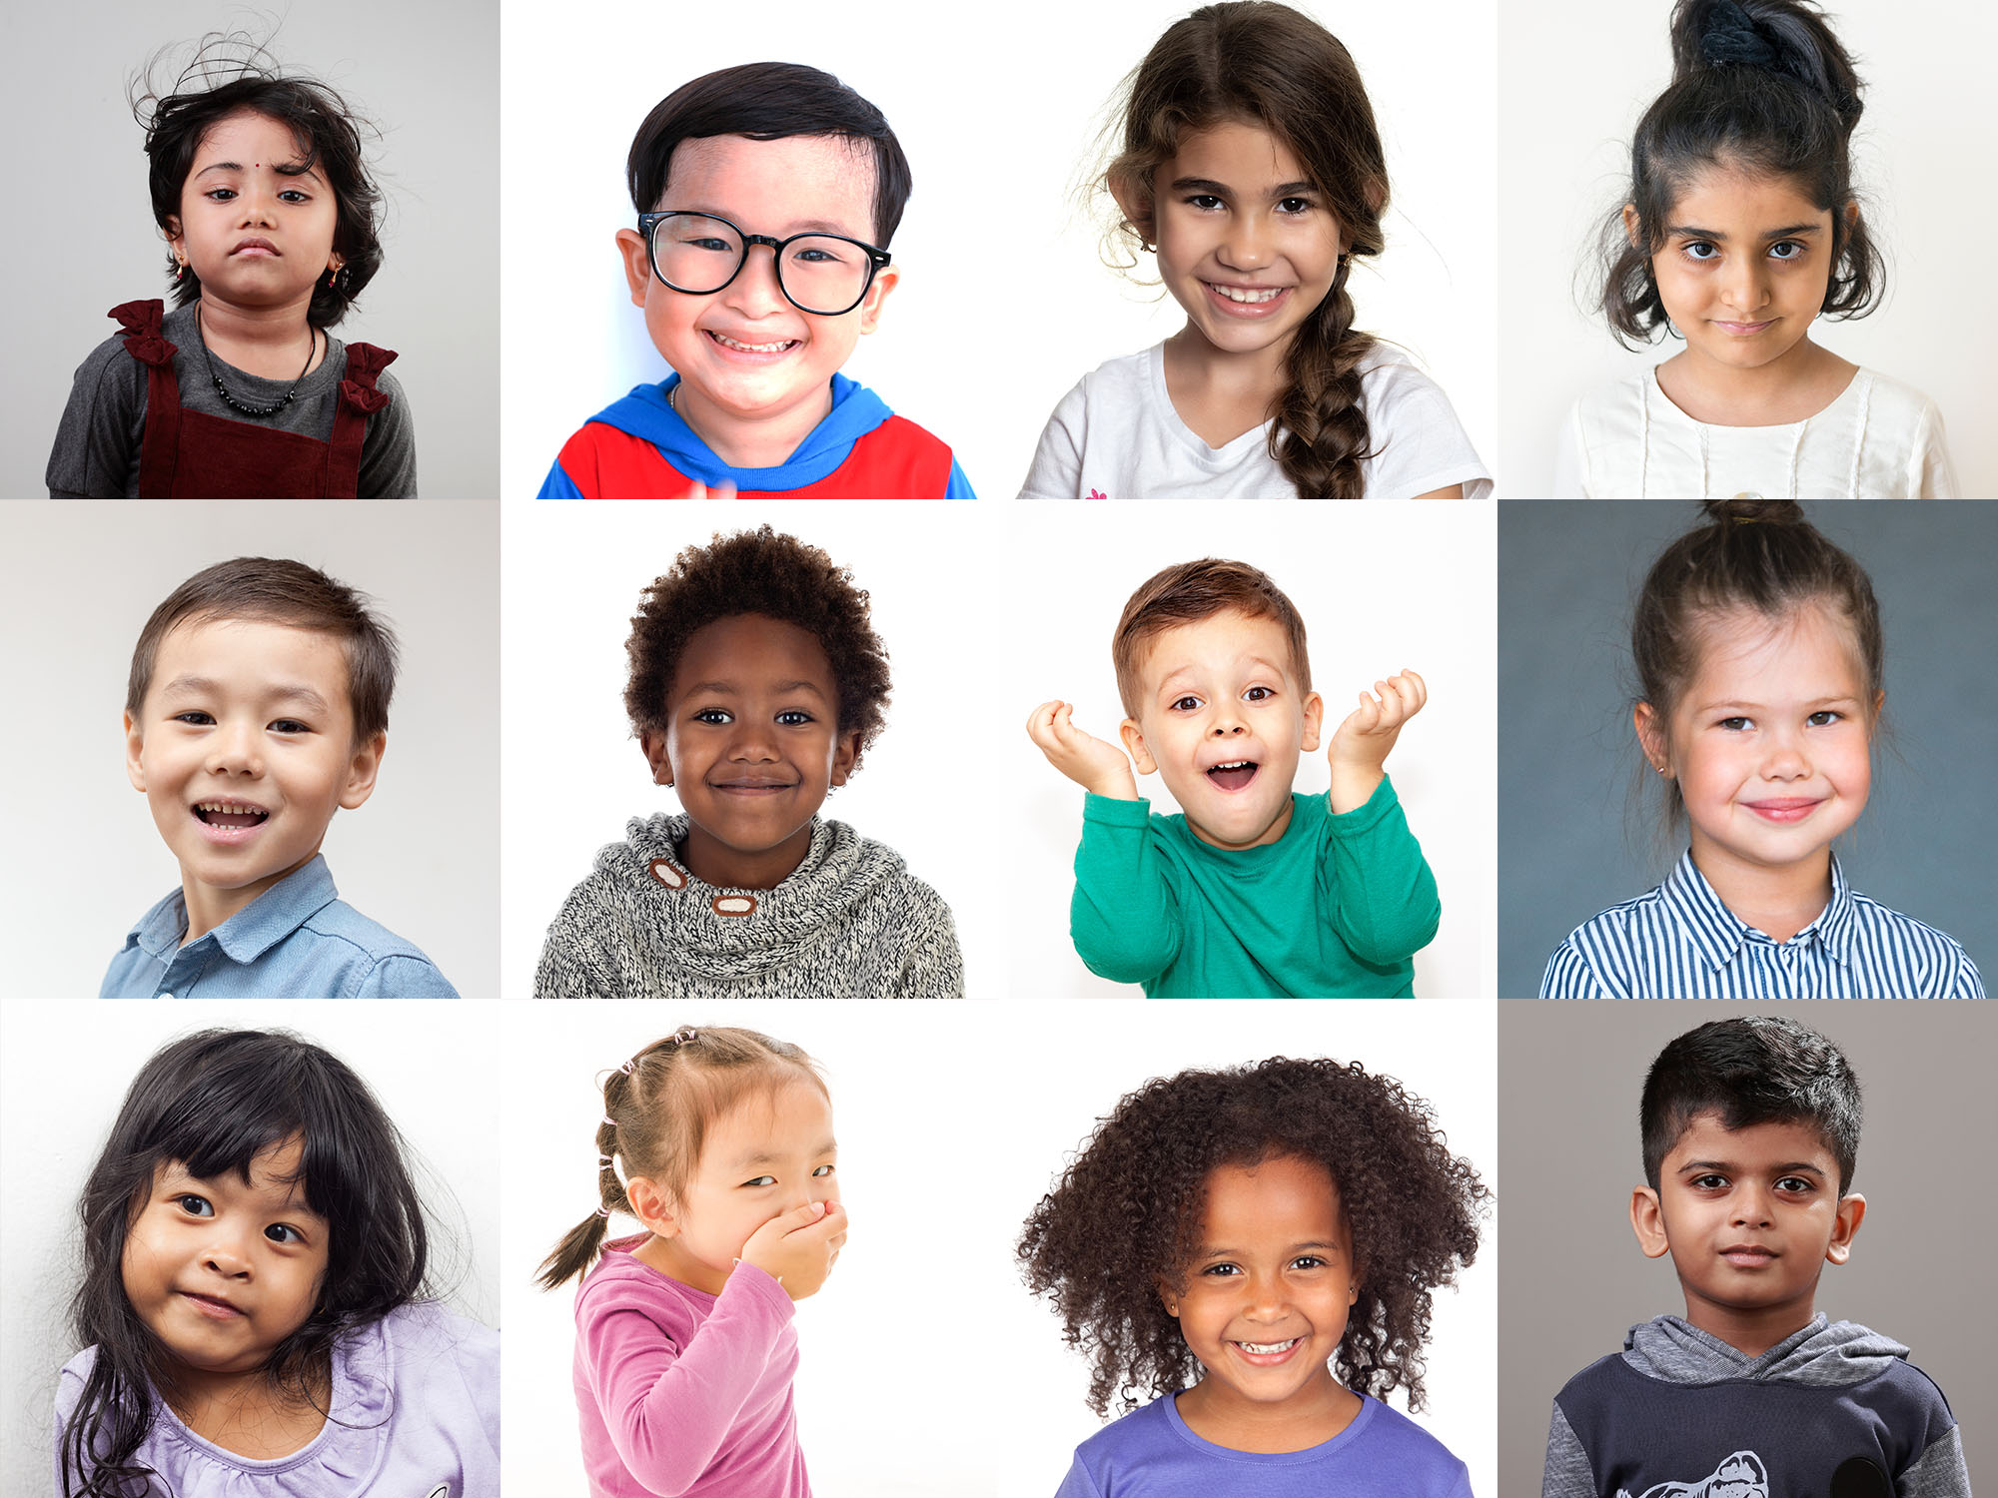



What did you notice as you looked around?
We all have DIFFERENT strengths!
We all have strengths!
Notes:
Instructor Notes:
Once students have a chance to look around and observe their peers, instruct them to sit back down.
Then ask: What did you notice as you looked around?
Lead the class in making the observation that most (if not all) students were making different movements. This shows that we are all unique and all have different qualities that we like about ourselves!
Click and explain that these qualities are called our strengths­. Strengths are things that we are good at and proud of about ourselves.
Click again and explain: Because we are all different, we all have different strengths.
Ask a few students to verbally share the strength that they just acted out. You may choose to kick off the discussion by sharing your own.
Once a few students have shared, stress again that everyone has their own strengths. While we may share some of the same strengths, we also have different strengths.

Slide 5
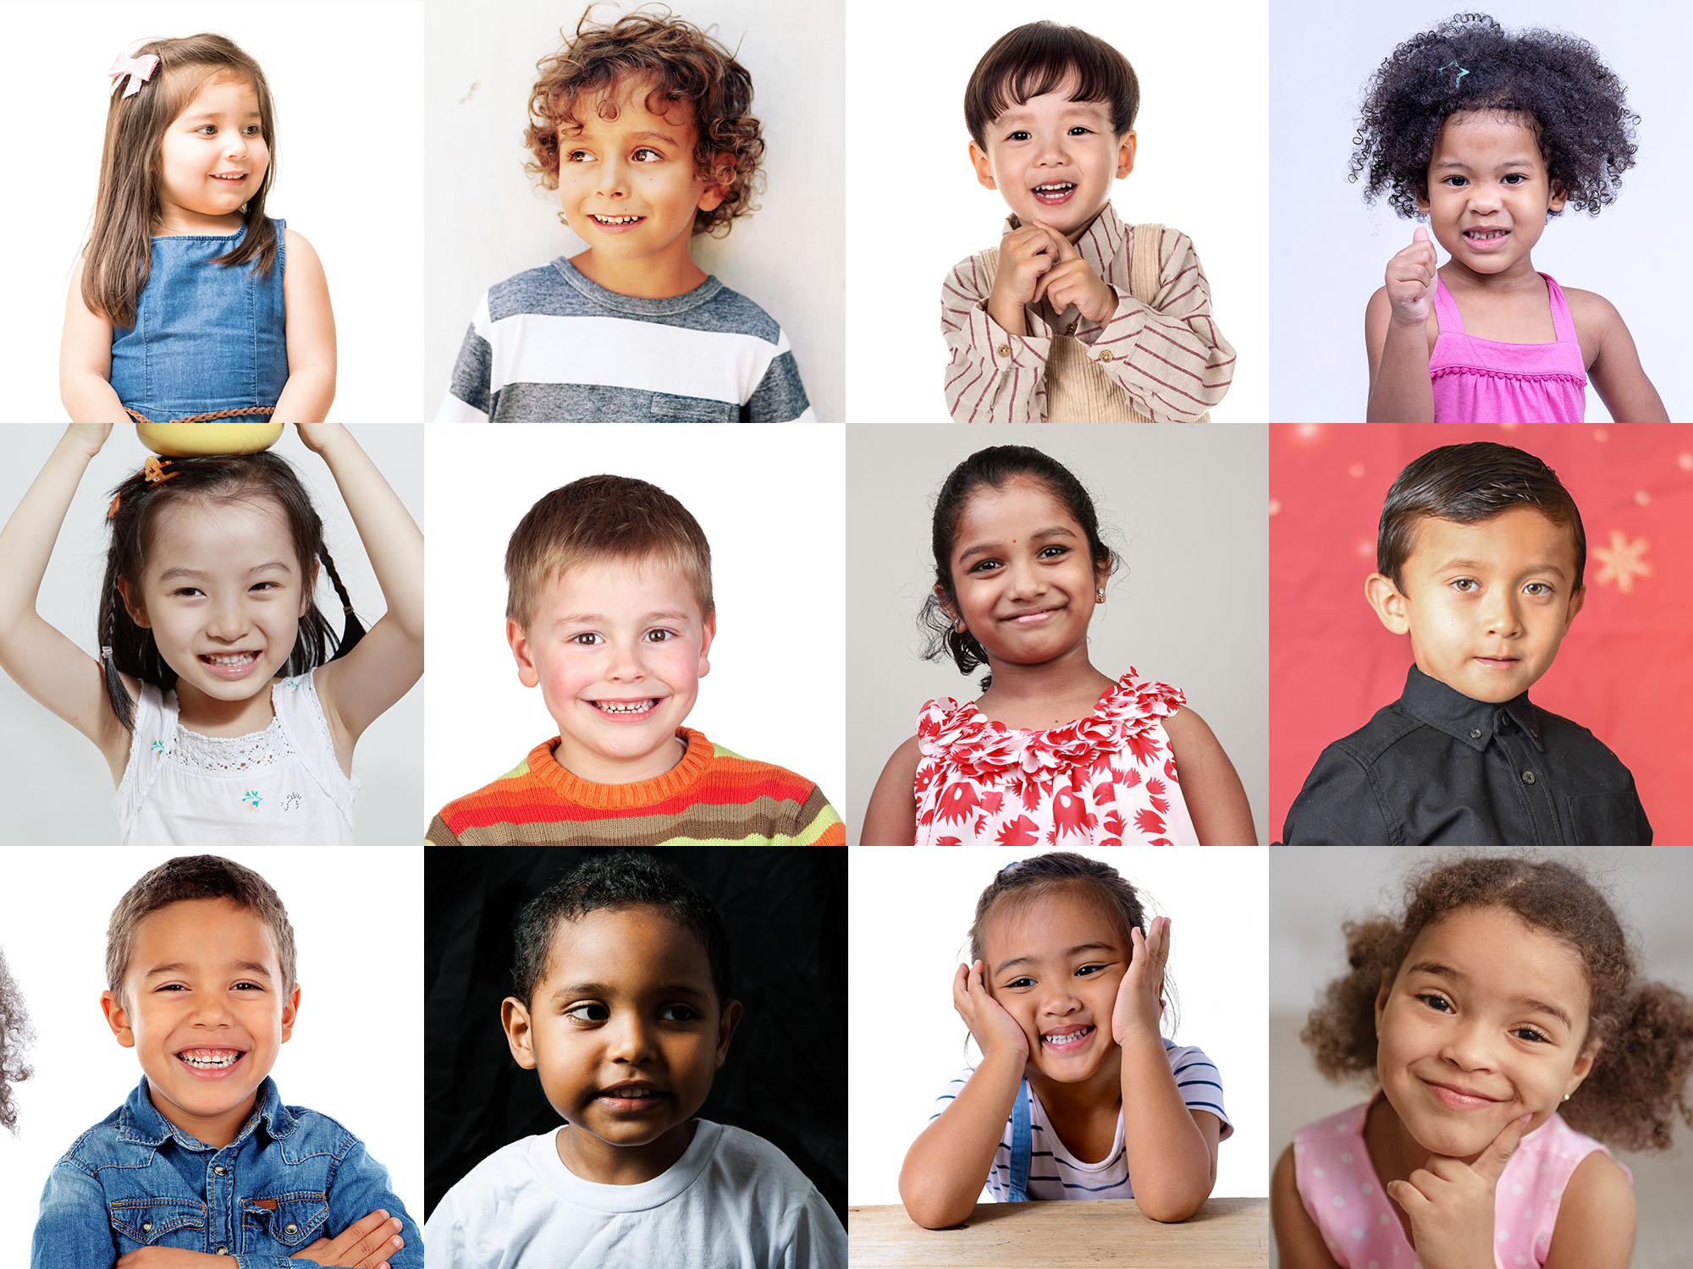


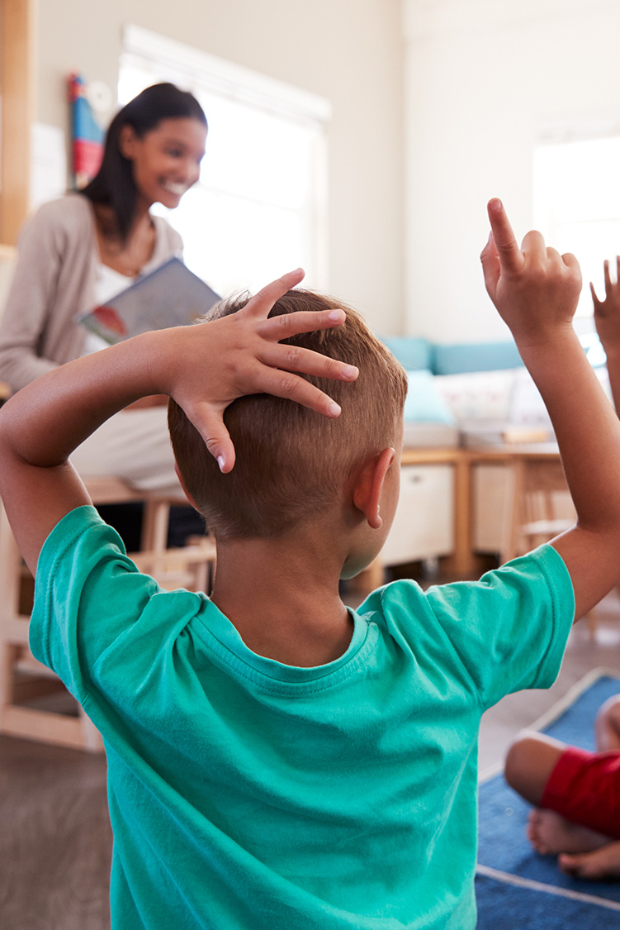
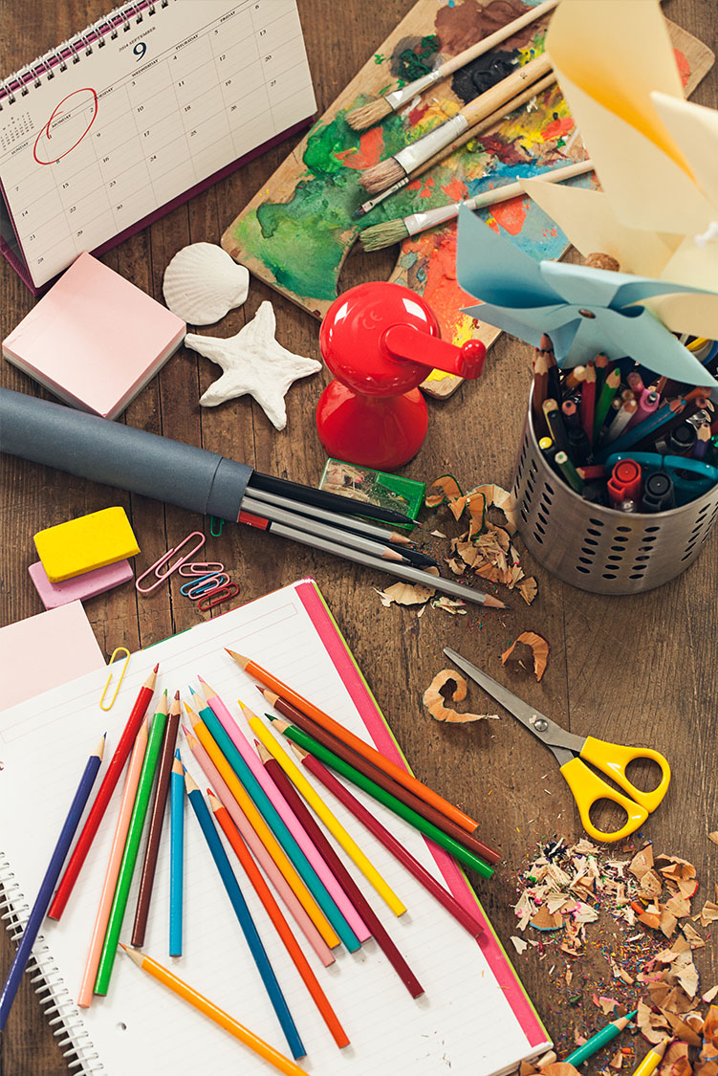
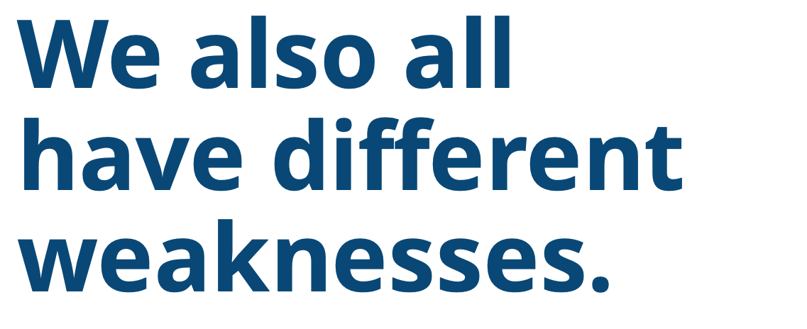


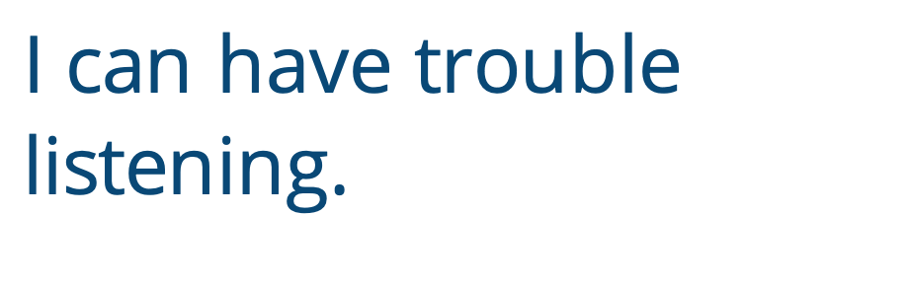
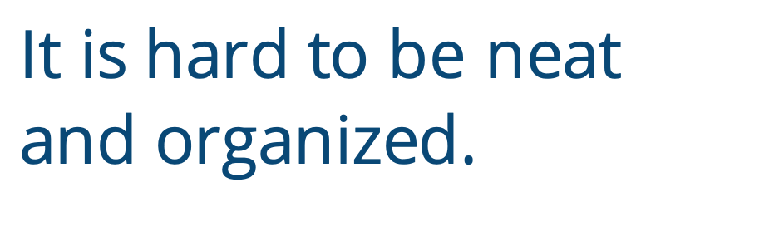
We also all have different weaknesses.
Math is hard for me.
I can have trouble listening.
It is hard to be neat and organized.
Reading is hard for me.
Notes:
Instructor Notes:
Move on to introduce the concept of a weakness. Explain that a weakness is something that you may not be very good at or something that you have to work really hard at. We should never be embarrassed about our weaknesses, because everyone has them! It just means that we have to work a little harder in this area.
Click to display the weakness: It is hard for me to be neat and organized.
Ask the class to:
1. Consider if they have this weakness. If they do, encourage them to give a thumbs up. Remind students that weaknesses are never something to be ashamed of.
2. Discuss:
How could someone get better at this weakness?
Who could we ask to help us with this weakness?
Click to remove this weakness and display the next one. Continue to follow the directions above for the following three weaknesses*:
Math is hard for me.
I can have trouble listening.
Reading is hard for me.
*Note: If there are other weakness(es) with which your class struggles, feel free to edit the presentation!
Click to remove the final weakness and again display the original picture. Before moving to the next side, reiterate that every person in the world has weaknesses, and no one should ever be embarrassed about them! Instead, we should try to work on our weaknesses so they get better, and ask for help when we need it.

Slide 6
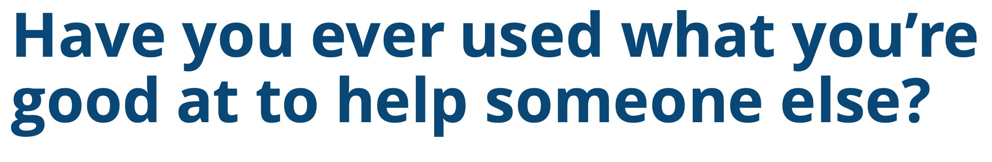







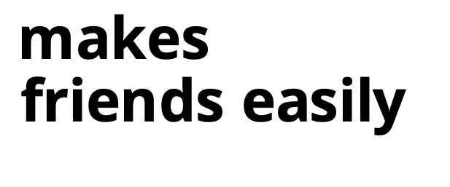
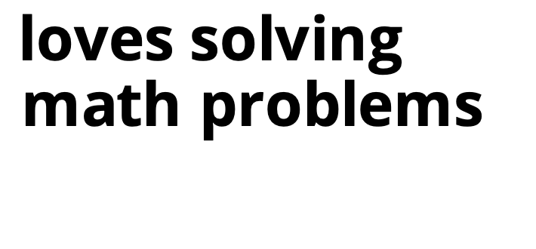
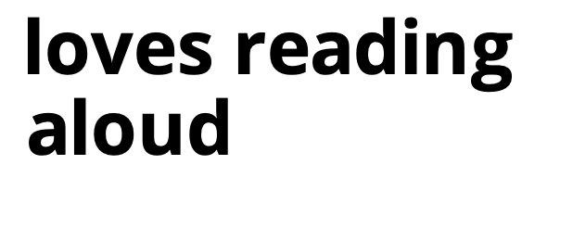
STUDENT 1
STUDENT 2
thinks math facts are hard
always follows directions
is shy
forgets the teacher’s directions
has trouble with letter sounds
makes
friends easily
loves solving math problems
loves reading aloud
Notes:
Instructor Notes:
Ask students if they’ve ever been able to use one of their strengths to help someone else with one of their weaknesses. Or, in simpler words: Have you ever used what you’re good at to help someone else? Invite a couple students to share.
Ask for two student volunteers who would like to be actors. Tell one volunteer that s/he is now Student #1, and tell the other student that s/he is now Student #2.
Click once to display two stick figures with the following descriptors:
Student #1: Is shy
Student #2: Makes friends easily
Read the descriptors to the class and then ask: How could one of these students use his/her strength to help the other student?
Invite a couple students to share their ideas. Then ask the volunteer actors to act out how Student #2 could help Student #1. If the students are unsure, you may suggest that Student #2 ask Student #1 if s/he would like to play a game together.
Next, divide students into pairs, and assign one student in each pair to be Student #1 and the other student to be Student #2.
Explain that each pair is going to act out a few new scenarios.
Click to display each of the following scenarios. Each time, instruct the student pairs to act out how one student could use their strength to help the other student with their weakness.
Scenario 2:
Student #1: Has trouble with letter sounds
Student #2: Loves to read aloud
Scenario 3:
Student #1: Always follows directions
Student #2: Forgets the teacher’s directions
Scenario 4:
Student #1: Thinks math facts are hard
Student #2: Loves solving math problems

Slide 7


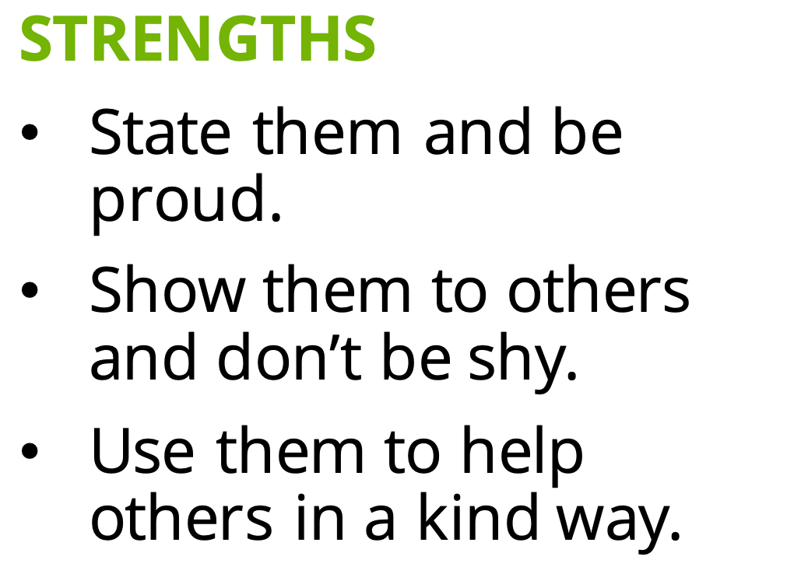
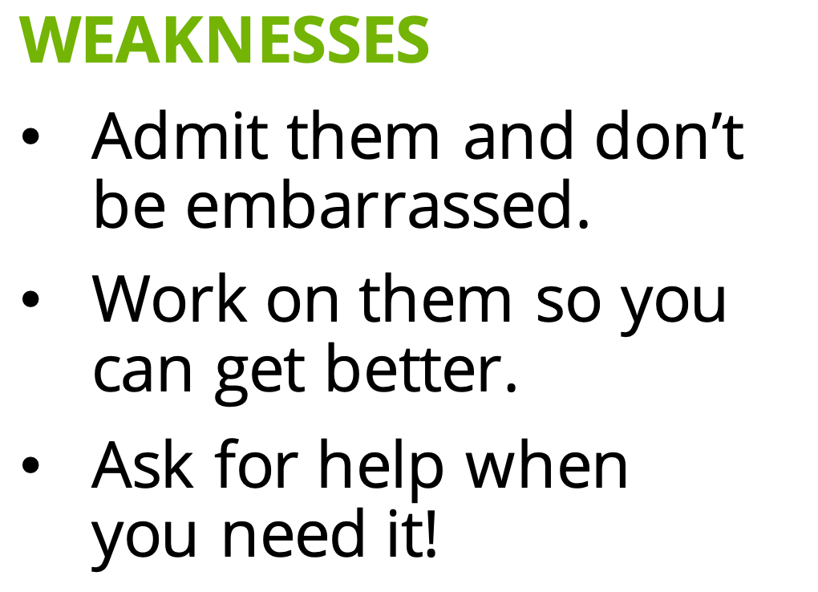
Everyone has strengths and weaknesses!
I love and accept who
I am on the inside!
STRENGTHS
State them and be proud.
Show them to others and don’t be shy.
Use them to help others in a kind way.
WEAKNESSES
Admit them and don’t
be embarrassed.
Work on them so you
can get better.
Ask for help when
you need it!
Notes:
Instructor Notes:
Bring the class back together, and prompt students to consider what they learned. Say: Everyone (including adults!) has strengths and weakness.
Ask: What is important to remember about our strengths?
Allow students to share their ideas.
Then click and read the following bulleted summary, perform the accompanying action as you read each line, and instruct the class to repeat after you:
State them and be proud. [Action: Put both hands in the air.]
Show them to others and not be shy. [Action: Put both hands out in front of you with your palms up, like you are offering something to someone.]
Use them to help others in a kind way [Action: Gently fist-bump a peer.]
Ask: What is important to remember about our weaknesses?
Allow students to share their ideas.
Click again and read the following bulleted summary, perform the accompanying action as you read each one, and instruct the class to repeat after you:
Admit them and don’t be embarrassed. [Action: Shoulder shrug with arms out to the side.]
Work on them so you can get better. [Action: Muscle arms!]
Ask for help when you need it! [Action: Raise your hand.]
Click and tell students that when they think about and share their strengths and weaknesses, they are showing: I love and accept who I am on the inside!

Slide 8
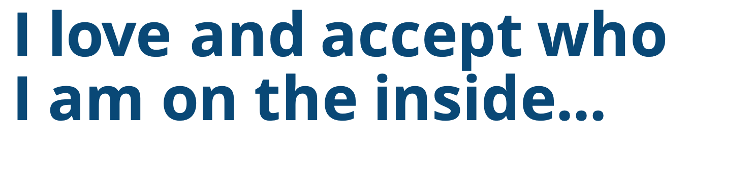
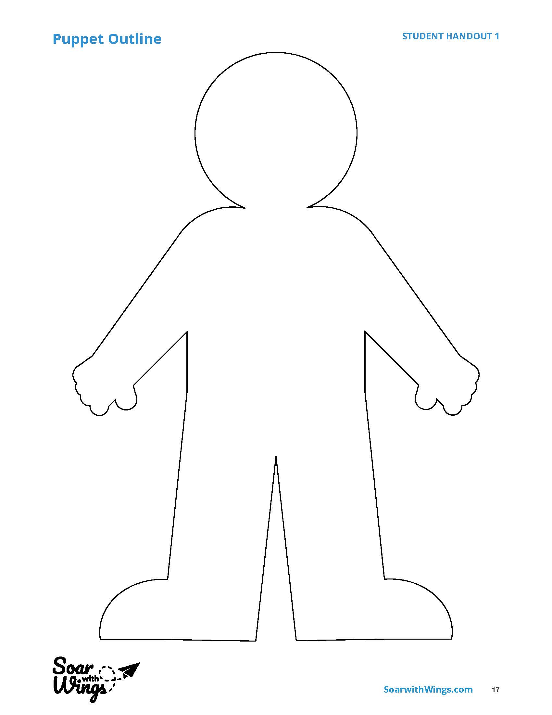
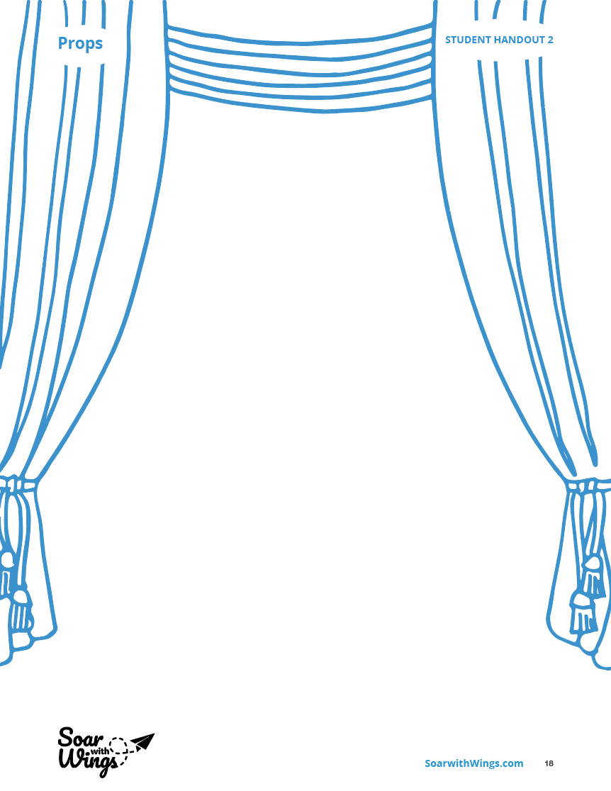
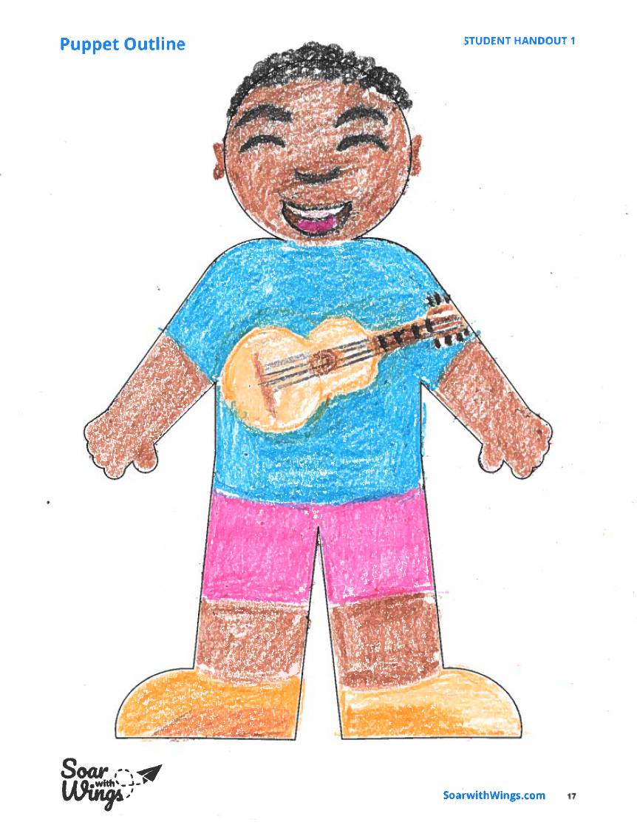
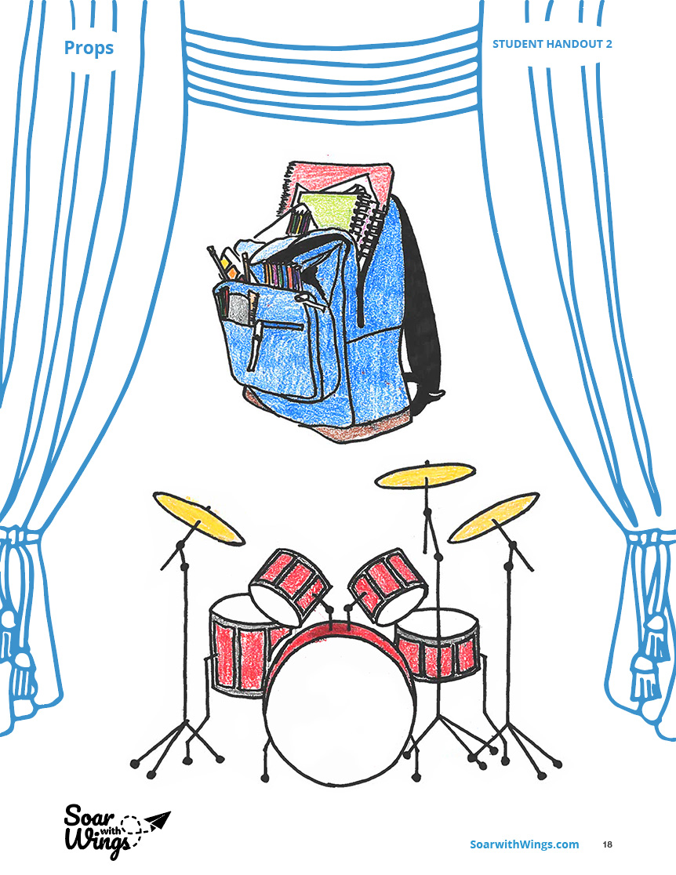
Notes:
Instructor Notes:
Tell students that over the next few sessions, they will work on creating a puppet show that features them as the main character! Their puppet character will have the same strengths and weaknesses as their actual self.
Explain that for the time that remains in this session, students will be creating two items for their puppet show:
Click once to display a copy of Handout 1: Puppet Outline and explain that students will decorate this outline to create a puppet that looks like them!
Click again to display Handout 2: Props and explain that students will draw props on this paper that could help others understand at least one of their strengths and one of their weaknesses.
*Tip: You may challenge older classes or advanced students by increasing this number.
Click to show a completed example of both handouts. Explain that in this example, one of this student’s strengths is that he is good at playing music, which is shown by the guitar on his shirt and the drum set on the Props Handout. One of his weaknesses is that he is a little disorganized, which is shown by the messy backpack on the Props Handout!
Answer any questions that students may have and then distribute Handout 1: Puppet Outline and Handout 2: Props to each student, as well as coloring materials.
Instruct students to raise their hands when they are done so you can review their work and provide any suggestions.

Slide 9
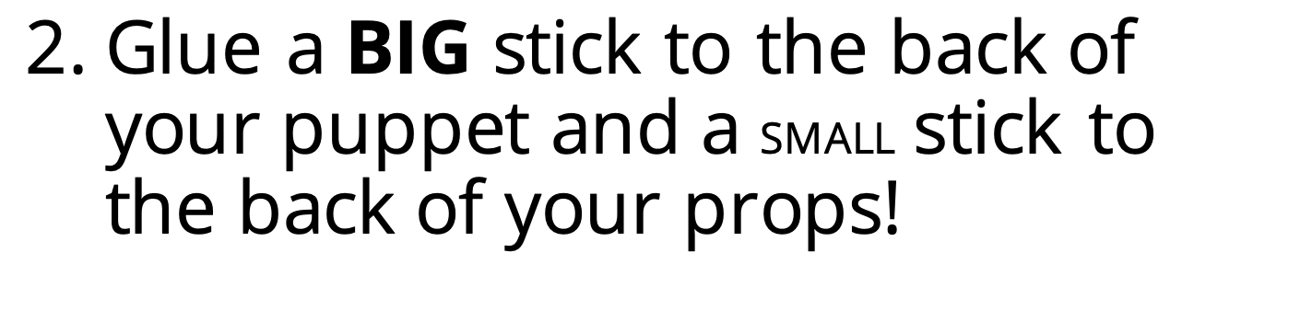
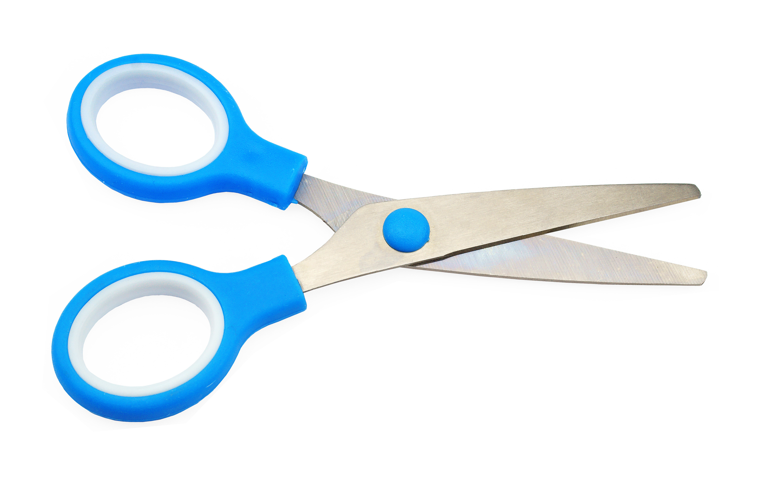
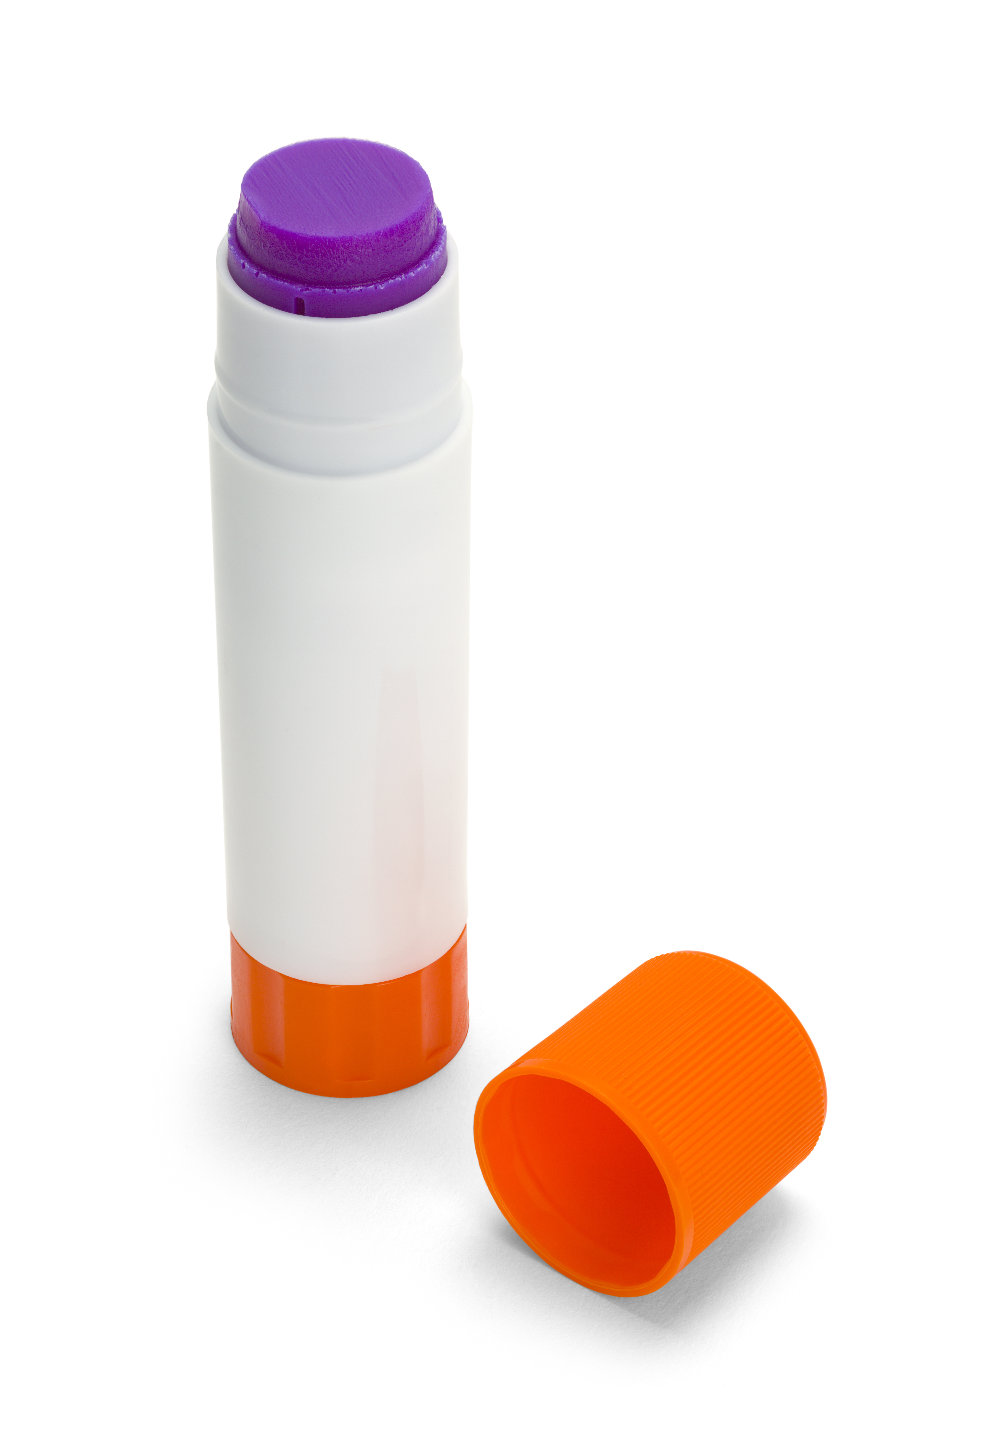
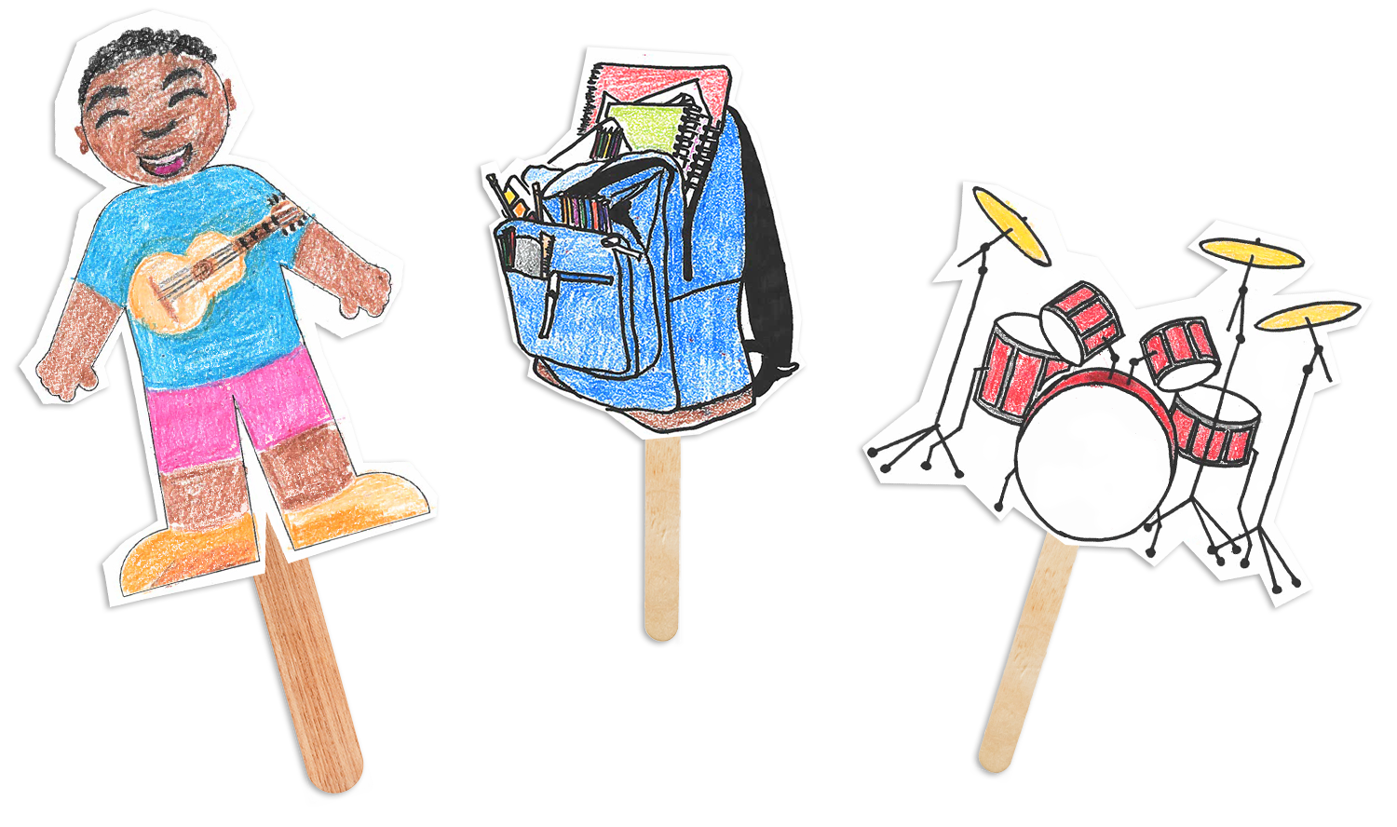
1. Cut out your puppet and props!
2. Glue a BIG stick to the back of your puppet and a SMALL stick to the back of your props!
Notes:
Images:
Image 1: Scissors
Image 2: Glue Stick
Image 3: Cut-out Puppet Image from Slide 7, with a BIG wood stick behind it (like this: http://realpurdy.com/wp2012/wp-content/uploads/2012/09/IMG_4149.jpg)
Image 4: Cut-out Backpack Prop Image from Slide 7 with a small wood stick behind it
Image 5: Cut-out Drum Set Image from Slide 7 with a small wood stick behind it
Design Notes:
Landing Slide: Puppet Directions Header
1st click: Step #1 and Image #1
2nd click: Add Step #2 (with “big” and “small” accentuated), as well as Images 2-5
Instructor Notes:
Pass out scissors, one paint stirrer (for the puppet handle), craft sticks (for the prop handles), and a glue stick to each student.
Click once and instruct the class to first cut out their puppet and props.
Click again and explain that once their puppet and props are cut out, they will glue their puppets and props onto the sticks, so they become puppets! Be sure to show students that the big craft stick is for the big puppet and the smaller sticks are for their props.
Once students have finished the assembly, have them place their completed materials into bags or folders labeled with their names.
Note: If the puppet and props can’t be entirely completed this session, they may be finished in stations or as an activity in upcoming sessions before you move on to Day 2.

Slide 10
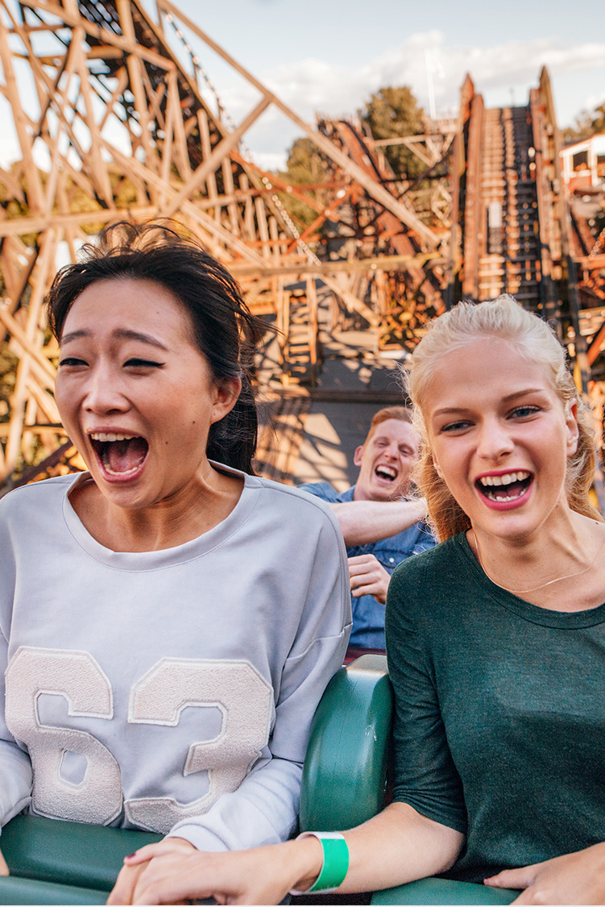
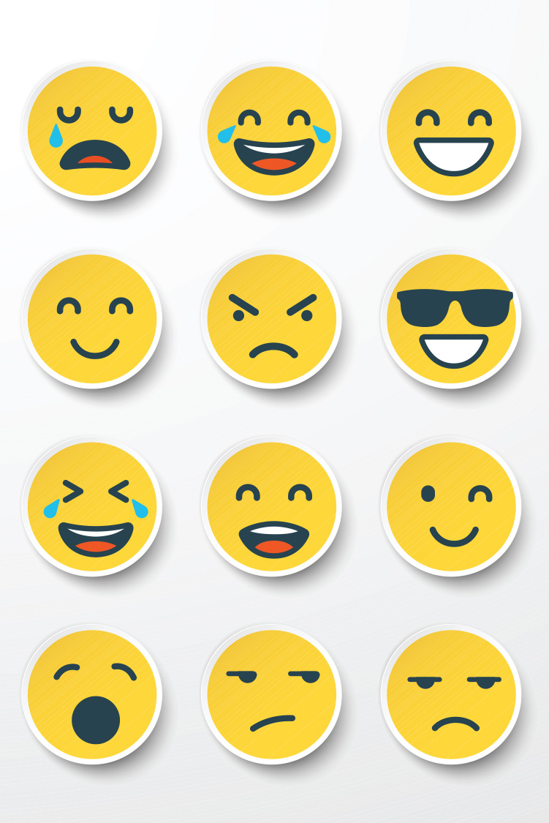


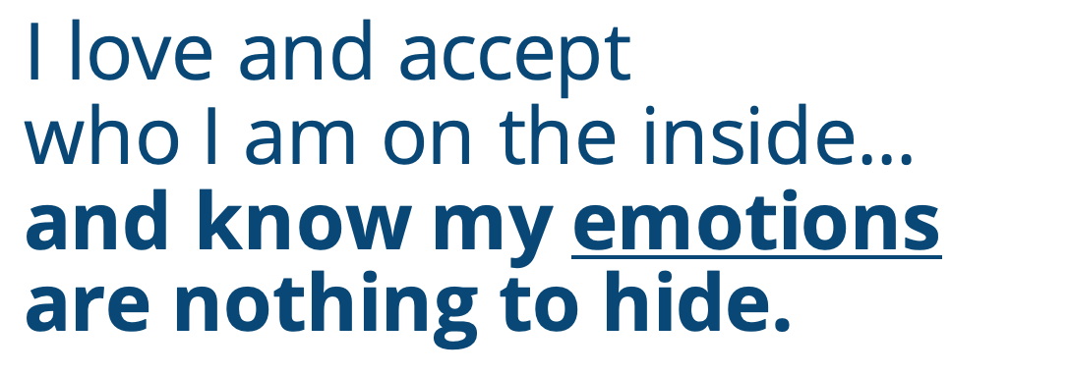
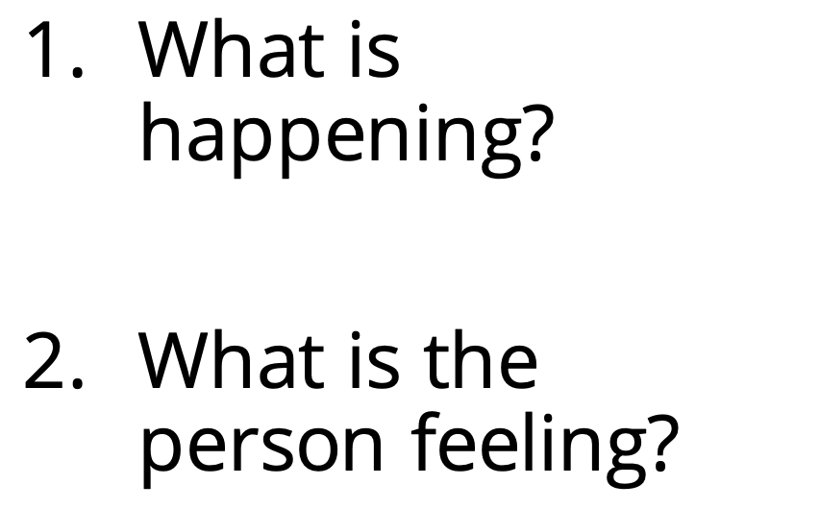
I love and accept who I am on the inside... and know my emotions are nothing to hide.
SCENE: ROLLER COASTER RIDE
What is happening?
What is the person feeling?
Notes:
Instructor Notes:
Assemble students on the floor in a circle or semi-circle. Then begin the second session by reading the following Wings Words to Live By excerpt aloud, accentuating the italicized portion: “I love and accept who I am on the inside and know my emotions are nothing to hide.”
Click once and ask students to think about what the word “emotion” means, and tell them you are going to play a game together before you discuss the answer.
Ask students to give you a thumbs up if they have heard of a game called charades.
Explain that in this game, one person silently acts something out while the other players have to guess what is happening.
Click again and explain that in today’s game, one student will secretly select a scene to act out. While they act out this scene, the rest of the class will have to guess:
1. What is happening?
2. What is this person feeling?
Click once to display the following scene: Roller Coaster Ride.
Explain that if you were the actor and you secretly selected “roller coaster ride,” you would act out what it looks like to be on a roller coaster ride and how you would be feeling.
Model what this would look like by sitting on a chair, putting your hands in the air, and pretending to move up and down. Explain that you would feel terrified, and then show students your scared face!
Click to remove the scenario and display a new image.
Call on a student volunteer to select one charade slip from your bowl of cut-out Handout 3: Charades Slips and then act it out for the class. You may need to give the students suggestions on how to act out the scene, and that’s okay…but try to encourage each student to come up with how they would feel on their own!
As the student actors are acting out each scene, ask the class to guess:
1. What is happening?
2. What is the person feeling?
After a scene and emotion is guessed correctly (or the correct answer is eventually given), ask students to raise one hand if they would feel the same way as the actor or two hands if they would feel differently. Invite a couple students who put two hands in the air to share how else they may feel in the same situation.
Once different student volunteers have acted out each of the scenarios or after about 10 minutes have passed, tell students that you are impressed with all of the emotions that they were able to act out and guess.
Ask: Do we now have a better idea of emotions?
Lead students in understanding that an emotion is a feeling: It is what we feel on the inside. Everyone’s emotions are unique, and sometimes people have different emotions even when they are in the same situation. Just like our strengths and weaknesses, our emotions are nothing to hide.

Slide 11
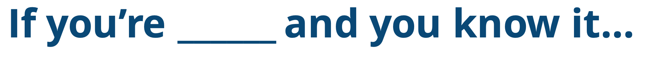
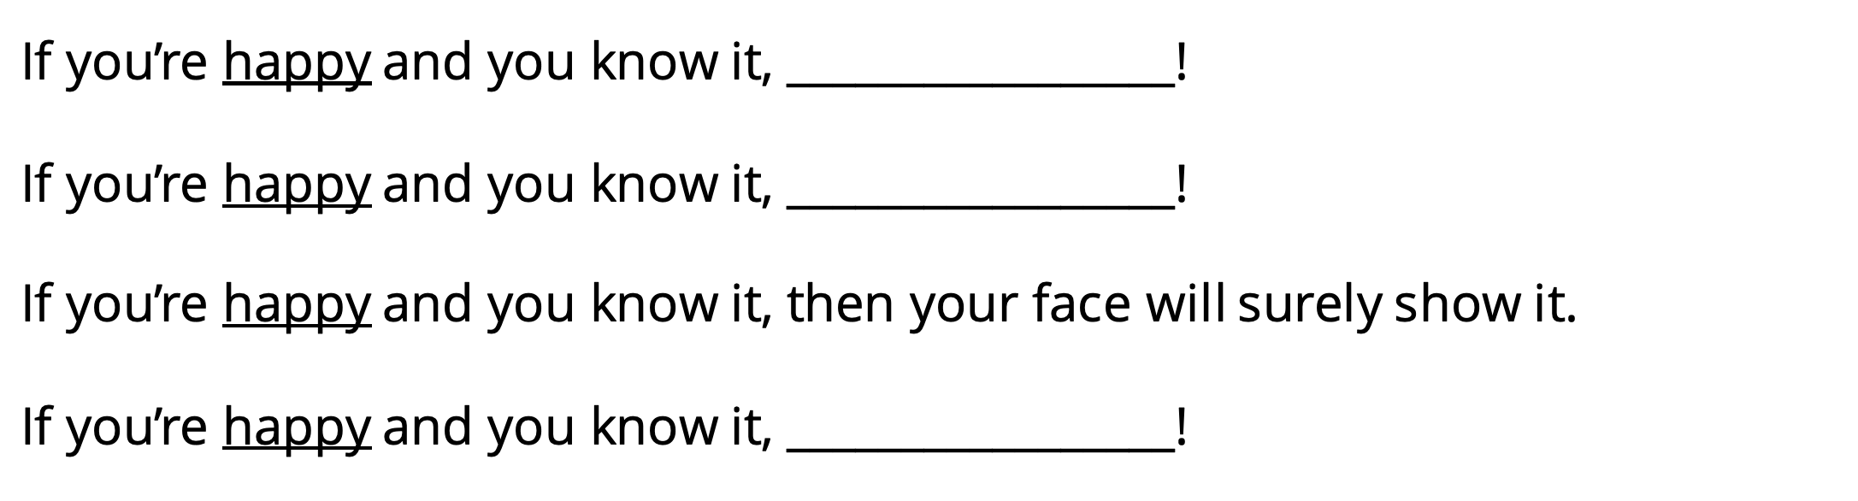
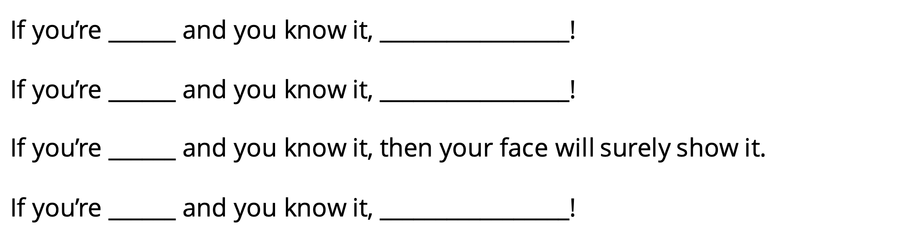
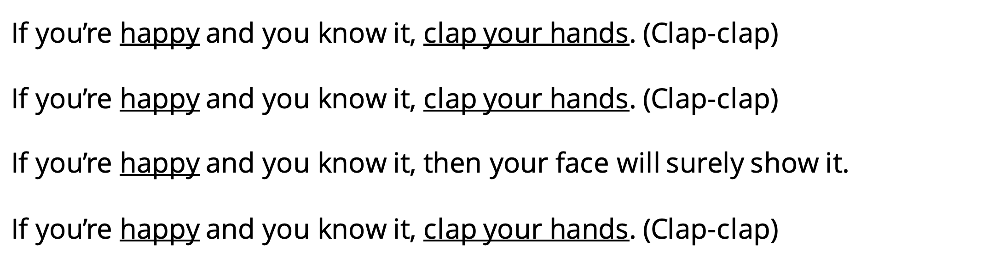
If you’re ______ and you know it…
FRUSTRATED
HAPPY
NERVOUS
ANGRY
EXCITED
EMBARRASSED
If you’re happy and you know it, _________________!
If you’re happy and you know it, _________________!
If you’re happy and you know it, then your face will surely show it.
If you’re happy and you know it, _________________!
If you’re ______ and you know it, _________________!
If you’re ______ and you know it, _________________!
If you’re ______ and you know it, then your face will surely show it.
If you’re ______ and you know it, _________________!
If you’re happy and you know it, clap your hands. (Clap-clap)
If you’re happy and you know it, clap your hands. (Clap-clap)
If you’re happy and you know it, then your face will surely show it.
If you’re happy and you know it, clap your hands. (Clap-clap)
Notes:
Instructor Notes:
Next, explain that not only do people feel many different emotions, but they may behave in different ways when they feel these emotions.
Tell students that when people feel happy, for instance, some people may clap their hands!
Click once and invite students to join you in singing the first verse of “If You’re Happy and You Know It.” Be sure to also clap your hands!
Click again, and ask students to consider what else they do when they’re happy. Insert one of the student’s suggestions into the song, and then sing the song together as a class with these new words and this new action.
For instance: If you’re happy and you know it, jump up and down!
Then click to reveal a new emotion: anger.
Call on a student volunteer to explain one way they act when they feel angry. Lead the class in singing the song with this new emotion and new action.
Next, repeat that everyone responds to emotions in different ways. Ask students to think about how they act when they feel angry, and give you a thumbs up when they have an idea.
Tell students that you are going to sing the “angry” version of the song together again, but this time every student should call out what they do when they’re angry and act it out…So everyone will say and do something a little different!
*Tip: Be prepared for this to be a little chaotic, but it will show students that different people act in different ways when they feel the same emotion!
Once the class has demonstrated how they act when they are angry, continue the steps above to lead the class through “excited,” “nervous,” “frustrated,” and “embarrassed.” Once you have double-clicked to reveal one of the new emotions, remember to:
Read the emotion.
Select a volunteer to fill in the song blanks with how they act when they feel this way.
Sing the song once as a class with this student’s action inserted.
Ask every student to think about what they do when they feel this emotion.
Sing the song with this emotion a second time, but this time have each student call out and act out what they do when they feel this way.
Before you move on, ask students: When we all showed how we act when we feel an emotion, what did you notice?

Slide 12



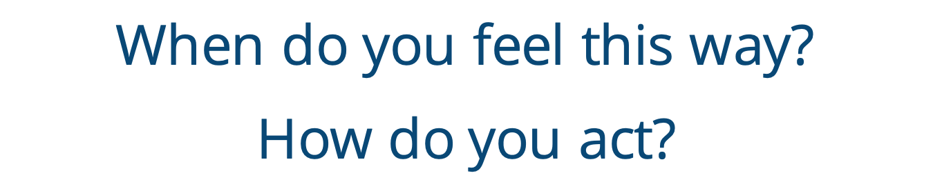
PROUD
DISAPPOINTED
_________________
When do you feel this way?
How do you act?
Notes:
Instructor Notes:
Divide students into pairs, distribute the students’ puppets, and tell the class that they are now going to use their puppets (including their strength/weakness props) to create a few mini puppet shows about different emotions.
Then click once and say: Come up with a time when you or your partner may feel disappointed. Use your puppets to act out what makes you feel disappointed, and show how you act when you’re disappointed!
Once a couple minutes have passed, click again and say: Now trade and act out a time when the other partner feels disappointed. Remember to also show how you act when you feel this way.
After a couple minutes, click and say: Next, come up with a time when you or your partner may feel proud. Act out what makes you feel proud, and show how you act when you’re proud.
Click again and say: Now swap and act out a time when the other partner feels proud. Remember to show how you act when you’re proud!
After a couple more minutes have passed, double-click again and say: Lastly, come up with another emotion that you sometime feel. Act out a time when you feel this way, and show how you act when you feel this way.
Then click a final time and say: Now swap and act out a time when the other partner feels this emotion. Remember to show how you act when you feel this way!
If time allows, invite a couple pairs to share one of their puppet shows with the class.
Then wrap up by saying: By thinking about how we feel and sharing what we feel, we are able to better understand our emotions and why we may act certain ways. Always remember: I know my emotions are nothing to hide!
Note: Like last session, if students can’t complete their puppet shows during this session/period, they may be completed in stations or as an activity in upcoming sessions before you move on to Day 3.

Slide 13
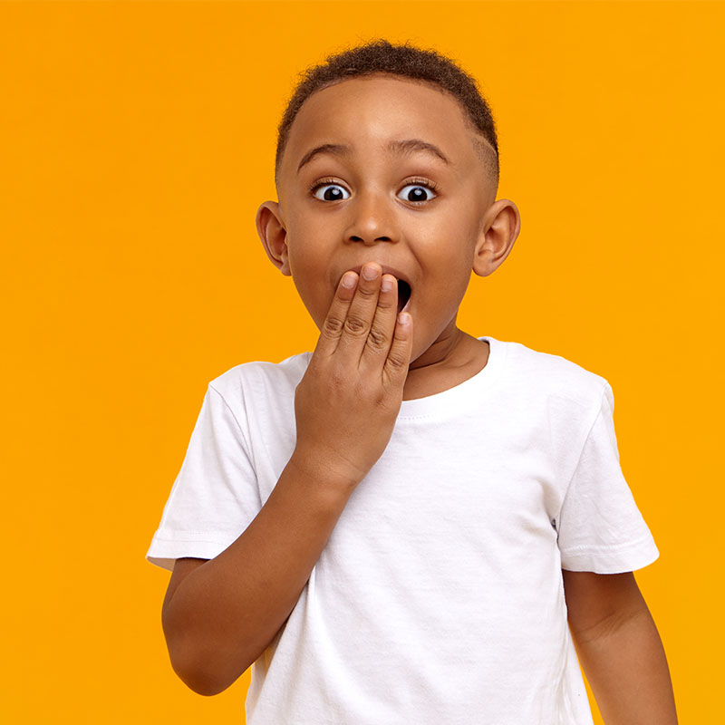
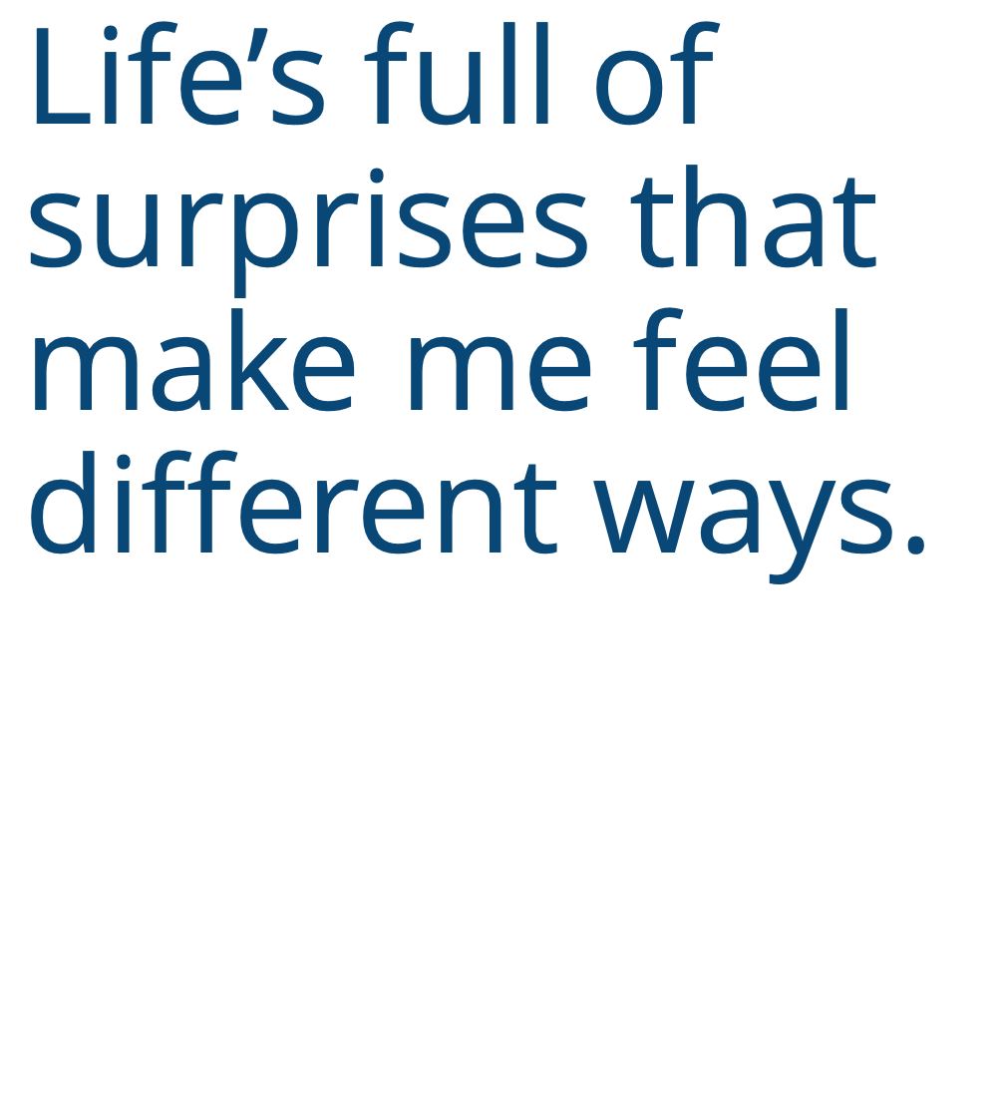
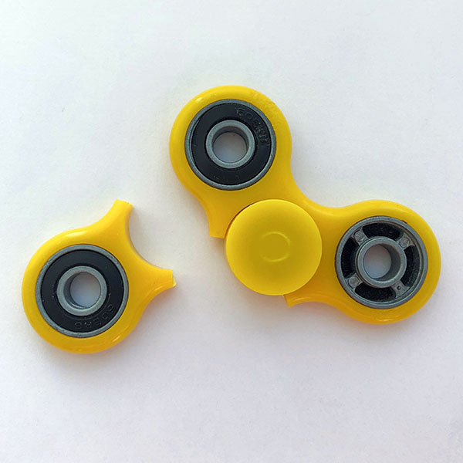


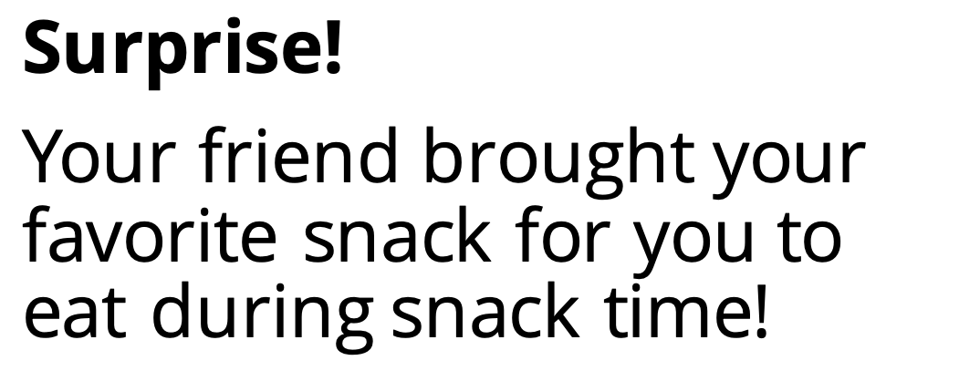
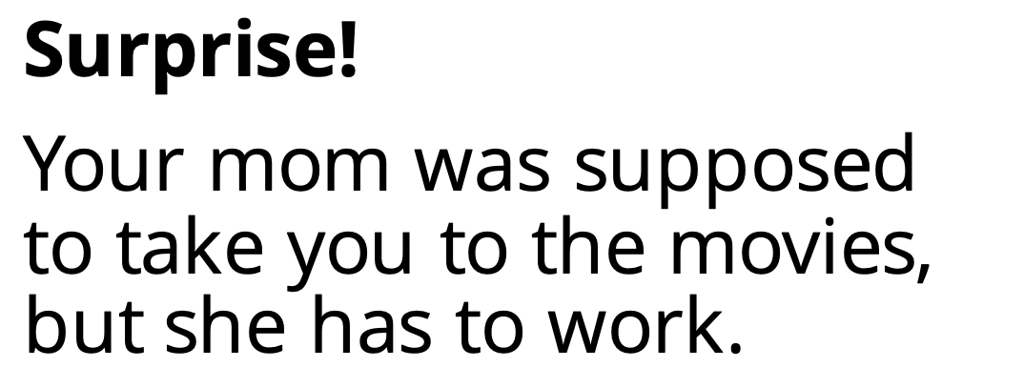
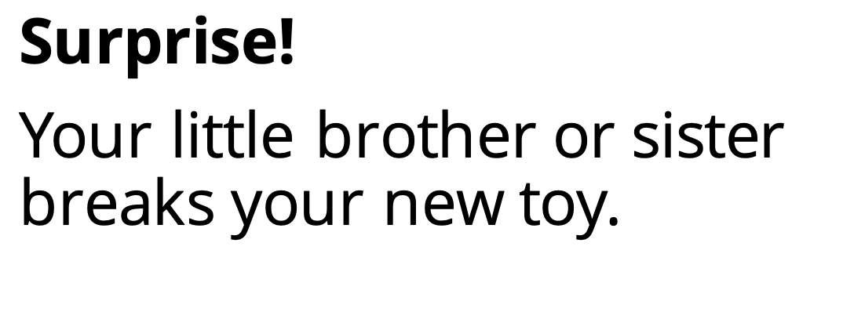
Surprise!
Your friend brought your favorite snack for you to eat during snack time!
Surprise!
Your mom was supposed to take you to the movies, but she has to work.
Surprise!
Your little brother or sister breaks your new toy.
Notes:
Instructor Notes:
Begin this session with students sitting in a large circle or semi-circle, and read the header (Life’s full of surprises that make me feel different ways) aloud.
Explain that there are all kinds of surprises: good and bad. Anything that happens that we aren’t expecting is a surprise!
Ask students to give you a thumbs up if they have ever been surprised before.
Click and read the following surprise scenario: Your little brother or sister breaks your new toy.
Call on a couple students to reflect:
How would this surprise make you feel?
How would you want to react?
Then click to reveal a new scenario: Your mom was supposed to take you to the movies but she has to work.
Ask student pairs to answer the same two reflection questions using a think-pair-share strategy. In a think-pair-share, students are encouraged to first think through the answer individually, then discuss their answer with a partner, and then share their thoughts with the class.
Once a few students have shared their thoughts, repeat the same process with a third scenario: Your friend brought your favorite snack for you to eat during snack time!

Slide 14
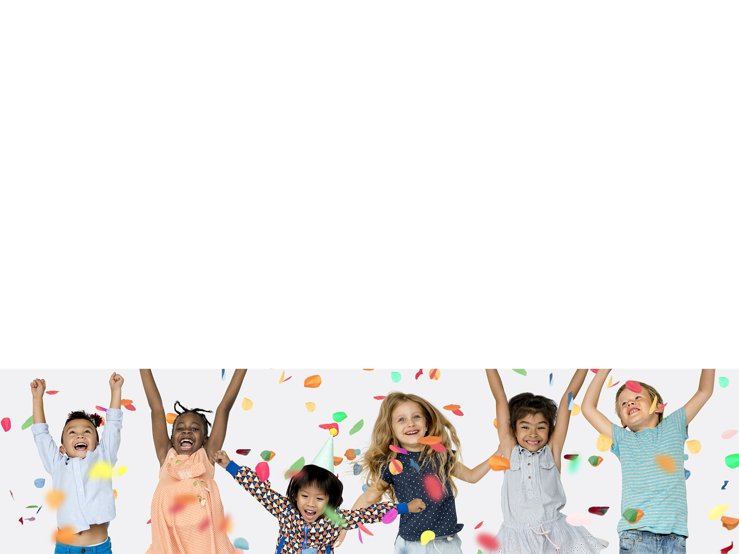

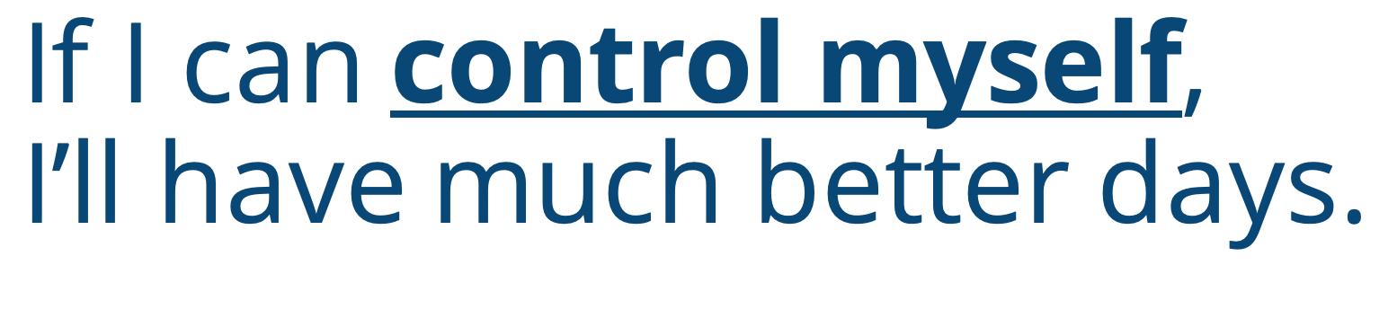
Notes:
Instructor Notes:
Teacher Prep: Select two songs and have them ready to play on your laptop or smart phone. The first song must have a quick tempo, be upbeat, and fun to dance to. Try to choose a song you know your students will like and/or recognize! If you don’t have a song in mind, Kidz Bop and GoNoodle are good places to start. The second song should be much slower and harder to dance to. Relaxing classical music like this would work well.
Explain to students that while we never want to hide our emotions, it is also important to act in a kind and responsible way. When surprises happen, we must try to control our impulses.
Tell the class that they are going to play a game like Freeze Dance to learn what it means to “control our impulses.”
Explain that like Freeze Dance, students must dance when they hear music and must freeze when the music stops. However, this game has two extra rules!
When students hear the fast song, they must dance quickly. Play a sample of the fast song so students know what to expect.
When students hear the slow song, they must dance slowly. Play a sample of the slow song so students know what to expect.
Then say: “3, 2, 1: Dance!”, begin one of the songs, and instruct students to get up and start dancing!
Once you have played one song for several seconds, stop it (which is when students should freeze), and then begin playing music again. Don’t always flip back and forth between the two songs. Sometimes, play the same song in a row so students don’t know what to expect!
Once the class seems to be used to the game’s rules, announce a rule change: Students must now dance slowly to the fast song and quickly to the slow song.
Spend two or three minutes playing and alternating short segments of each song, reminding students of the new rules if need be.
After a few minutes have passed, stop the music and instruct students to return to sitting in a circle.
Ask students to think-pair-share which version of the game was more difficult and why.
Summarize the students’ thoughts by explaining that the second game required them to control their impulses. Explain that an impulse is your gut reaction: It is what your body wants to do before you have a chance to think about it. For instance, when students heard the fast dance music, their impulse was to dance quickly…not slowly. Go on to explain that the game proved that they can control their impulses. When they thought about it, they could dance slowly while listening to a fast song and dance quickly when listening to a slow song. It just required a little more thought and control!

Slide 15










I can control what I…
THINK
SAY
DO
Notes:
Instructor Notes:
Tell students that now that they understand what an impulse is, it’s also important to learn ways to control impulses. Click once and explain that when we are faced with surprises, we often want to react right away—but controlling ourselves takes more time. Explain that one way to help us stop, think, and control our impulses is with a strategy called “Control Check”!
Tell students that before we react, we should stop, check, and try to control how we…
Click once to display: “Think.”
Explain that we can ask ourselves if our minds are clear and focused.
Have we thought about how we feel before we say or do anything?
Click a second time to display: “Say.”
Explain that we can make sure the words we are about to say are gentle and kind.
Click a third time to display: “Do.”
Explain that before we act, we can make sure our actions are going to be calm and kind.
Explain that Control Checks are good to use when we are surprised because they help us stop and think… and then act in kinder and calmer ways!

Slide 16
Notes:
Instructor Notes:
Tell students that you are going to go back to a couple of the surprises that you discussed at the beginning of this session.
Click to re-display a picture of the first surprise, and say: Surprise! Your little brother or sister breaks your new toy.
Click to redisplay one more surprise picture, and say: Surprise! Your mom was supposed to take you to the movies but she has to work.
Instruct partners to discuss the same Control Check question: If you stopped and did a Control Check, how could you react to this surprise in a calm and kind way?

Slide 17


Notes:
Instructor Notes:
Announce that for the rest of this session, student will create a puppet show that features a surprise and a Control Check.
Click once and explain that students will first plan for their puppet show by completing a storyboard. Point to the storyboard displayed on the presentation and explain that people who make puppet shows, plays, television shows and movies first create a storyboard to plan out the action. It’s similar to a comic strip or graphic novel! Explain that a storyboard doesn’t have to be a complicated picture…It is just a simple sketch that shows the most important details! They will then use this plan to help them put on their puppet show.
Explain that in their Control Check Storyboard, students will sketch three pictures that show:
1 - What surprised me?
2 - How do I feel?
3 - How will I respond after I do a Control Check?
Once you answer any questions, encourage students to think quietly about a surprise that has happened to them or a surprise that could happen to them. Once they have a surprise in mind, they should raise their hand and you will give them a copy of Handout 4: Storyboard so they can get started.
If any students can’t think of a surprise, encourage them to use one of the surprises that you discussed at the beginning of the session.
*Tip: If you think students would benefit from the extra guidance, create a sample Control Check Storyboard together before they begin their own.

Slide 18




1. Puppets
2. Props
3. Backdrop
Notes:
Images:
Image 1: Copy of final designed version of Handout 1: Puppet Outline (same image as on Slide 7)
Image 2: Copy of final designed version of Handout 2: Props (same image as on Slide 7)
Image 3: Illustration that could be used as the background of a puppet show (like https://thumbs.dreamstime.com/z/children-s-drawing-city-cityscape-street-colorful-gray-houses-vector-illustration-92188549.jpg)
Instructor Notes:
Once about ten minutes have passed and/or students are beginning to finish up their storyboards, tell the class that they must share their storyboard with you before they move on.
Once you approve their storyboard, students can begin getting ready for their puppet show! Click once and explain that students will need to prepare:
Puppets: If any new puppets are needed to tell the story on their storyboard, students can use additional copies of Handout 1: Puppet Outline and craft sticks to create them.
Props: Students can use Handout 2: Props and craft sticks to make any new props that are needed.
Backdrop: Students should consider: Where does my story take place? Students may use a large piece of paper (or a couple pieces of paper taped together) to draw a backdrop.
Display all of the materials in an easily-accessible location and make sure students know where to find everything they need. It will be easiest to have everything in one place! Because students have already created puppets and props, they should be able to work independently on this phase and decide what they need for their own show.
As the session is wrapping up, have students put their materials back into their labeled bags or folders, and tell them that next session they will finish their puppet show and perform!

Slide 19



Notes:
Instructor Notes:
Distribute each student’s puppet show materials and begin the session by reminding students of the steps they must complete to prepare for their puppet show:
Puppets: Students can use Handout 1: Puppet Outline and craft sticks to create any new puppets that are needed.
Props: Students can use Handout 2: Props and craft sticks to make any new props that are needed.
Backdrop: Students should consider: Where does my story take place? Students may use a large piece of paper (or a couple pieces of paper taped together) to draw a backdrop.
Tell students that once they finish these steps, they should begin to practice! They should use their storyboard as a reminder of the story they planned.
Deduct 20 minutes from the end of the session and set the timer on the presentation. Tell students how much time they have left until showtime and then instruct students to get to work. Occasionally remind them of the time that remains!

Slide 20





I think you felt ___________!
I could tell you did a Control Check because___________.
Notes:
Instructor Notes:
Once the timer goes off, it’s presentation time! Arrange students in groups of two or three and assign the groups to specific areas around the classroom. Try to choose locations where the students can tape or prop their backdrop against a wall or table.
Explain that students should take turns performing their shows to each other. As they watch each other’s shows, they should think about the emotion that their partner’s puppet felt and how they controlled their actions! At the end of each show, the student(s) in the audience should think about the show and say:
Click once: I think you felt ___________!
Click again: I could tell you did a Control Check because___________.

Slide 21


Notes:
Instructor Notes:
Bring the class back together and conclude by passing out a copy of Handout 5: Goal-Setting to each student. Read through it together and explain that every student will set a goal for the next time they feel the emotion that they acted out in their puppet show.
Give the example: If my puppet show was about a time that I felt embarrassed, I might say: The next time I feel embarrassed, I will take a deep breath and remember that every one makes mistakes! I could then draw a picture of myself closing my eyes and taking a deep breath.
Encourage each student to think about what they could try to do in the future to control their impulses and make positive choices.
Before students get to work, read aloud the following portion of the Wings Words to Live By and encourage students to join you as you say:
I soar with wings.
Let me tell you why.
I learn lots of skills that help me reach the sky.
I love and accept who I am on the inside
and I know my emotions are nothing to hide.
Life’s full of surprises that make me feel different ways.
If I can control myself, I’ll have much better days.
Explain that by setting a goal, students are using all of the skills they have learned to soar, reach the sky and have much better days!
Then encourage students to begin their goal-setting. If you think it will be helpful for students to discuss their goal with a peer before working individually, encourage them to do so.
Once students’ work is complete, collect their goal sheets and display them in the classroom. Or, if this is not possible, try to incorporate time for goal-sharing into the next several sessions.

