Slide 1



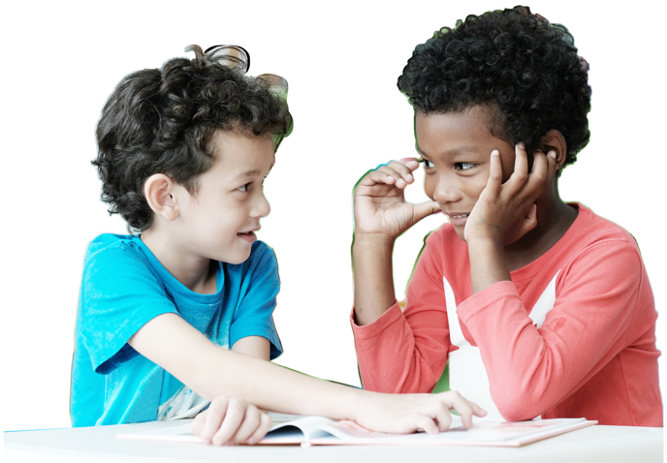

Slide 2
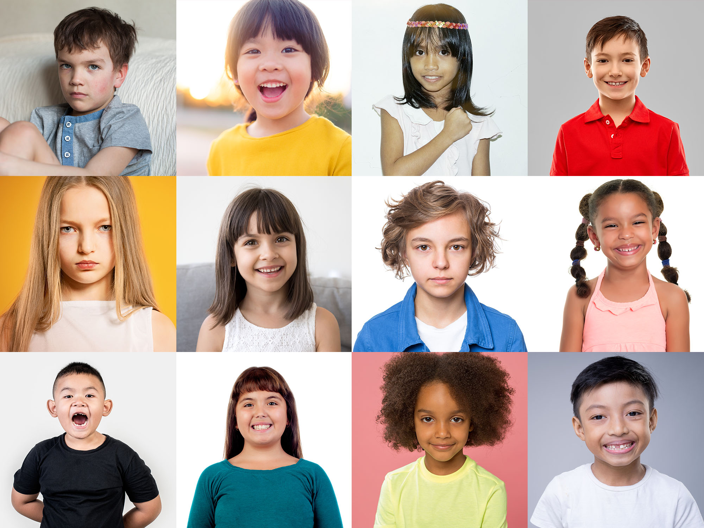

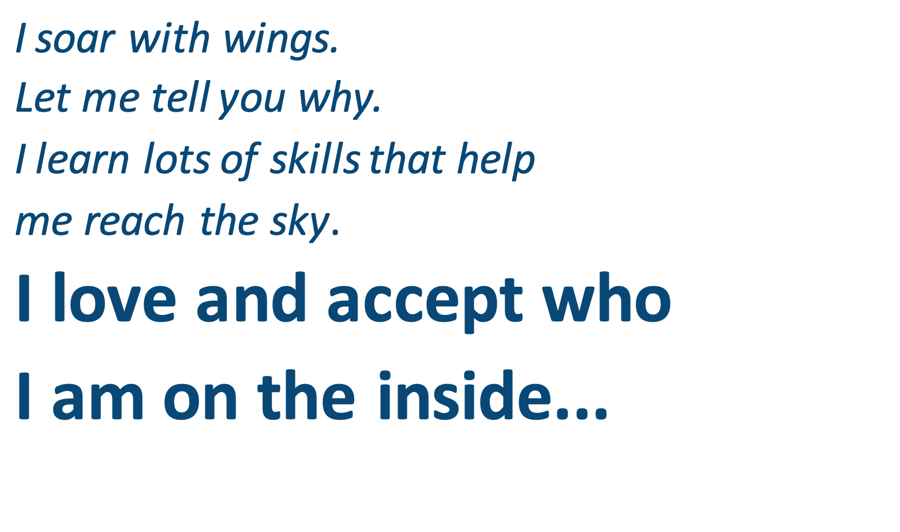
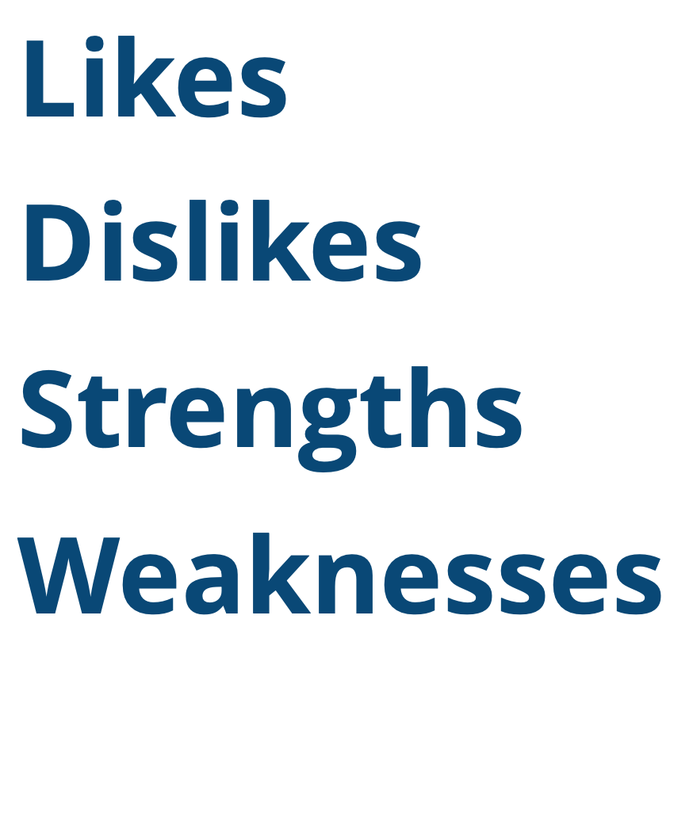
I soar with wings.
Let me tell you why.
I learn lots of skills that help
me reach the sky.
I love and accept who
I am on the inside...
Likes
Dislikes
Strengths
Weaknesses
Notes:
Instructor Notes:
Instruct the class to sit on the floor in a circle or semi-circle, and join the students by sitting at their level. Then begin the first session by reading the following excerpt aloud from Words to Live By:
“I soar with wings.
Let me tell you why. I learn lots of skills that help me reach the sky. I love and accept who I am on the inside...”
Click once and ask students: What does “on the inside” mean? What are some of the qualities that make up who we are on the inside?
Click again and add to (or underscore) students’ responses by explaining that our likes, dislikes, strengths, and weaknesses are just some of the inside qualities that make us unique. In order to love and accept ourselves, it is important to love and accept all of these qualities!

Slide 3
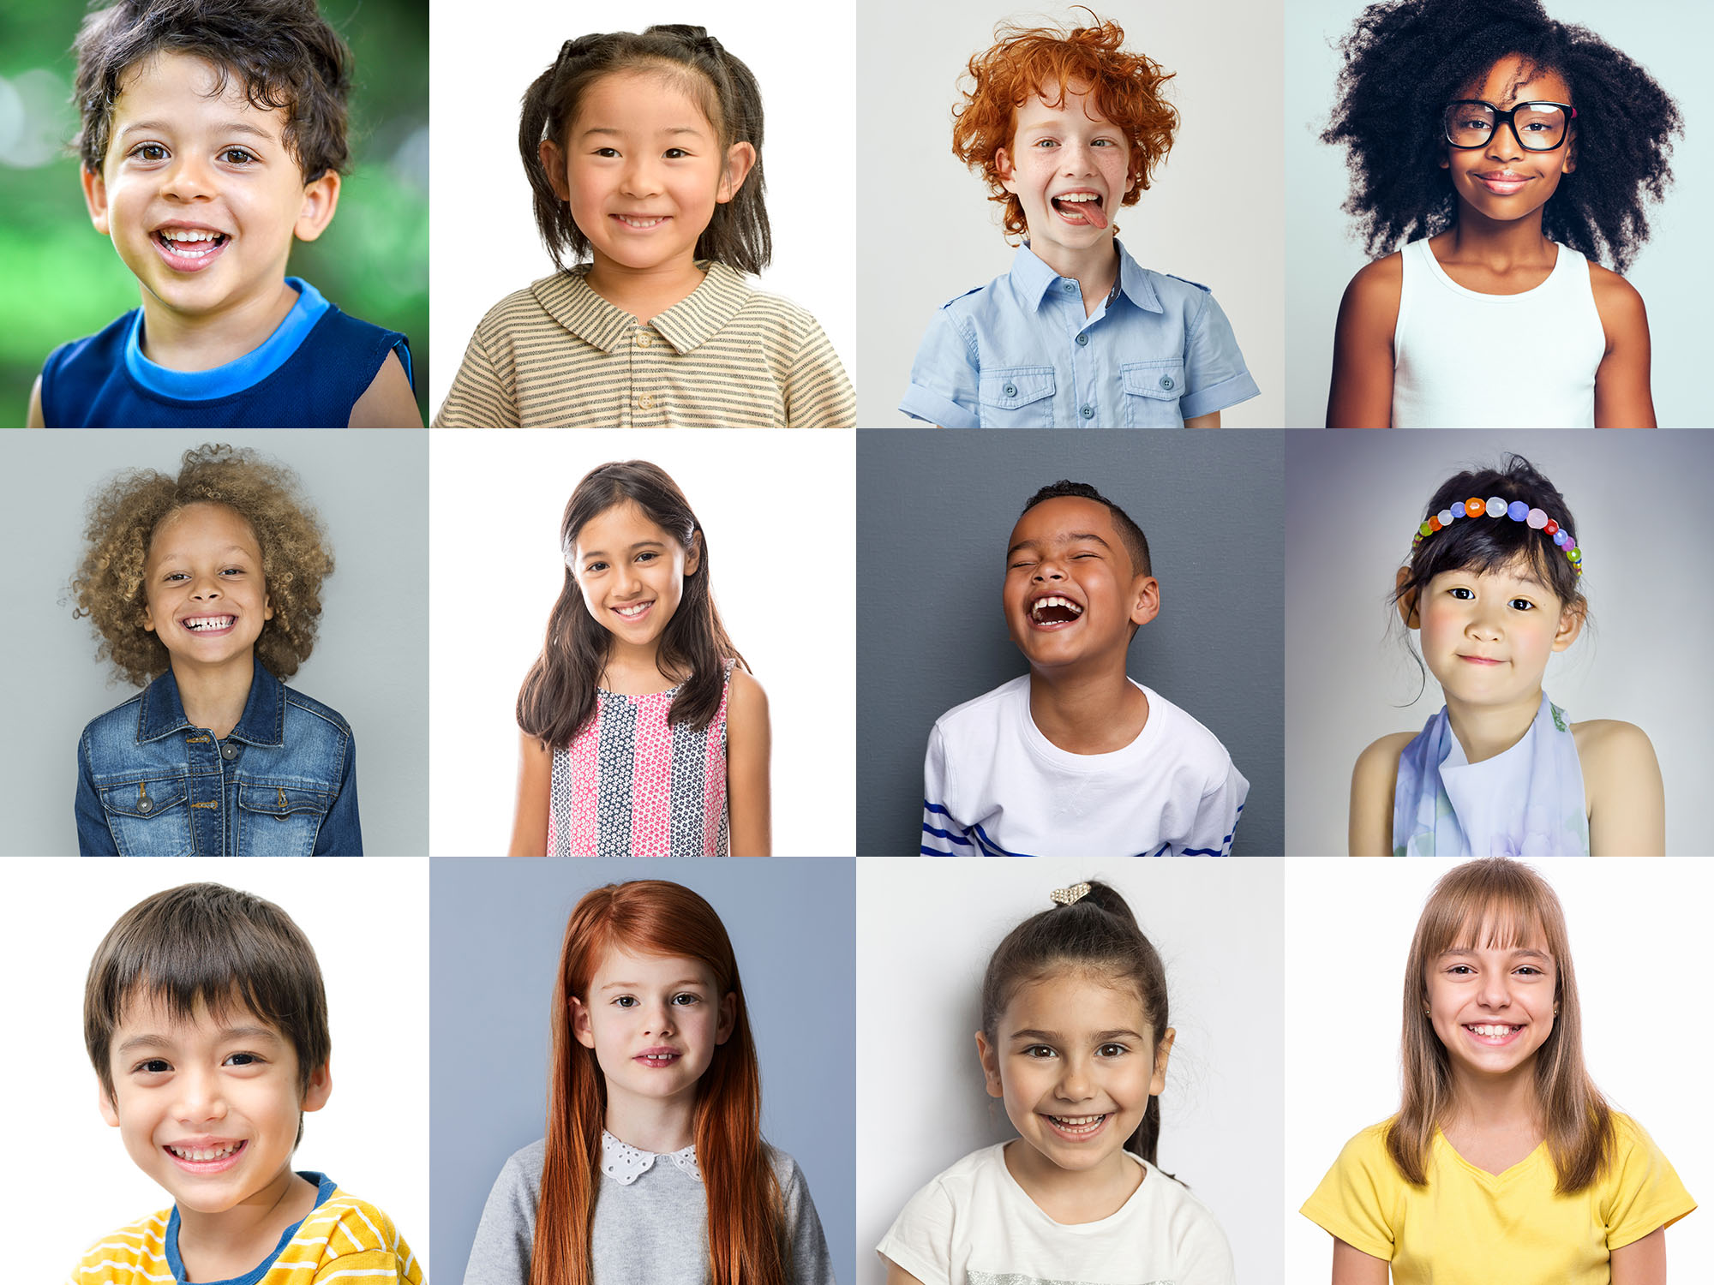
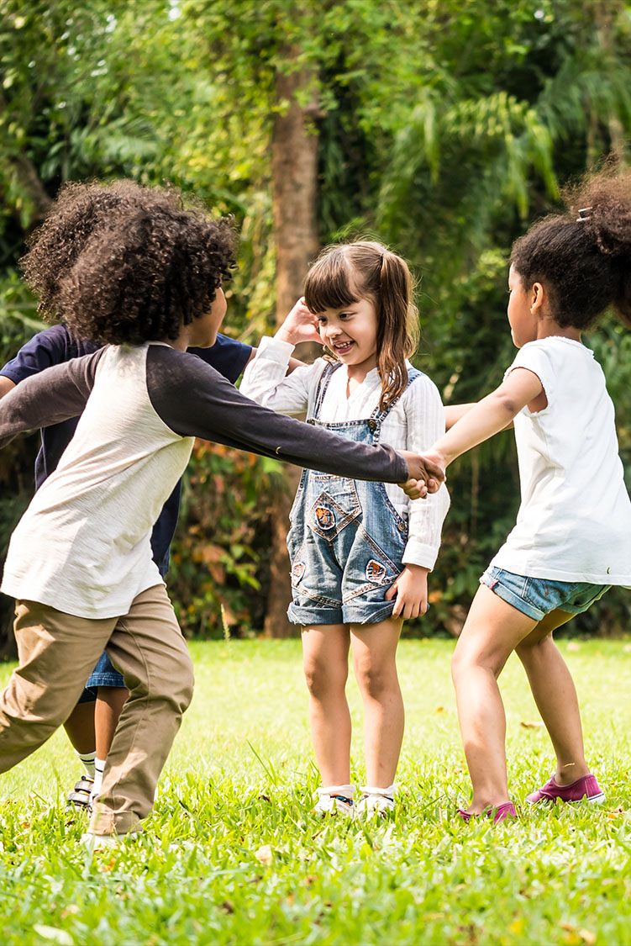
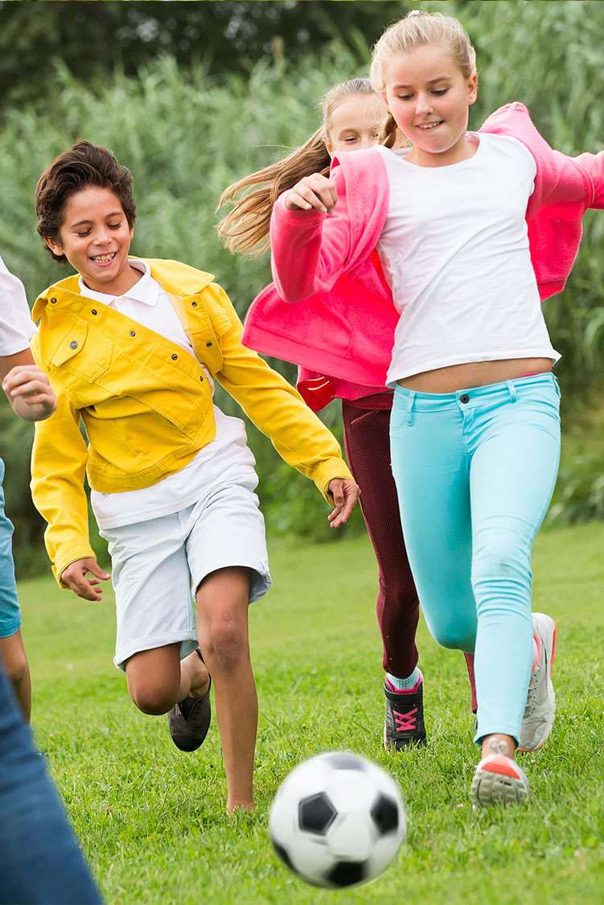
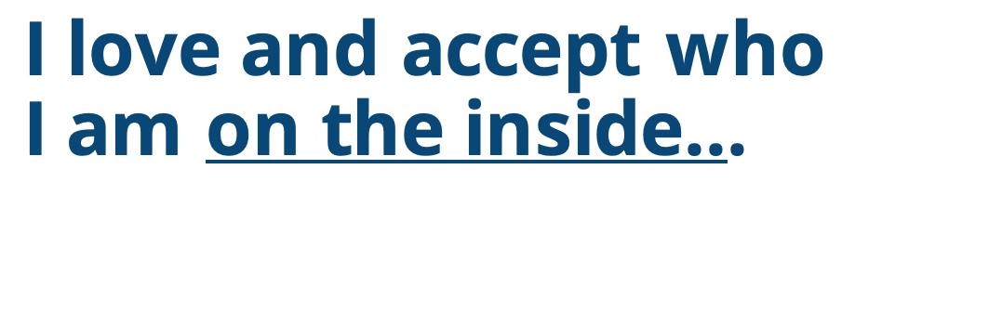

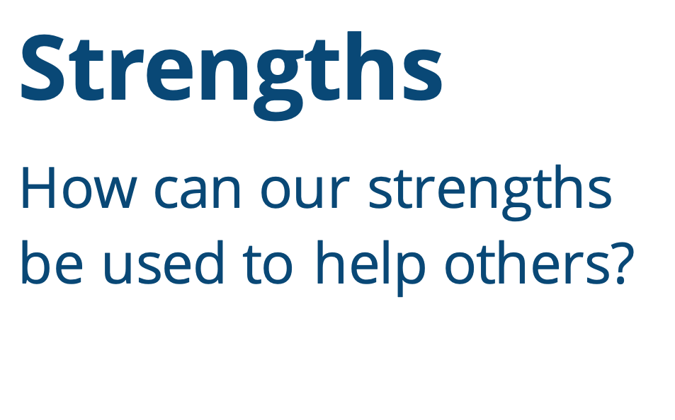
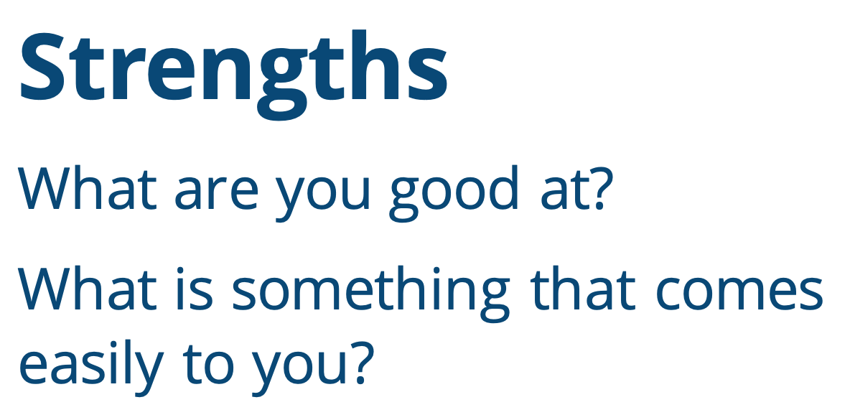
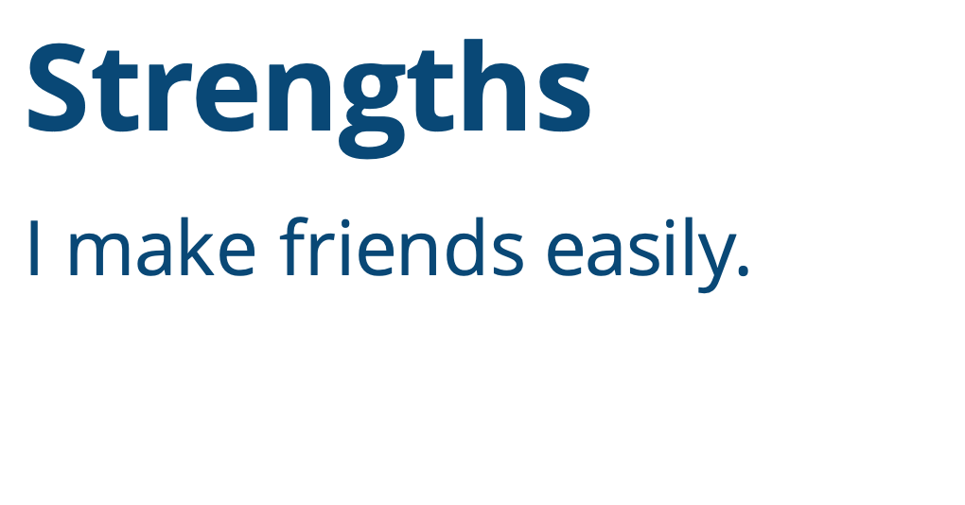
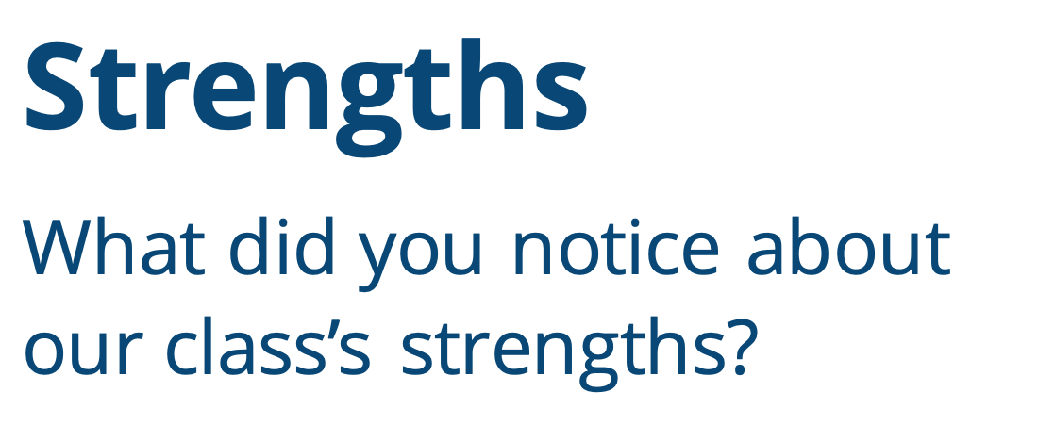
I love and accept who
I am on the inside...
Strengths
I am athletic.
Strengths
How can our strengths
be used to help others?
Strengths
What did you notice about our class’s strengths?
Strengths
What are you good at?
What is something that comes easily to you?
Strengths
I make friends easily.
Notes:
Instructor Notes:
Tell students that they are first going to think about their strengths.
Explain that a strength is something they are good at or something that comes easily to them.
Acknowledge that it can be uncomfortable to say something we are good at aloud, but part of loving ourselves is being proud of our strengths!
Explain that there are many different kinds of strengths: For instance, someone may be really good at a particular subject in school or at a specific sport. Everyone also has their own personality strengths – such as being organized, brave, or kind. Share an example of one of your own personality strengths with the students.
Once you share one of your strengths, ask: Who else has this strength too?
Encourage any students who also have this strength to “pop up”. Demonstrate popping up by standing up, jumping in the air, and then sitting back down.
Explain that the class will now go around the circle and take turns sharing their strengths. Encourage students to think of unique strengths that make them special. After each student shares a strength, instruct them to ask: “Who has this strength too?” Any students who share a similar strength should pop up and then sit back down.
*Tip: If needed, help students think of a strength by sharing an observation with them. For instance, you may say: “I notice that you are always very kind to others!” Or: “I notice that you run really quickly during recess.” Then encourage the student to translate this observation into a strength!
Once everyone has shared, discuss the follow questions:
Click and ask: What did you notice about our class’s strengths?
Lead the class to understanding that everyone has strengths, and everyone has different strengths.
Click again and ask: How could we use our strengths to help others?
Lead the class to understanding that because everyone has different strengths, we can use our own strengths to help others who may not have the same strength.
Then double-click to display and read the following strength aloud: I make friends easily.
Instruct students to think-pair-share how this strength could be used to help someone else. Encourage students to first think through the answer individually, then discuss their answer with a partner, and then share their thoughts with the class.
Click once more to display “I am athletic” and complete a similar think-pair-share with this strength as well.

Slide 4
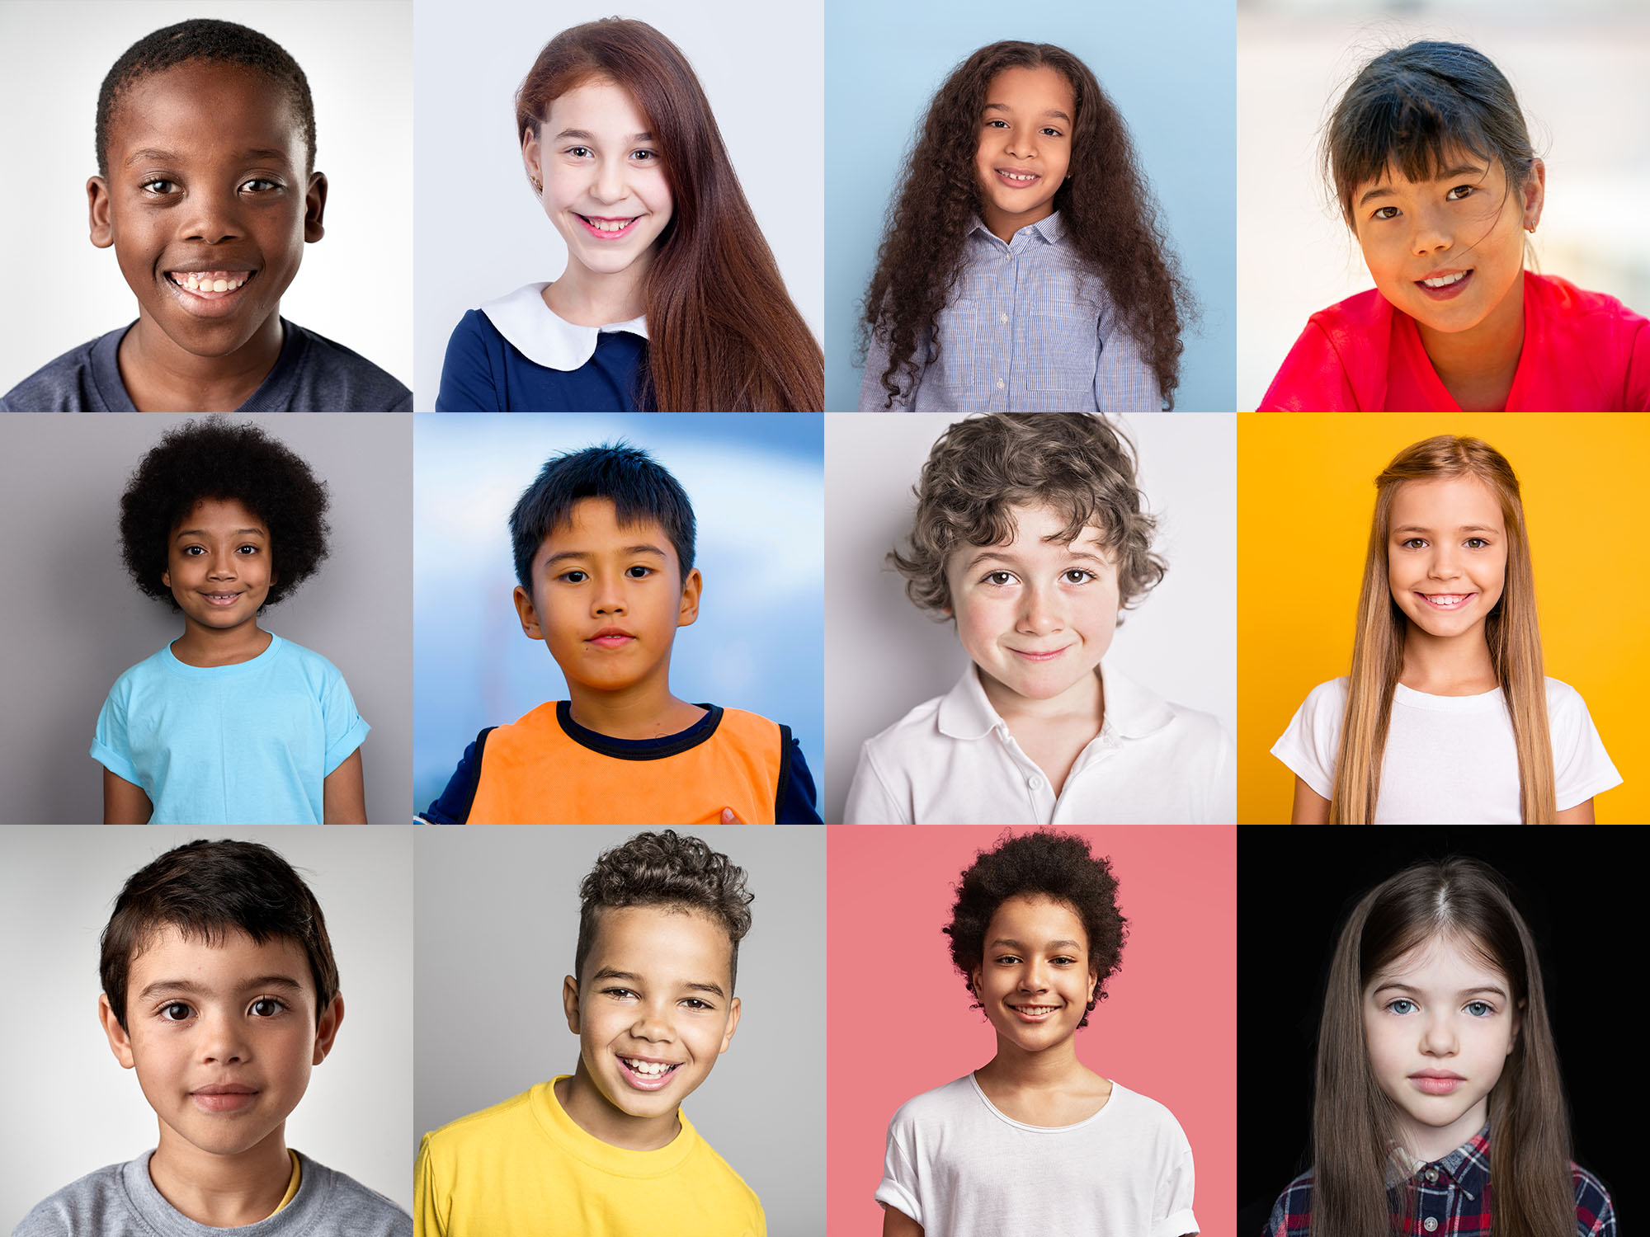


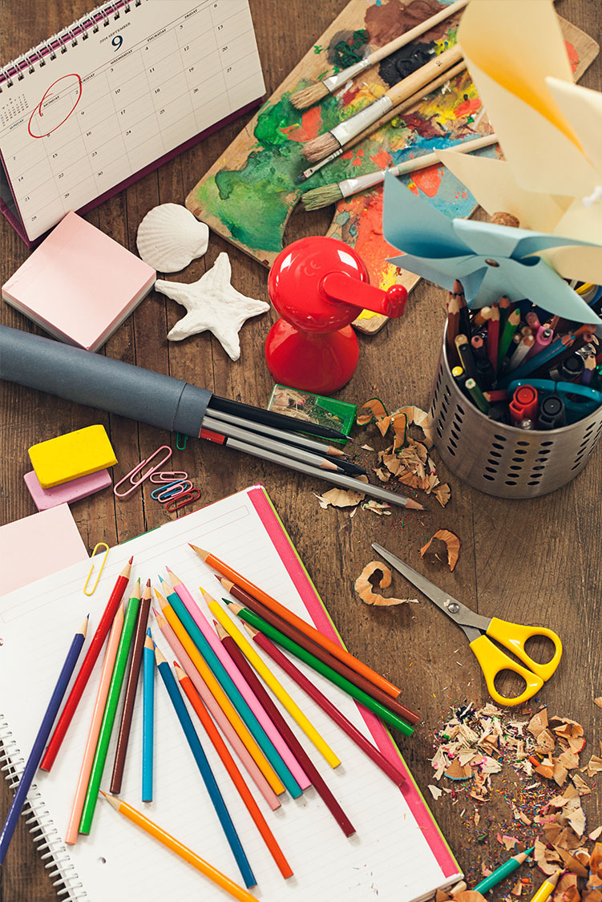
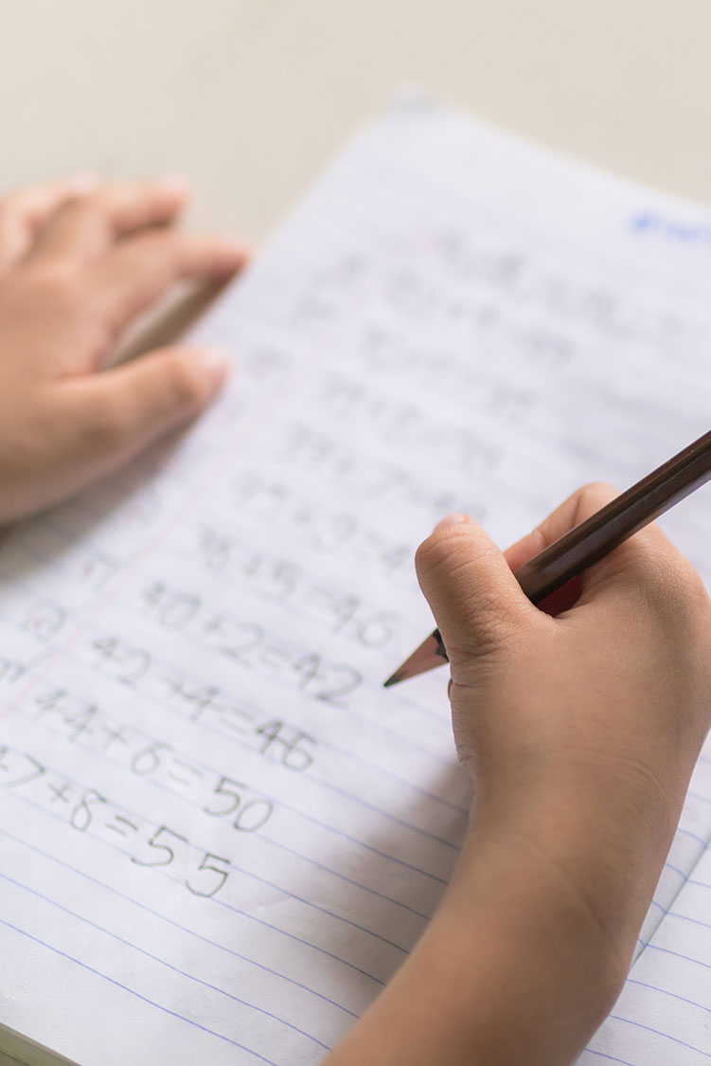
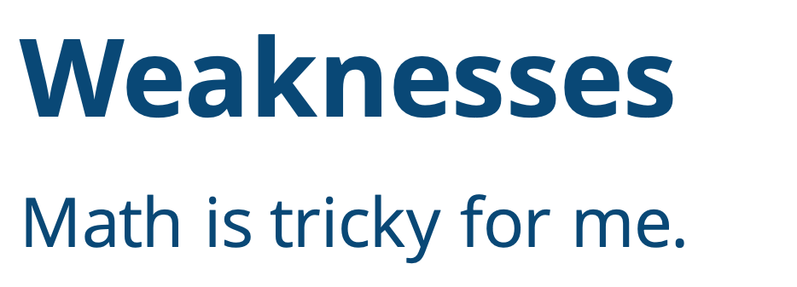
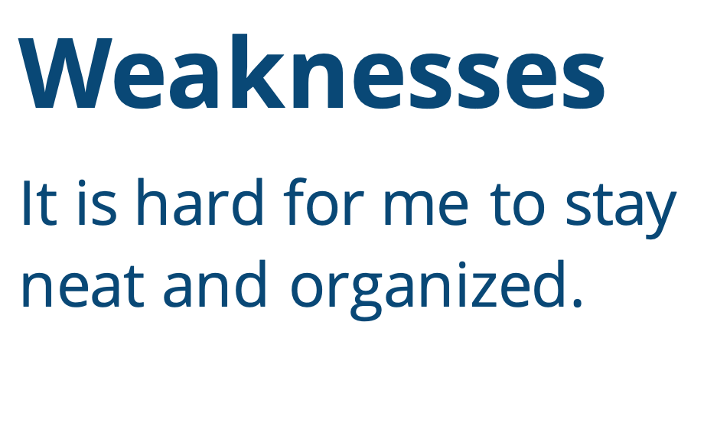
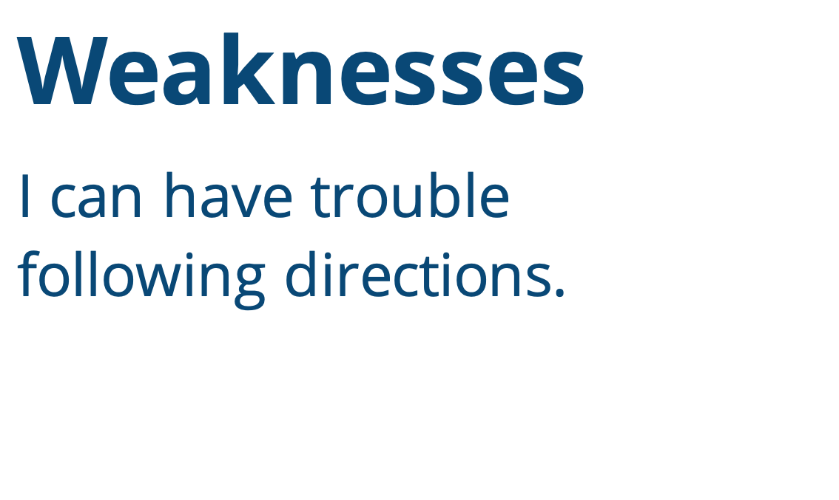
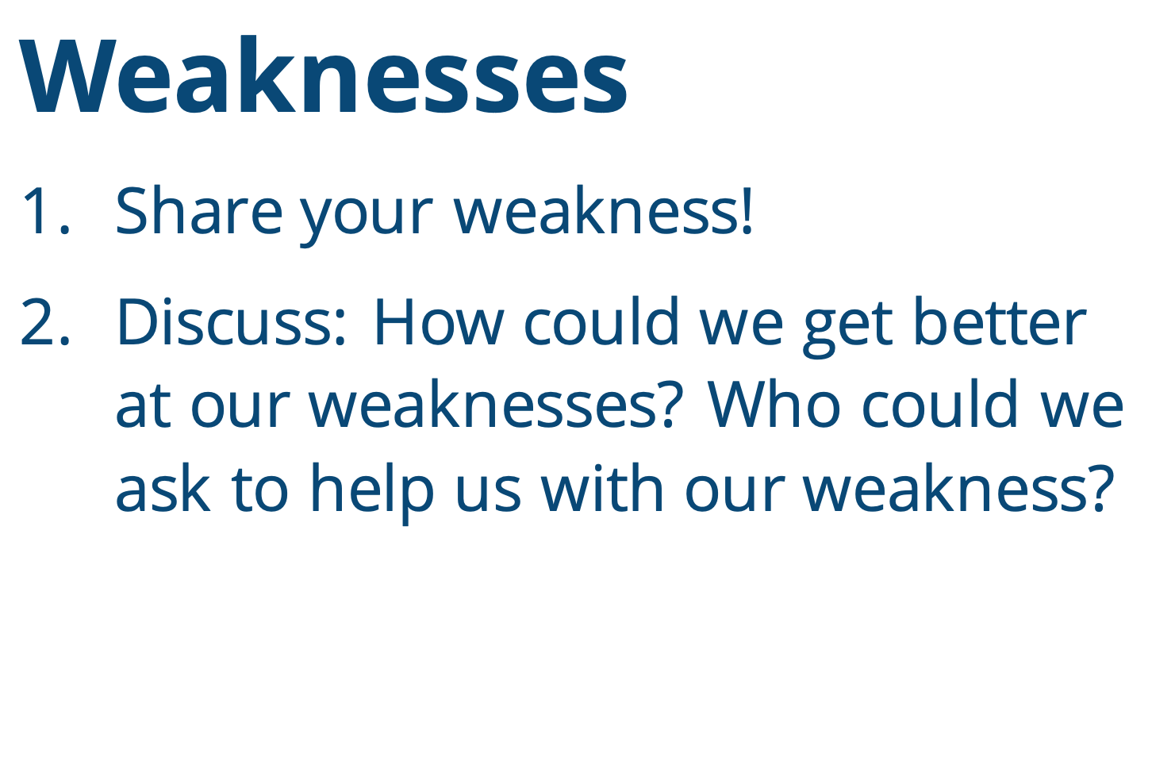
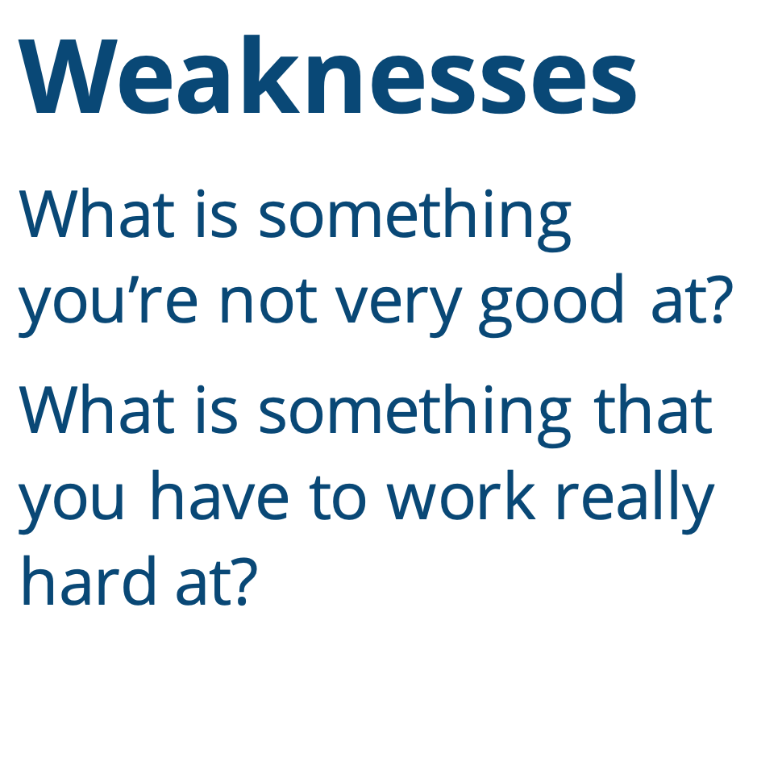
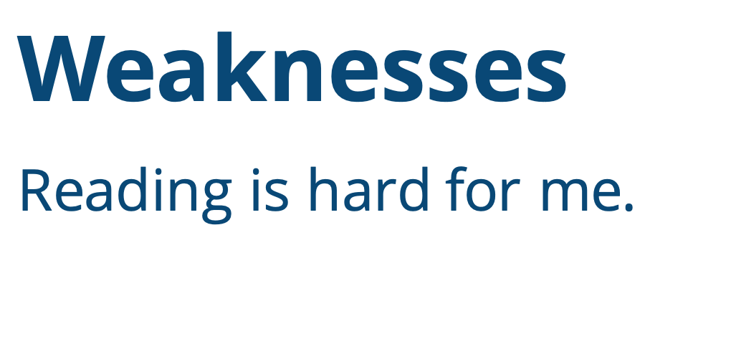
I love and accept who
I am on the inside...
Weaknesses
Math is tricky for me.
Weaknesses
I can have trouble
following directions.
Weaknesses
What is something you’re not very good at?
What is something that you have to work really hard at?
Weaknesses
It is hard for me to stay neat and organized.
Weaknesses
Share your weakness!
Discuss: How could we get better at our weaknesses? Who could we ask to help us with our weakness?
Weaknesses
Reading is hard for me.
Notes:
Instructor Notes:
Share that another part of loving yourself is accepting your weaknesses. Explain that a weakness is something that you are not very good at or that you have to work really hard at. It can be difficult to talk about our weaknesses!
Explain that you will project a few examples of weaknesses. As you display each weakness, students should consider if they have this weakness. If they do, encourage them to give a thumbs up. Explain that you’re asking students to give a thumbs up because weaknesses are never something to be ashamed of!
Then click to project each of the following:
It is hard for me to be neat and organized.
Math is tricky for me.
I can have trouble following directions.
Reading is hard for me.
*Note: If there are other weakness(es) with which your students struggle, feel free to edit the presentation!
Next, challenge students to come up with their own weakness. Ask students to think about something that they have to work really hard at… whether it’s in school, during an afterschool sport or activity, or at home. Help students brainstorm by sharing a few examples of your own weaknesses. Then instruct students to put one hand in the air once they have a personal weakness in mind.
Click again and explain that once student pairs have high-fived, they should:
Share their weakness.
Discuss:
How could we get better at our weakness?
Who could we ask to help us with our weakness?
Put their hand back in the air when their discussion is complete and wait quietly.
When most students have their hands back in the air, direct the class to complete the same activity with a new partner and discuss a different weakness.
After you have led the class through this process two or three times, instruct students to return to their seat in the circle.
Before moving on to the next slide, ask: What did you notice about each other’s weaknesses?
Lead the class in understanding that everyone has weaknesses, and everyone has different weaknesses.

Slide 5


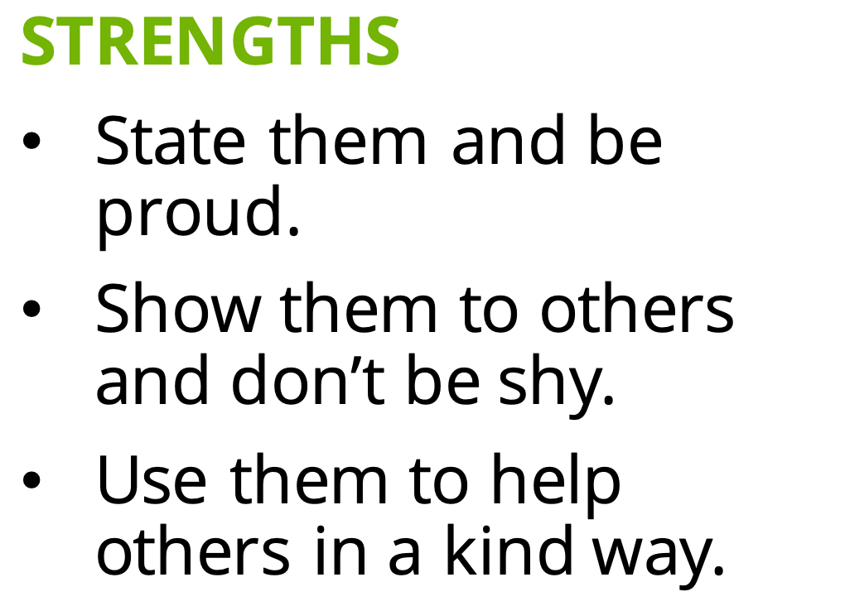
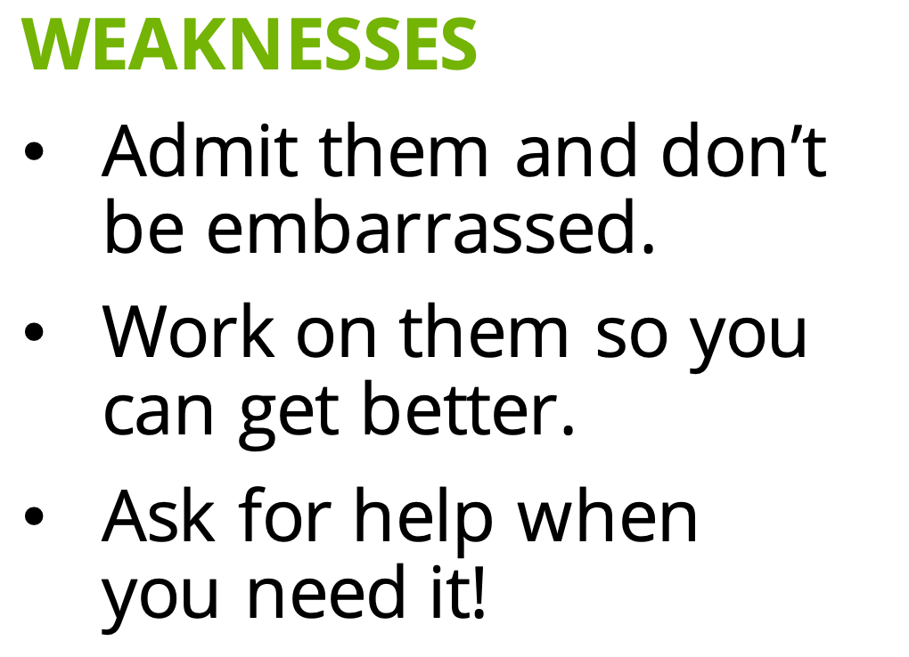
Everyone has strengths and weaknesses!
I love and accept who
I am on the inside!
STRENGTHS
State them and be proud.
Show them to others and don’t be shy.
Use them to help others in a kind way.
WEAKNESSES
Admit them and don’t
be embarrassed.
Work on them so you
can get better.
Ask for help when
you need it!
Notes:
Instructor Notes:
Summarize that everyone (even adults!) has strengths and weaknesses.
Click once and reiterate that when it comes to our strengths, it is important to remember the following statements. Ask different students to help you read each statement aloud:
State them and be proud.
Show them to others and don’t be shy.
Use them to help others in a kind way.
Click again and reiterate that when it comes to our weaknesses, it is important to remember the following statements. Again, ask different students to help you read each statement aloud:
Admit them and don’t be embarrassed.
Work on them so you can get better.
Ask for help when you need it!
Click once more and explain that being aware of our strengths and weaknesses is important in order to love and accept who we are on the inside!

Slide 6

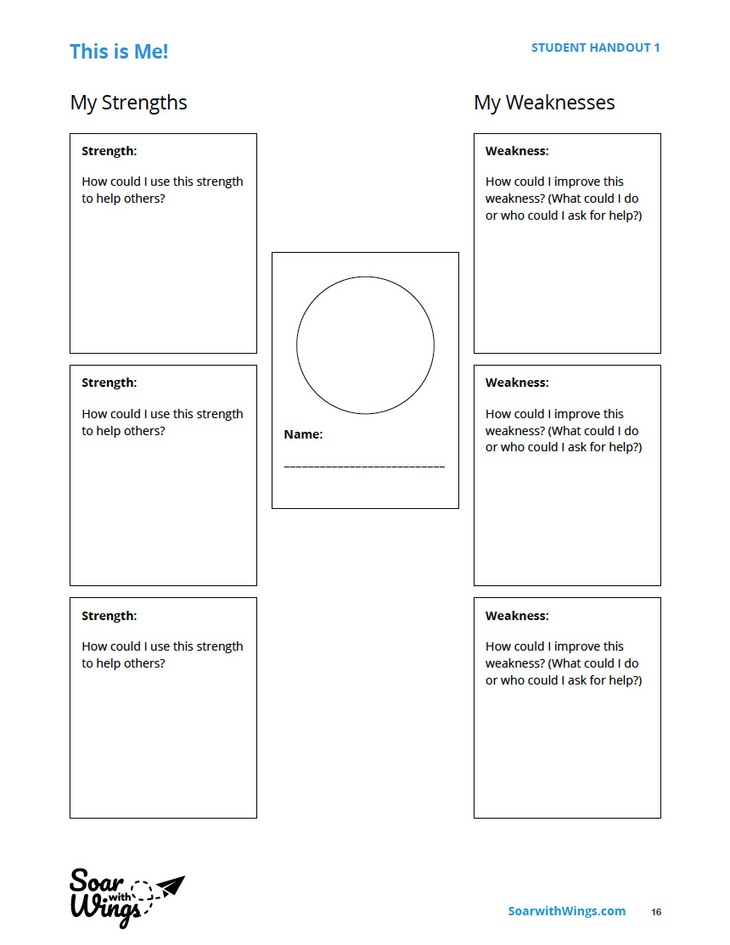
Notes:
Instructor Notes:
Explain that in order to better understand themselves, students are going to be writing a narrative that features themselves as the main character. If needed, remind students that a narrative is a short story, not an essay. While narratives can be true or fictional, this narrative will be true because it is all about them.
Tell the class that they will begin the story during this session, and they will then continue to add to the story over the next couple class sessions.
Pass out a copy of Handout 1: This is Me! to each student, and explain that before they begin writing, they are going to perform a character analysis on themselves. This means that they are going to think about their own personal qualities – especially their strengths and weaknesses—so that they are ready to begin writing about their “character.”
Bring students’ attention to the handout and explain that they should sketch a picture of themselves in the center of the handout. On the left side, they should describe three of their personal strengths, as well as how these strengths could be used to help others. On the right side of the page, they should describe three of their weaknesses as well as how they could try to improve these weaknesses.
Reassure students that it is fine to begin with some of the strengths and weaknesses that they have already discussed, but encourage them to also add a few new ones.

Slide 7


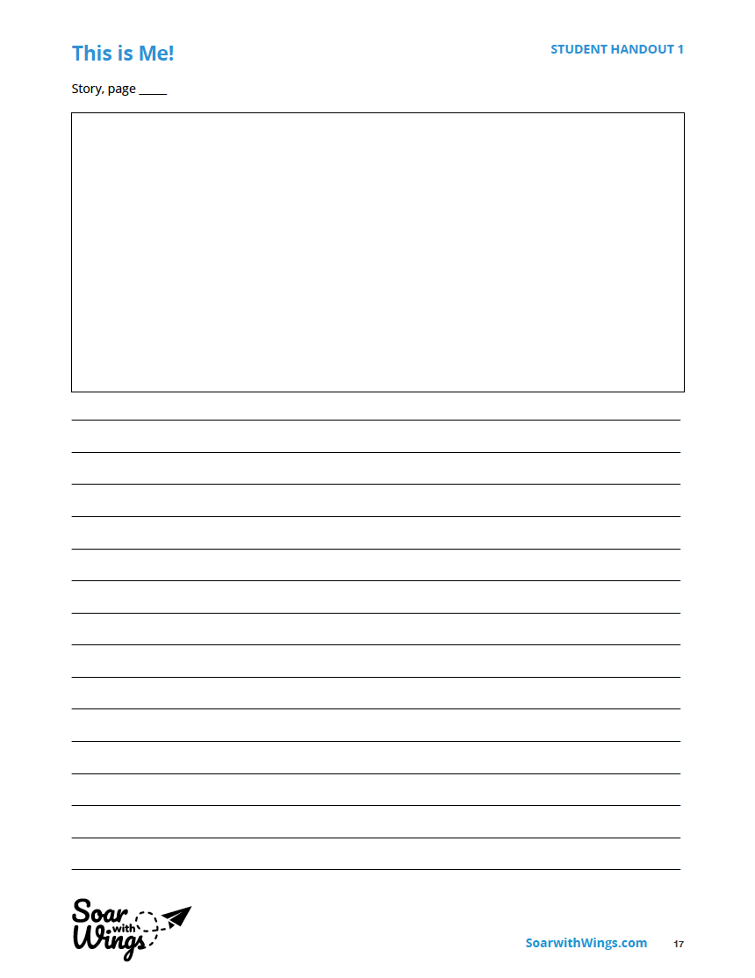

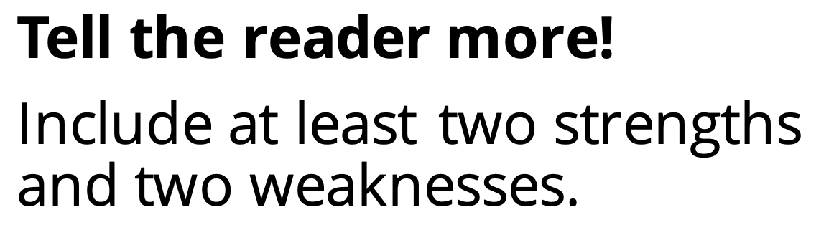

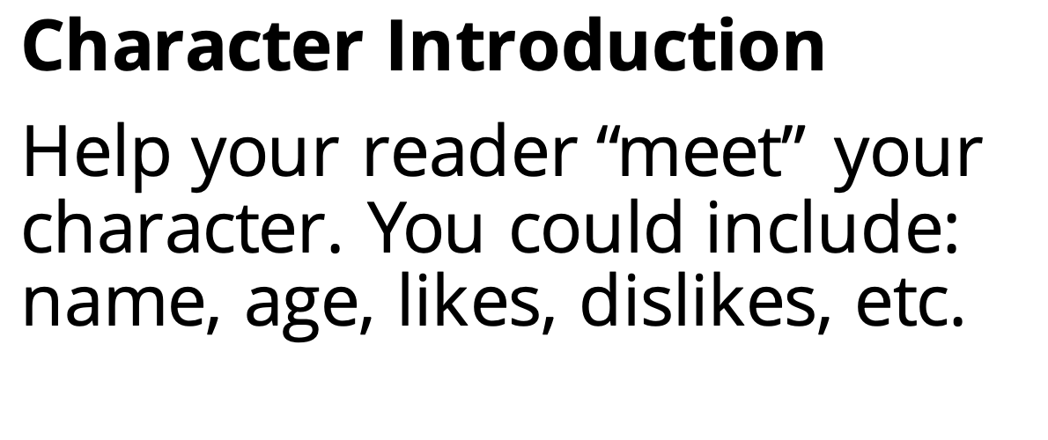
Character Introduction
Help your reader “meet” your character. You could include: name, age, likes, dislikes, etc.
Tell the reader more!
Include at least two strengths and two weaknesses.
Illustration:
Support your words with a picture.
Notes:
Instructor Notes:
Once students have completed or nearly completed Handout 1: This is Me!, announce that for the rest of the session, students will begin writing their narratives.
Tell the class that even though their story will feature themselves as the main character, they should write about themselves in the third person. This means that they won’t use “I”. Instead, they will call themselves by their first name as they write. For instance: ­­­­Maria* may write: “Maria is a fourth-grade student” or Andre* may write: “Andre loves to dance.” *Tip: Insert real students’ names instead!
Click once to display the blank story page, and explain that they will begin writing on a page that looks like this. The narrative’s first couple paragraphs will help readers get to know the main character.
Click again and explain that the first paragraph will introduce the character.
Ask students: What would you want to know about a person if it was your first time meeting them?
Click and explain that the first paragraph should include characteristics like the character’s name, age, likes, dislikes, where they live, etc. Remind students that they are the main character, so this information should be true!
Click again and tell students that after introducing themselves in the first paragraph, their second paragraph should go on to describe at least two of their strengths and two of their weaknesses. Remind the class to use Handout 1: This is Me! to help them.
Click once more and explain that the page’s picture should illustrate at least some of the qualities they include in their writing. They may also include other characteristics that they would like the reader to know about themselves!
Then pass out one copy of the Story, page ___ handout to each student, encourage them to find a position/area in the room where they can write comfortably, and let them get to work!
When the session is over, collect all student work. It may be helpful to paperclip each student’s work together or designate a separate folder for each student to help keep their work organized throughout this module.
Notes:
1 - If students need more room to write, they can use a copy of the Story, Extra Page __ handout, fill in page “2”, and then continue writing.
2 - If students don’t finish writing during this session, it may be completed in stations or as an activity in upcoming sessions before you move on to Day 2.

Slide 8
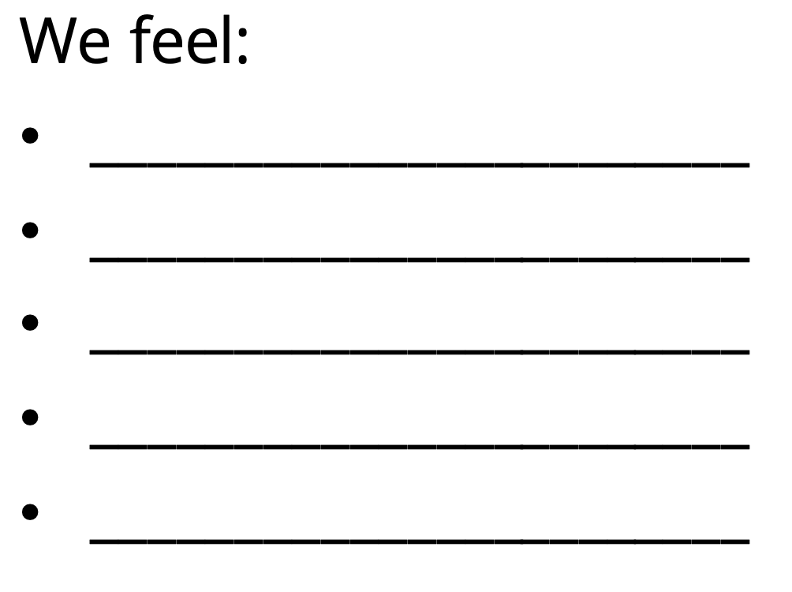
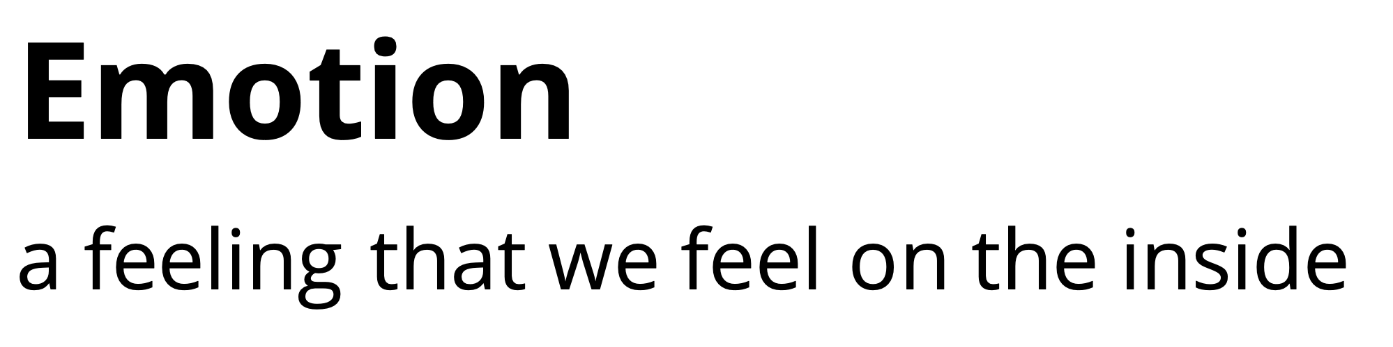

We feel:
_______________________
_______________________
_______________________
_______________________
_______________________
Emotion
a feeling that we feel on the inside
_______________________
_______________________
_______________________
_______________________
_______________________
Notes:
Instructor Notes:
Assemble students on the floor in a circle or semi-circle. Then begin the second session by reading the following Wings Words to Live By excerpt aloud, accentuating the italicized portion: “I love and accept who I am on the inside and I know my emotions are nothing to hide.”
Click once and remind students that an emotion is a feeling that we feel on the inside.
Pass out Handout 2: Quick Write/Draw to each student. Tell the class that you will give them about five minutes to jot a few sentences or draw a picture that explains an emotion they felt today or yesterday, as well as why they felt this way.
Once about five minutes have passed, click and ask several students to share what they wrote or drew. Use the blank lines on the slide to keep a list of the different emotions that students share.

Slide 9

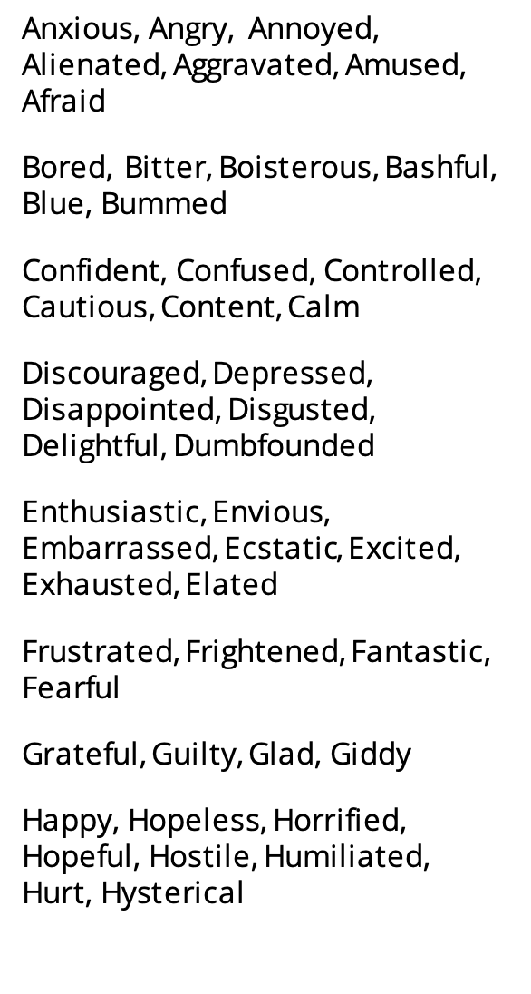
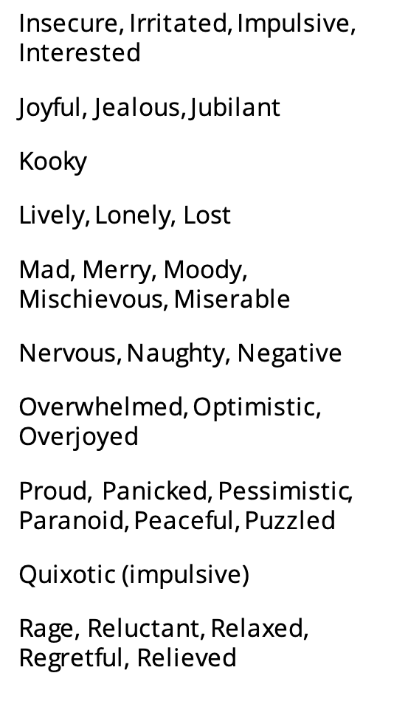
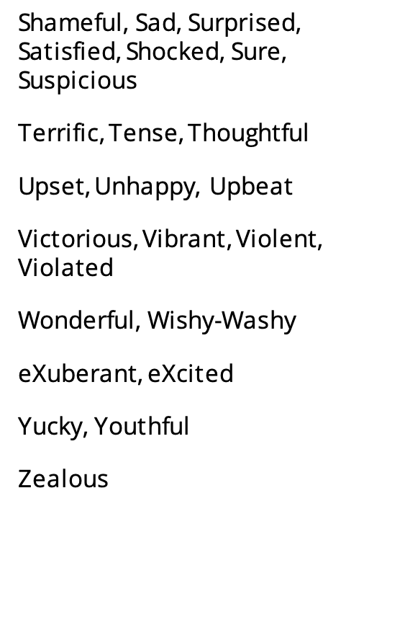





I’m feeling…
A
B
C
D
E
F
G
H
Anxious, Angry, Annoyed, Alienated, Aggravated, Amused, Afraid
Bored, Bitter, Boisterous, Bashful, Blue, Bummed
Confident, Confused, Controlled, Cautious, Content, Calm
Discouraged, Depressed, Disappointed, Disgusted, Delightful, Dumbfounded
Enthusiastic, Envious, Embarrassed, Ecstatic, Excited, Exhausted, Elated
Frustrated, Frightened, Fantastic, Fearful
Grateful, Guilty, Glad, Giddy
Happy, Hopeless, Horrified, Hopeful, Hostile, Humiliated,
Hurt, Hysterical
I
J
K
L
M
N
O
P
Q
R
Insecure, Irritated, Impulsive, Interested
Joyful, Jealous, Jubilant
Kooky
Lively, Lonely, Lost
Mad, Merry, Moody, Mischievous, Miserable
Nervous, Naughty, Negative
Overwhelmed, Optimistic, Overjoyed
Proud, Panicked, Pessimistic, Paranoid, Peaceful, Puzzled
Quixotic (impulsive)
Rage, Reluctant, Relaxed, Regretful, Relieved
S
T
U
V
W
X
Y
Z
Shameful, Sad, Surprised, Satisfied, Shocked, Sure, Suspicious
Terrific, Tense, Thoughtful
Upset, Unhappy, Upbeat
Victorious, Vibrant, Violent, Violated
Wonderful, Wishy-Washy
eXuberant, eXcited
Yucky, Youthful
Zealous
8
Notes:
Instructor Notes:
Explain that the more we learn about our emotions, the easier it is for us to understand what we’re feeling, talk about our emotions, and not hide them.
Click once to display the Emotional Alphabet, and tell students that this alphabet includes names that describe many of the emotions we can feel. Explain that you are sharing this alphabet to help students understand just how many different kinds of emotions we can feel! Give students a moment to take in all of the different emotions.
Note: The objective of sharing the Emotional Alphabet with students is not to make sure they understand every emotion, but to help them begin to understand the range and complexity of the emotions we feel!

Slide 10
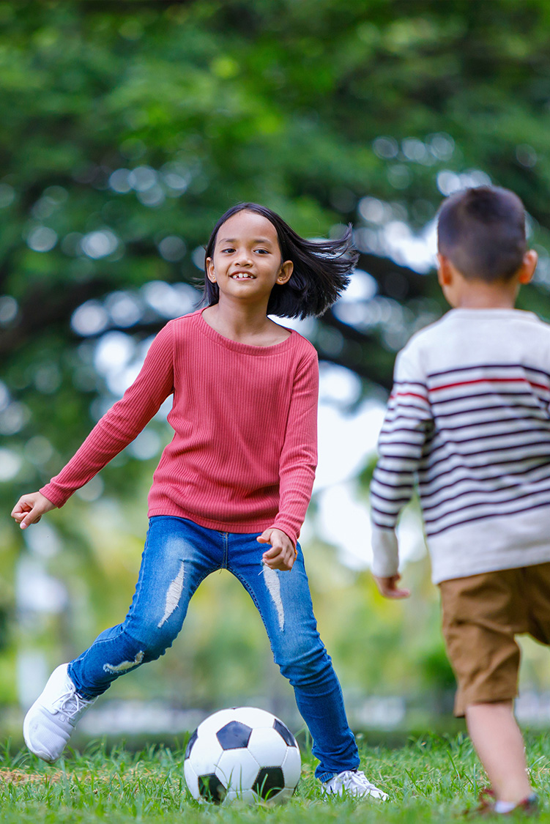
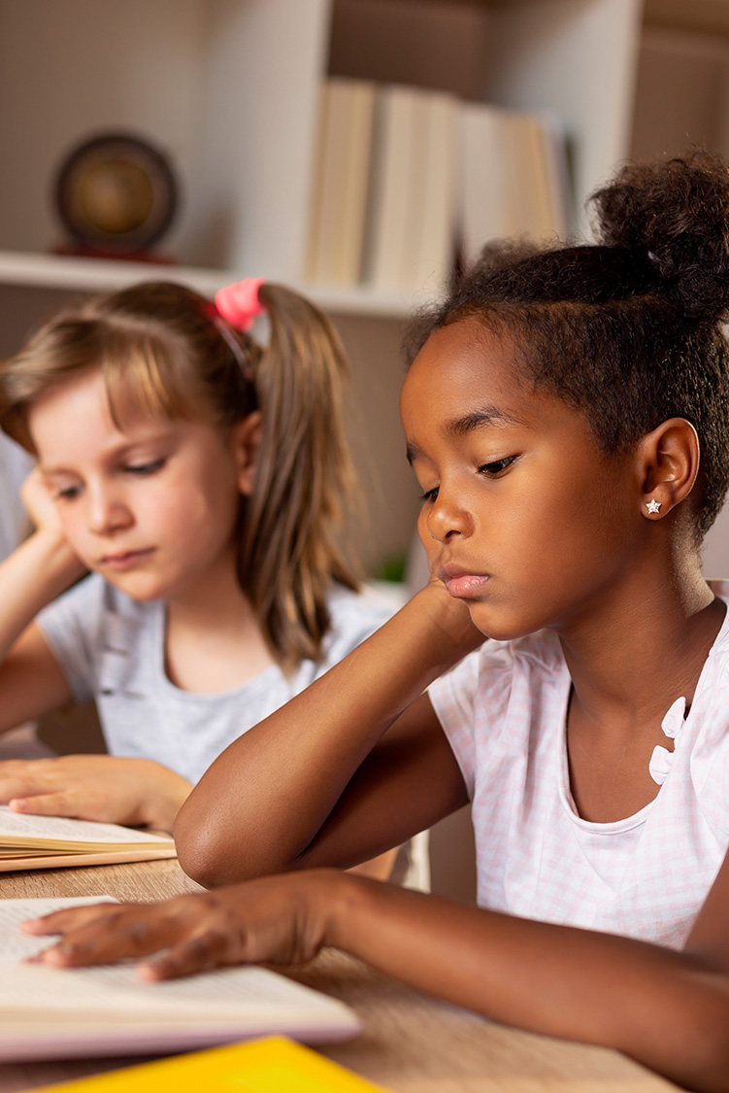

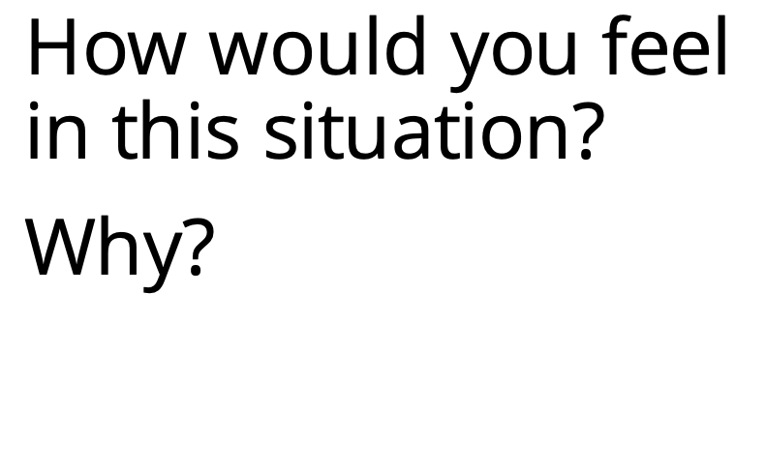
How would you feel in this situation?
Why?
Notes:
Instructor Notes:
Click once to display a photograph. Instruct students to imagine that the photograph is showing an important game and they are the student who is just about to kick the ball.
Ask: How would you feel in this situation? Why?
*Tip: It may be helpful to click back to Slide 8 so students can read through the different emotions and choose one to describe their feelings.
After one student has shared, ask students to demonstrate through a show of hands who would feel a similar way.
Then ask: Who would feel differently? Ask a couple students who would feel differently to share how they would feel and why.
Click and repeat the same process, this time having students imagine that they are the student who is reading.
Before moving to the next slide, summarize that everyone’s emotions are unique. Sometimes people have different emotions even when they are in the same situation. Just like our strengths and weaknesses, our emotions are nothing to hide.

Slide 11

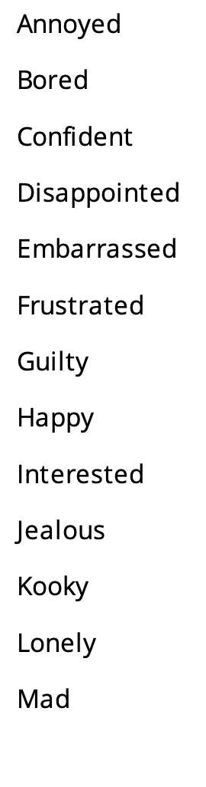
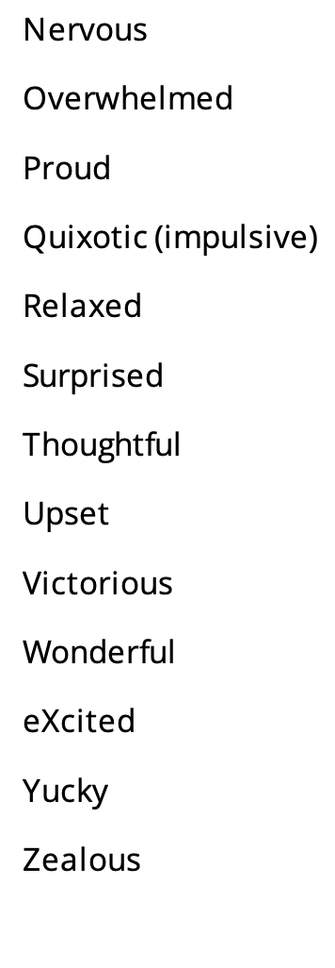

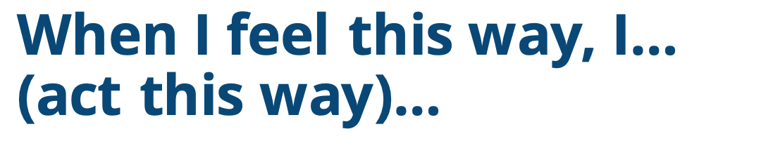

A
B
C
D
E
F
G
H
I
J
K
L
M
Annoyed
Bored
Confident
Disappointed
Embarrassed
Frustrated
Guilty
Happy
Interested
Jealous
Kooky
Lonely
Mad
N
O
P
Q
R
S
T
U
V
W
X
Y
Z
Nervous
Overwhelmed
Proud
Quixotic (impulsive)
Relaxed
Surprised
Thoughtful
Upset
Victorious
Wonderful
eXcited
Yucky
Zealous
I feel this emotion when…
When I feel this way, I…
(act this way)…
Notes:
Instructor Notes:
It’s Game Time! Divide students into groups of three or four, and tell students that they’re going to play a game that challenges them to explain their emotions.
Explain that each group will receive a stack of cards. Each card contains one of the emotions from the Emotional Alphabet on the slide. If needed, quickly review the emotions displayed in the alphabet.
Then distribute a copy of Handout 4: Game Directions to each group. Click once to reveal the sentence starters and read through the handout’s directions together.
Explain that groups will compete against each other to see how many cards they can get correct in ten minutes!
Once all questions have been answered, distribute a card set to each group, begin the timer, and let the game begin! Once the timer runs out, proceed to the next slide.

Slide 12





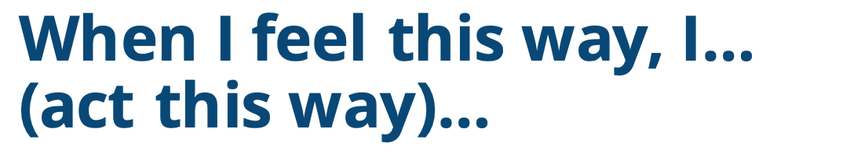
nervous
frustrated
confident
Notes:
Instructor Notes:
When the timer gets to zero, bring the class back together. Find out how many cards each group accumulated, and announce the winning group!
Tell students that you are going to discuss how they (or their group members) described a few of the cards’ emotions. If groups didn’t get to any of the cards mentioned, encourage them to instead think about what they would have said if they had they selected this card.
Click once to display “Frustrated.”
Ask several students to help you fill in the blanks:
I feel this emotion when…
When I feel this emotion, I… (act this way) …
Click to display a new word: “Nervous.” Ask students to help you fill in the same blanks.
Then click one final time to display and discuss the word “Confident.”
Wrap up the slide by asking: We already know that people can feel many different emotions. Do people always act the same way when they feel an emotion?
Summarize, as everyone just shared, that people can act in very different ways when they feel the same emotion! For this reason, it is important to explain the emotion we are feeling so others can understand how we feel!

Slide 13
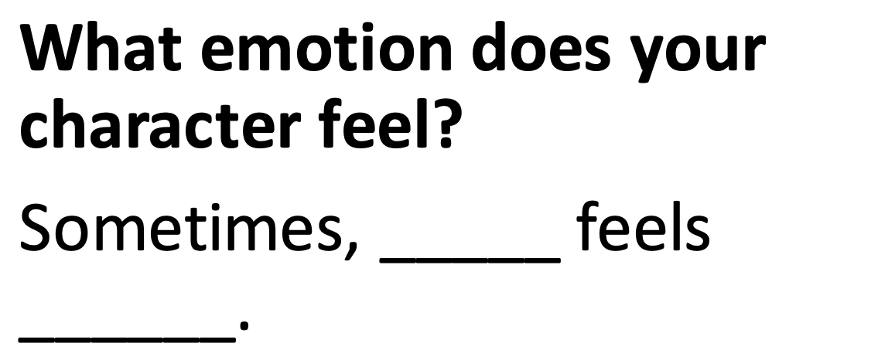
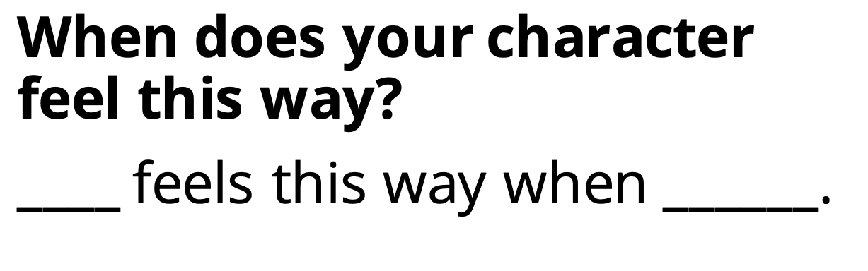
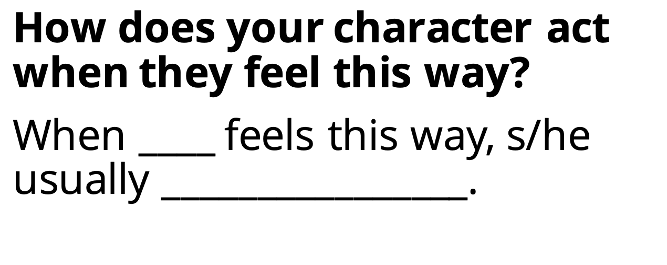
What emotion does your character feel?
Sometimes, _____ feels ______.
When does your character feel this way?
____ feels this way when ______.
How does your character act when they feel this way?
When ____ feels this way, s/he usually ________________.
Notes:
Instructor Notes: Explain that for the time that remains in class, students will continue adding pages to their narratives. This time, they will be writing about emotions!
Click once and explain that each student will choose two or three different emotions that they often feel. One page will be used to describe each emotion.
For each emotion, students should:
Click once: Describe what they feel.
Click again: Explain what makes them feel this way.
Click a third time: Describe how they act when they feel this way.
*Tip: If your students would benefit from using sentence stems, make a point of reading the sentence stems that are provided on the slide. If you don’t think your students need the sentence stems, you can point them out and explain that they are there as a suggestion.
Explain that, like last session, each page’s square should be used for an illustration. On these pages, each drawing should illustrate the emotion they are writing about.
Then pass out two copies of the Story, page __ handout to each student, encourage them to find a position/area in the room where they can write comfortably, and let them get to work!
If students find they have time to describe a third emotion, they may get a third story page from you.
When the class session is complete, collect the students’ work and wrap up by summarizing: When we think about and share our emotions, we are able to better understand how we feel and why we act the way that we do. Always remember: I know my emotions are nothing to hide!
Notes:
1 - If students need more room to write, they can use a copy of the Story, Extra Page __ handout, fill in the appropriate page number, and then continue writing.
2 - Like last session, if students can’t complete their work during this session, it may be completed in stations or as an activity in upcoming sessions before moving on to Day 3.

Slide 14

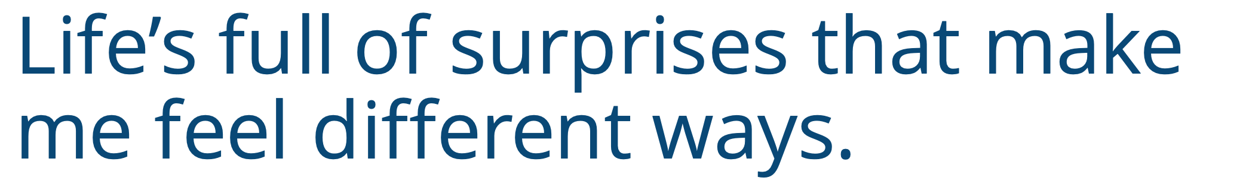
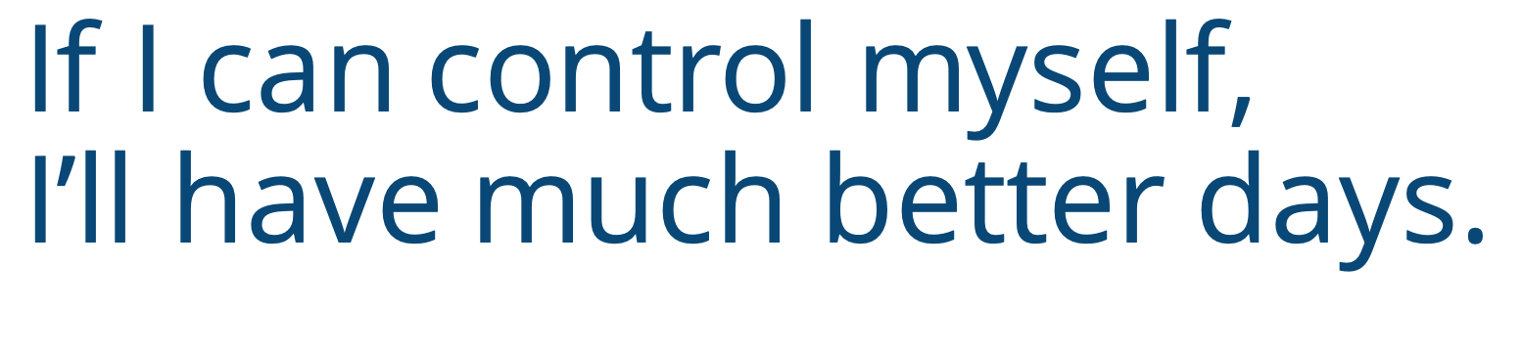
Life’s full of surprises that make me feel different ways.
If I can control myself,
I’ll have much better days.
Notes:
Instructor Notes:
Once students are sitting in a large circle or semi-circle, read the following Wings Words to Live By excerpt aloud: Life’s full of surprises that make me feel different ways.
Explain that there are all kinds of surprises: good and bad. Anything that happens that we aren’t expecting is a surprise!
Ask the students to brainstorm and share a couple examples of good or positive surprises and a couple examples of bad or negative surprises. As these are shared, ask students to consider: How would you react to this surprise?
Then click once to add a second line to the Words to Live By header and read the full header aloud: Life’s full of surprises that make me feel different ways. If I can control myself, I’ll have much better days.
Tell students that they are about to explore what this means!

Slide 15

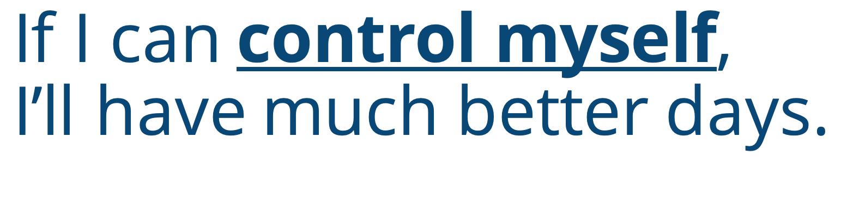
Notes:
Instructor Notes:
Teacher Prep: Select two songs and have them ready to play on your laptop or smart phone. The first song must have a quick tempo, be upbeat, and fun to dance to. Try to choose a song you know your students will like and/or recognize! If you don’t have a song in mind, Kidz Bop and GoNoodle are good places to start. The second song should be much slower and harder to dance to. Relaxing classical music like this would work well.
Explain to students that while we never want to hide our emotions, it is also important to act in a kind and responsible way. When surprises happen, we must try to control our impulses.
Tell the class that they are going to play a game similar to Freeze Dance to learn what it means to “control our impulses.”
Explain that like Freeze Dance, students must dance when they hear music and must freeze when the music stops. However, this game has two extra rules!
When students hear the fast song, they must dance quickly. Play a sample of the fast song so students know what to expect.
When students hear the slow song, they must dance slowly. Play a sample of the slow song so students know what to expect.
*Tip: Encourage students who may not want to dance to at least move their feet to the music. They could jump, march, etc., as long as it is to the appropriate pace.
Then say: “3, 2, 1: Dance!”, begin one of the songs, and instruct students to get up and start dancing!
Once you have played one song for several seconds, stop it (which is when students should freeze), and then begin playing music again. Don’t always flip back and forth between the two songs. Sometimes, play the same song in a row so students don’t know what to expect!
Once the class seems to be used to the game’s rules, announce a rule change: Students must now dance slowly to the fast song and quickly to the slow song.
Spend two or three minutes playing and alternating short segments of each song, reminding students of the new rules if need be.
After the class seems a bit more used to this new set of rules, announce an additional rule change: This time, students should freeze when they hear any kind of music…and dance when the music stops!
Continue to alternate slow music, fast music and silence for a couple minutes. Then instruct students to return to sitting in a circle.
Ask students to think-pair-share which version of the game was more difficult and why.
Summarize the students’ thoughts by explaining that the second and third versions of the game required them to control their impulses. Explain that an impulse is your gut reaction: It is what your body wants to do before you have a chance to think about it. For instance, when students heard the fast dance music, their impulse was to dance quickly…not slowly. Go on to explain that the game proved that they can control their impulses. When they thought about it, they could dance slowly while listening to a fast song, dance quickly when listening to a slow song, and then later freeze when they heard any kind of music. It just required a little more thought and control!

Slide 16







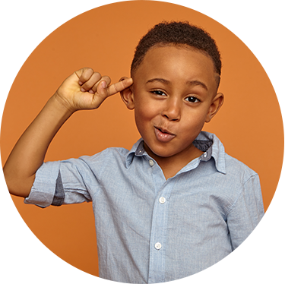
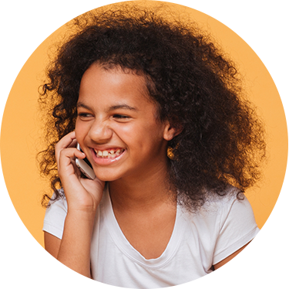
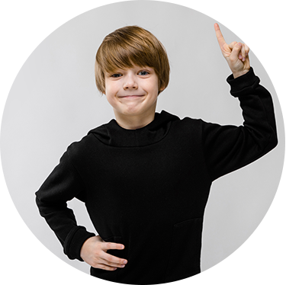
I can control what I…
THINK
SAY
DO
Notes:
Instructor Notes:
Tell students that now that they understand what an impulse is, it’s also important to learn ways to control impulses. Click once and explain that when we are faced with surprises, we often want to react right away—but controlling ourselves takes more time. Explain that one way to help us stop, think, and control our impulses is with a strategy called “Control Check”!
Tell students that before we react, we should stop, check, and try to control how we…
Click once to display: “Think.”
Explain that we can ask ourselves if our minds are clear and focused.
Have we thought about how we feel before we say or do anything?
Click a second time to display: “Say.”
Explain that we can make sure the words we are about to say are gentle and kind.
Click a third time to display: “Do.”
Explain that before we act, we can make sure our actions are going to be calm and kind.
Explain that Control Checks are good to use when we are surprised because they help us stop and think… and then act in kinder and calmer ways!

Slide 17




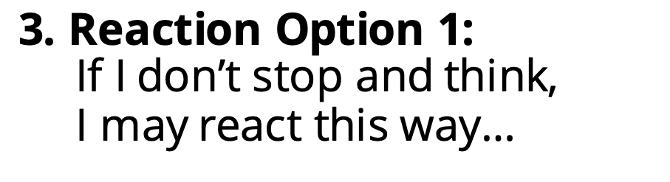

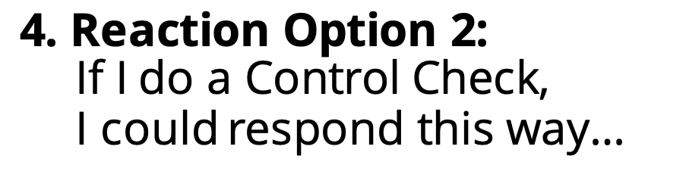
Read your scenario with your group. Then create a comic strip that explains:
THINK
1. What is the surprise?
SAY
2. How may the surprise make you feel?
3. Reaction Option 1:
If I don’t stop and think,
I may react this way…
DO
4. Reaction Option 2:
If I do a Control Check,
I could respond this way…
Notes:
Instructor Notes:
Divide students into groups of two or three and explain that each group is going to create a comic strip about a Control Check!
Click and explain that you will pass out a scenario to each group that describes some kind of surprise.
Each group will then develop a comic strip that:
Click once: Illustrates and explains the surprise.
Click a second time: Illustrates and explains how the surprise may make someone feel.
Click a third time: Illustrates and explains how someone may react if they don’t stop and think.
Click a fourth time: Illustrates and explains how someone could react if they do a Control Check!
Explain that, like a real comic strip or graphic novel, each panel should tell a story through drawings and speech bubbles. Students can use the lines on the right side of the page to explain anything that may not be clear in the drawing.
Go on to answer questions as needed, and then distribute one scenario (cut out from Handout 5: Control Check) and one Handout 6: Control Check Comic Strip to each group. Explain that the class will have about 10-15 minutes to make their comic strip…so it’s okay for the drawings to be more like sketches!
Once time is up, encourage groups to swap comics with each other a couple of different times so groups have a chance to consider how Control Checks can help a variety of situations.

Slide 18



Second Page: Describe what your character can think, say, and do the next time they feel this way in order to control themselves!
First Page: Think of the last time a surprise made you feel frustrated or disappointed
and you did NOT do a Control Check. Include:
What happened?
How did your character feel?
What did your character say
and do?
Notes:
Instructor Notes:
Now that students have thought through how to use a Control Check, explain that each student will add the final section to their narrative.
Click once and ask students to think about a time when a surprise led to frustration or disappointment and they did NOT do a Control Check. Elaborate by saying that this may mean that they acted less kind or less calm than they could have.
Explain that each student will receive two more blank story pages. On their first page, students should describe this surprise, how they felt, and how they reacted—being sure to use their character’s name and not “I”!
While they can use their own name, instruct students to avoid using specific names of other people in their stories, and instead replace the name with descriptors like “friend”, “sister” or “brother.” Then click and explain that on their second page, each student should set a goal for how their character will use a Control Check in the future to respond in a calmer and kinder manner next time they feel this emotion.
Explain that the illustrations on each page should show the differences between the two reactions.
Answer any questions that the students have, and then give the class a moment to brainstorm a surprise. Instruct students to raise their hand when they have a surprise in mind. Once they have raised their hand, you will give them two story pages so they can get to work.
Tell students that they should get as far as they can today, but they will have a little more time next session to wrap up. As always, they can grab an extra story page from you if they need more room to write!
Collect the students’ work when the session is complete.

Slide 19





1. Finish writing.
2. Put your pages in order, number the pages, and proofread every page.
3. Create your Cover Page!
Notes:
Instructor Notes:
As usual, begin this session in a circle or semi-circle and explain that the first part of today’s session will be a Writer’s Workshop work day: Students will be responsible for completing their narrative! Click once to display and explain each of the steps below so students understand what they must accomplish:
Finish writing: If students haven’t yet completed their two Control Check pages from last session, they need to do this first. If needed, go back a slide to review these instructions.
Assemble the pages and proofread your work: Students should put their pages in order and number them accordingly. They should then read through everything they have written and correct any mistakes, paying attention to punctuation, capital letters, and spelling!
Create a Cover Page: Show students where they can pick up the Cover Page handout when they are ready. Explain that this will be used as the front page of their narrative. Show students that the Cover Page handout already has part of the Wings Words to Live By written on it. Students will need to write their name, and then draw a picture that illustrates this section of the Words to Live By.
Click again to display the timer. Subtract 15 minutes from the time you have remaining in the session, and set the timer for this amount of time. Tell students they have ____ minutes to finish steps 1,2, and 3!
Then pass back each student’s work from the last three sessions and instruct them to get started.
When students have completed all three steps, help them staple their pages together into a book!

Slide 20


Notes:
Instructor Notes:
When time is up and there are about 15 minutes left in the session, it’s time to share!
Instruct students to find a place to display their completed narratives around the classroom. Explain that by sharing our emotions, reactions, and goals with each other, we’ll be able to better understand ourselves and others.
*Tip: If anyone doesn’t feel comfortable sharing what they have written, a couple students may complete the next portion of the activity in pairs.
Once their narratives are displayed, tell the class that they will now participate in a Library Walk. Explain the rules of a Library Walk:
Students should quietly walk around the classroom like they are in a library. As they do so, they should observe the cover illustrations on their peers’ narratives and may even carefully flip through some of the pages.
When you say “read”, students should carefully select one of the narratives closest to them, find a comfortable spot in the classroom, and read what their peer has written.
Depending on the time remaining, you may choose to lead students through Steps 1 and 2 just once, or a few different times.
Before the session ends, bring the students back together, and congratulate them on working so hard to understand the first section of Words to Live By. By investigating their strengths and weaknesses, exploring their emotions and reactions, and setting a goal to help them control their impulses, they have (as the pledge begins) learned lots of skills that will help them reach the sky!
Conclude by reading the first portion of Words to Live By, as displayed on the slide, together as a class.

