Slide 1
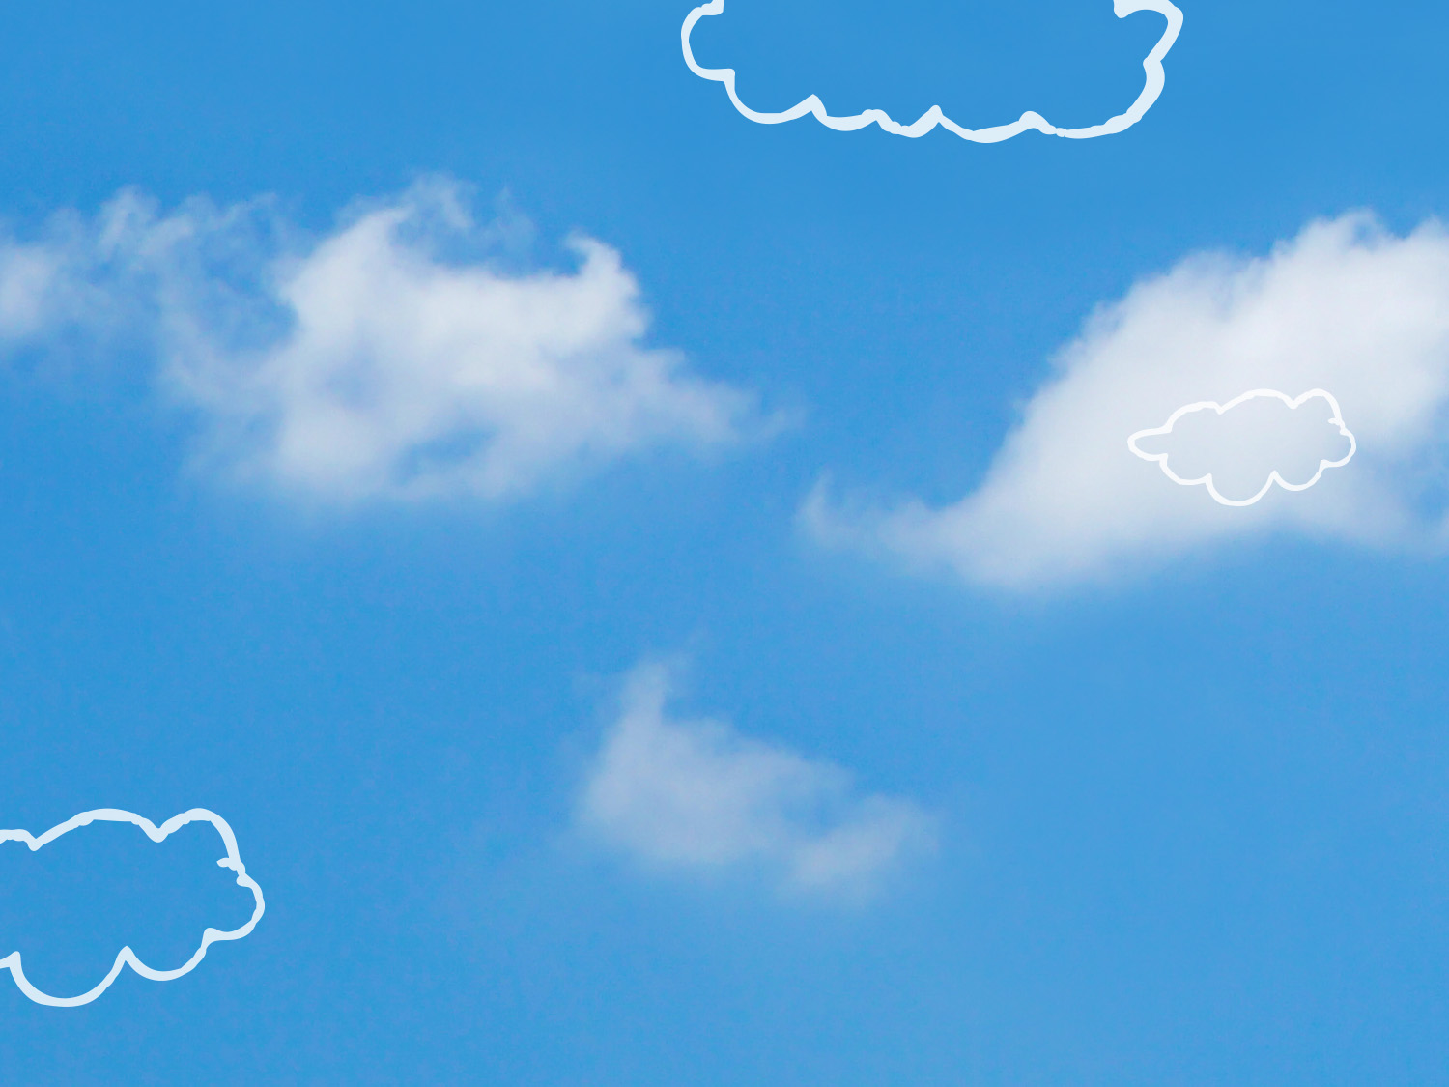



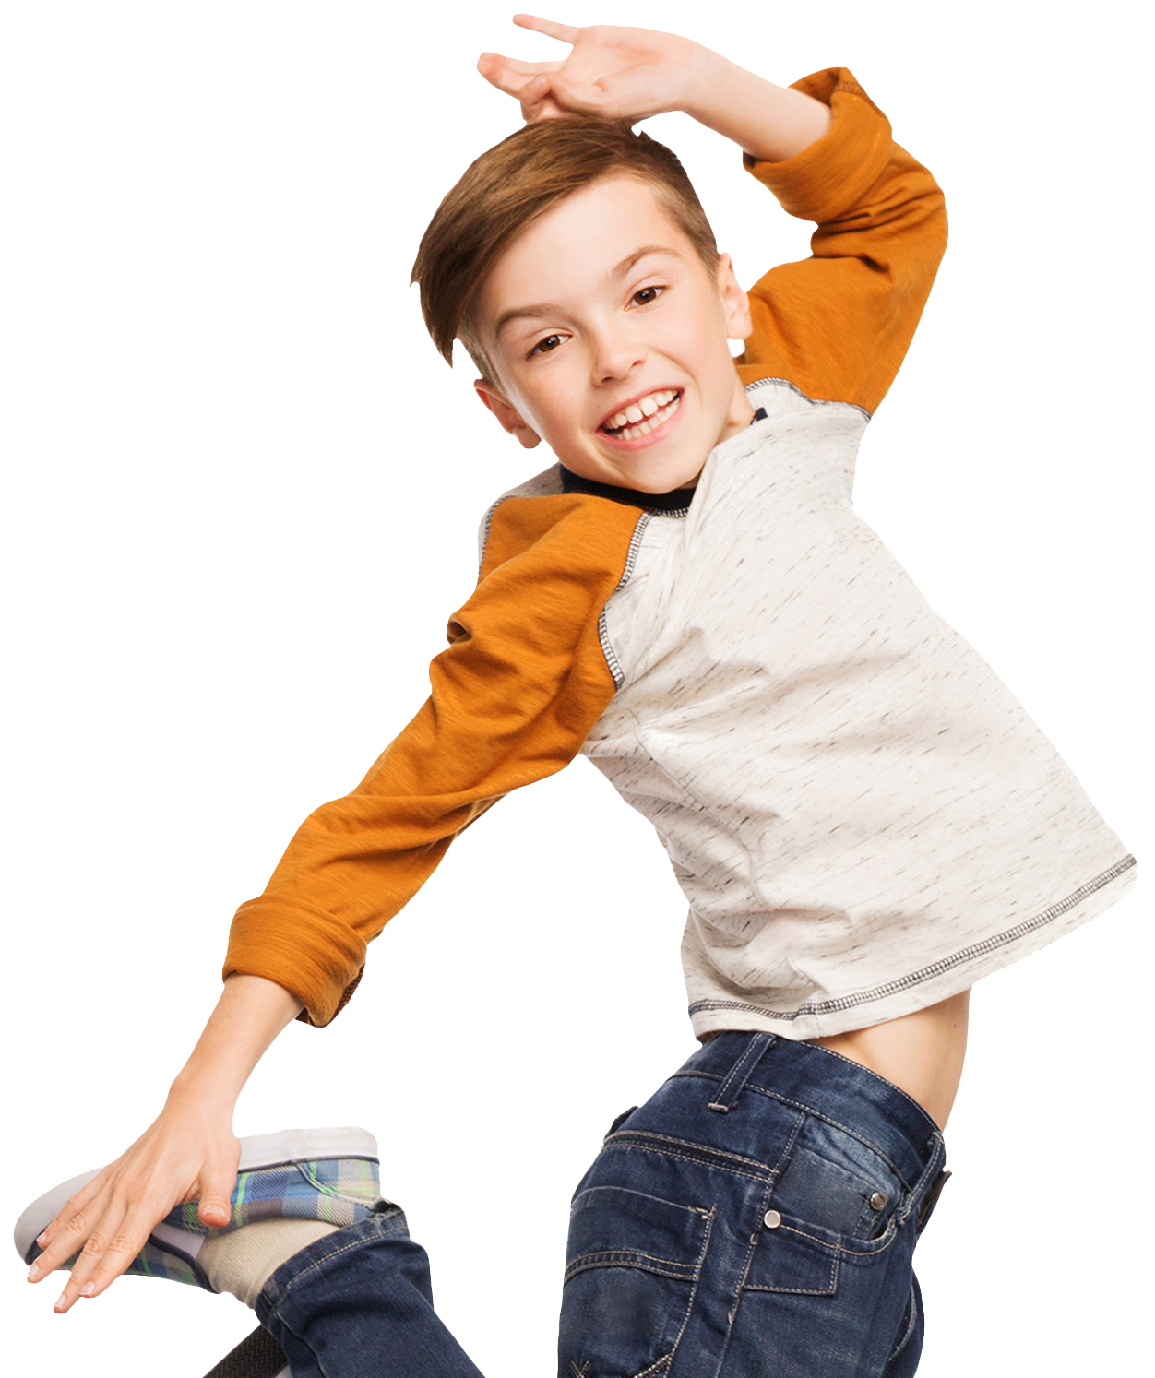
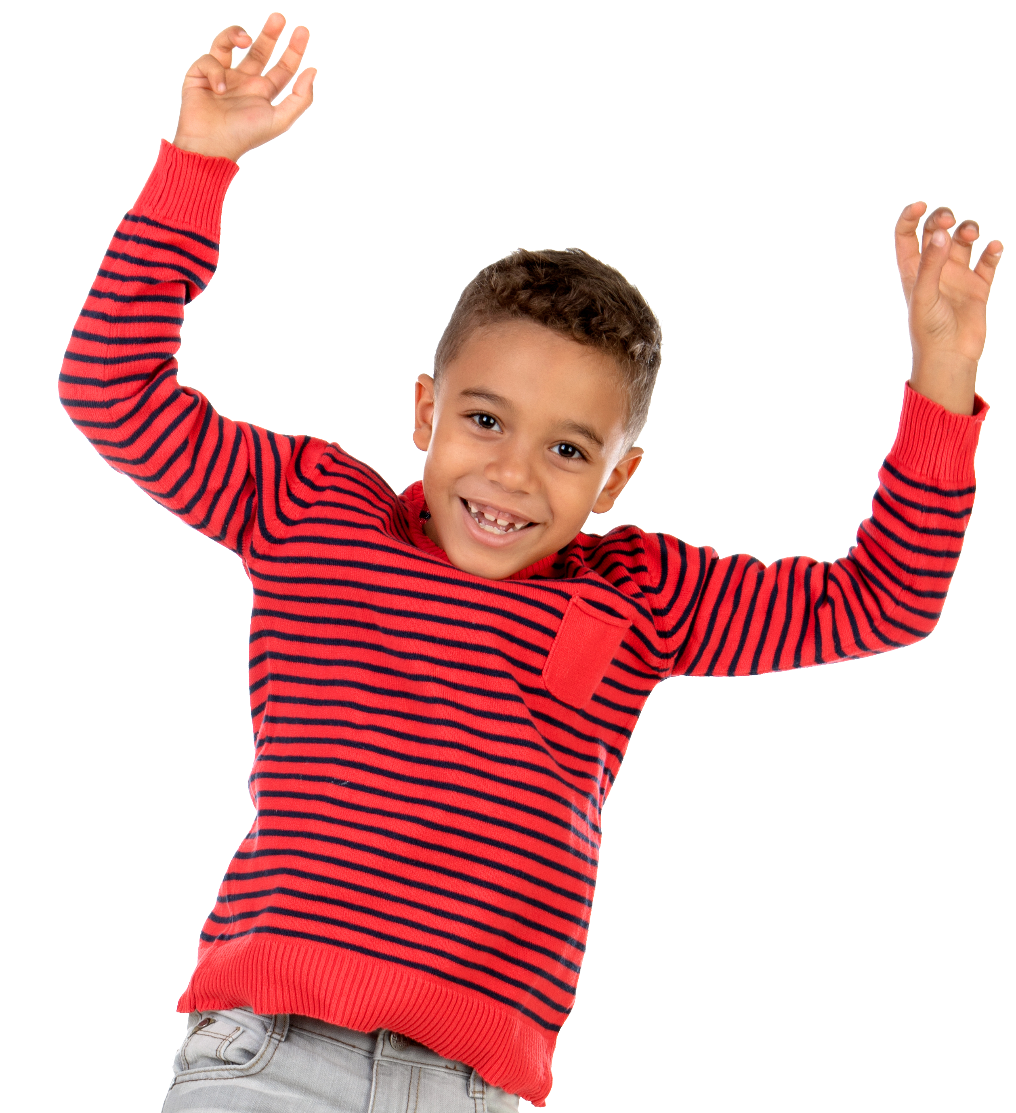
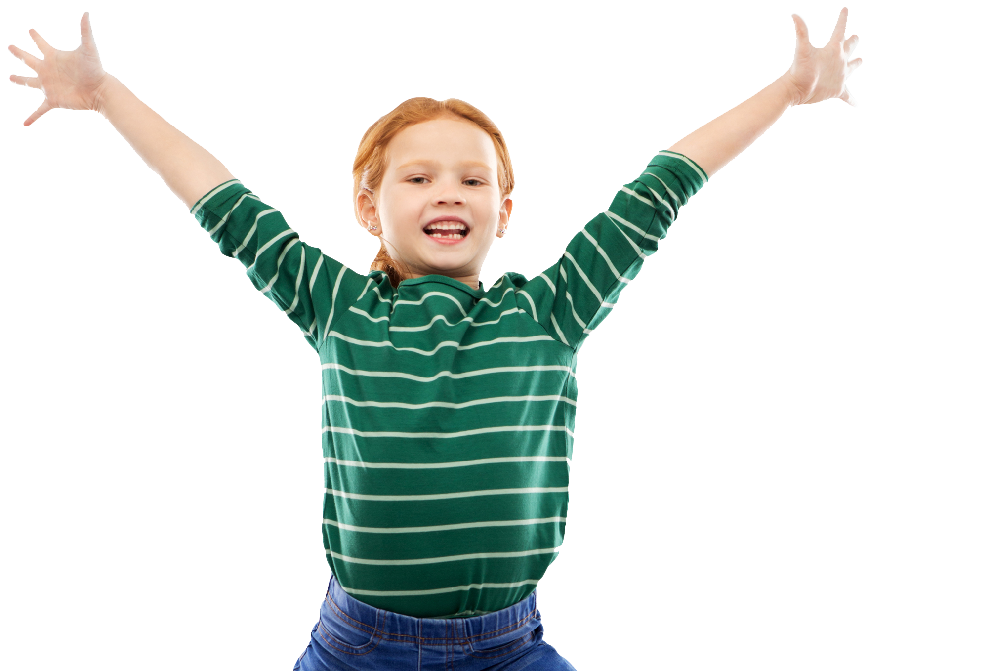

Slide 2
Live Together | Play Together | Work Together
Type here... | Type here... | Type here...
Notes:
Instructor Notes:
Begin by instructing the class to sit on the floor in a circle or semicircle. Join the students by sitting at their level.
Click once to display the word “community.” Encourage students to share what comes to mind when they hear this word.
Click again and explain that a community is a place where people live, work, and/or play together. There are many different kinds of communities!
Then divide the students’ circle or semicircle into three sections and explain that each section will be responsible for brainstorming examples of one type of community.
Assign one section of the circle “where people live,” another section “where people work,” and the remaining section “where people play.”
Give each student a sticky note and a marker. Encourage students (either individually or with a partner) to brainstorm a community in their assigned category.
*Tip: As needed, provide examples to kick off student brainstorming. For instance:
People live in homes, neighborhoods, and cities together.
People work in classrooms, schools, and offices together.
People play in clubs, sports teams, and after-school care together.
Then ask for students to share what they recorded for each category, beginning with “where we live together.”
As a student shares, place their sticky note on the board.
If the examples provided in the *Tip section above are not included, be sure to add them.
Once all three columns are complete, quickly recap by restating all of the communities that the students just brainstormed.

Slide 3
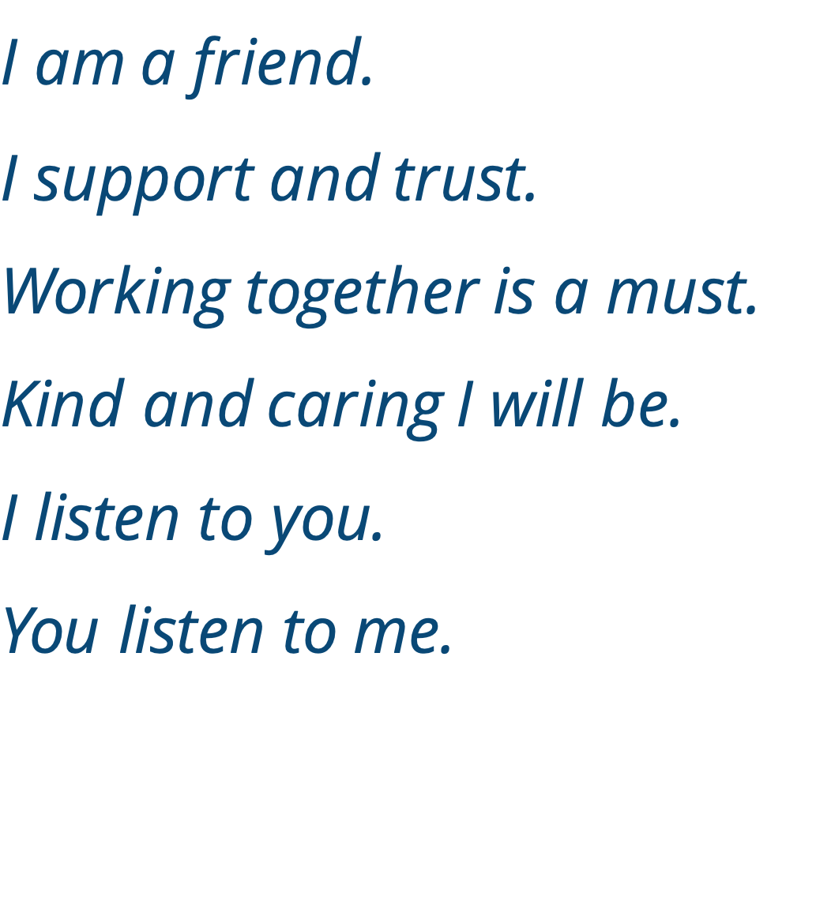
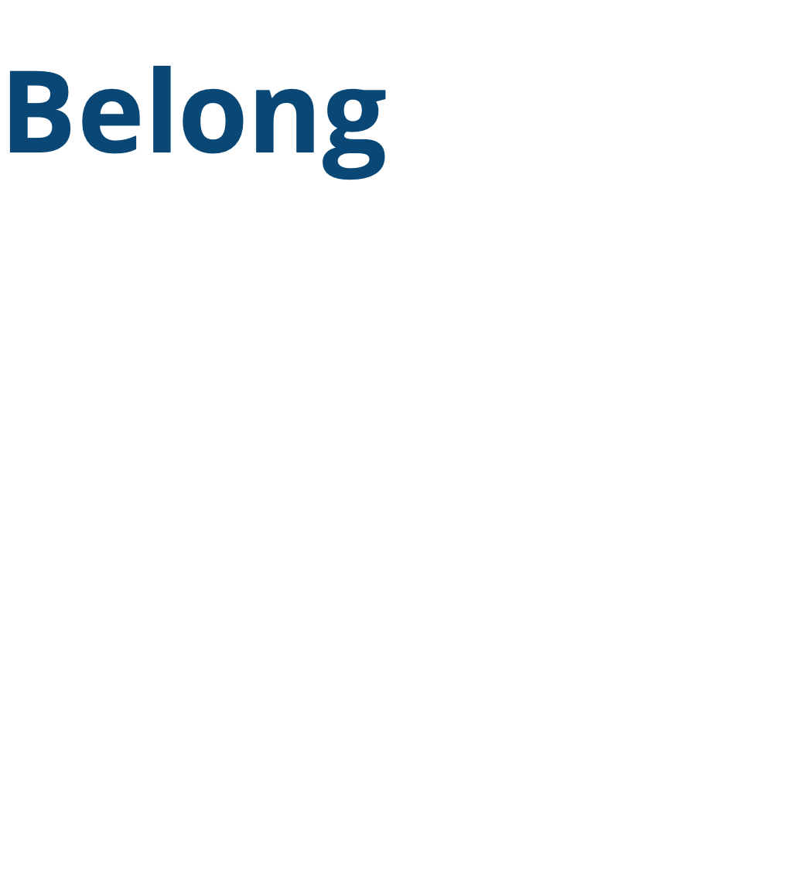
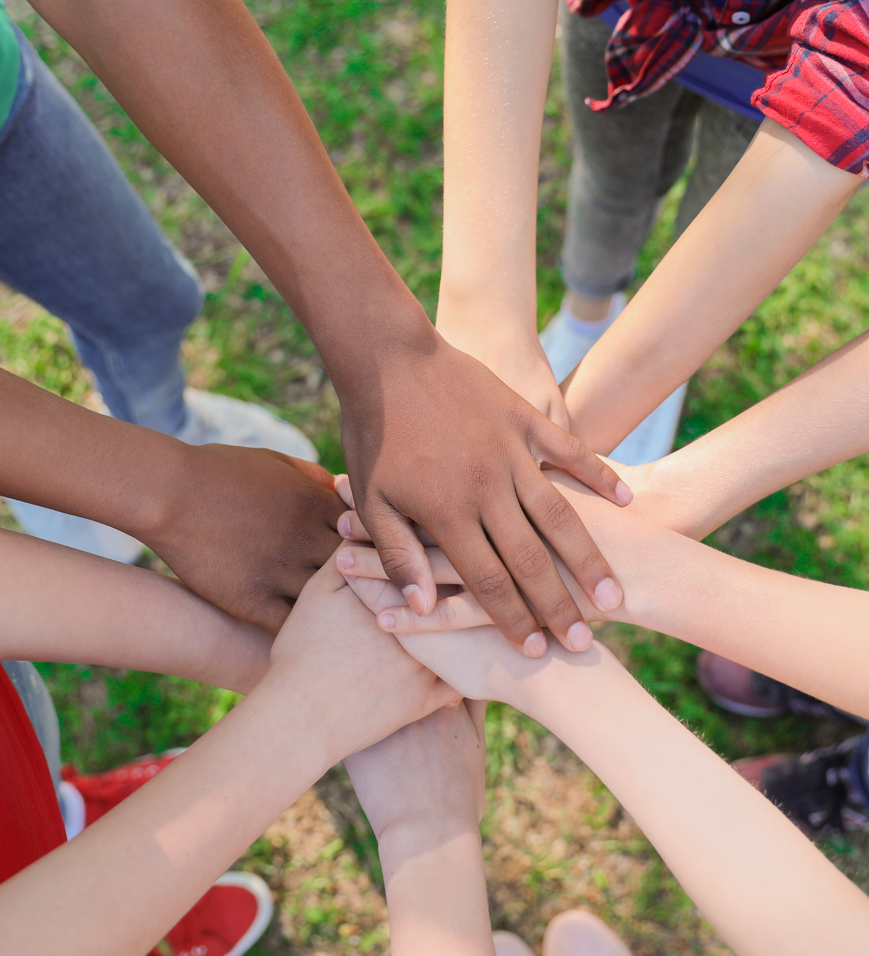
Notes:
Instructor Notes:
Click once to display and read the following Words to Live By:
I am a friend. I support and trust.
Working together is a must.
Kind and caring I will be.
I listen to you. You listen to me.
Explain that these words can help us understand how to treat other members of our community.
Then click twice to display the word “belong.”
Explain that when you feel like you belong, you are comfortable being yourself, and you believe other people like you for being you!
Click two more times to bring the Words to Live By back on the slide. Point to the lines of text and tell the class that acting in this way is one way to help others feel like they belong.

Slide 4
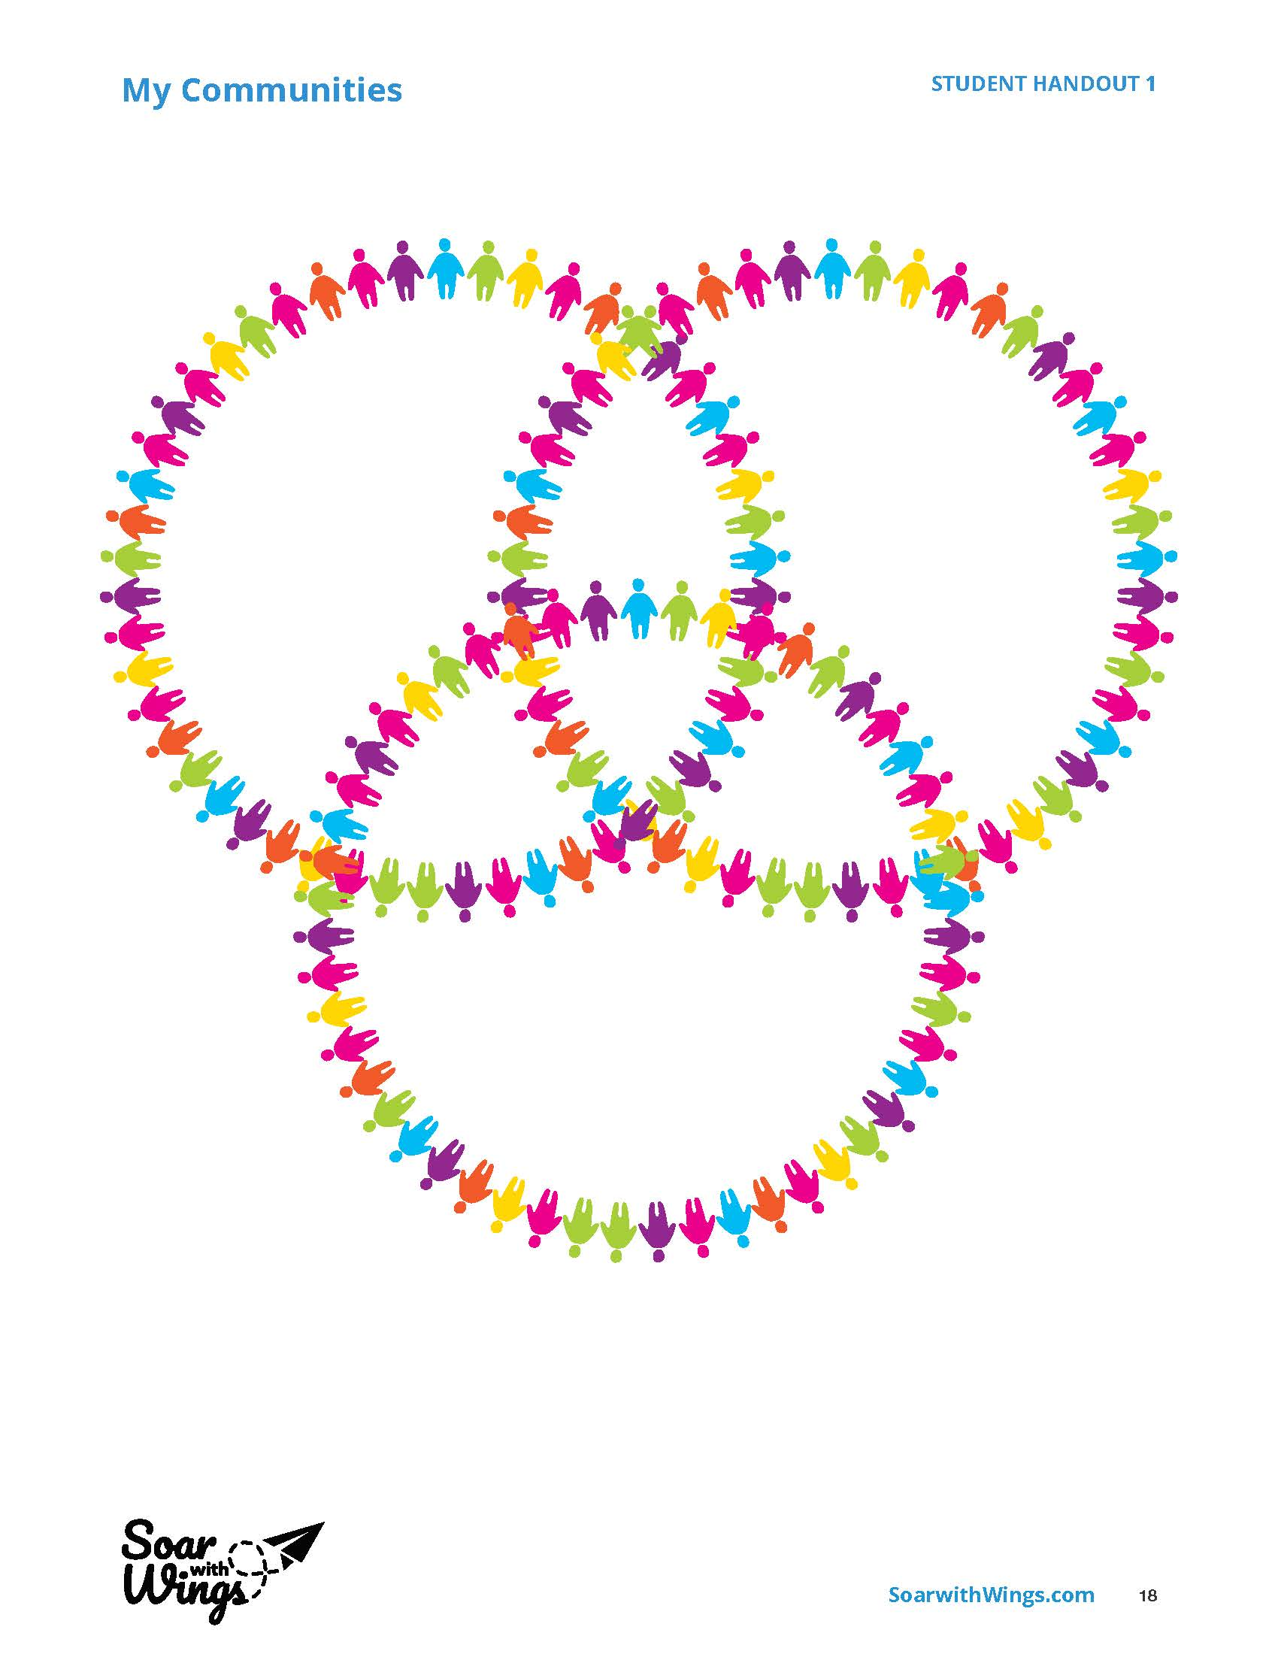
Notes:
Instructor Notes:
Distribute one Handout 1: My Communities to each student.
Point to each of the three circles on the slide and challenge the class to think about where they feel like they belong. Students should include at least one community they work in, one community they live in, and one community they play with.
Then point to the intersecting sections and challenge the class to think of communities that are a combination of these categories.
For instance: Are there any communities they belong to in which they work and play? Or, are there any communities they belong to in which they live and work?
Remind them that communities can be as small as a family or home or as big as a country!
Then instruct students to return to their seats and use the circles to brainstorm and record communities where they feel like they belong.
*Tip: As students brainstorm, it may be helpful to switch back to the Communities Chart that you created together on Slide 1 so students have ideas to reference.

Slide 5




Notes:
Instructor Notes:
Bring the class back together in a circle or semicircle with their completed handouts.
Click to project and read the sentence stem on the slide: “When I am _________, I feel like I belong.”
Then encourage students to use their Handout 1: My Communities to fill in the blank and invite them to share.
*Tip: It may be helpful to give an example such as: “When I am having dinner with my family, I feel like I belong.”
Click to project the next sentence stem: “When I feel like I belong, I also feel _____________.” Encourage students to share with a peer the emotions they feel when they belong somewhere.
Once several students have shared, explain that this feeling of belonging to a community can make us feel safe, content, loved, and many other positive emotions. A sense of belonging is one of the most important parts of being part of a community!
Then click again to project and share two more sentence stems:
I don’t feel like I belong when ______.
When I feel like I don’t belong, I feel _______.
Go on to explain that people do not always feel like they belong to their communities. Encourage students to think about a specific time when they felt like they did not belong and consider how it made them feel.
Wrap-up by encouraging students to think about and share: In the situation that you have in your mind, what would have to change for you to feel like you DO belong?
Invite students to share their responses.
Tell students that they will continue investigating this idea over the next few days.

Slide 6
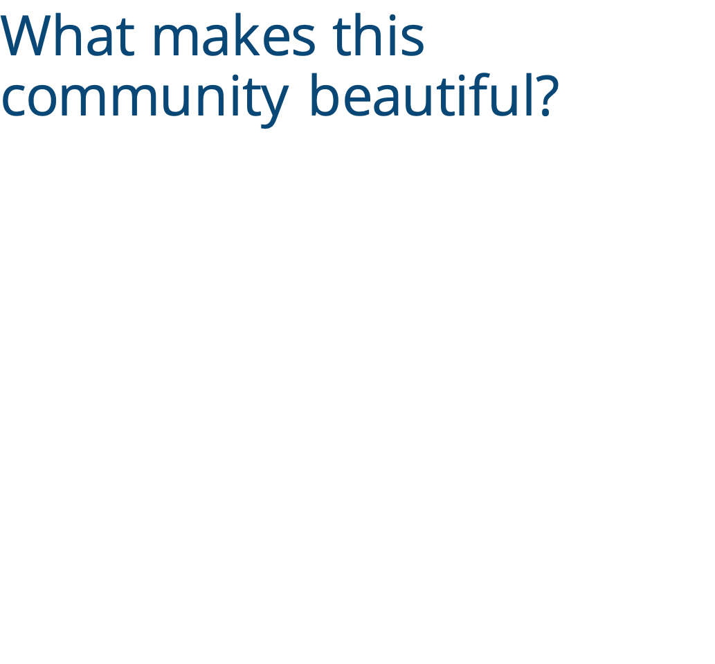
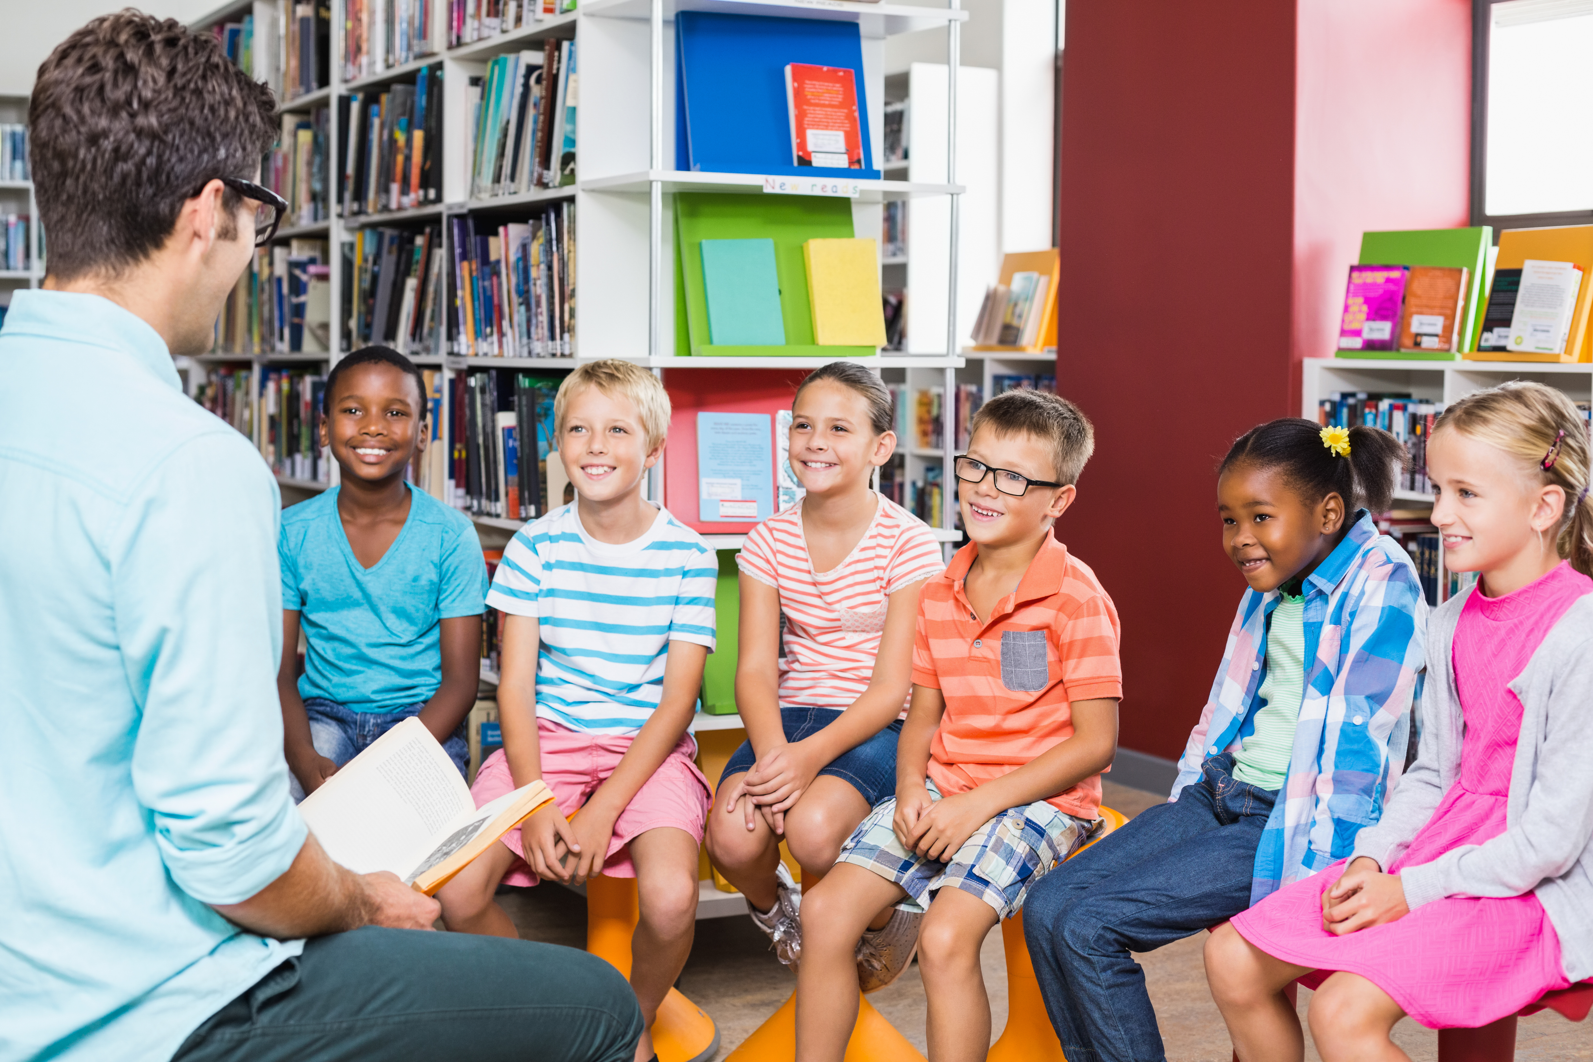
Notes:
Instructor Notes:
Introduce the book Last Stop on Market Street by Matt de la Pena. If the book is unavailable, you may also project a version of the video read-aloud.
Display the book’s cover, read the title aloud, and take a picture walk through the pages. (If you do not have a copy of the book, you can still do a picture walk by clicking through the video and pausing at different points.) As you do, invite students to share what they think the story will be about.
Then tell the class that they are about to take a bus ride through someone else’s community. Encourage them to pay attention to what makes this community beautiful and special as they listen.
Begin to read the story or display a version of the video read-aloud.
Pause to clarify vocabulary and/or hold a brief discussion after you read the following lines:
Text line: “Nana squeezed the man’s hand and laughed a deep laugh.”
Say: We have met many members of this community so far.
Ask: What are some of the differences among the people we have seen so far? What are some of the similarities?
Text line: ‘“How come it’s always so dirty over here?”’
Ask: Why is it difficult for CJ to see the beauty in this community? Do you think a community has to be perfect to be beautiful? Why or why not?
Text line: “CJ saw the perfect rainbow arcing over their soup kitchen.”
Explain: A soup kitchen is a place where free food is served to those in need.
Once you have read the whole story, ask: Every community is beautiful in its own way. What makes this community beautiful?
Then summarize the story and your discussion by sharing:
The unique people in this community are one of the things that make it beautiful.
Another beautiful part of this community is that people are willing to help others. When people come together to help each other in a community, it can help make everyone feel like they belong.
Conclude the day’s session by encouraging students to find and observe the beauty in the community where they live over the next day—including what they see, hear, and smell—so they can describe it during the next class session.

Slide 7

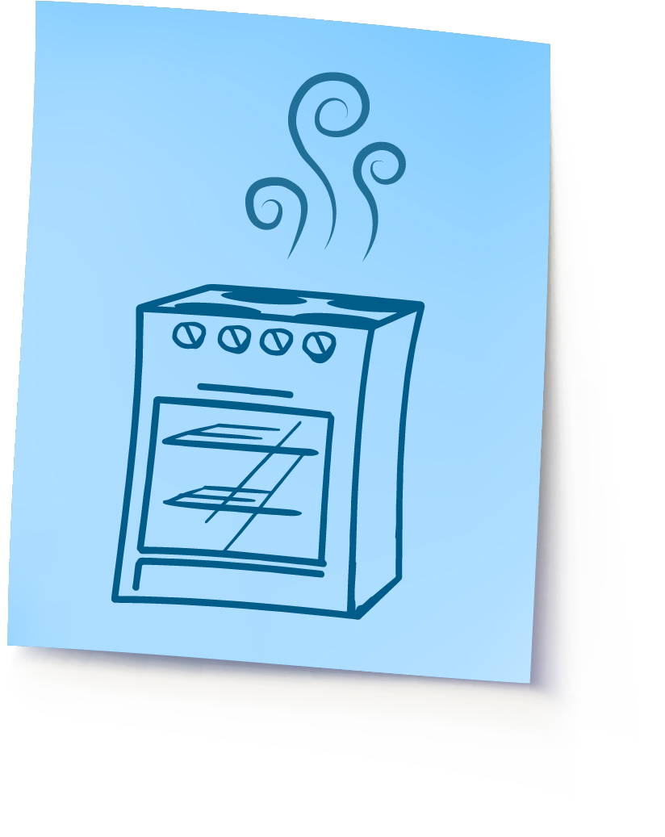
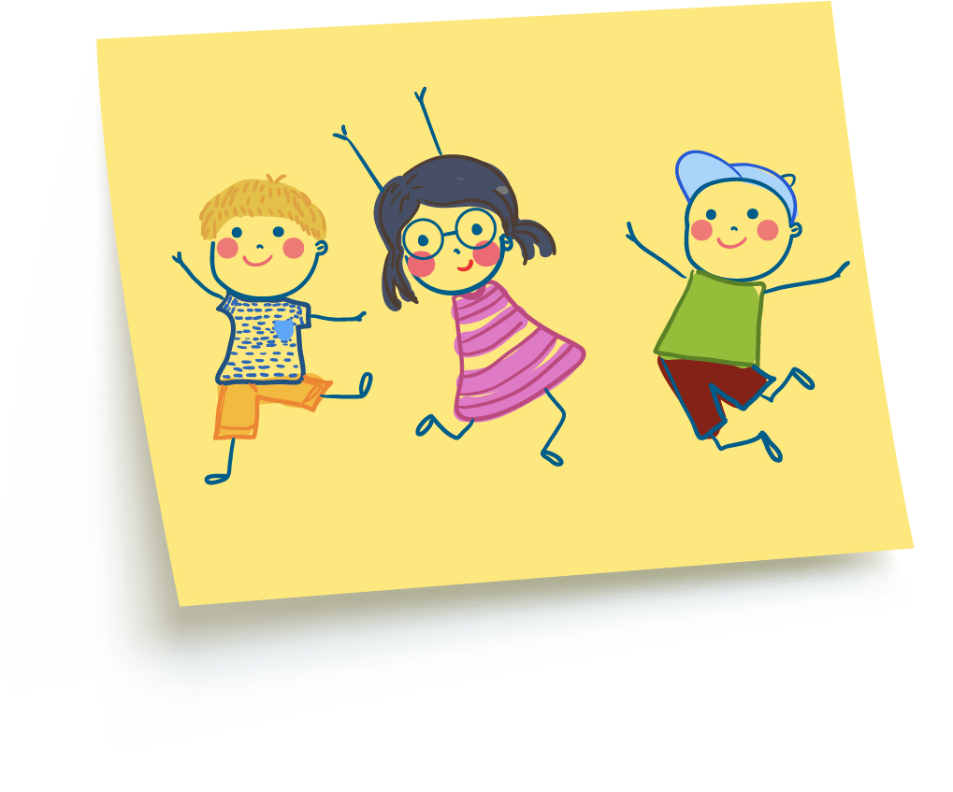
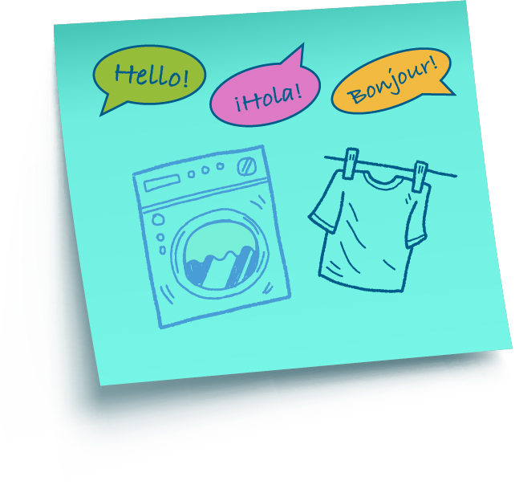
Notes:
Instructor Notes:
Begin the second session by instructing the class to sit on the floor in a circle or semicircle. Join the students by sitting at their level.
Explain that today the class will be focusing on the community where they live.
Distribute three sticky notes to each student. Be sure each student also has a writing or drawing utensil.
Encourage students to think about the observations they made yesterday. Ask them to draw or write descriptions of where they see, hear, and smell beauty in their community.
Click to show a few examples:
This student smells beauty as she passes the corner shop where arepas are cooking.
This student hears beauty in people speaking different languages as he walks by the laundromat.
This student sees beauty in the children laughing as they run in the park.
Then call students up a few at a time to share and stick their ideas to the board.
Once all students have shared, ask: Have you heard the expression, “Beauty is in the eye of the beholder?”
Explain that that the “beholder” is the “observer”—or the person who is looking, listening, or smelling.
Then restate the expression, and ask: What does this expression have to do with your community observations?
Summarize: Each of these unique sounds, smells, and sights is what makes your community beautiful to you. Even though we all may live or work or play in the same community, we see beauty around us in different ways.

Slide 8
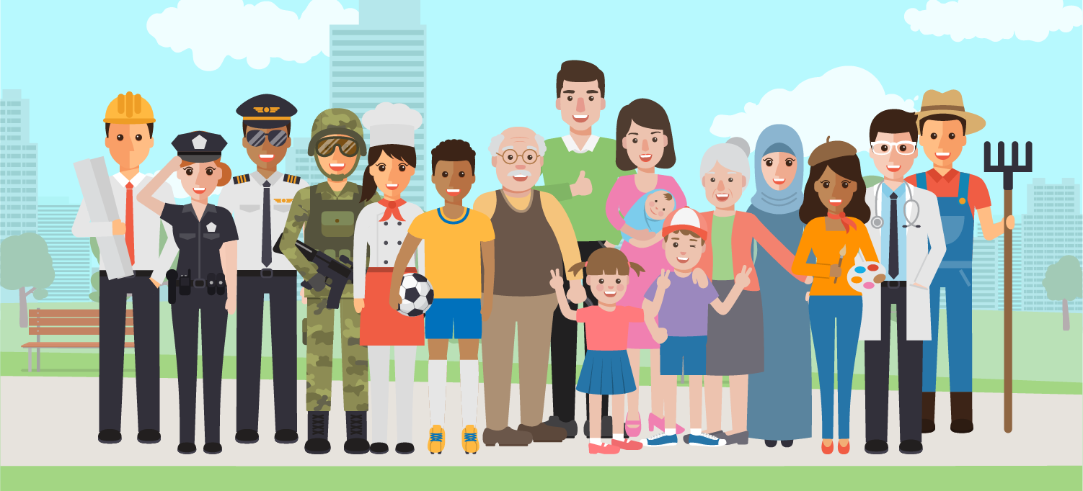
Notes:
Instructor Notes:
Take a moment to define “unique” as being one-of-a-kind and different from everyone else.
Reiterate that having unique people come together to live, work, and play is another beautiful part of a community.
Tell the class that one way people can be unique is in the roles that they play and the responsibilities they have in their community.
Ask students to consider: What hats do you wear, or roles do you play, in your community?
Pass out one Handout 2: Community Hats to each student and review the instructions. Be sure students understand that:
They should first use their pencil to draw an outline of a hat they would like to wear.
Along the hat’s outline, they should list all of the different roles they play in their community.
Give examples of some of the different roles that you play, such as Teacher, Parent, Volunteer, Sports Fan, Friend, etc.
Within the hat, instruct students to jot down some of the different responsibilities or jobs that come with these roles.
Give examples, such as:
As a teacher, I am a role model, teach students to read, plan lessons, etc.
As a friend, I give advice, listen, make people laugh, etc.
If time allows, students may then color and/or add design elements to their hat.

Slide 9

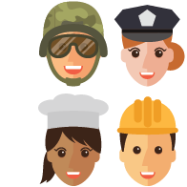
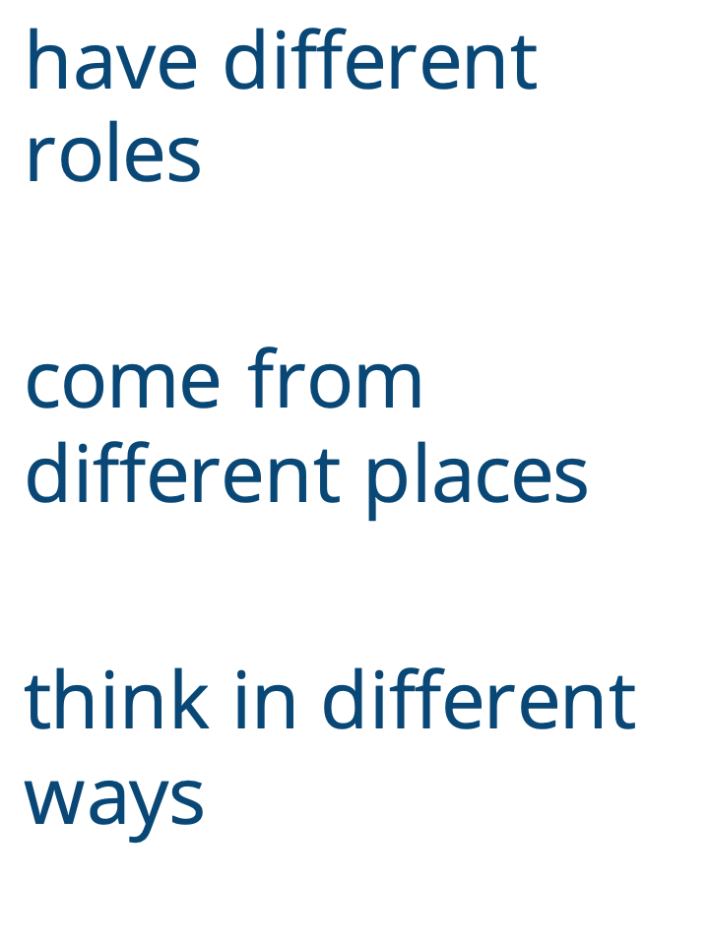
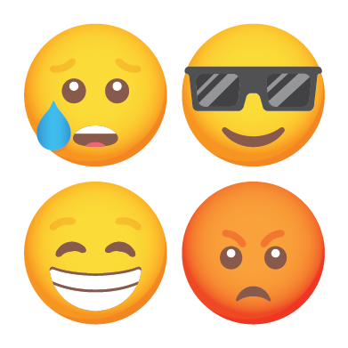
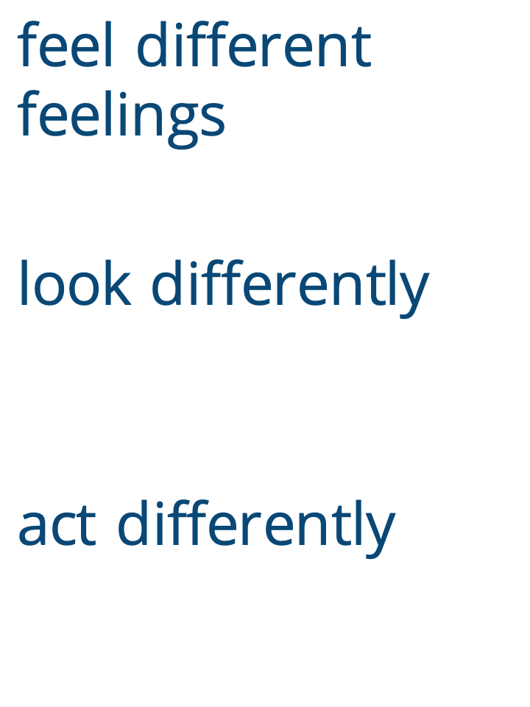

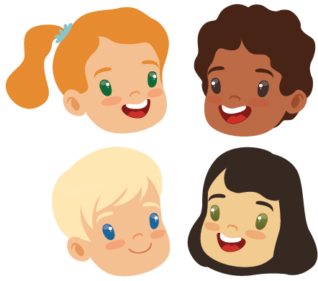
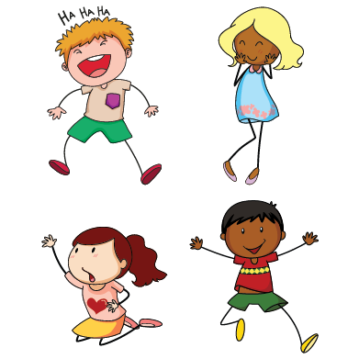
Notes:
Instructor Notes:
Once students have completed their own community hat, encourage them to share their work with at least two of their peers.
Ask the class: If the roles and responsibilities of each community member are one of the ways that community members are unique, what else makes community members unique and different from each other?
After hearing students’ thoughts, click and explain that community members can:
Come from different places
Think in different ways
Feel different things
Look differently
Act differently
Before moving on to the next slide, collect the students’ hats and try to display them somewhere in the classroom before the next class session.

Slide 10
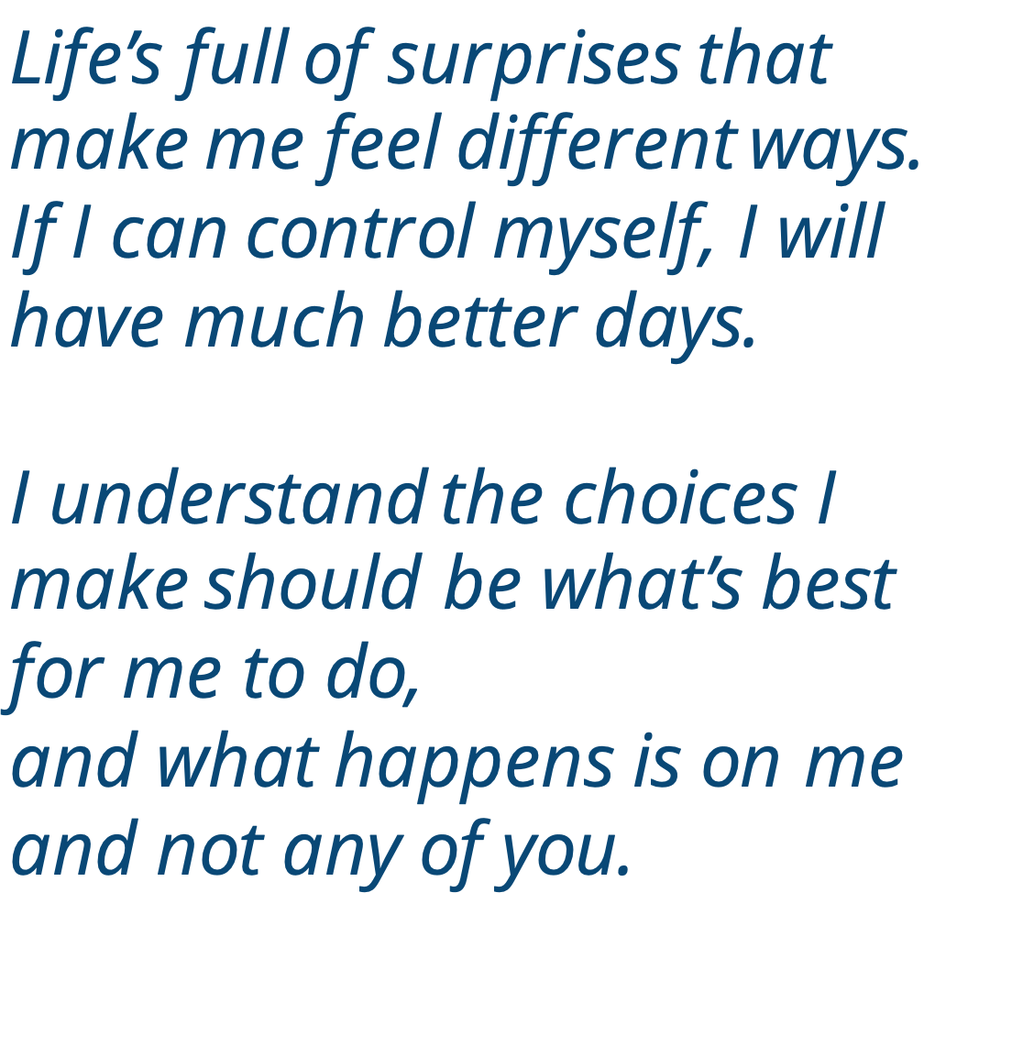
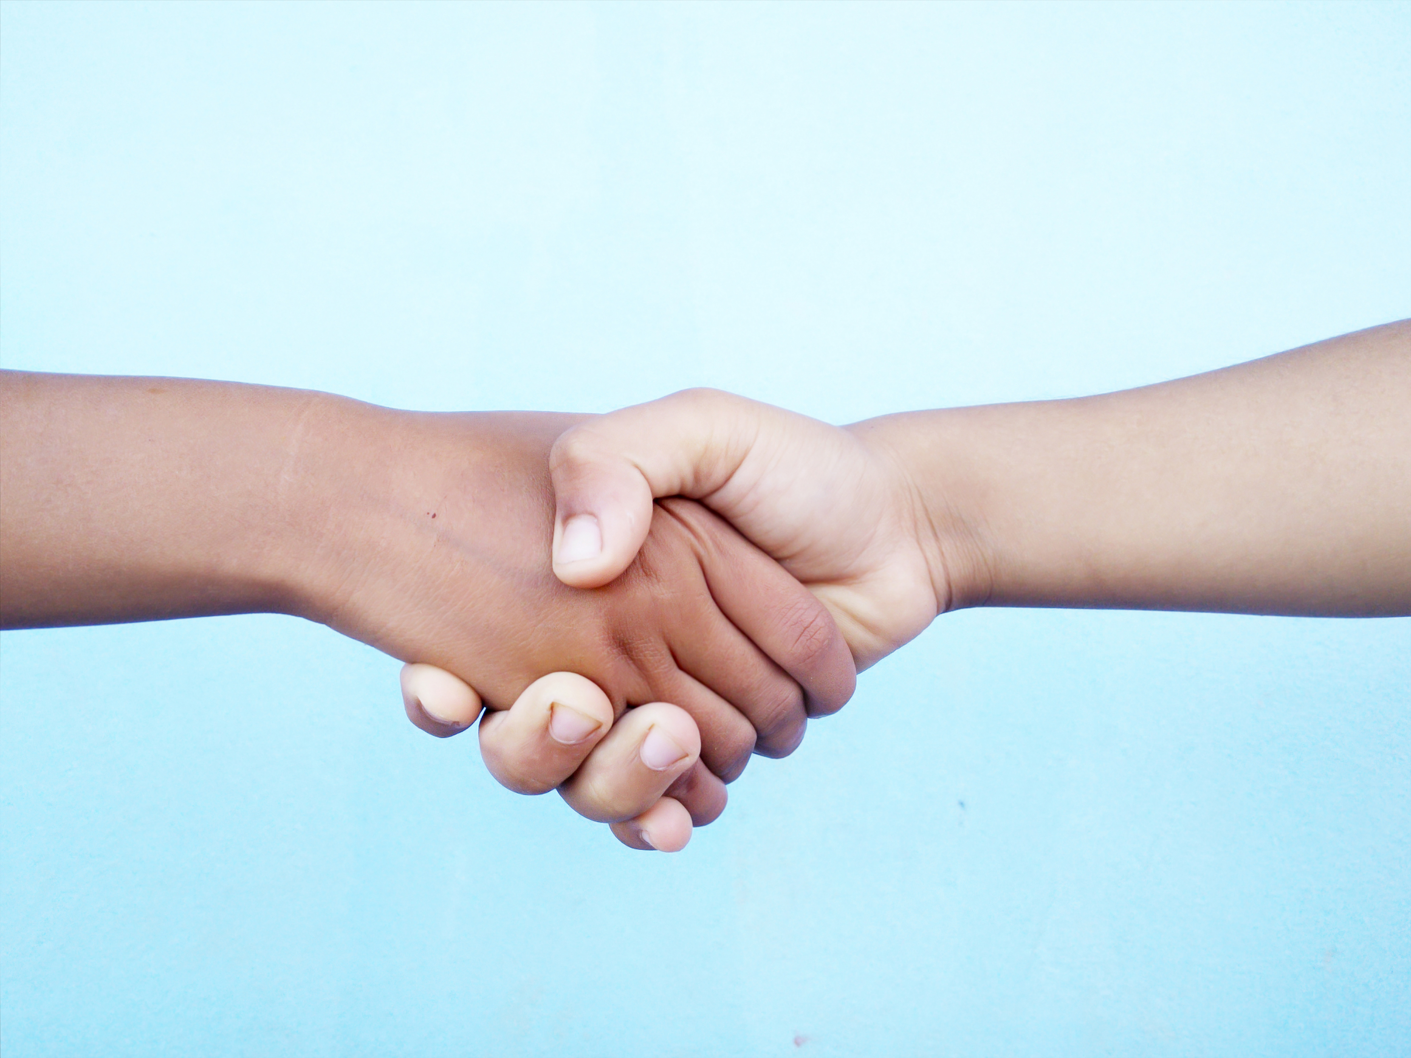
Notes:
Instructor Notes:
Tell the class that while everyone’s differences are one of the most special parts of a community, they can also be one of the most difficult parts.
Explain that because we are all different, we can sometimes be surprised or upset by other people’s actions.
Click twice to project the following segment from Wings Words to Live By, and read it aloud:
Life’s full of surprises that make me feel different ways.
If I can control myself, I will have much better days.
I understand the choices I make should be what’s best for me to do,
and what happens is on me and not any of you.
Explain that the class will think about these words as they complete the next few activities.

Slide 11
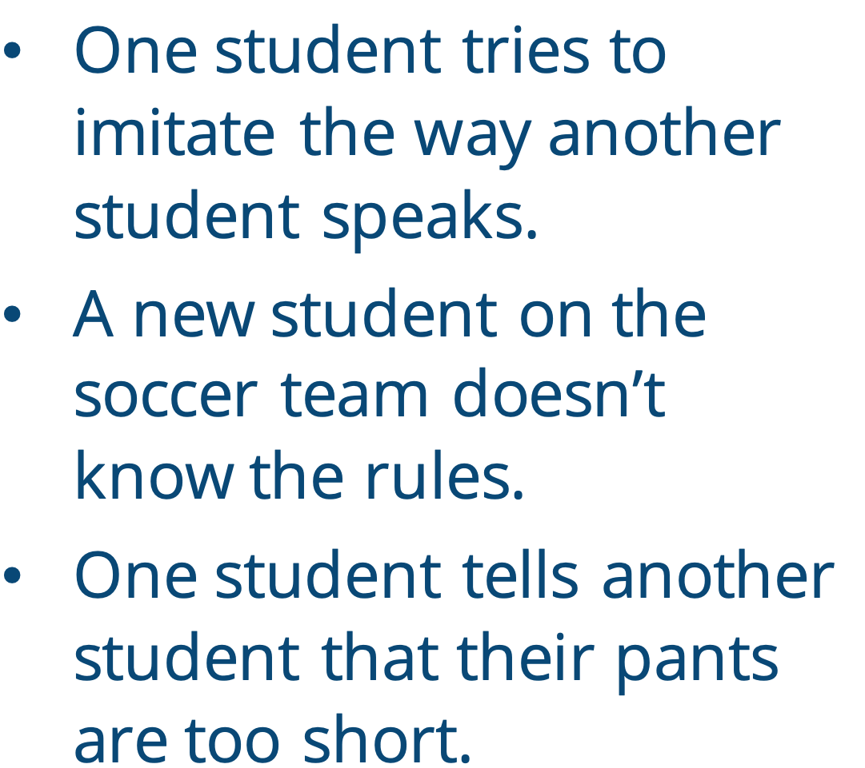
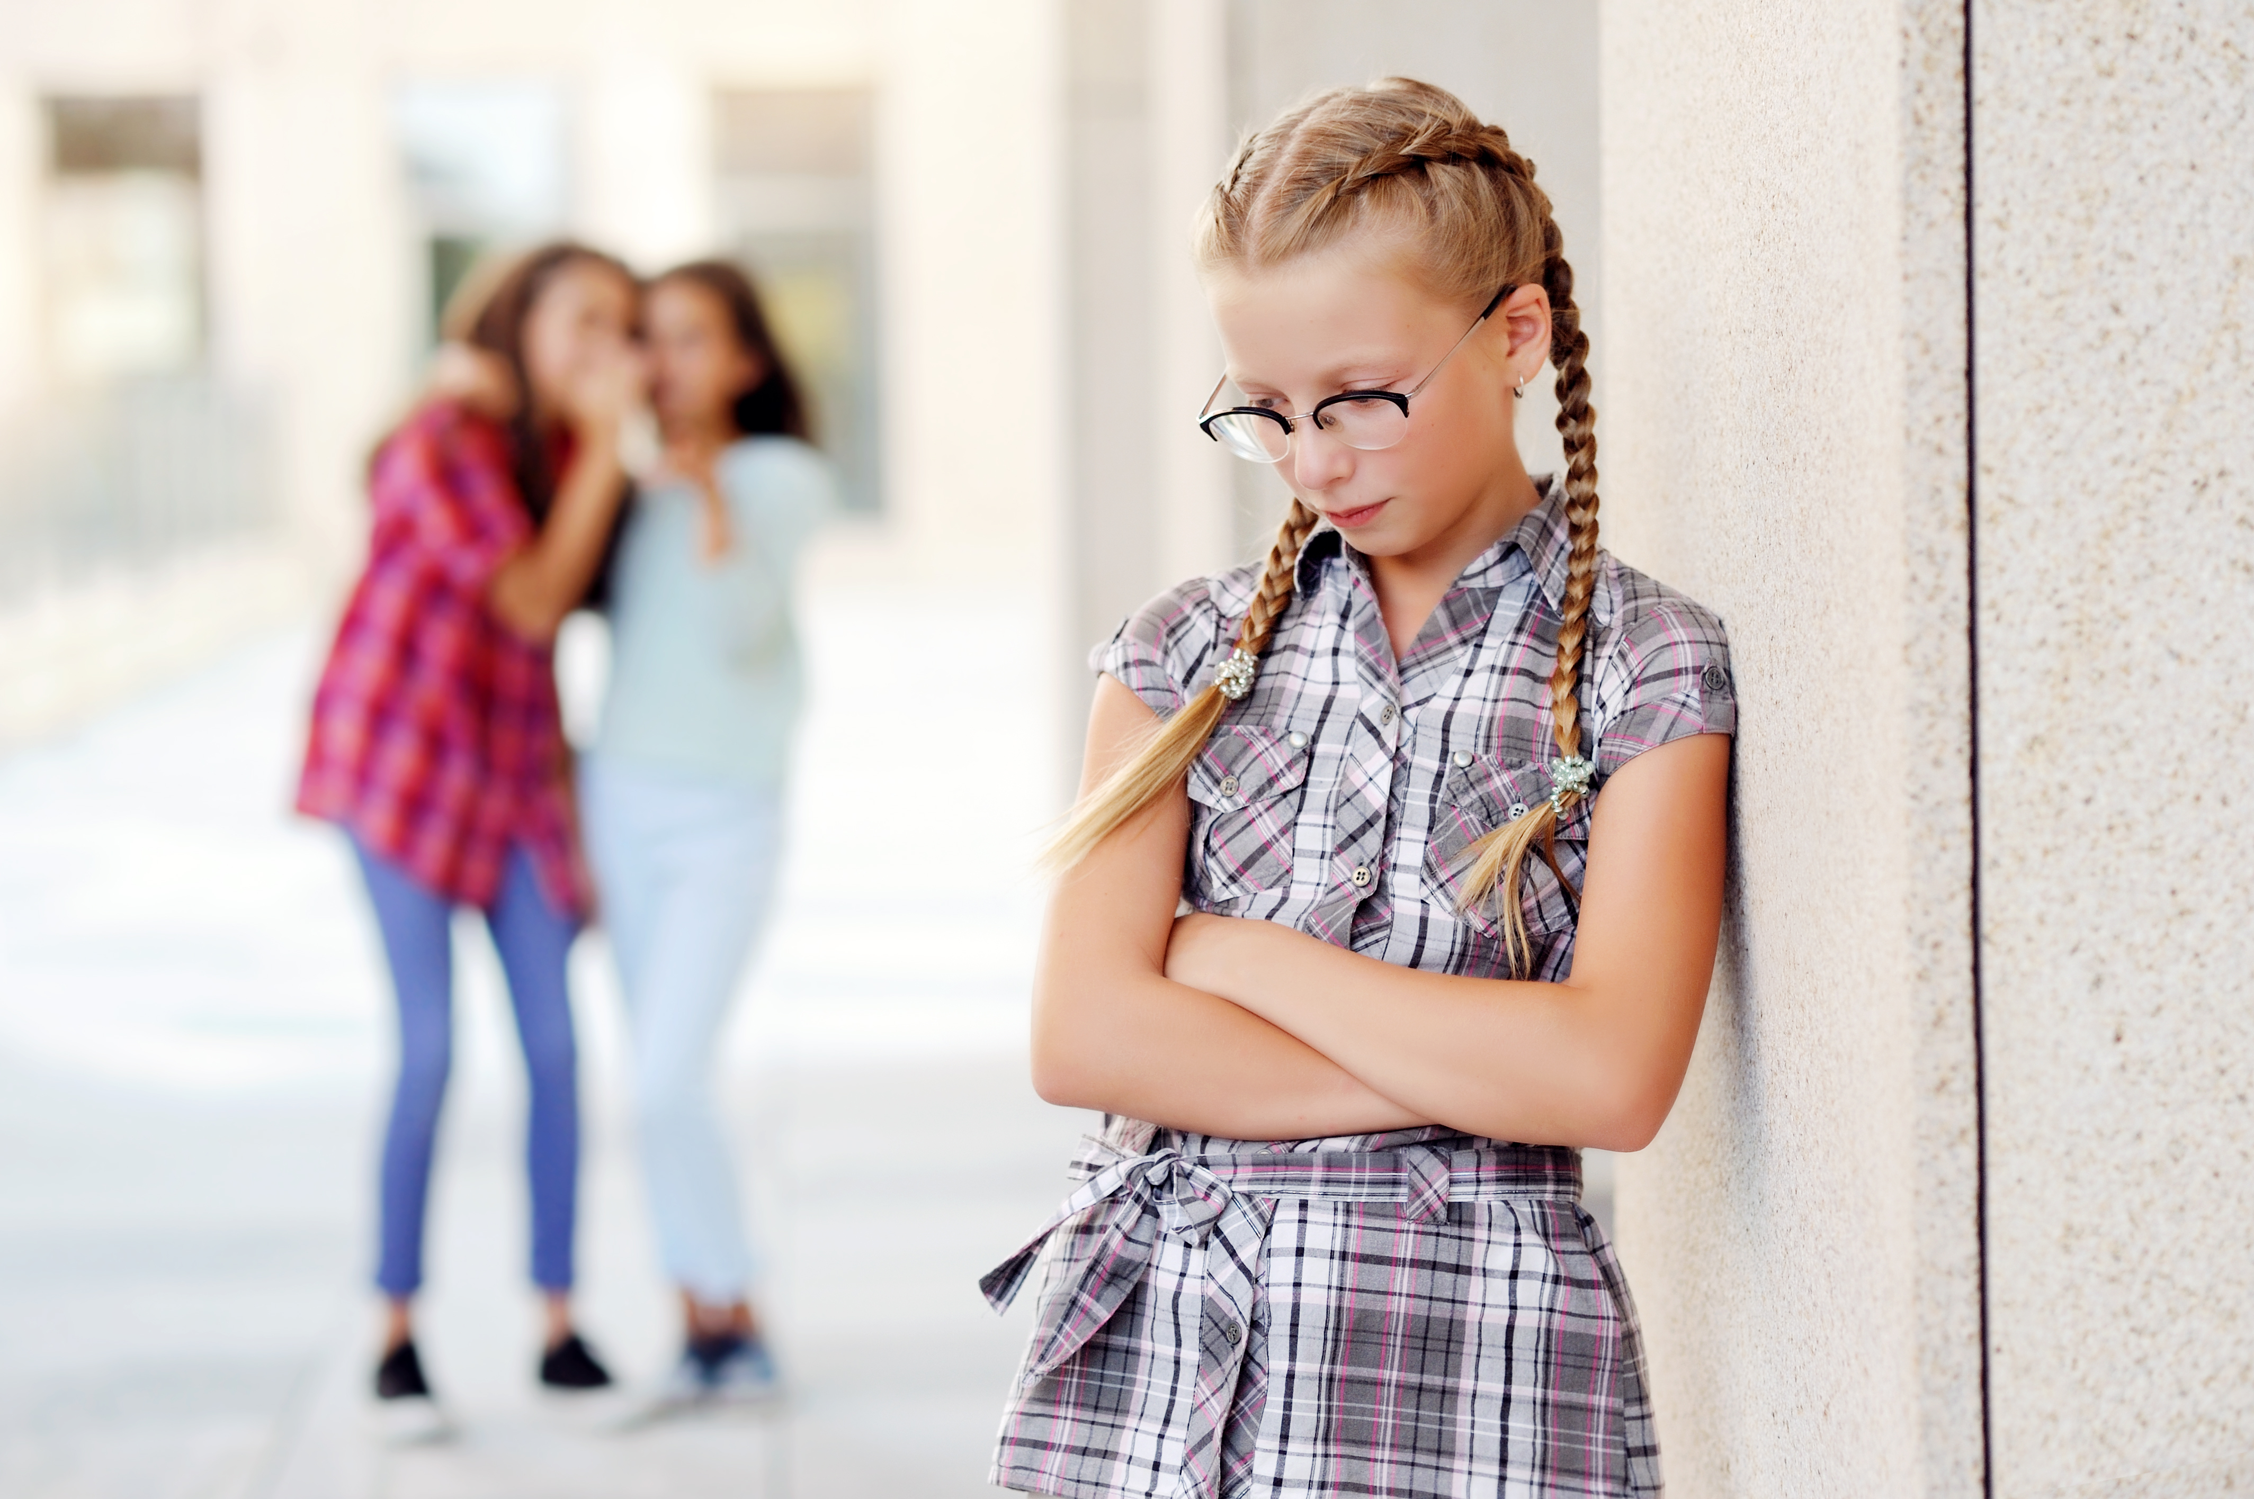
Notes:
Instructor Notes:
Click to project the word “Conflict” and explain that everyone is about to think of a time when they had a conflict with someone in their community.
Explain that a conflict is when something happens to cause bad feelings between two or more people or even when people have a difference of opinion.
Click to share each of the following examples of situations where differences may cause community conflict. As you do, ask students to describe why each example might cause bad feelings or difference of opinion:
Example #1: One student tries to imitate the way another student speaks.
Example #2: A new student on the soccer team doesn’t know the rules.
Example #3: One student tells another student that their pants are too short.

Slide 12
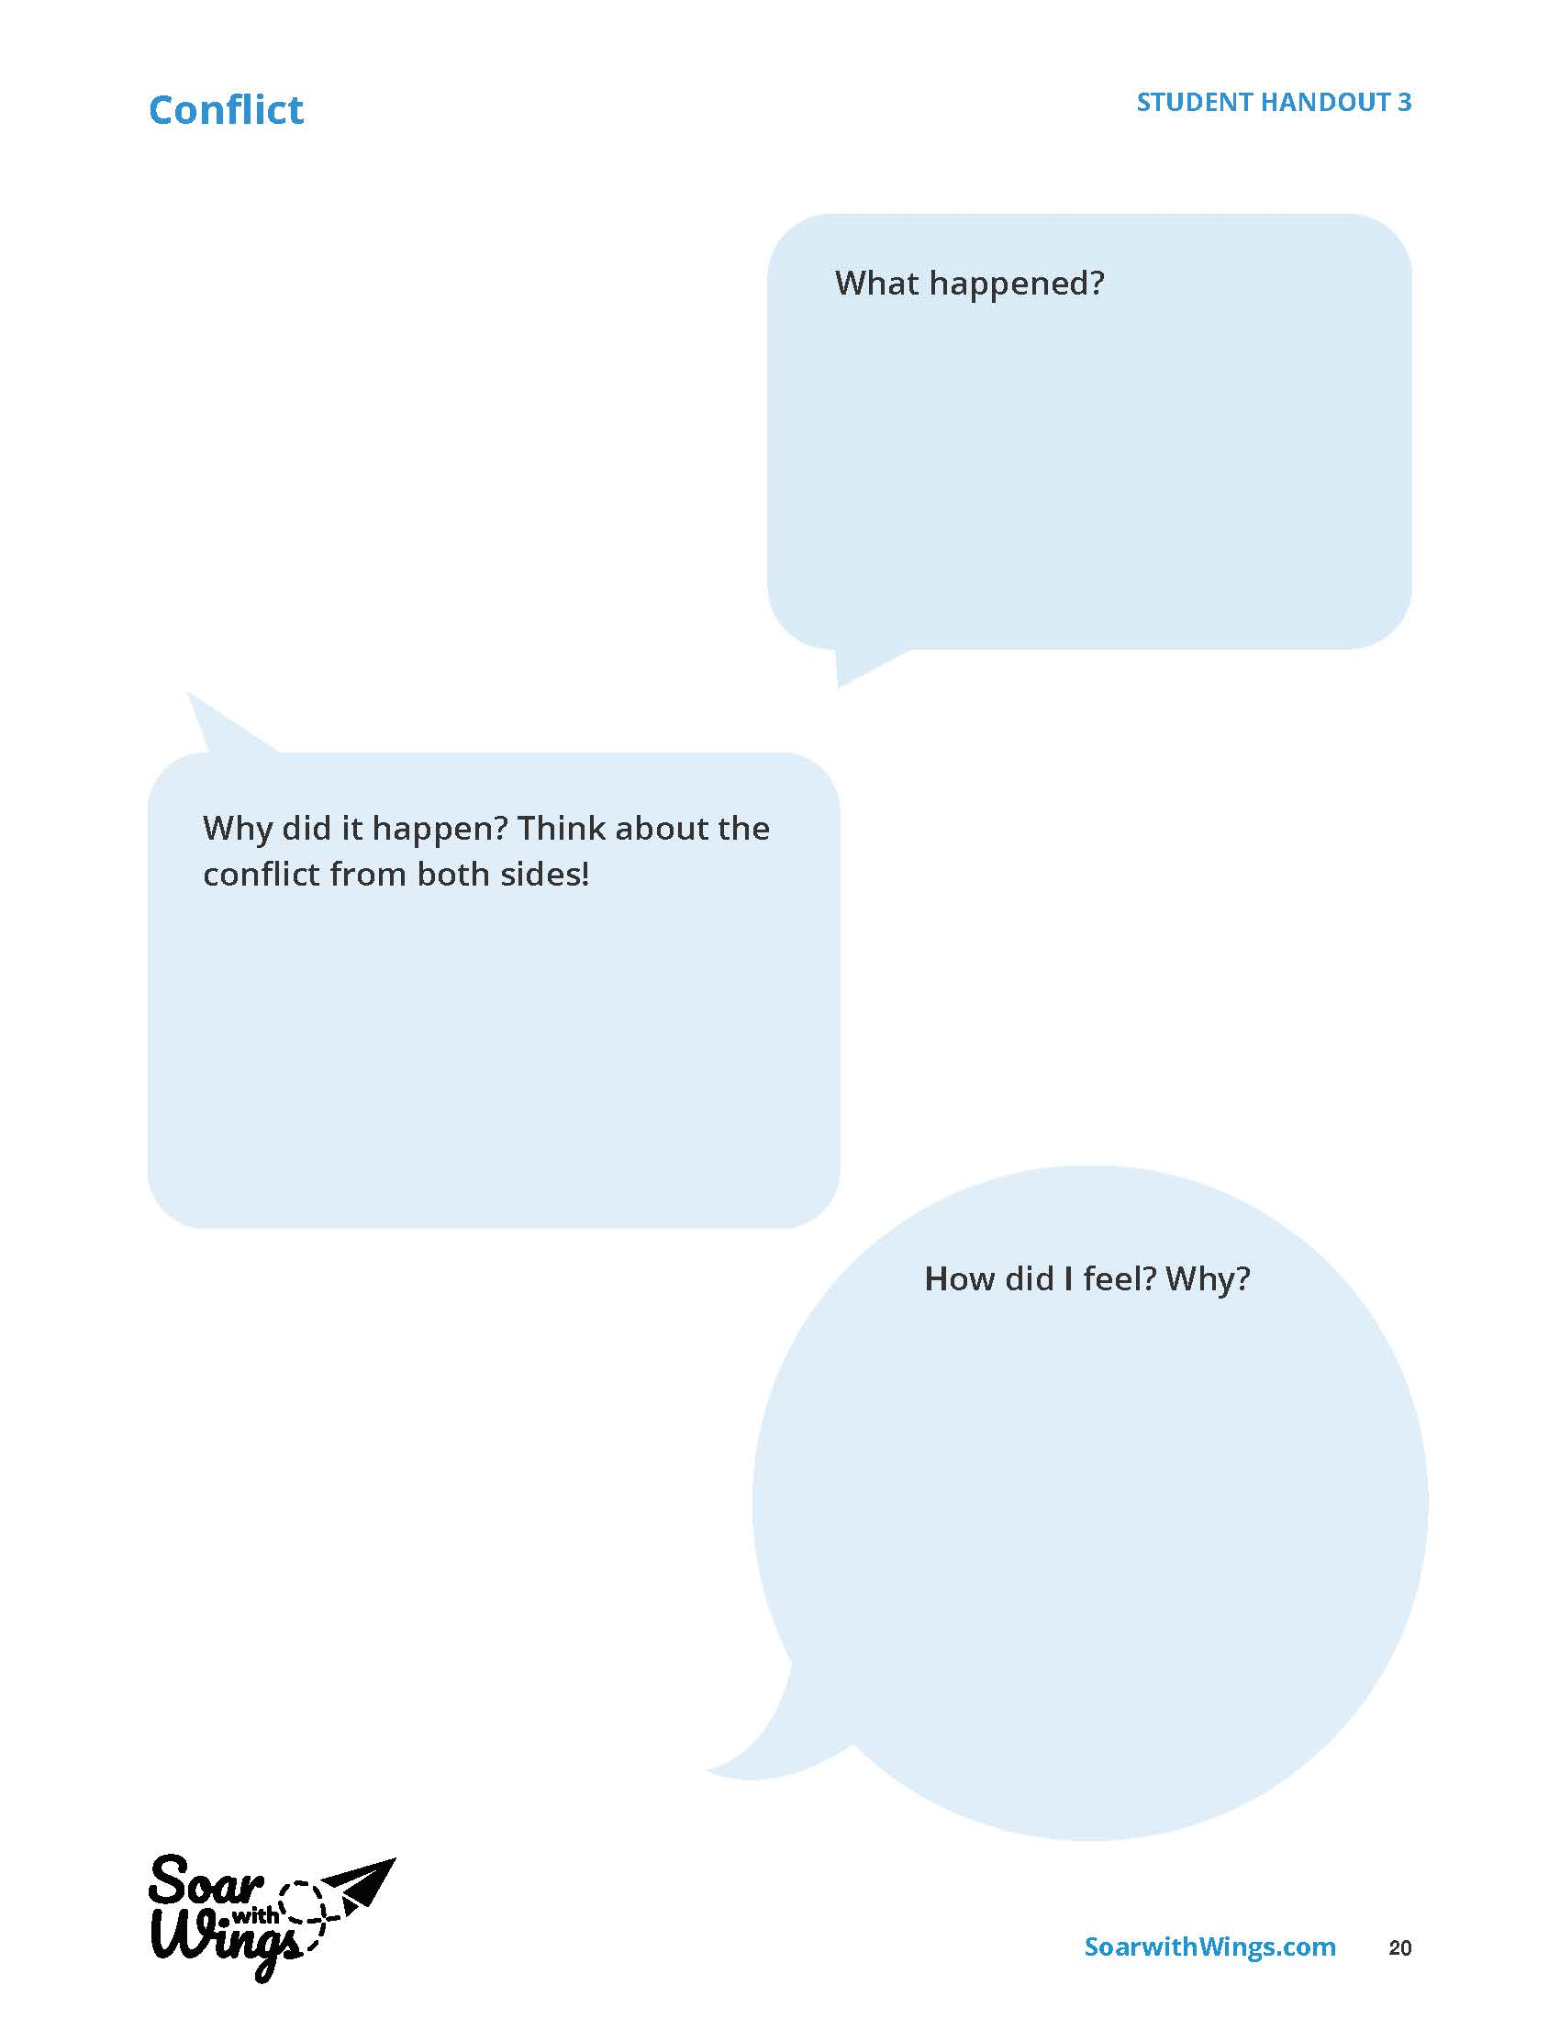
Notes:
Instructor Notes:
Pass out one Handout 3: Conflict to each student.
Explain that students will now think about a time when they personally had a conflict that involved someone in their community outside of their family.
Encourage students to fill in the handout’s three shapes with the following details:
What happened?
Why did it happen? (Think about how both you and the other person would answer this question!)
How did it make me feel? Why?

Slide 13

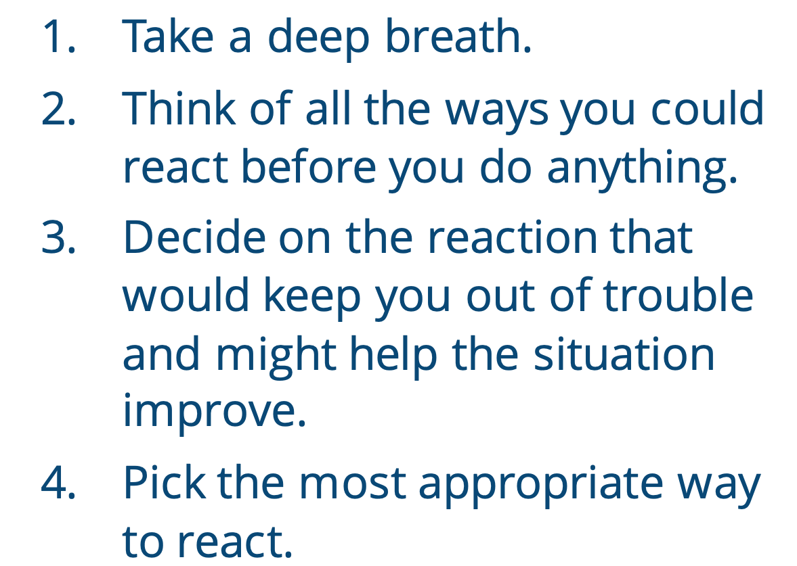
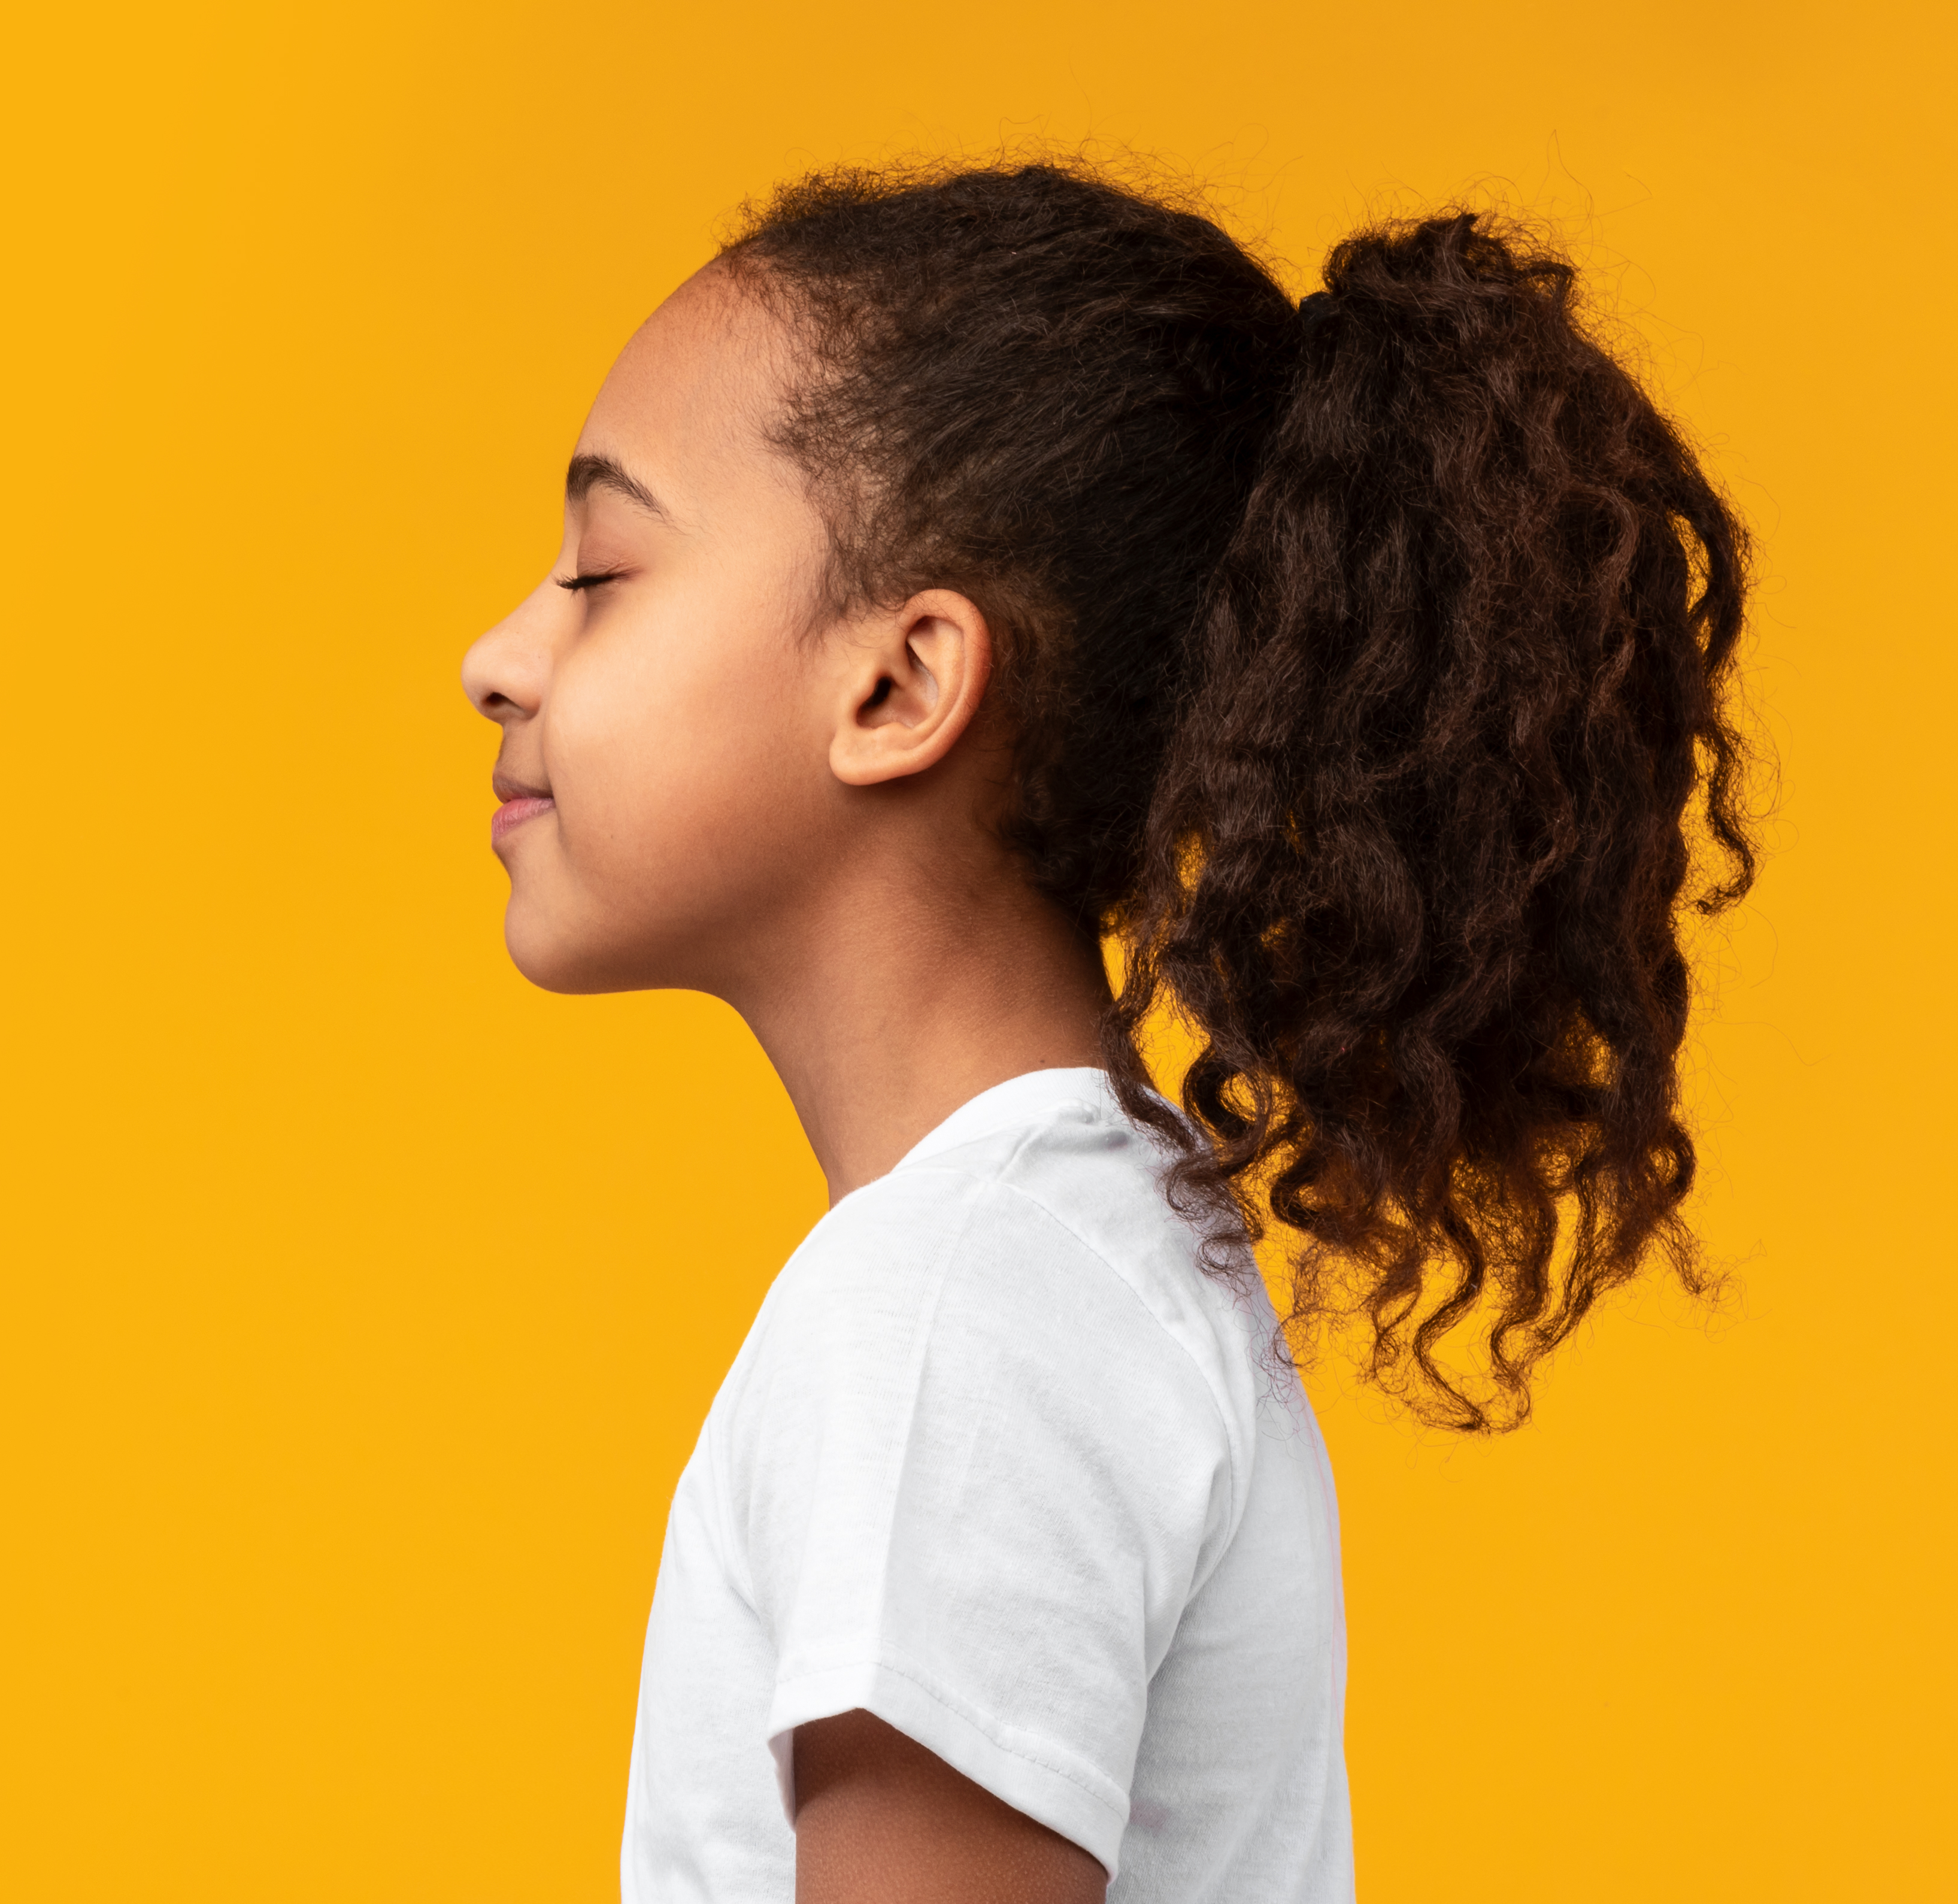
Notes:
Instructor Notes:
Bring the class back together in a circle or semicircle and instruct them to put their completed handouts on the floor in front of them.
Explain that one way to avoid conflict and build a positive relationship with those around us is to manage our impulses.
Review and/or explain that an “impulse” is what your body wants to do before you have a chance to think about it. When we are surprised or upset, it can be hard to control our impulses.
When we “manage” our impulses, we think first, feel second, and then respond.
Click to display four steps to help students manage their impulses and respond to negative situations. Explain that when a conflict or negative situation occurs, we can follow these steps in our mind. Following these steps can help us respond in a more caring way.
Then take a moment to read through the steps:
Take a deep breath.
Think of all the ways you could react before you do anything.
Decide on the reaction that would keep you out of trouble and might help the situation improve.
Pick the most appropriate way to react.
Encourage students to look over their Handout 3: Conflict as they consider how they could have reacted differently if they had used these steps.
Ask students to show you with between one and ten fingers (one finger for “not at all” and up to ten fingers for “a lot”) how differently the conflict they described could have ended if they used these steps.

Slide 14
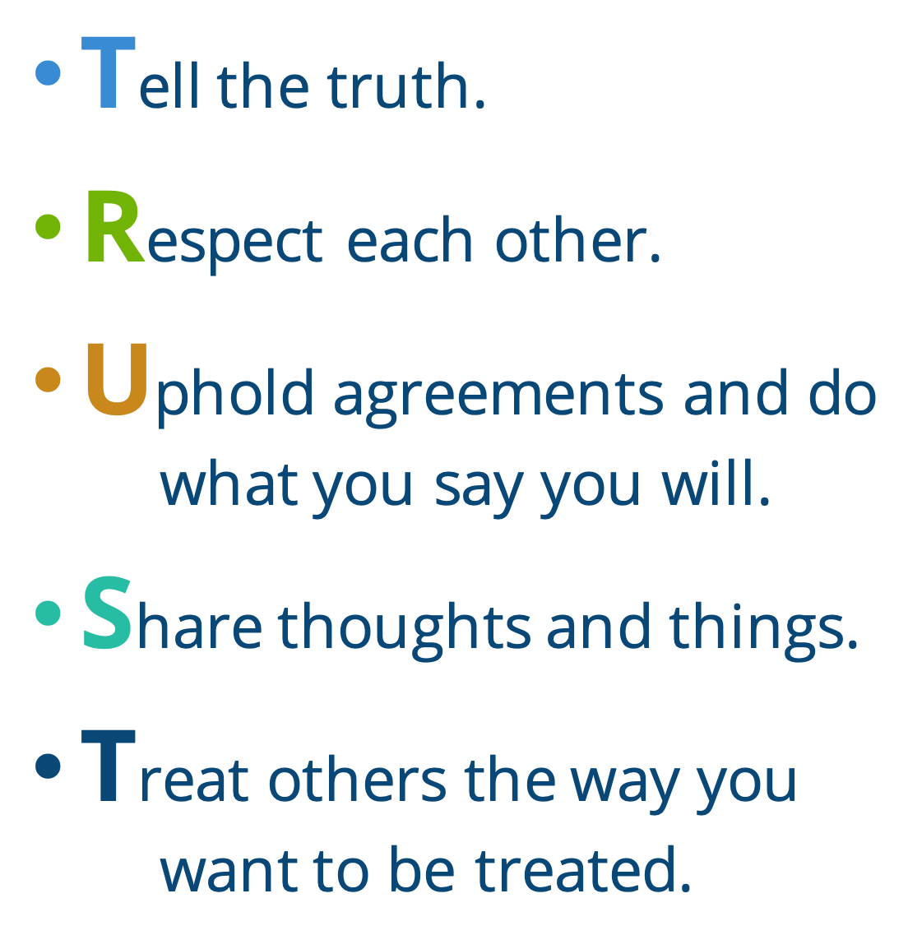
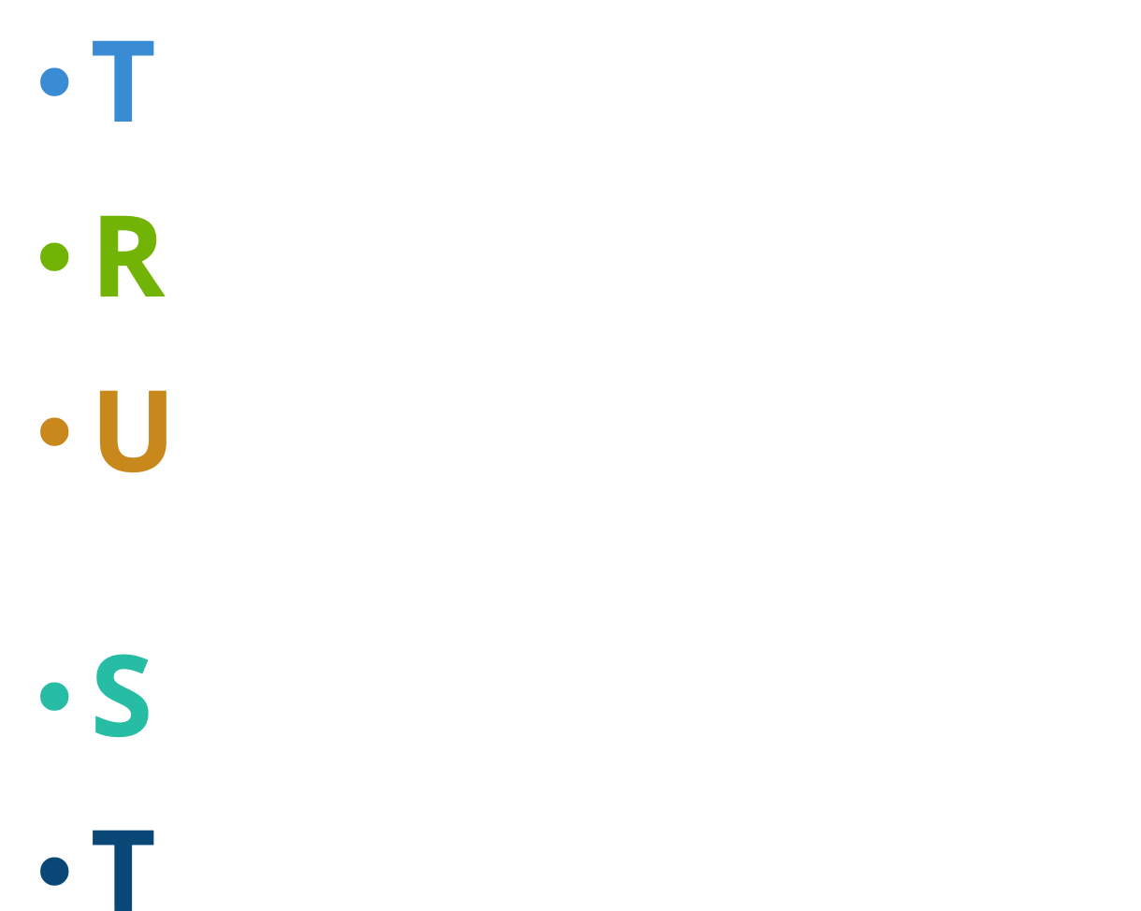
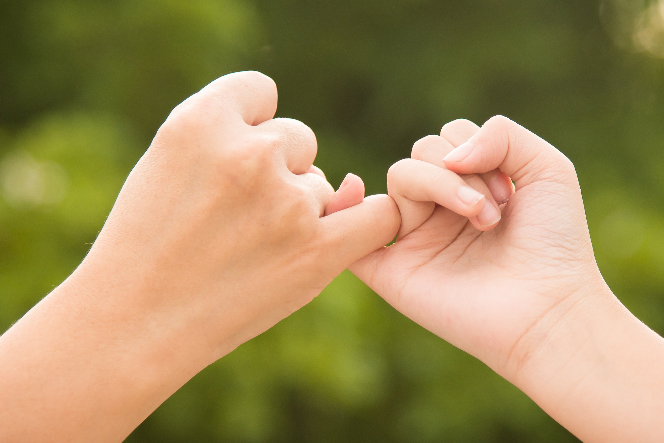
Notes:
Instructor Notes:
Go on to explain that another way to help community conflict is to work on our relationships with others.
Explain that in addition to working on our own reactions and responses, we can also choose to build trust with others.
Elaborate and tell the class that when you trust someone, you believe you can count on the person to make good decisions. By choosing to build trust between you and someone else, you learn to believe in each other. This can help you avoid conflict!
Tell the class that there are some actions we can take to help trust grow. Click once to display and read each of the following:
Tell the truth
Respect each other
Uphold agreements and do what you say you will
Share thoughts and things
Treat others the way you want to be treated
Encourage students to think again about the conflict they described on their handout. This time, ask them to consider how they could have instead chosen to build TRUST with the other person or people.
Challenge students to choose at least one letter that they think could help them build a better relationship with the person/people they had a conflict with and invite them describe why this would help them build trust.

Slide 15




Notes:
Instructor Notes:
Tell the class that while learning how to react and build trust are two important ways to help prevent conflict with people in our communities, sometimes conflict does still happen. For this reason, it is also important to know how to handle conflict with others while it is occurring.
Assemble students into pairs or groups of three. Distribute one Handout 4: Community Conflict and a marker to each group.
Explain that groups are about to think about where and why they see conflict in their school community.
First, challenge each group to brainstorm three different places that conflict can occur in school, and write these places in the three circles on their handout.
If students need help, explain that the cafeteria, at recess, in the classroom, at dismissal, during gym class, and in the bathrooms are all possibilities.
Guide groups in brainstorming why conflict exists in these places. In other words:
How does the conflict start?
What is the conflict about?
Who is the conflict between?
Encourage students to write or draw notes on each of the lines to show what can cause conflict in each place. (Groups may also draw more lines if they have more than two ideas.) For instance:
On one of the lines coming out from “cafeteria” could be details such as “fights about where people sit,” “between peers,” or “some students aren’t welcome.”
On one of the lines coming out from “recess” could be details such as “arguments about who’s on which team” or “some people are better at sports than others.”
Then ask a few groups to share details about one of the conflicts that they recorded.
Tell the class that when these situations happen, continuing to argue or fight doesn’t solve any problems. It only leads to more!

Slide 16
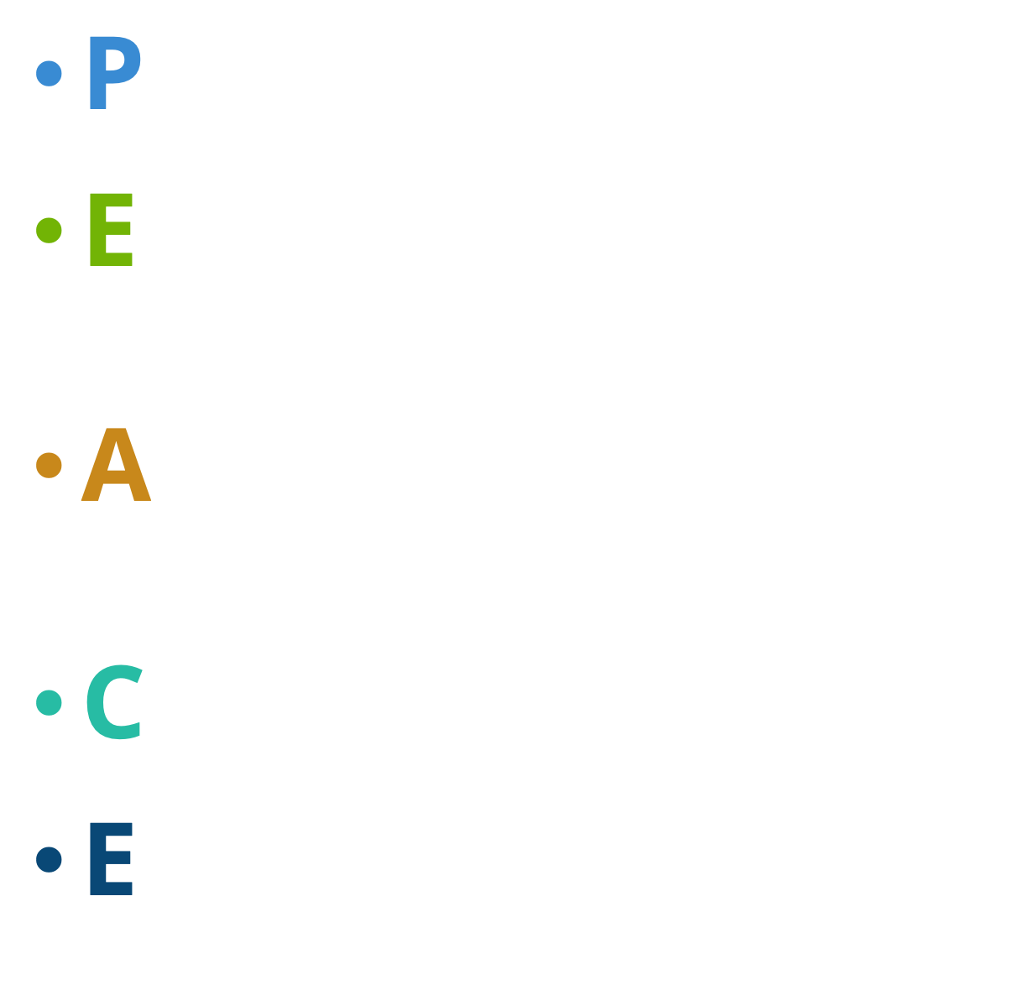
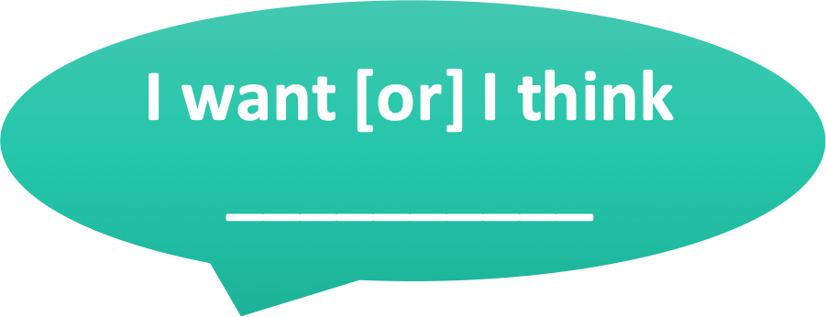
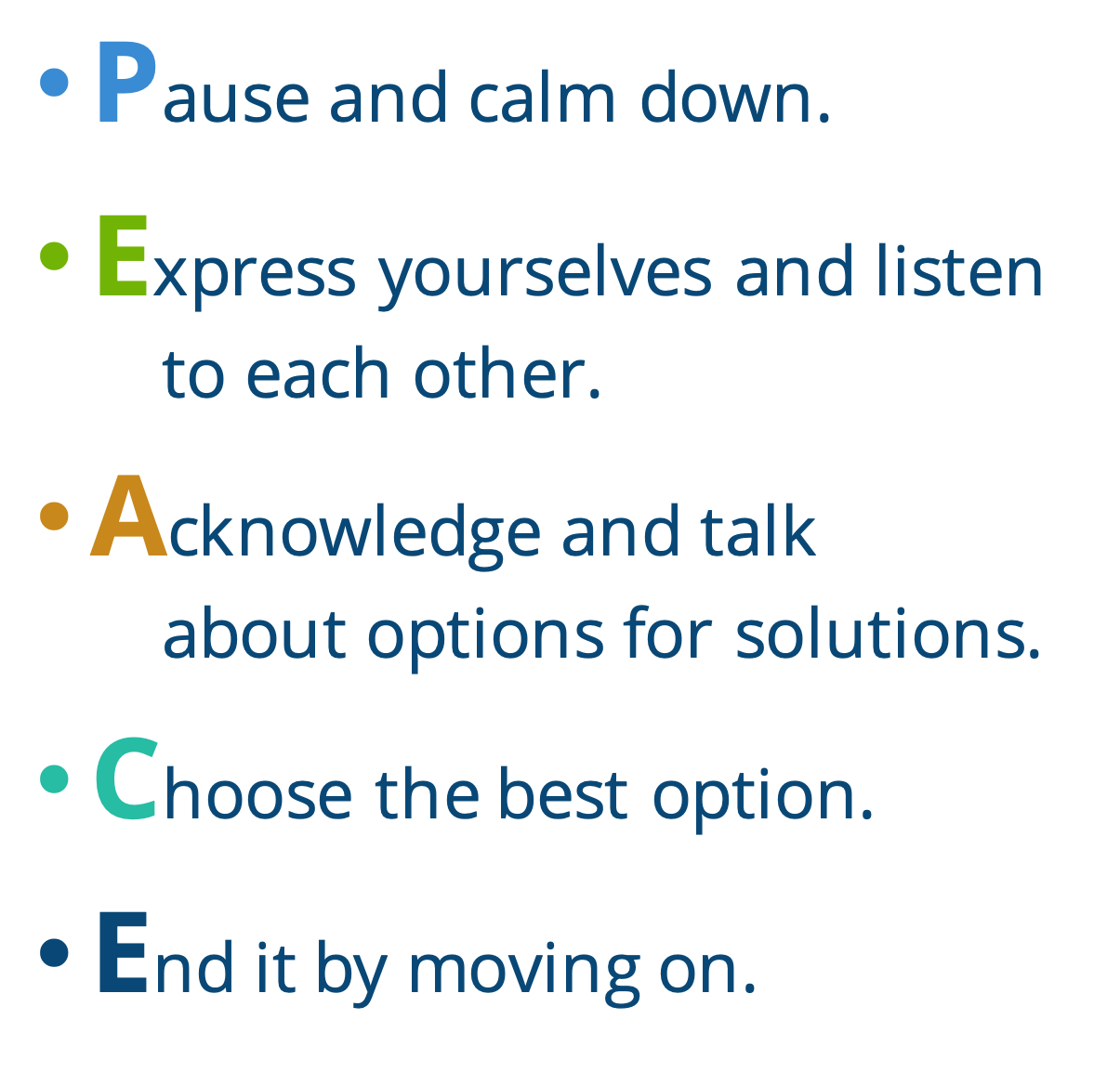



Notes:
Instructor Notes:
Click once to continue the discussion and explain that instead of letting conflict continue and get out of control, students can make the choice to aim for PEACE.
Tell the class that when you are in the middle of an argument, you can:
Pause and calm down
Express yourselves & listen to each other
Acknowledge and talk about options for solutions
Choose the best option
End it by moving on
Be sure students understand what each letter means.
Ask two students to volunteer as actors and designate one student as “Student A” and the other student as “Student B.”
Present the following scene: Student A is told that Student B is saying mean things about them. Student A confronts Student B at recess, and Student B says it’s not true. Student A doesn’t believe Student B, and the two students start having an argument.
Coach the two volunteers through using PEACE to resolve the conflict:
Encourage each student to demonstrate how they would take a moment to calm themselves down.
Click once to project “I want (or) I think___” and ask each student to explain what they would like to happen if they were in this situation.
For instance: Student A might say, “I want you to stop saying mean things about me.” Student B might say, “I want you to stop accusing me of doing things I haven’t done!”
Click again to project “We could___” and encourage the class to help the volunteers brainstorm at least two solutions to the problem.
Click one final time to project: “Let’s___” and ask the volunteers to fill in the blank with the solution they like best.
Then encourage the student groups to work together to act out one of the conflicts they described on Handout 4: Community Conflict.
As groups reach a resolution and complete the “Let’s____” statement, ask them to give you a thumbs up.
Conclude the day’s session by congratulating students on learning and using strategies to control themselves and make decisions that will help them get along better with others in their community.

Slide 17
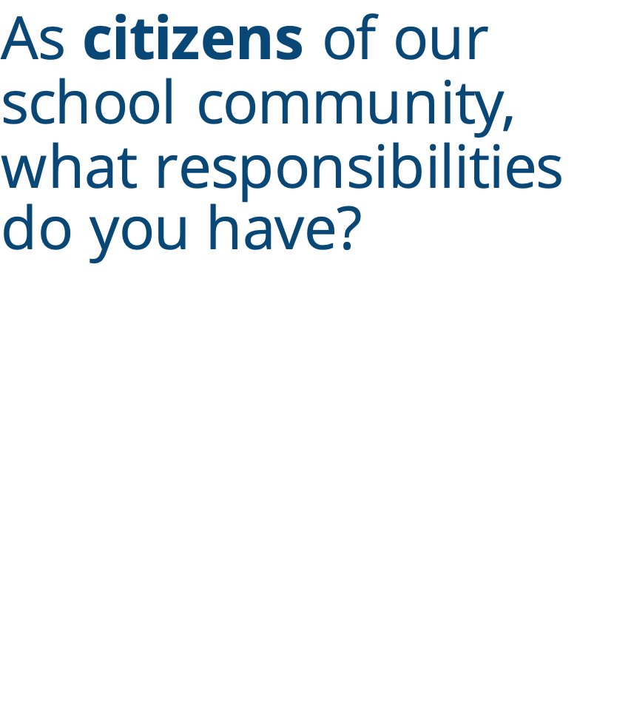
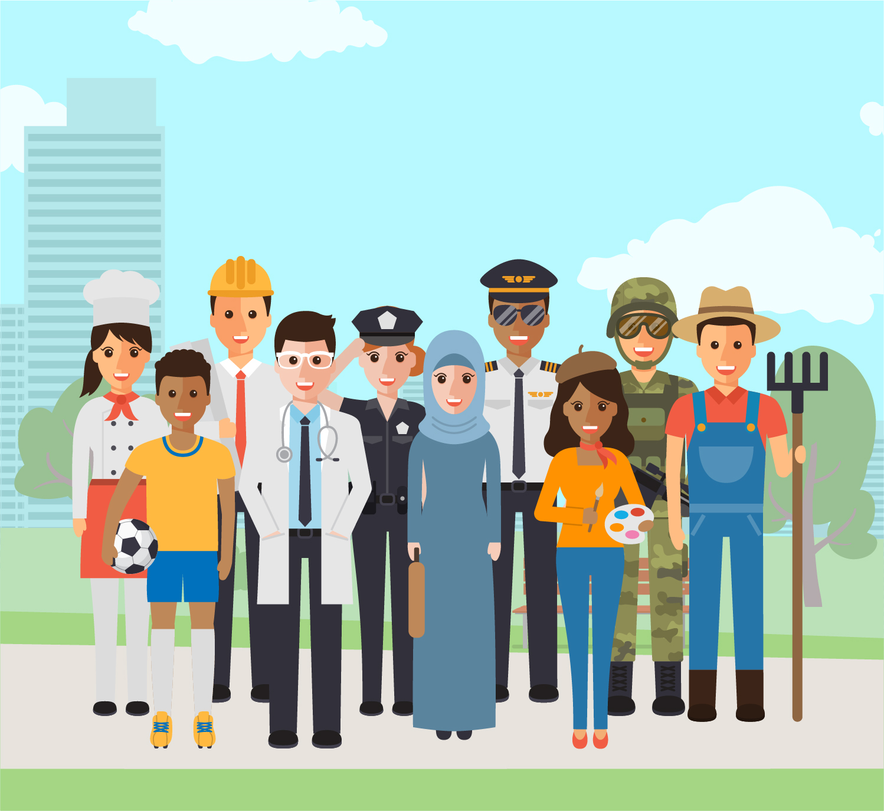
Notes:
Instructor Notes:
Begin the final session by gathering students on the floor in a circle or semicircle. Join them by sitting at their level.
Bring students’ attention to the slide’s header and ask students what the word “citizen” means.
Explain that a “citizen” is a member of a community. Students are citizens of the classroom community, of the school community, and of the world at large!
Remind the class that students have already thought of many of the responsibilities they have as “citizens.” They thought of these when they brainstormed the jobs and responsibilities associated with all of the hats that they wear! (If you displayed these hats somewhere in the classroom, bring students’ attention to them.)
Then click once and encourage students to apply the brainstorming they already completed as they consider: As citizens of our school community, what responsibilities do you have?
Have students brainstorm and share ideas specific to their school community before moving on to the next slide.

Slide 18
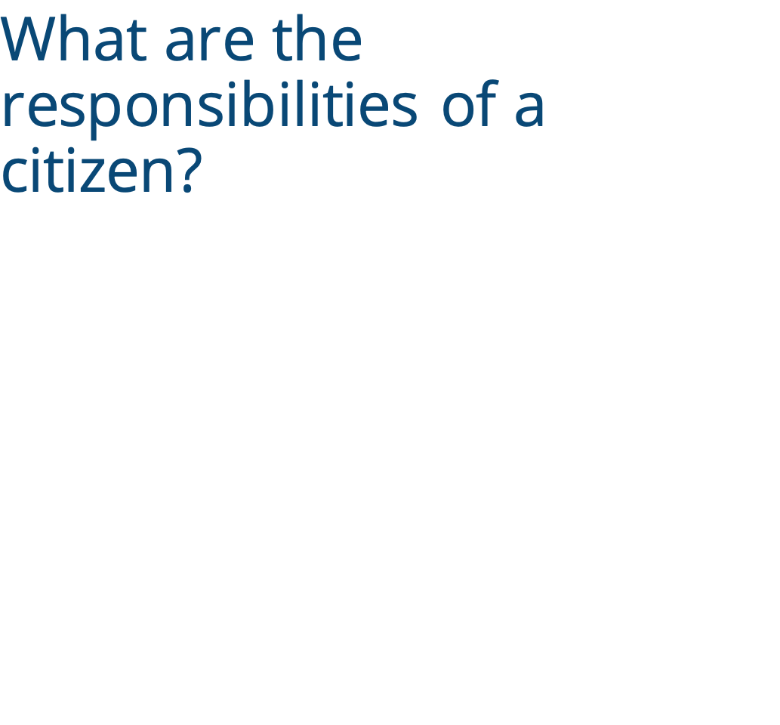
Notes:
Instructor Notes:
Introduce the book What Can A Citizen Do? by Dave Eggers or prepare to project a version of the video read aloud.
Click once before you begin reading and ask students to listen for responsibilities of being a citizen that they may not have considered before.
Pause after you read the line “A citizen is what you do,” and ask students: Why did the author say that “a citizen could be a bear, a citizen could be a kid, or a citizen could wear pink pants”?
Be sure students understand that the author said this not just to be silly! Instead, he wanted the readers to understand that a citizen can be anyone (or anything!). There is no “one” type of citizen.
At the end of the book, lead a discussion around the focus question: What are the responsibilities of a citizen?
Arrive at the answer that one of the most impactful and important things that a citizen can choose to do is make the world a better place.

Slide 19




Notes:
Instructor Notes:
Direct students’ attention to the large word on the slide and read it aloud.
Ask: What do you think this word means?
Click once and help the class arrive at the definition that a changemaker is a person (a citizen) who changes the world in order to make it a better place.
Then click again and tape the four signs from Handout 5: Changemaker to the four corners of the classroom.
Take a moment to point out what each sign says: “I agree”; “I strongly agree”; “I disagree”; and “I strongly disagree.”
Explain:
The students are about to hear a few statements.
Each student should take a moment to decide if they strongly agree, agree, disagree, or strongly disagree with each one.
When you say “Show us how you feel!” they should silently move to the corner that explains their feelings.
Once they are quietly in the corners of the room, a few students will be asked to explain how they feel and why.
Then read the statements below, each time guiding students through the directions above:
I think there are beautiful parts to my school community.
I appreciate and love my school community.
I think there are parts of my school community that could be improved.
I love and appreciate my community if I want to be a changemaker and make it a better place.
Once all statements have been discussed, encourage students to rejoin your circle or semicircle.
Explain that even though it may seem like wanting to change your community means that you do not love it, it can actually mean the reverse. If you try to change your community for the better, it is a sign that you care for, love, and appreciate your community. When you are a changemaker, you try to make your community into a better place for all community members. Being a changemaker is one of the best ways to celebrate your community and show that you care!

Slide 20

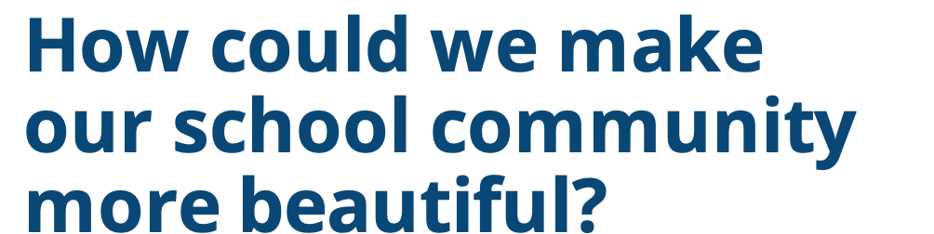
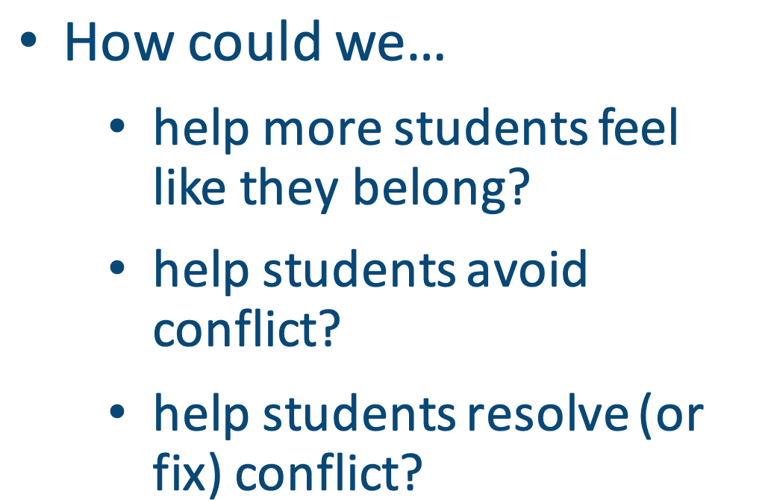
Type here...
Notes:
Instructor Notes:
Explain that students will be working together to brainstorm what they love about their school community and what they could change to make it even better.
Divide students into groups of three and pass out one Handout 6: Community Brainstorming to each student.
Click once and encourage students to brainstorm and record where they already see beauty in their school community. Prompt them to think about the little things and the big things that they love and appreciate. Remind them that they all count.
Move to the second column, and encourage groups to brainstorm and record how their school community could be improved and made even better.
Click again and encourage students to think especially about:
How could we help more students feel like they belong?
How could we help students avoid conflict?
How could we help students resolve (or fix) conflict?
Give groups a few minutes to discuss, brainstorm, and record ideas on their handout.

Slide 21

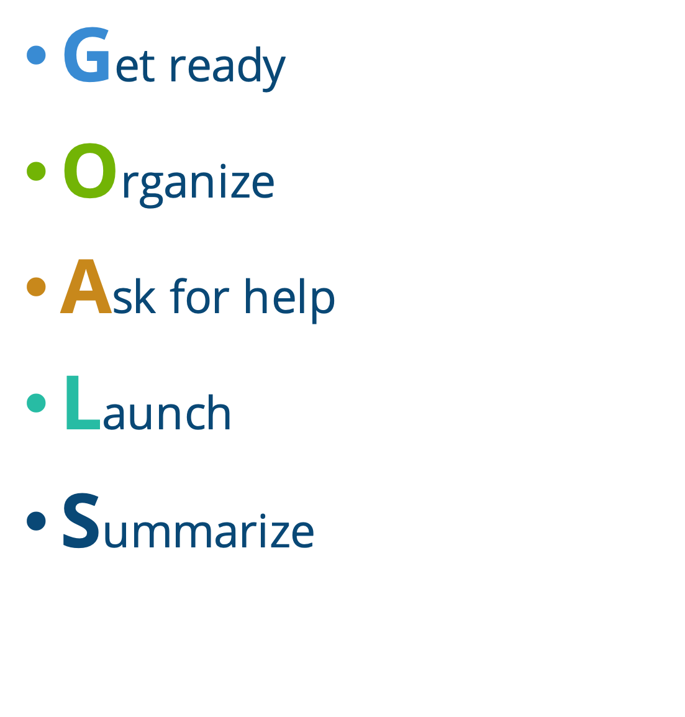
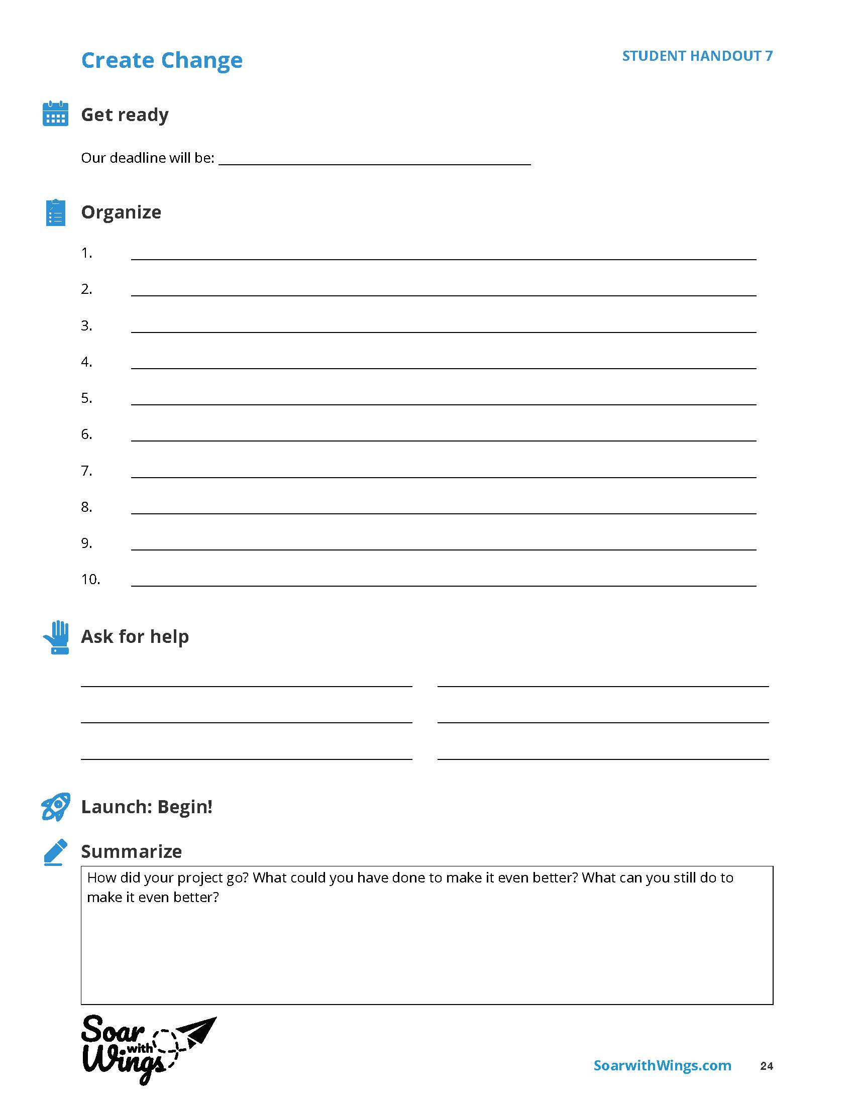
Notes:
Instructor Notes:
Explain that each group will now be creating a plan for making one of these changes happen.
Encourage groups to choose one of their change ideas that they think will make their community more beautiful.
Ask groups to give you a thumbs up when they have a change selected.
Then pass out one Handout 7: Create Change to each group.
Explain that one way to make change happen is to reach for your GOALS. When people want to create change, it is often the small things that count. When these small steps combine, they transform into BIG changes.
Click once to reveal “Get Ready.”
Explain that before any change can take place, the changemakers must be ready for it.
One way to do this is to create a deadline. Often when you know you have to do something by a certain date, you are more motivated to achieve it.
Give the example:
If my goal is to start an after-school club where everyone can feel welcome, I could try to hold the first meeting in two months.
Depending on the ability level of your students, you can choose to have them select a specific date, a month, or a season (e.g., “by this winter”) when they will try to have their goal achieved by and instruct them to write it in the space provided.
Then click to reveal: “Organize.”
Explain that making a big change requires smaller steps.
Ask students to consider: What are some of the smaller steps that would need to happen before the big change can occur?
Give the example:
If my goal was to create an afterschool club where everyone can feel welcome in two months, I would have to:
Tell people about my club.
Find a place to hold my club.
Find an adult who could chaperone my club.
Come up with activities for my club to do.
Develop a name for my club.
Give groups a few minutes to write their ideas in the space provided.
Then click again to project: “Ask for help.”
Explain that no one is expected to create change alone. It always makes sense to ask others who may be able to help you. You can accomplish more together than you can alone.
Share the example:
If I was creating an after-school club, I might ask:
A teacher who I know likes to help with afterschool clubs.
A friend who has been in lots of afterschool clubs to see what they like best.
Classmates who are not in after-school clubs to see what kind of club they may want to join.
Then encourage groups to make a list of all the people they could turn to for help.
Finally, click once more. Read through the last two categories and explain that these actions will not happen until all the planning is done.
At this point, students should “Get moving” and begin the smaller steps they brainstormed.
Then, when their project is complete, students should “Summarize” their work by looking back on what they accomplished and thinking about what they could do to make it even better.

Slide 22
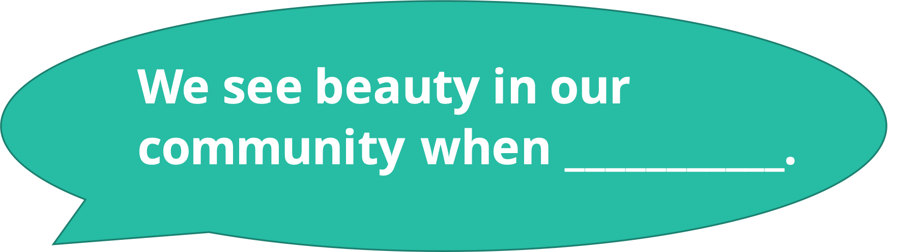
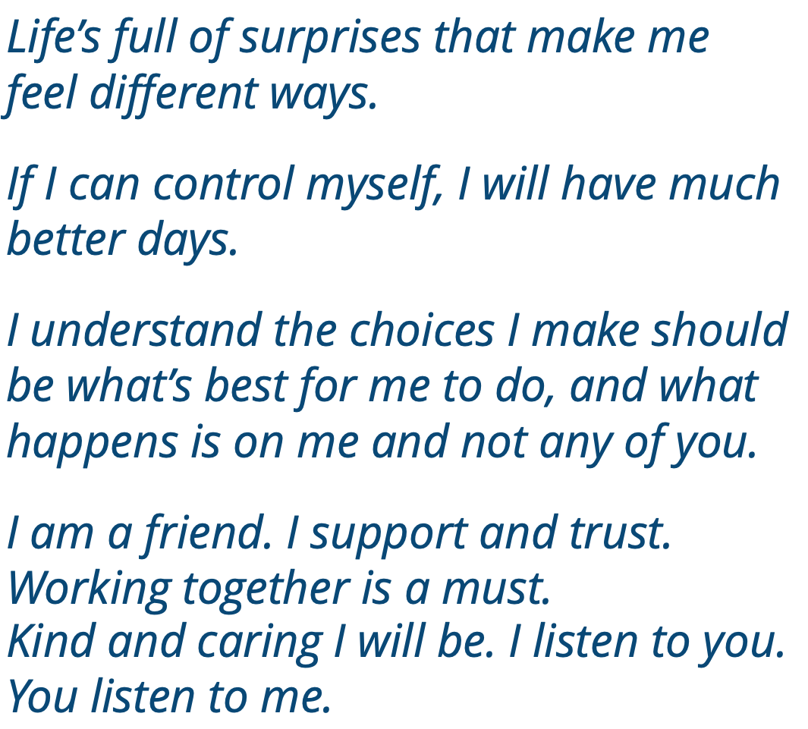
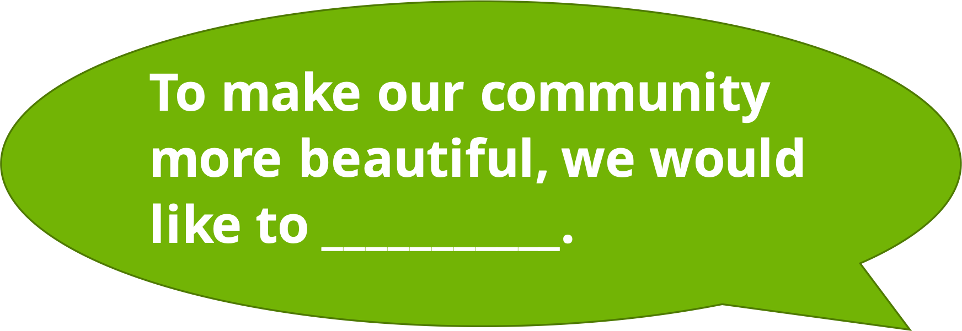
Notes:
Instructor Notes:
Wrap-up by asking each group of changemakers to present their ideas as you celebrate your school community together. Invite each group to begin by describing where they see beauty in their community and summarizing what they would like to do to make their community more beautiful.
As groups share, ask the rest of the class to consider how they could help, or contribute to, each group’s plan. Ask a few students to share following each presentation.
When the sharing is complete, acknowledge the work students have done to learn how to control their own behavior, make decisions that positively impact those around them, and appreciate and better the community in which they live.
Then click twice and conclude by asking the class to join you in reading the Words to Live By:
Life’s full of surprises that make me feel different ways.
If I can control myself, I will have much better days.
I understand the choices I make should be what’s best for me to do, and what happens is on me and not any of you.
I am a friend. I support and trust. Working together is a must.
Kind and caring I will be. I listen to you. You listen to me.

