Slide 1




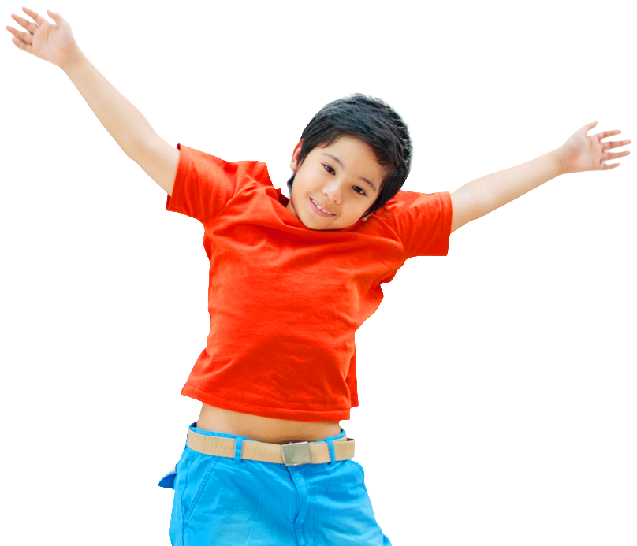
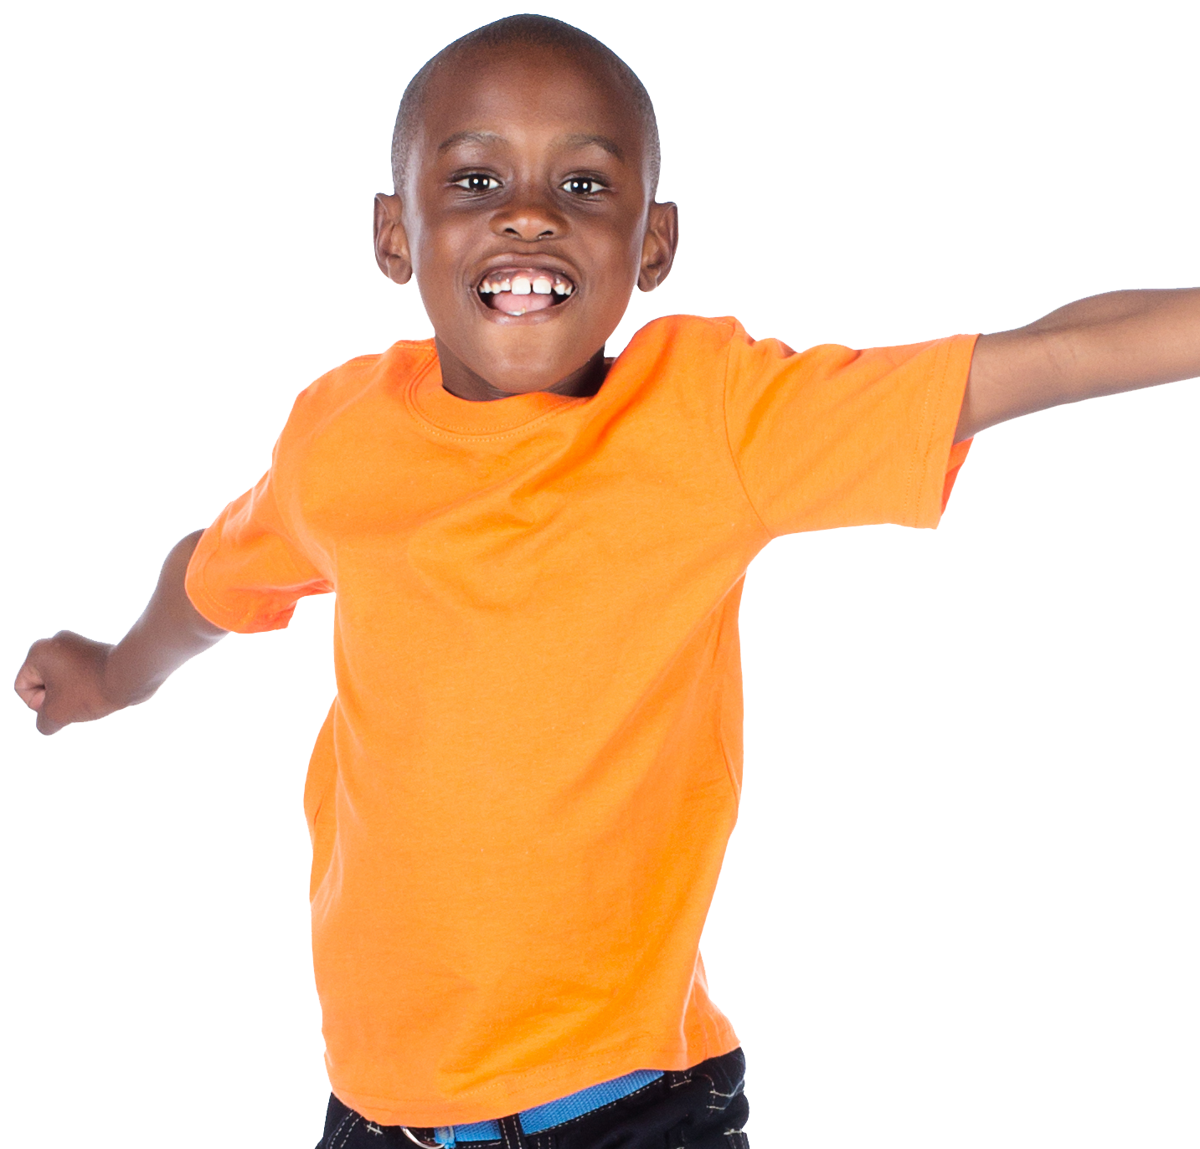
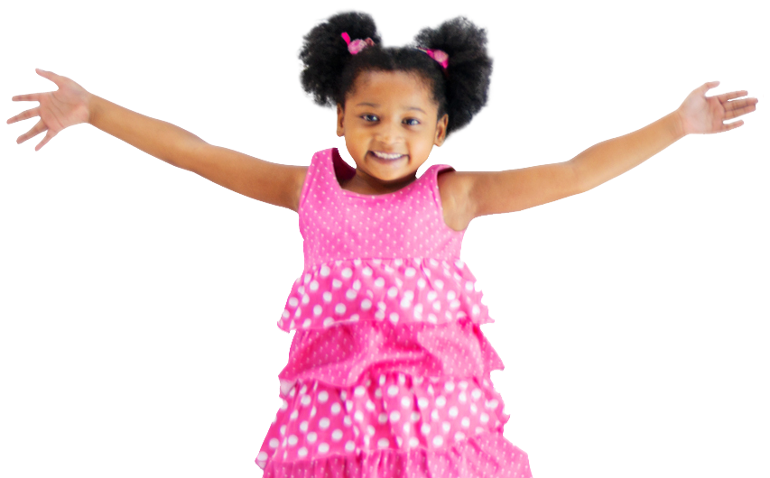

Slide 2
Live Together | Play Together | Work Together
Type here... | Type here... | Type here...
Notes:
Instructor Notes:
Begin by instructing the class to sit on the floor in a circle or semicircle and join the students by sitting at their level.
Click once to display the word “community.” Say it aloud and encourage students to share what comes to mind when they hear this word.
Click again and explain that a community is somewhere people live, work, and/or play together.
Focus students’ attention on the slide’s “Live Together” column.
Explain that one kind of community where people live together is the home.
Type “home” into the first column’s text box.
Then encourage students to think of other communities where people live that include more people than a single home.
Be sure to record “neighborhood,” “town” or “city,” and “country.”
Then move to the “Play Together” column. Ask: What kinds of communities, or groups, are you part of that play together?
Encourage students to share their thoughts and be sure to record ideas like sports teams, clubs, and scouts.
Finally, bring students’ attention to the “Work Together” column.
Give the students a sticky note and a crayon or marker and challenge them to draw a picture of somewhere that adults and/or children work together.
Move around the circle, asking students to share what they recorded and sticking each picture on the board. Continue until all new ideas have been shared.
Be sure “school” and “classroom” are on the list before wrapping up.
Quickly recap by restating the communities that the students just brainstormed. Explain that there are all different kinds of communities and students are part of many of them!

Slide 3
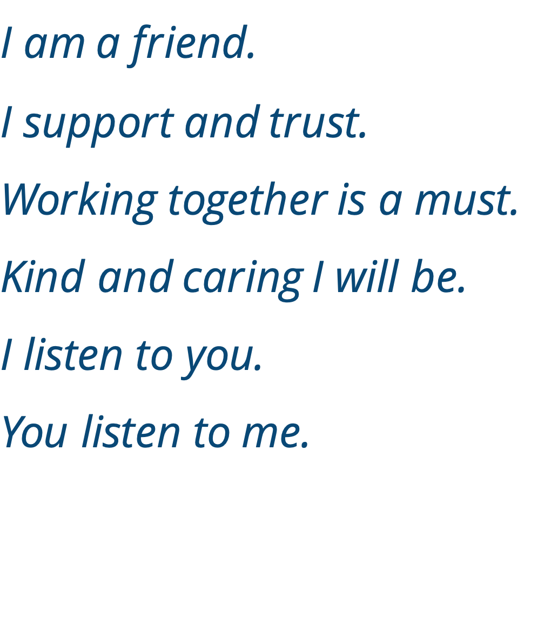
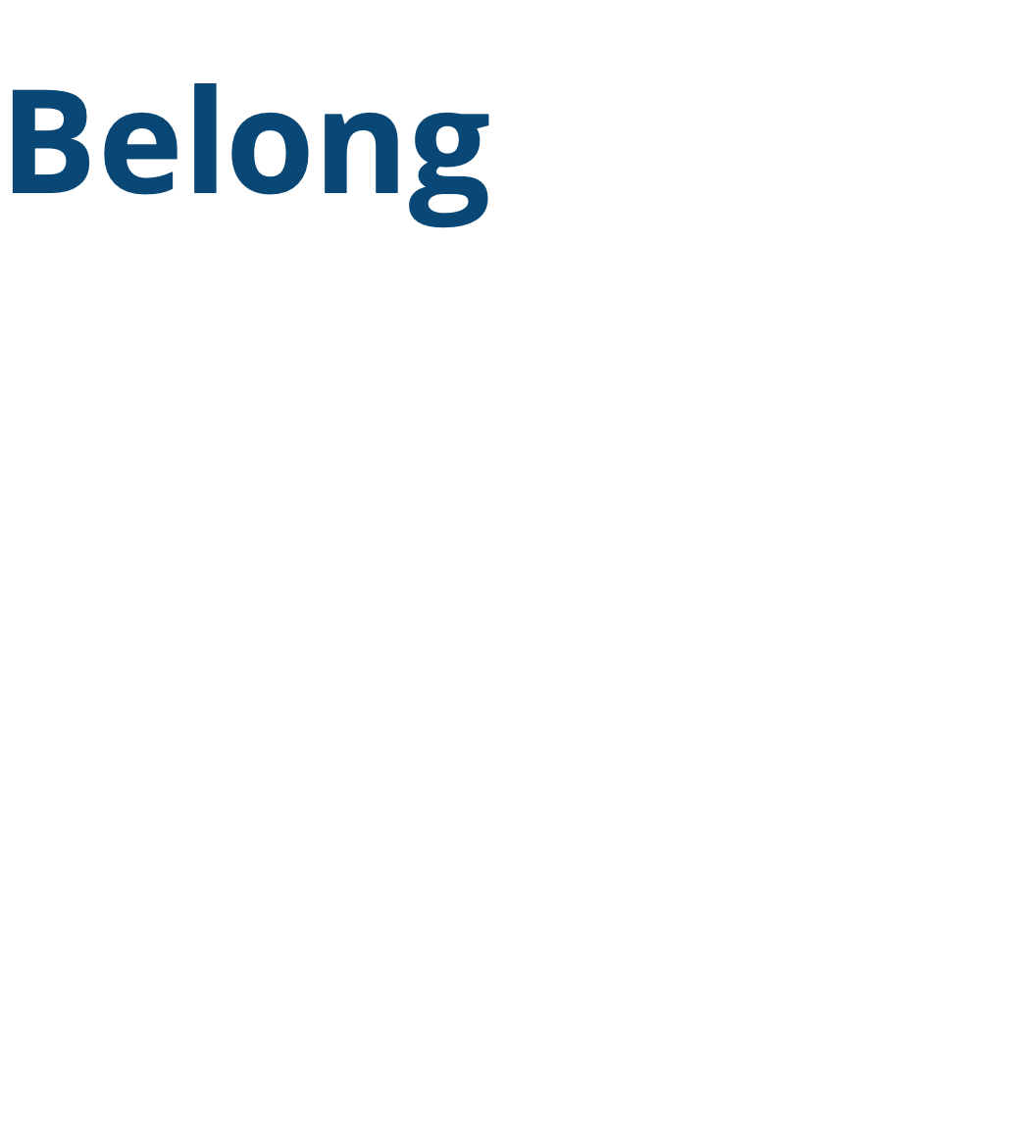
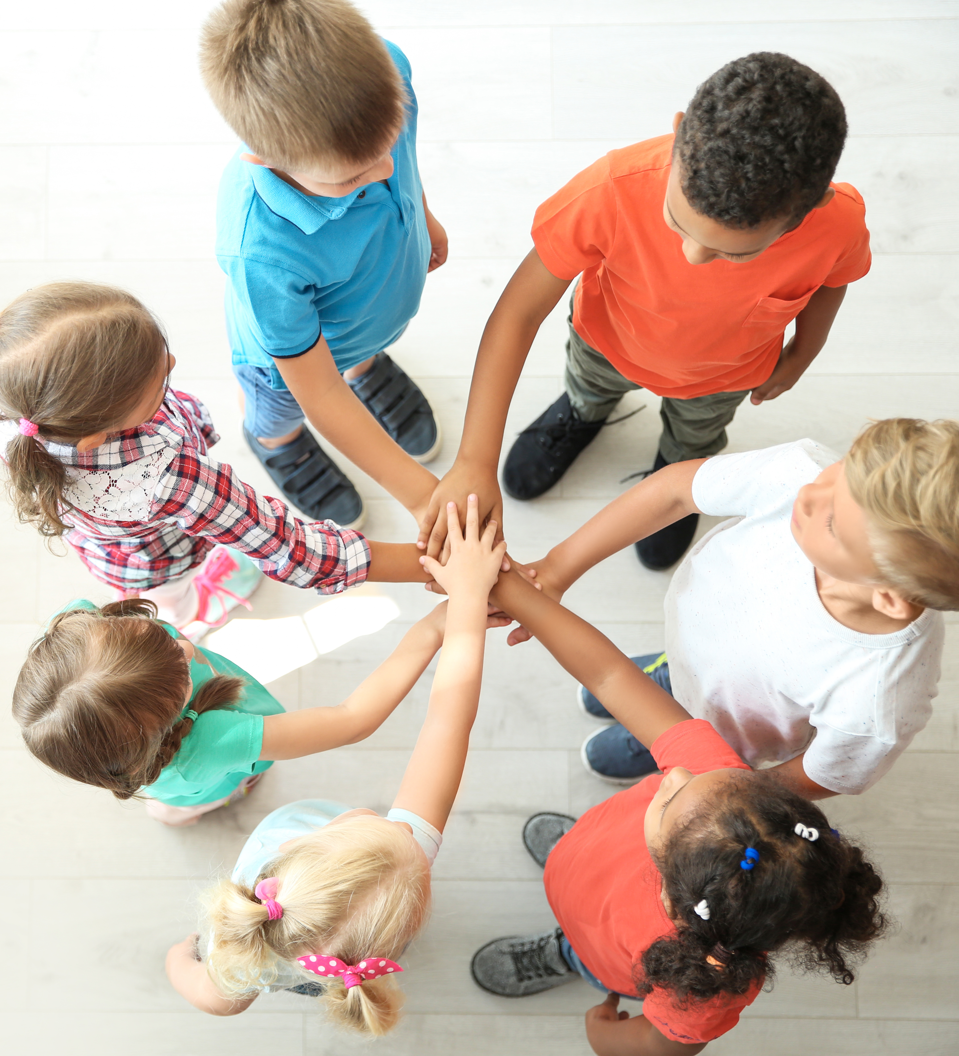
Notes:
Instructor Notes:
Click once to display and read the following Words to Live By:
I am a friend. I support and trust.
Working together is a must.
Kind and caring I will be.
I listen to you. You listen to me.
Explain that these words can help us understand how to treat members of our communities.
Click twice to display the word “belong.”
Explain that when you feel like you belong, you can be yourself. You believe other people like you for being you.
Click twice more to bring the Words to Live By back on the slide. Read the lines one more time and tell the class that acting in this way is one way to help others feel like they belong.
Then ask students to think to themselves: How does it make you feel when you know you belong somewhere?
Distribute one circle from Handout 1: I Belong to each student and encourage the students to draw an emoji (or face) that expresses how belonging makes them feel. If needed, invite them to consider the feelings of safe, happy, calm, or relaxed.
Help students tape their belonging “sticker” to their shirts and encourage them to look around and observe the positive emotions that belonging brings.

Slide 4
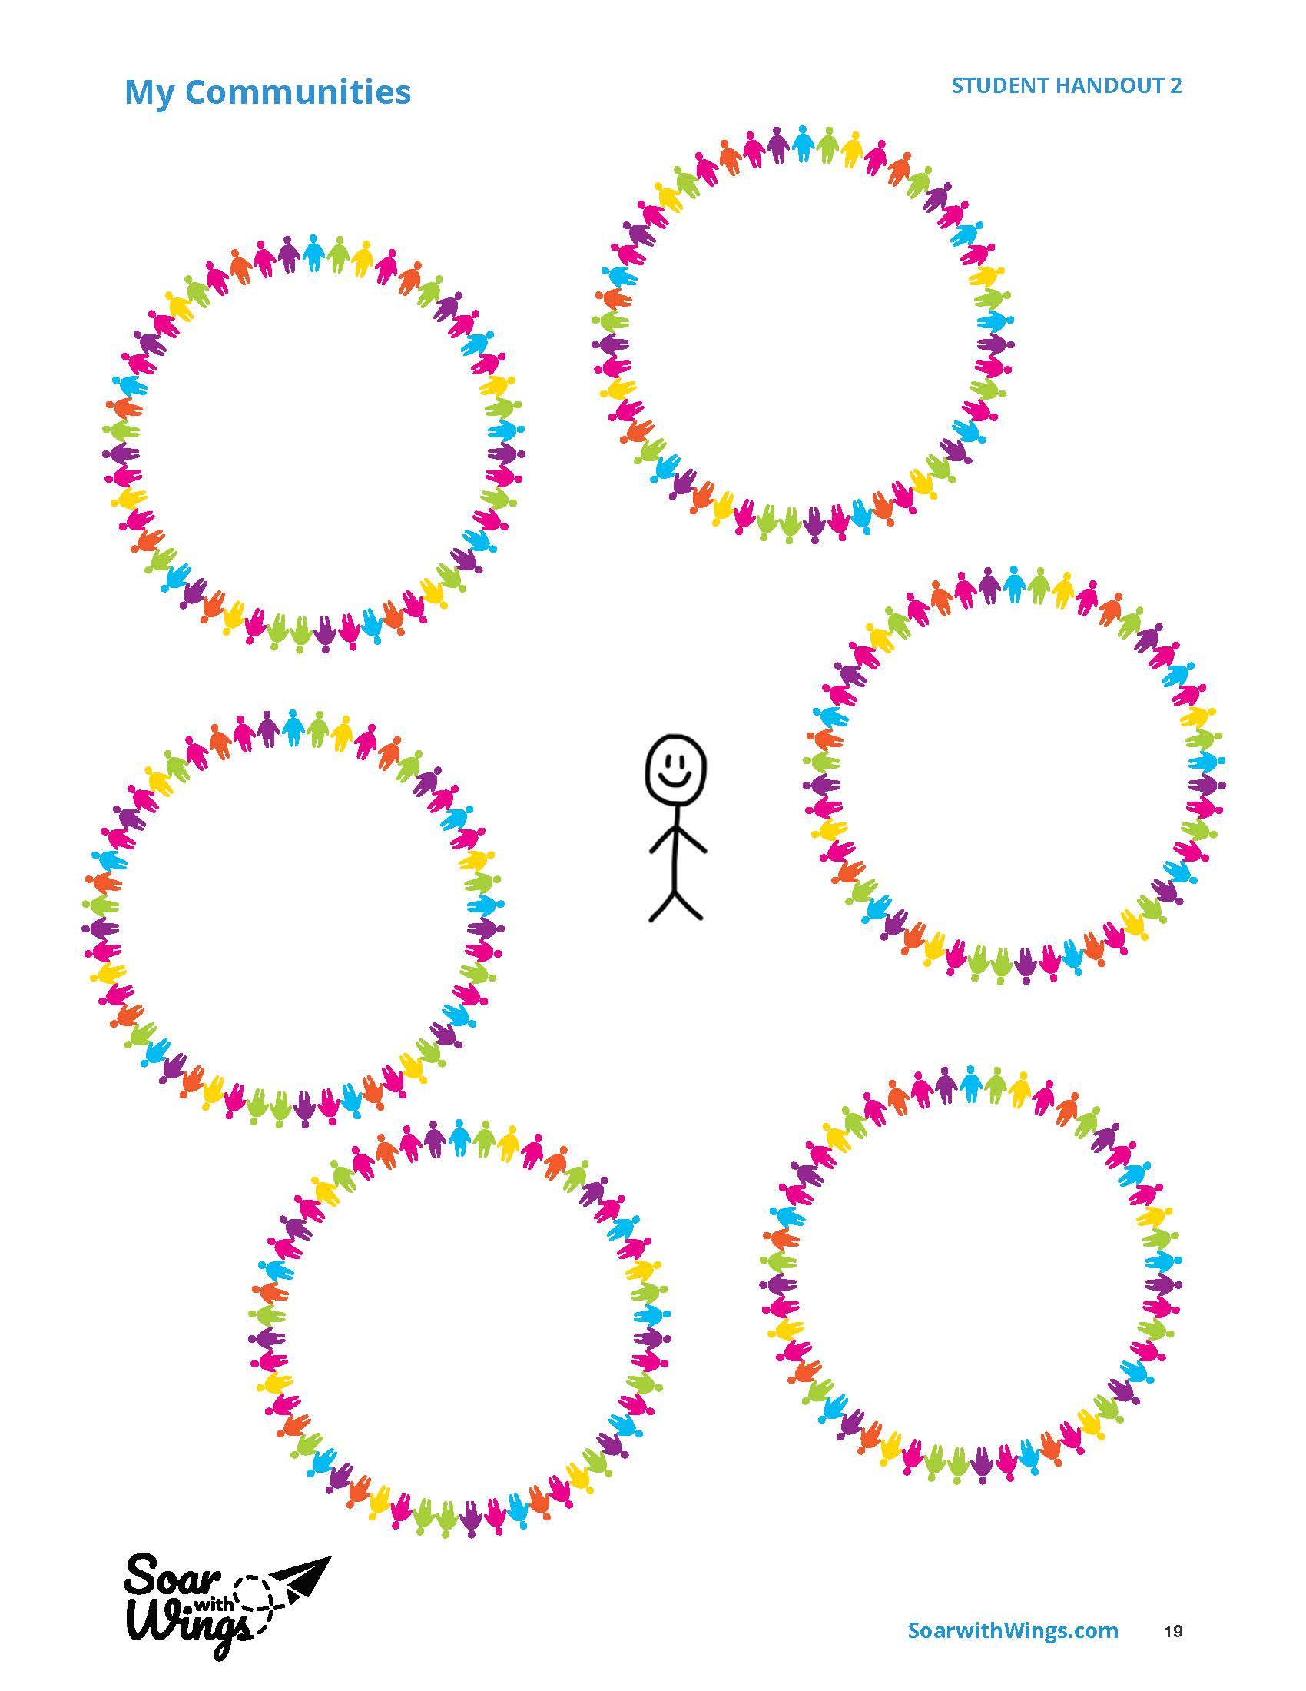
Notes:
Instructor Notes:
Distribute one Handout 2: My Communities to each student.
Ask students to return to their seats and encourage them to think about all the communities that they feel like they belong to.
Challenge them to think about at least one community they work in, one community they live in, and one community they play in. Remind them that communities can be as small as a family or home or as big as a country or the world.
Then give the class a few moments to draw or write these communities within the circles.
*Tip: It may be helpful to switch back to the Communities Chart that you created together on Slide 1 so students have ideas to reference.

Slide 5


Notes:
Instructor Notes:
Bring the class back together and instruct the students to sit in a circle or semicircle with their handouts on the floor in front of them.
Click to project the following sentence stem and read it aloud: “When I am _________, I feel like I belong.”
Then encourage students to use their Handout 2: My Communities to fill in the blank.
*Tip: It may be helpful to give an example such as, “When I am having dinner with my family, I feel like I belong.”
Invite students to share their responses with a peer sitting next to them.
Then click again to project and read another sentence stem: “I don’t feel like I belong when _________.
*Tip: It may be helpful to give an example, such as, “I don’t feel like I belong when my brother and sister are mean to me.”
Encourage students to think to themselves about a time when they felt like they didn’t belong. Encourage them to reflect on the following question: What happened that made them feel like they didn’t belong?
Wrap up by encouraging students to think about and share their responses to the following question: In this situation that you have in your mind, what would have to change for you to feel like you did belong?
*Tip: It may be helpful to give an example, such as, “I would feel like I belong if my brother and sister treated me kindly.”
Once several students have shared, tell them that they will continue thinking about this over the next few days.

Slide 6
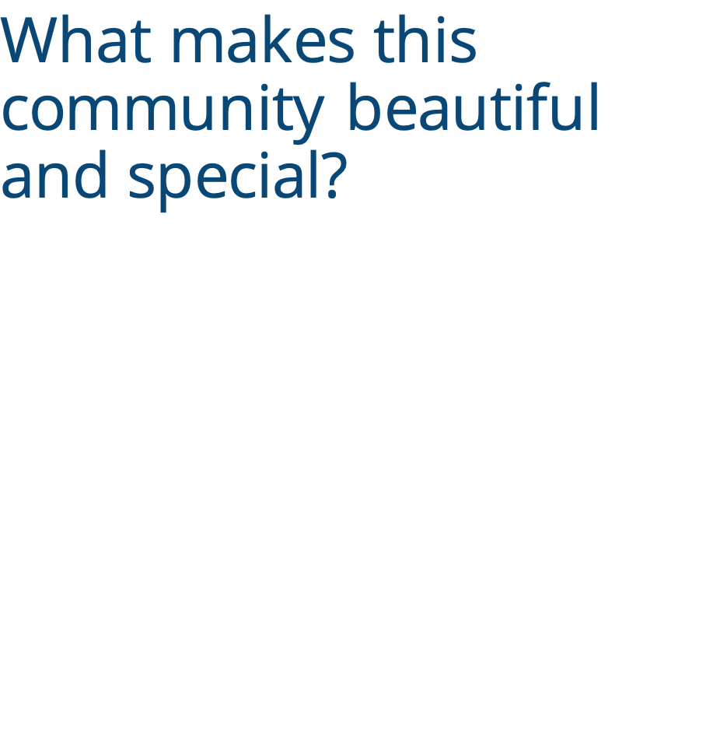
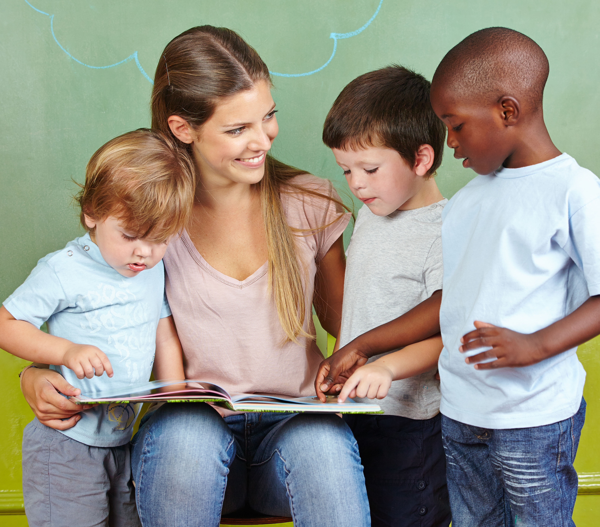
Notes:
Instructor Notes:
Introduce the book Last Stop on Market Street by Matt de la Pena. If the book is unavailable, you may also project a version of the video read-aloud.
Display the book’s cover, read the title aloud, and take a picture walk through the pages. (If you don’t have a copy of the book, you can still do a picture walk by clicking through the video and pausing at different points.) As you do, invite students to share what they think the story will be about.
Tell the class that they are about to take a bus ride through someone else’s community. Encourage them to pay attention to what makes this community beautiful and special as they listen.
Then begin to read the story or display a version of the video read-aloud. Pause to clarify vocabulary or hold a brief discussion after you read the following lines:
Text line: “Nana squeezed the man’s hand and laughed a deep laugh.”
Ask: We’ve met many members of this community so far. What are some of the differences among the people we’ve met and seen? Are there any similarities?
Text line: ‘“How come it’s always so dirty over here?”’
Ask: What does CJ seem to think about his community so far?
Text line: “CJ saw the perfect rainbow arcing over their soup kitchen.”
Explain that a soup kitchen is a place where free food is served to those in need.
Once you have read the whole story, ask: What makes this community beautiful and special?
After hearing students’ thoughts, summarize the story and discussion by sharing the following information:
The unique people in this community are one of the things that make it beautiful.
Another beautiful part of this community is that people are willing to help others. When people come together to help one another, it can help make everyone feel like they belong.
Conclude the day’s session by encouraging students to observe the community where they live over the rest of the day—including what they see, hear, and smell—so they can describe what makes it beautiful during the next class session.

Slide 7

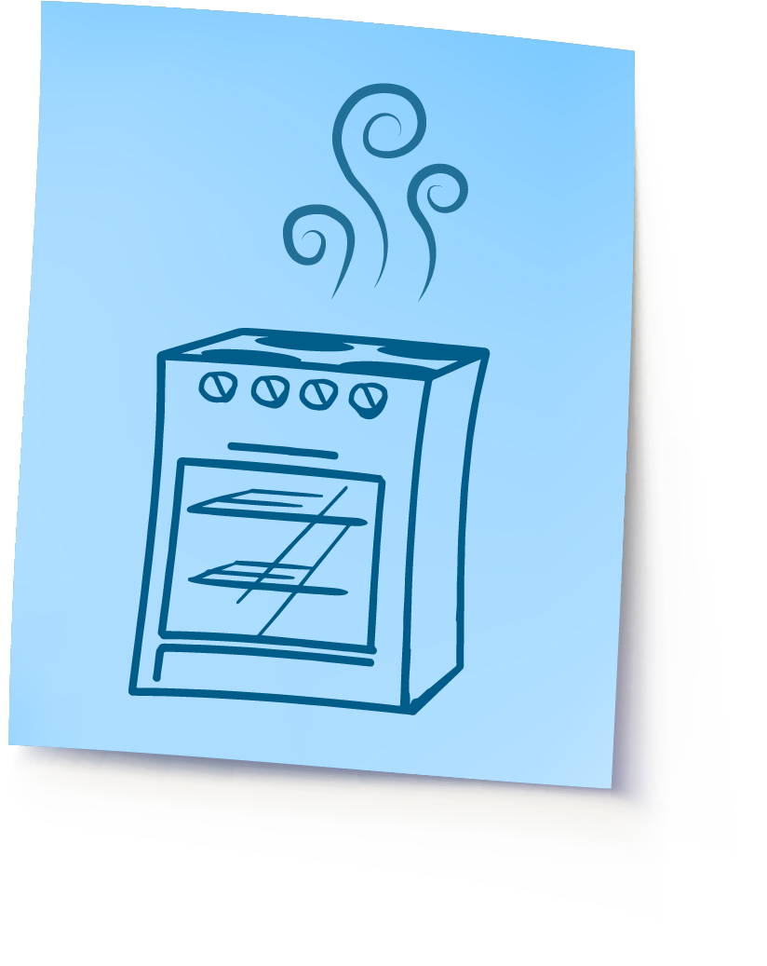
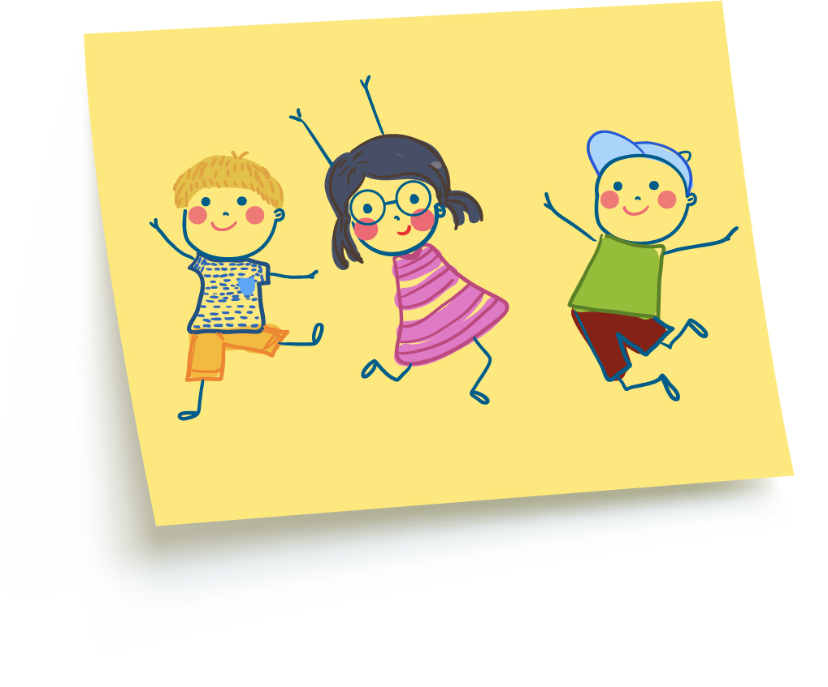
Notes:
Instructor Notes:
Begin the second session by instructing the class to sit on the floor in a circle or semicircle and join the students by sitting at their level.
Explain that today the class will focus on the community where they live.
Distribute a sticky note to each student and be sure each student also has a writing or drawing utensil.
Encourage students to think about the community observations they made yesterday and draw or write a description of the most beautiful thing they saw, heard, or smelled.
Before students begin, click to show a couple examples:
This student smelled the corner shop cooking arepas.
This student saw children laughing as they ran in the park.
Give students a moment to record what they saw, heard, or smelled in their community.
Then ask students to share what they recorded and stick their ideas to the board as they do.
Once all students have shared, summarize as follows: Each of these unique sounds, smells, and sights are one part of what makes your own community beautiful. The viewers, the listeners, and the smellers decide what is beautiful. And because we are all unique, we find beauty around us in different ways.

Slide 8

Notes:
Instructor Notes:
Take a moment to define “unique” as being one-of-a-kind and different from everyone else.
Reiterate that having unique people come together to live, work, and play is one of the most beautiful parts of a community.
Tell the class that one way people can be unique is in the roles they play in their community.
Ask students to consider the following question: What hats do you wear (or roles do you play) in your community?
Hold up the cutout from Handout 3: Community Hats and place it above your head. Explain that one hat you wear in your community is “teacher.”
Then pass the hat around the circle and instruct the students to hold the hat over their heads and describe one or more hats that they wear in their community.
*Tip: Ideas include student, athlete, child, church member, volunteer, fan, and friend.
Once the hat has made its way around the circle, explain that each and every hat that the students mentioned is an important part of the community. They all work together to make their community what it is today.

Slide 9
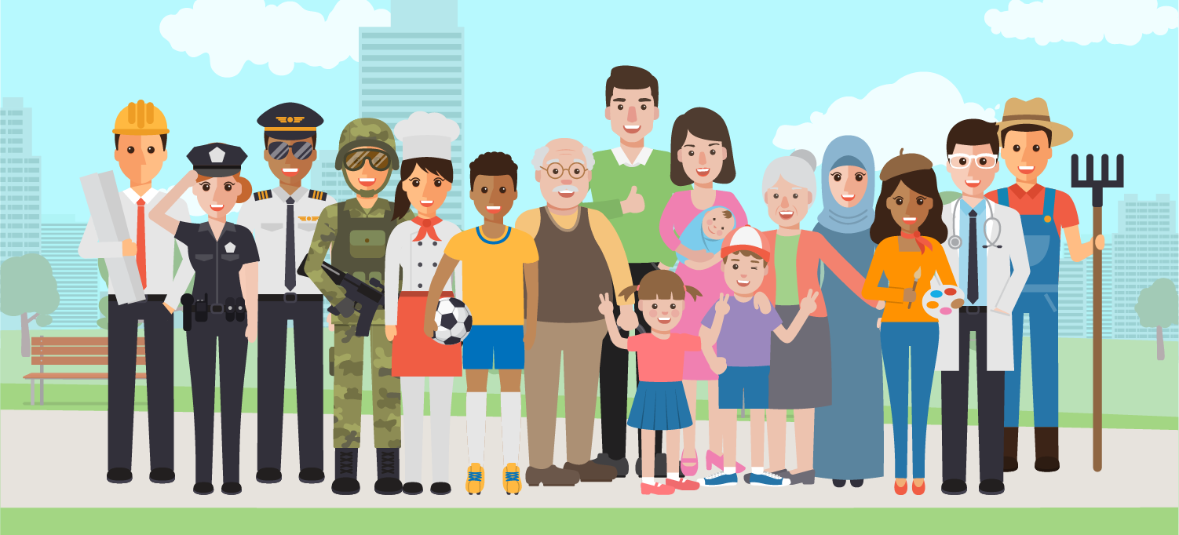
Notes:
Instructor Notes:
Go on to explain that in addition to all the roles the students play, another important role in the community is that of community helper.
Community helpers are people who do things for others. Some community helpers provide us with goods, which are things we can eat or use. Other community helpers provide us with services, which are things they do for us. For example, a cook at a bakery provides us with food, which is a good. A dentist cleans our teeth, which is a service. These are both examples of community helpers.
Use the following instructions to lead the class through an activity that encourages them to brainstorm community helper roles:
Have the students stand up and walk around the classroom.
As they do, encourage them to think about different community helpers.
When you say, “Time to help,” the students should begin silently acting out the job of a community helper of their choice.
As students act, walk around the classroom and give the helpers a thumbs up. As each student receives the thumbs up, he or she should name the job he or she is acting out!
*Tip: It may be helpful to guide the class in brainstorming community helpers before you begin—including everything from nurses and doctors to bus drivers, mail carriers, firefighters, librarians, farmers, bakers, and grocery store workers.
Once you have completed one or two rounds, instruct the students to return to their circle or semicircle

Slide 10
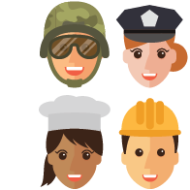
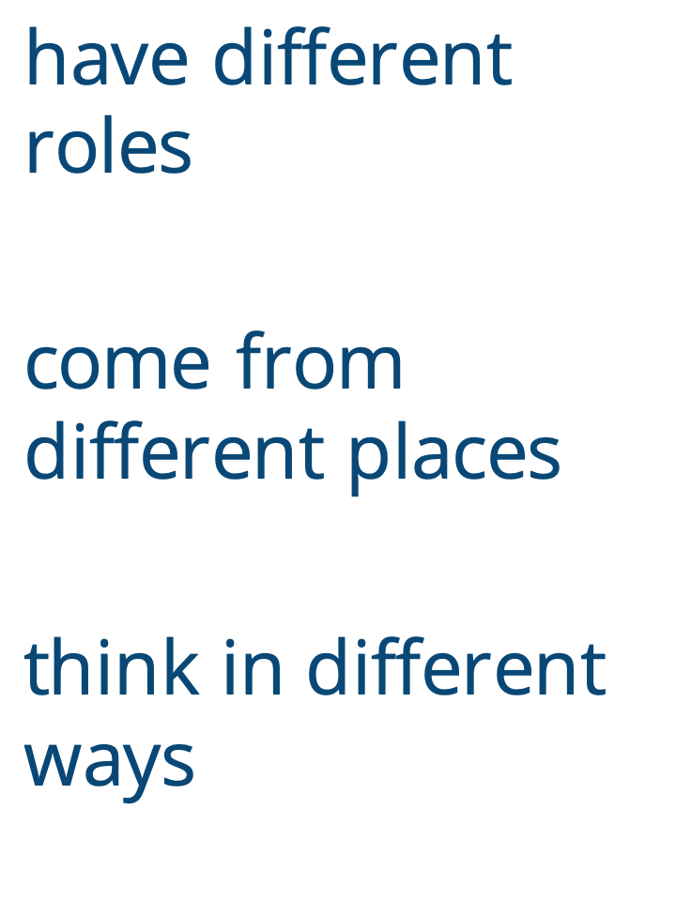
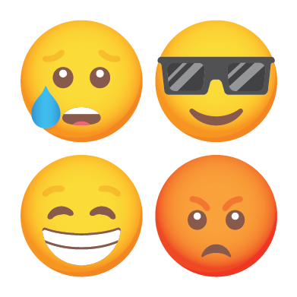
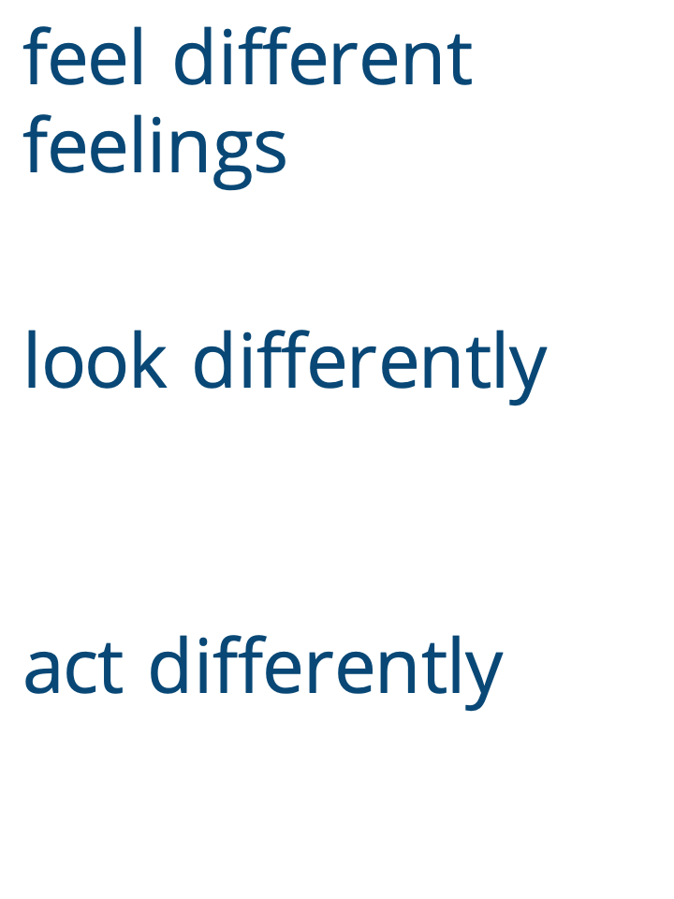

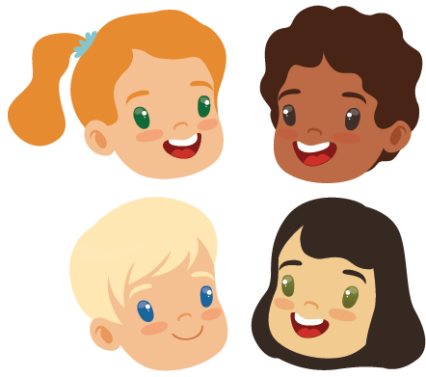
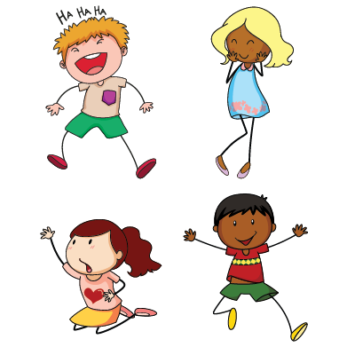
Notes:
Instructor Notes:
Now that they have brainstormed the different roles people play in their community, encourage students to think about some of the other ways that their community members are unique.
Ask: What else can make people different and unlike anyone else?
Encourage students to look around and think about how they are different from their classmates as they answer this question.
After hearing students’ thoughts, click and explain that people can be different in the following ways:
Have different roles
Come from different places
Think in different ways
Feel different feelings
Look differently
Act differently

Slide 11
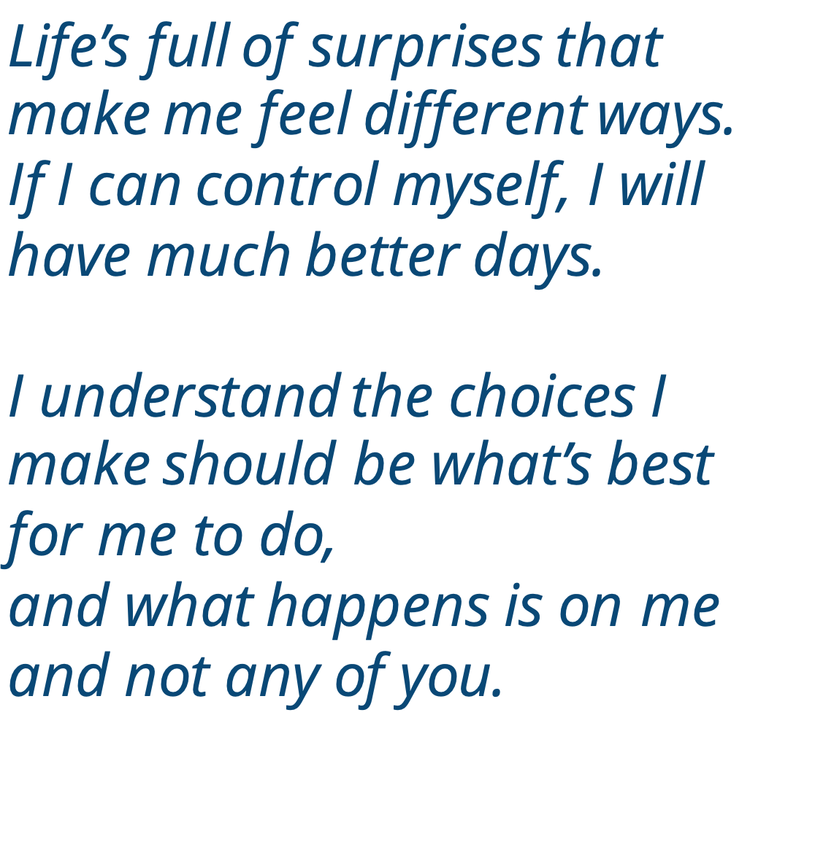
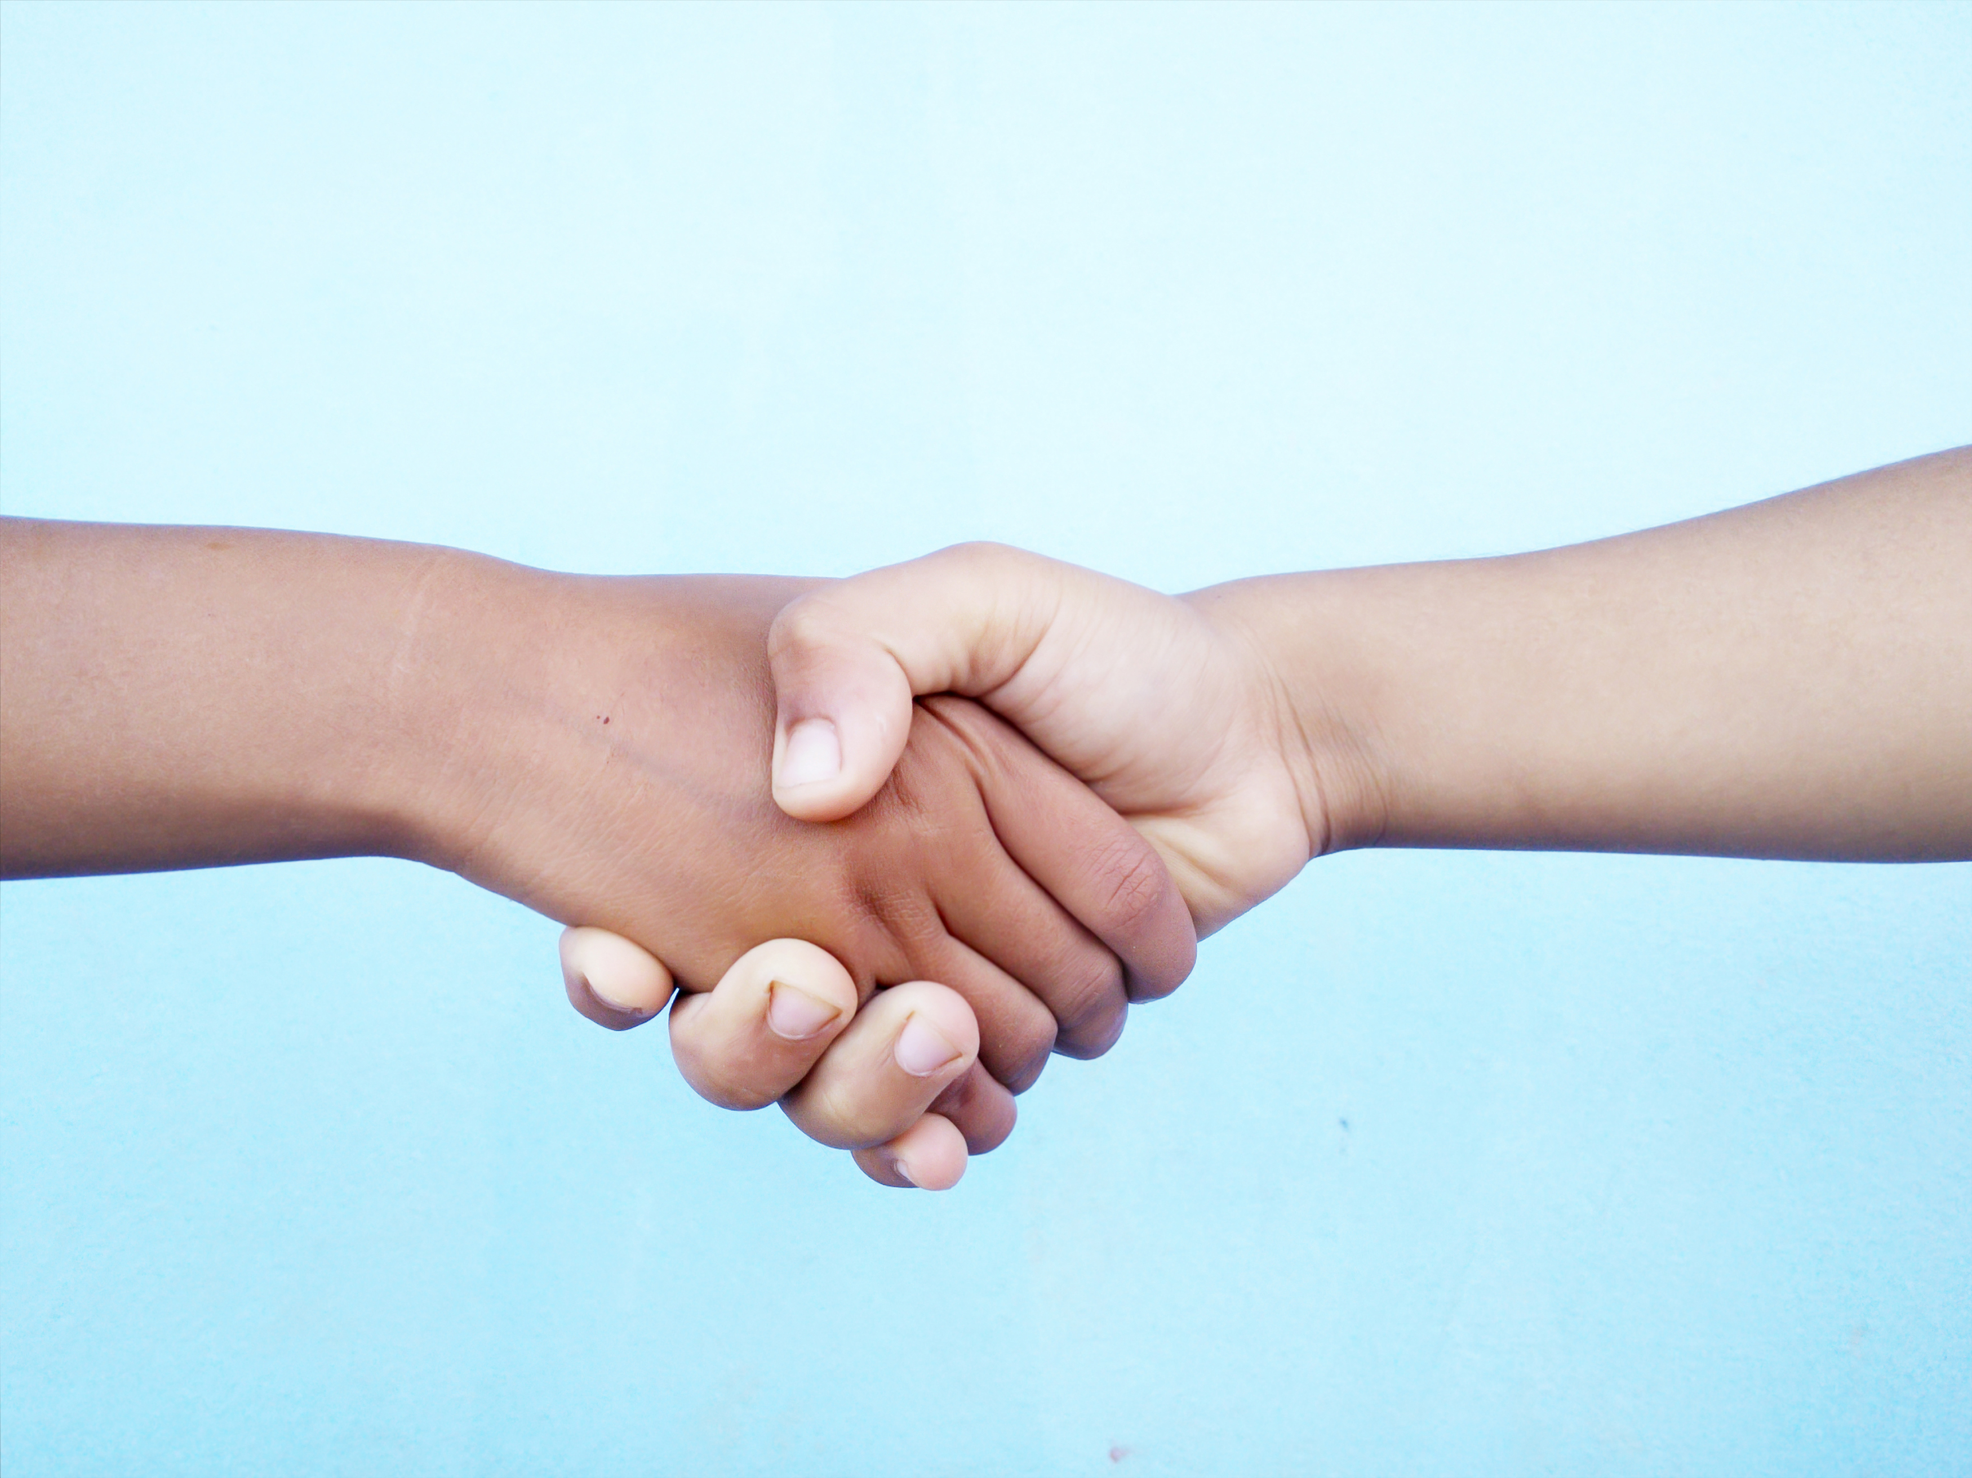
Notes:
Instructor Notes:
Tell the class that people’s differences are one of the most special parts of a community. However, they can also be one of the hardest parts.
Because we are all different, sometimes we can be surprised or upset by other people’s actions.
Click twice to project the following section from Wings Words to Live By, and read it aloud:
Life’s full of surprises that make me feel different ways.
If I can control myself, I will have much better days.
I understand the choices I make should be what’s best for me to do,
and what happens is on me and not any of you.
Explain that the students will think about these words as they complete the next few activities.

Slide 12
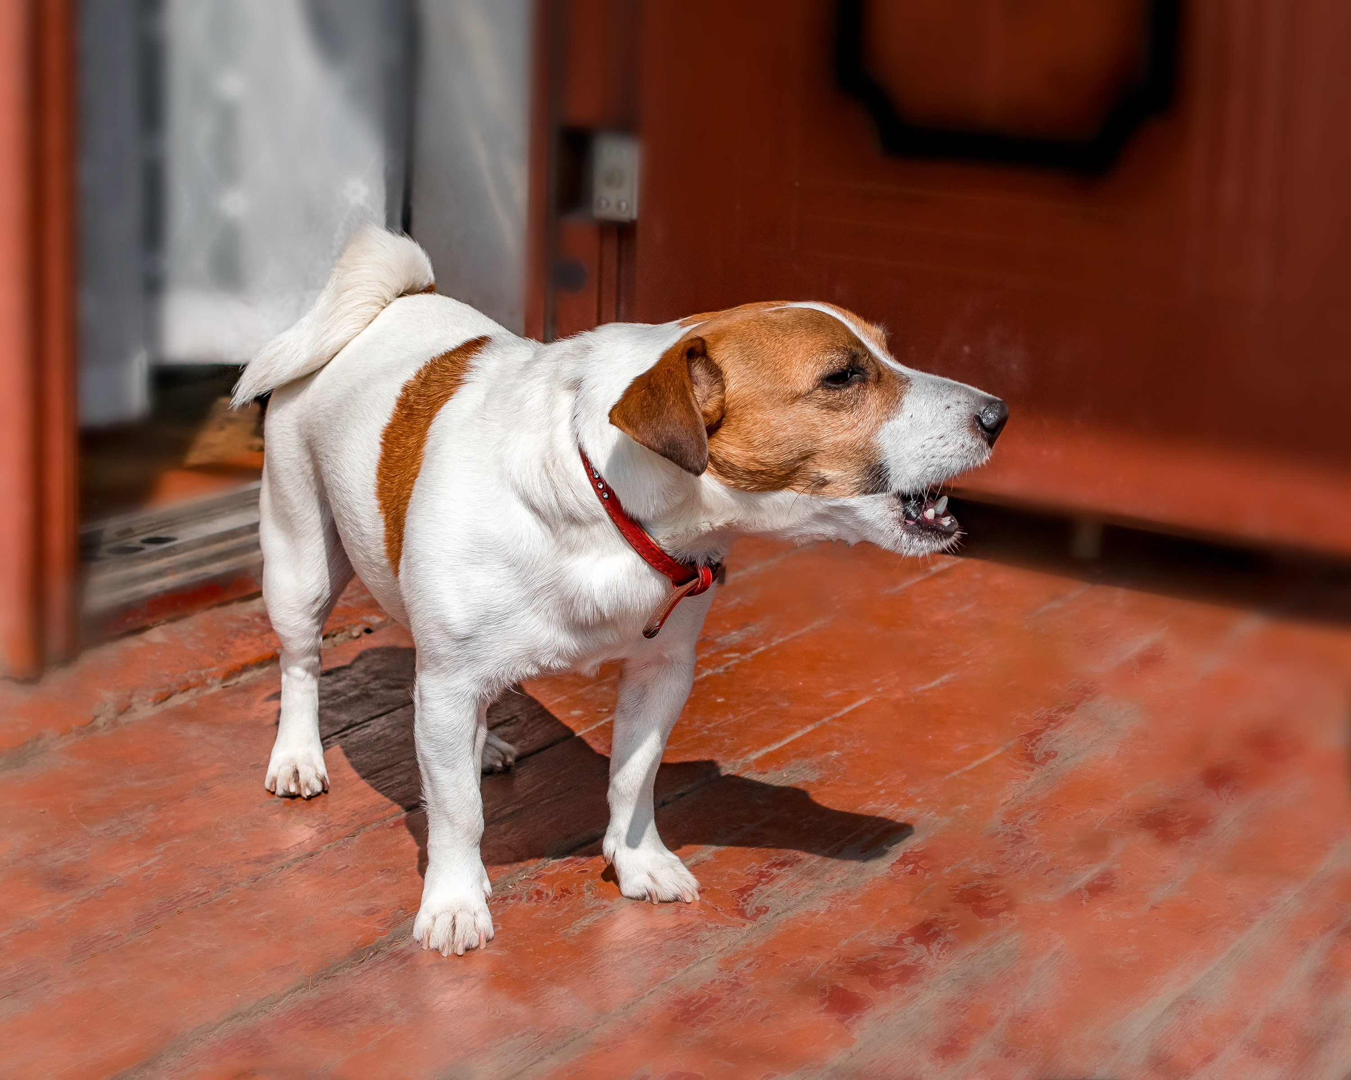
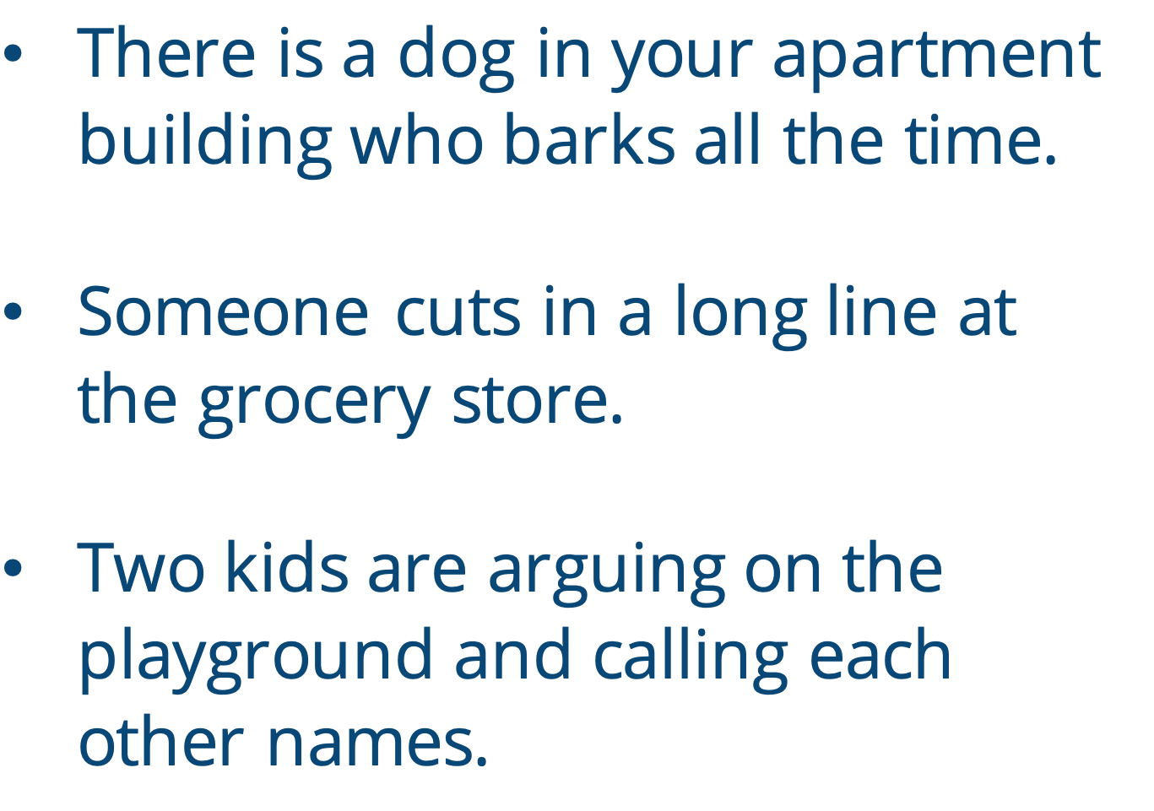
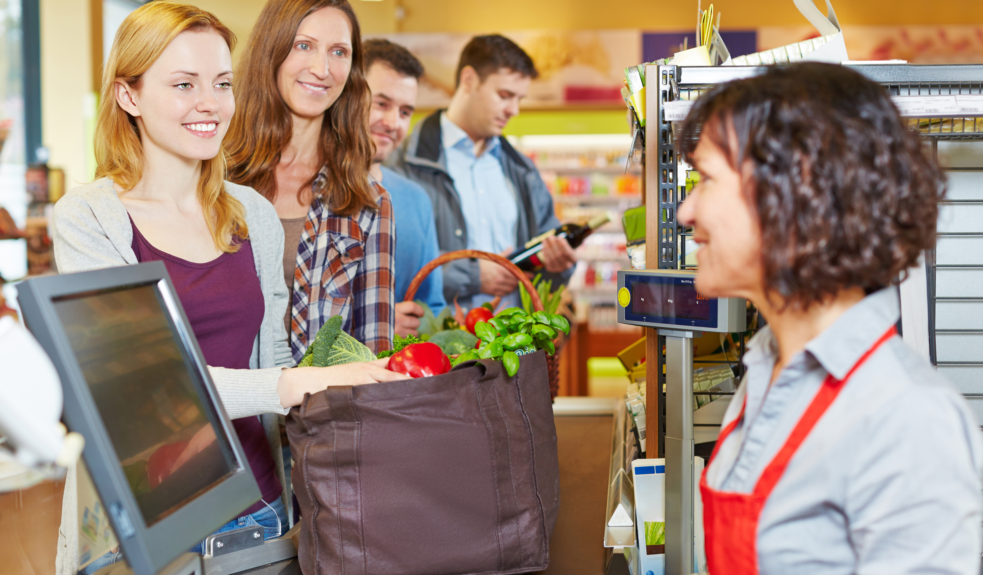
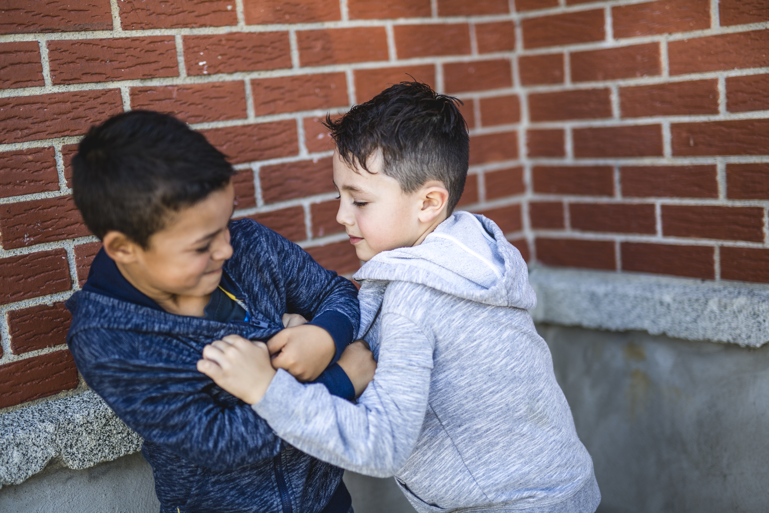
Notes:
Instructor Notes:
Click to project the word “conflict” and explain that the students should now think of a time when they had a conflict with someone in their community.
Explain that a conflict is when something happens to cause bad feelings.
Click to project the following examples of situations that may cause community conflict and ask students to turn to a partner and describe why each one may create bad feelings:
Example 1: There is a dog in your apartment building who barks all the time.
Example 2: Someone cuts in a long line at the grocery store.
Example 3: Two kids are arguing on the playground and calling each other names.

Slide 13
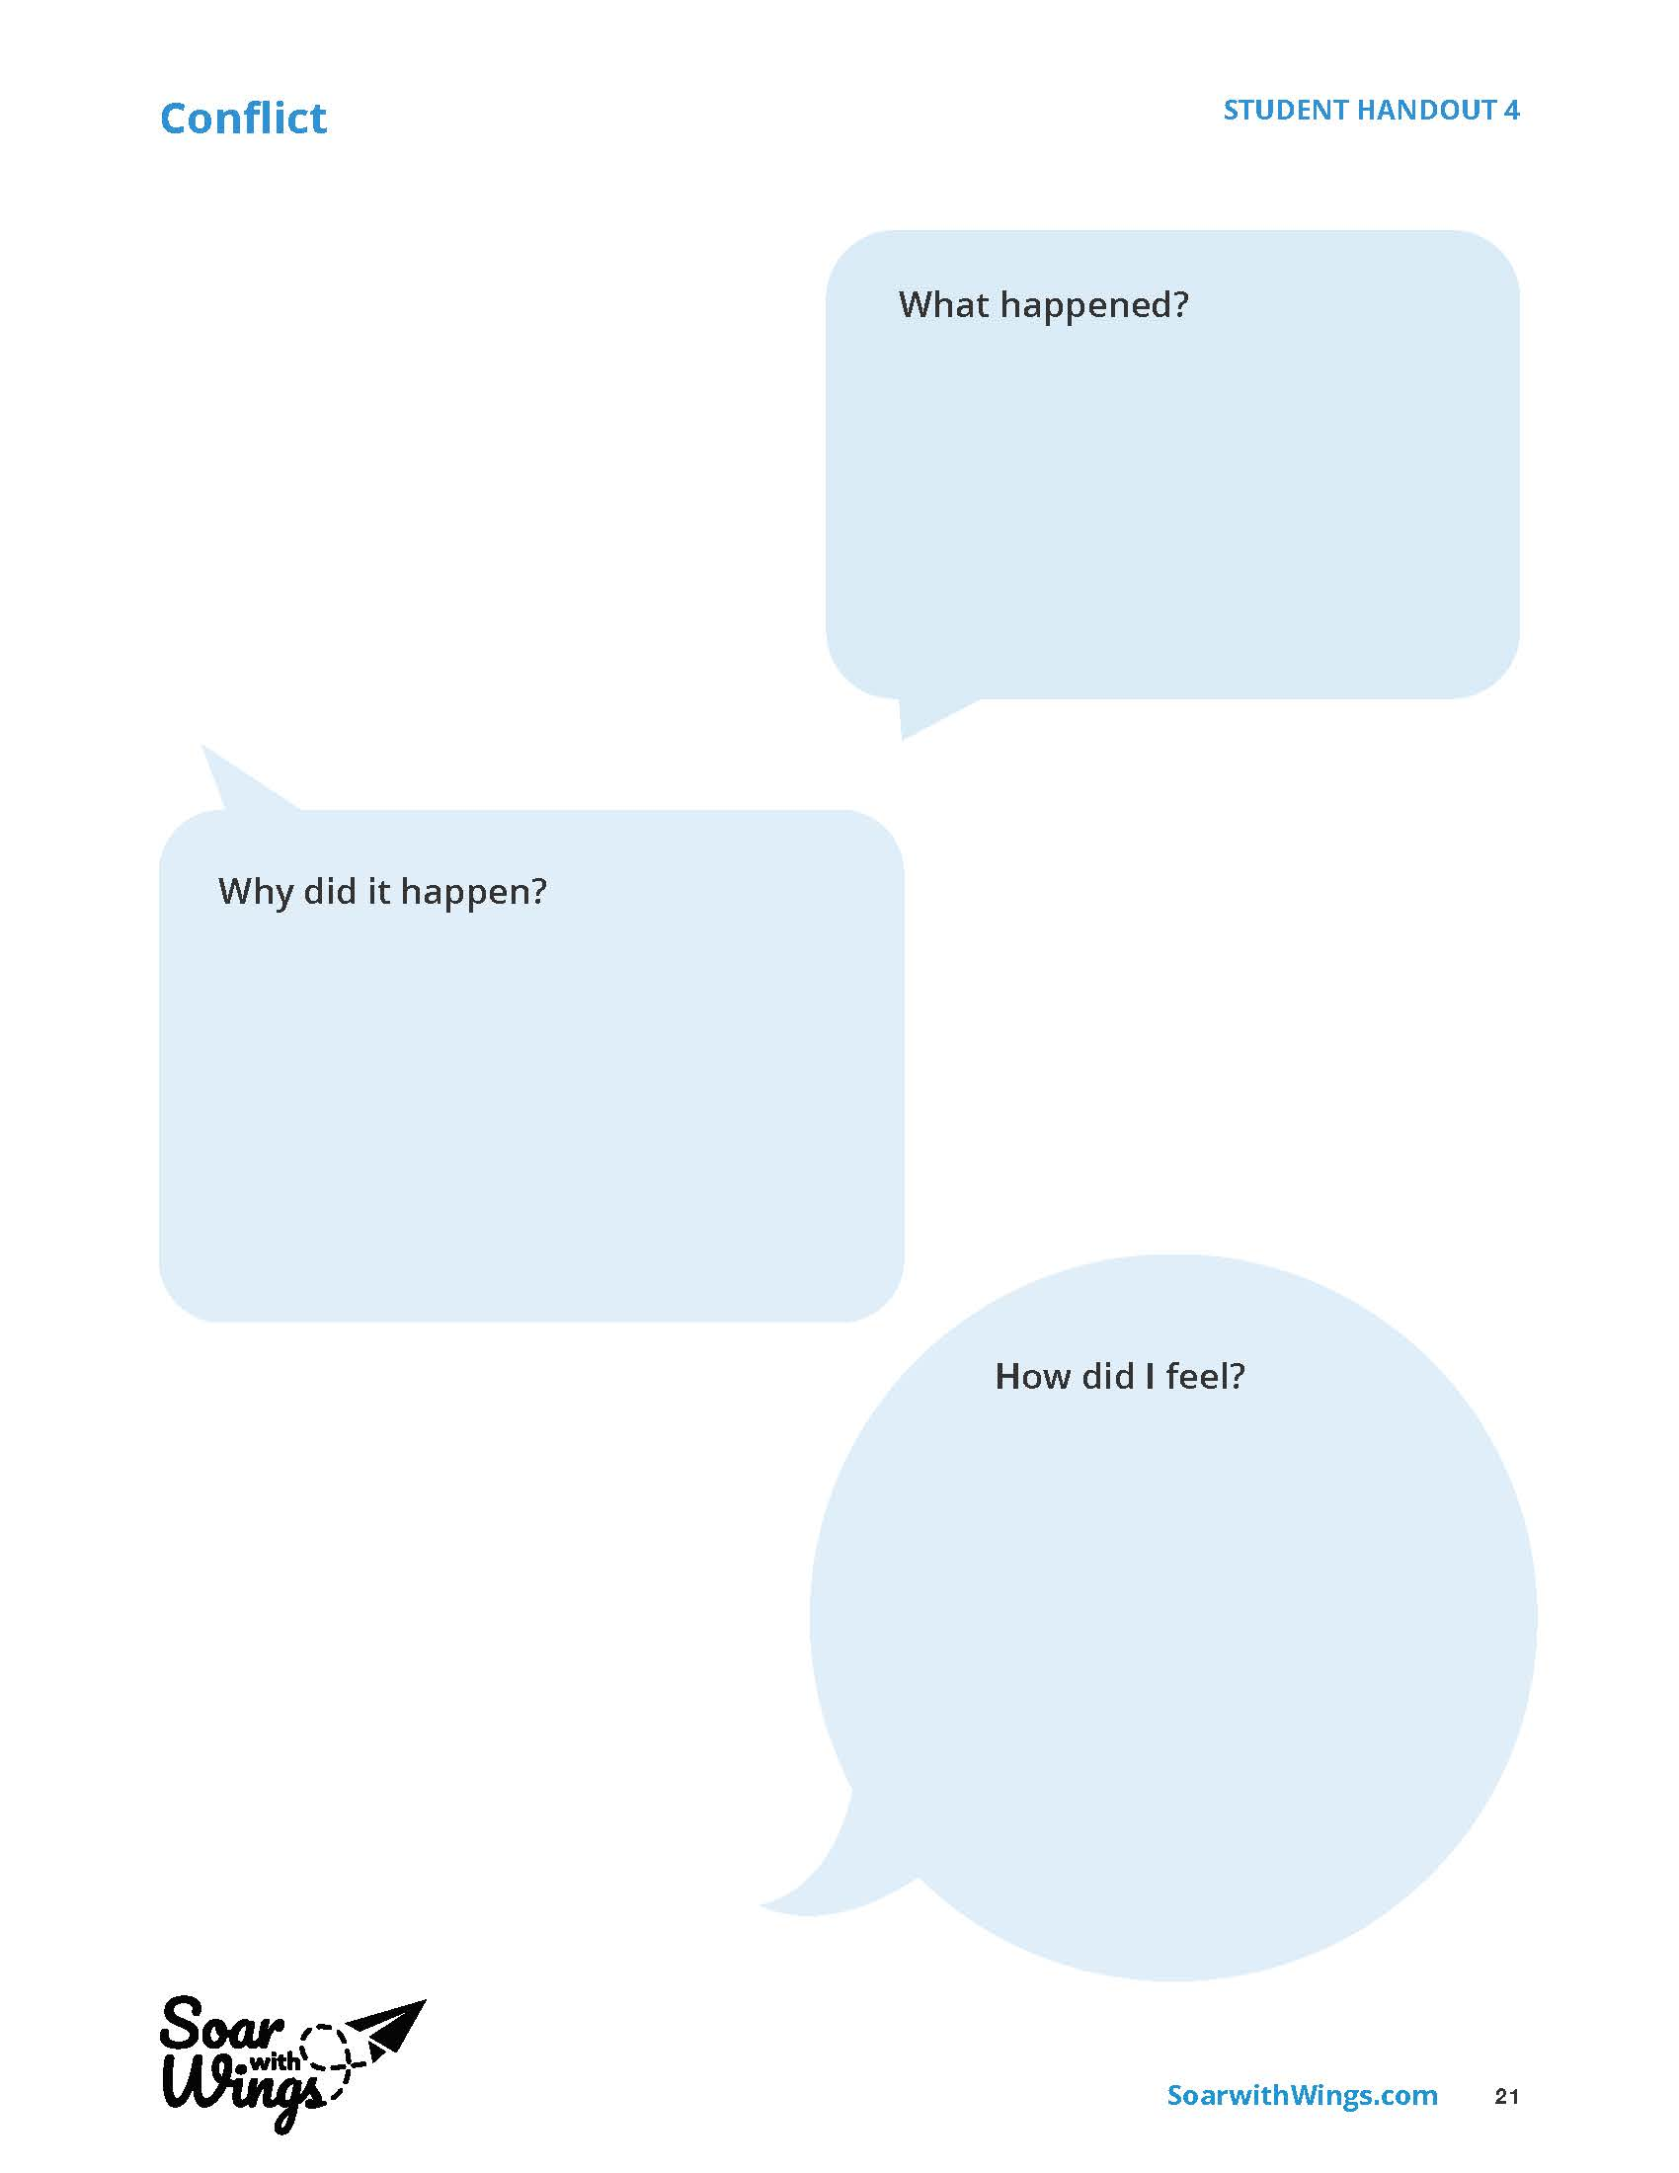
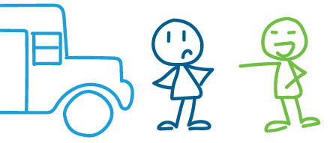
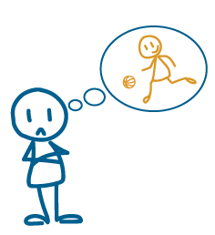
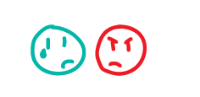
Notes:
Instructor Notes:
Pass out one Handout 4: Conflict to each student. Prepare students for the activity by completing the following:
Explain that each student should now think about a time when something happened that caused bad feelings between him or her and someone else in their community. Challenge students to think of a conflict that occurred outside of their family or home, such as at school, on their sports team, or at a club meeting.
Once the students have a conflict in mind, instruct them to fill in the handout’s three shapes with the following details:
What happened?
Why did it happen?
How did it make me feel?
Students may answer these questions however they would like to—drawing, comic, writing, etc.
To help students better understand the activity before they begin, click once to display an example of student work and explain that the drawings illustrate the following:
What happened?
“I got into an argument with another student at my bus stop.”
Why did it happen?
“The argument happened because the other student was saying bad things about my favorite basketball team.”
How did it make me feel?
“It made me feel angry and hurt.”
Encourage students to think about a time they experienced conflict in their community and complete their own handouts.

Slide 14
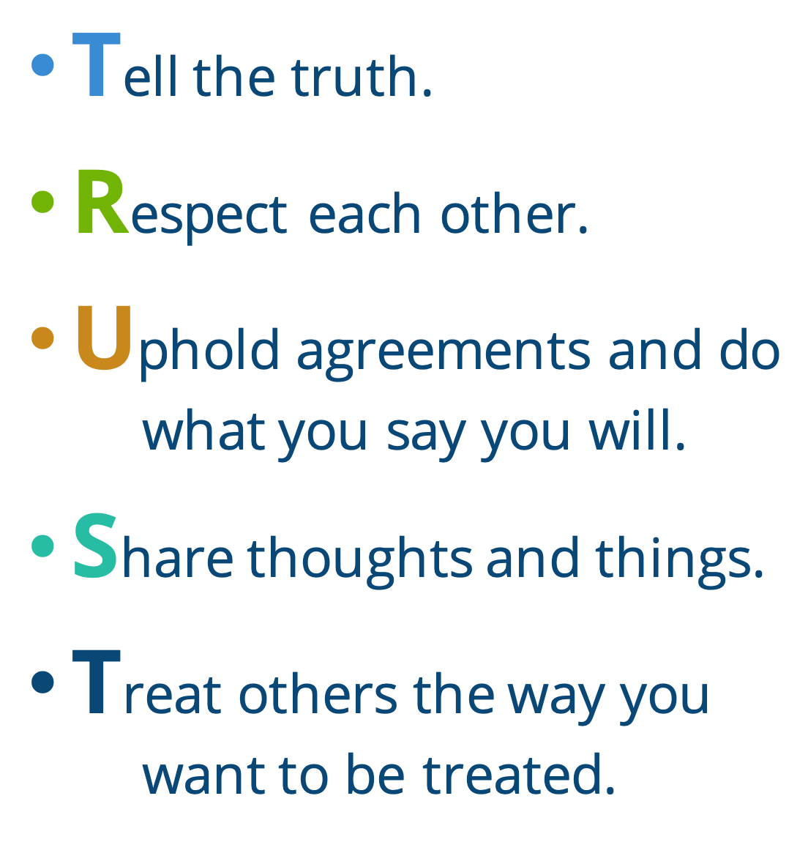

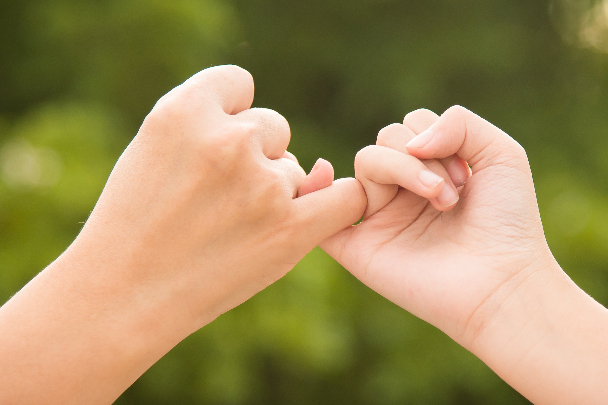
Notes:
Instructor Notes:
Bring the class back together in a circle or semicircle and instruct students to put their completed handouts on the floor in front of them.
Explain that one way to have a positive relationship with other community members is to build trust.
Explain that when you trust someone, you believe in the person and you know you can count on that person to make good decisions. This can help prevent conflict.
Explain that it’s not always easy to have trust right away. However, there are some choices you can make to help you build trust.
Click once to display each part of the following acronym and explain that you can build trust when you do the following:
Tell the truth.
Respect one another.
Uphold agreements and do what you say you will.
Share thoughts and things.
Treat others the way you want to be treated.
Then turn students’ attention to their completed handouts and ask: How can you try to build trust with the person or people you had a conflict with?
To help students answer this, pose the questions below and invite students to jump up if they can answer “yes” to any of them. Ask students who jump up to remain standing and tell them they can give another jump from a standing position if they can answer “yes” to any additional questions.
Ask the following questions based on the TRUST acronym:
In the future, can you
T: Try to always tell the truth when you’re with this person?
R: Treat this person with more kindness?
U: Keep the promises you make to this person?
S: Tell this person what you are thinking? Or share something that is yours with this person?
T: Treat this person how you hope he or she will treat you?
If any students are not standing after you read the last question, try to speak with them separately after the activity to better understand their conflicts.
Conclude by summarizing that it looks like most or all students could work on building trust with the person they had a conflict with.

Slide 15





Notes:
Instructor Notes:
Ask all students to sit down.
Explain that while building trust is a great way to prevent conflict with people in our lives, sometimes conflict still occurs. For this reason, it’s also important to know how to handle conflict when it is happening.
Ask students to turn to a partner and come up with a place in their school community where they see conflict or have been in a conflict.
For instance, have students ever seen conflict while having lunch in the cafeteria?
As pairs discuss, write “conflict” in the middle of a piece of chart paper, similarly to how it is displayed on the slide.
Ask the pairs to share some of the locations that they brainstormed. As pairs share, record their responses in new circles stemming from “Conflict.”
Next, direct the class’s attention to the locations you recorded. For each one, ask the following questions:
Why is there conflict here? What do people tend to argue about here?
Encourage students to brainstorm some of the reasons conflict exists in these places and record their responses in new circles stemming from each location.
*Tip: If students are stuck, kick off the brainstorming with examples of conflicts you have witnessed. For instance, “I’ve seen conflict at recess when two students want to go down the slide at the same time!”
Once you have recorded several examples of conflict, tell the class that when these situations happen, continuing to argue or fight doesn’t solve any problems; it only leads to more!

Slide 16
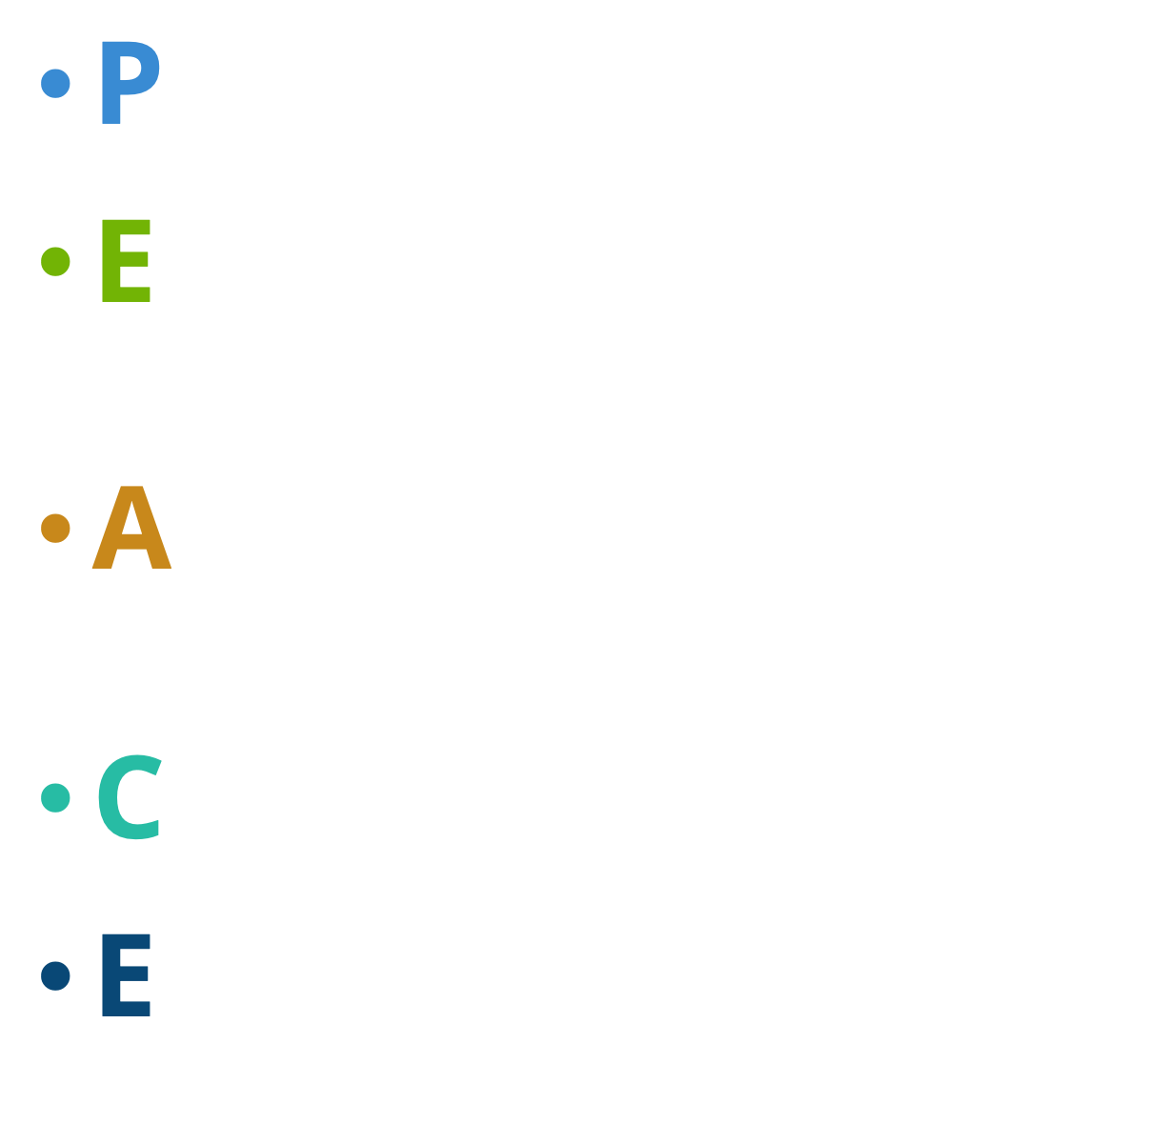

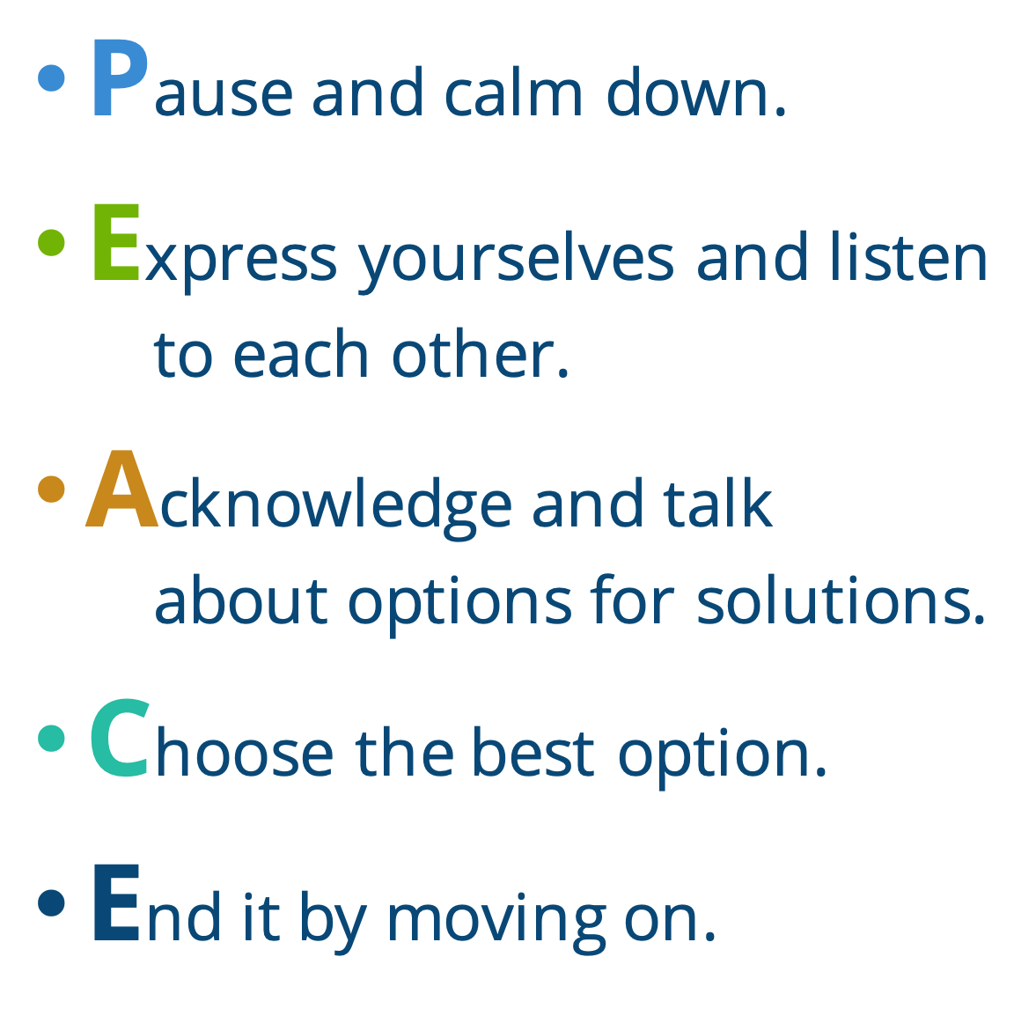



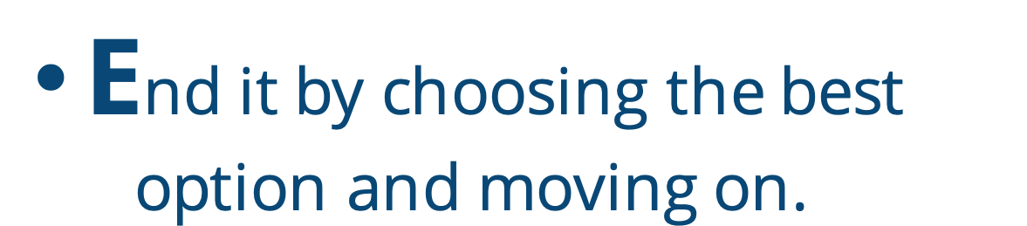
Notes:
Instructor Notes:
Continue the discussion by explaining that instead of letting conflict go on and on and get out of control, students can make the choice to aim for PEACE.
Click once and read the following acronym aloud as you perform the actions in italics. Explain that when you are in the middle of an argument, you can do the following:
Pause and calm down. (Take a deep breath.)
Express yourselves and listen to one another. (Put your hand next to your ear.)
Acknowledge and talk about options for solutions. (Nod your head.)
Choose the best option. (Put one finger up in front of you.)
End it by choosing the best option and moving on. (Make two thumbs up.)
Be sure students understand what each letter means.
Then ask students to join you in performing the actions as you read through PEACE one more time.
Next, read the following scene: You are at recess and you are angry because you and another student want to use the only soccer ball! The teacher says you have to figure it out together.
Ask a student volunteer to act out with the scene with you and try to resolve the conflict using PEACE:
Model how to pause and take a deep breath and encourage the student to do the same.
Click once to project “I want (or) I think _______” Then say the following: “I want to use the soccer ball so I can play a game with my friends.”
Put your hand next to your ear and encourage the student to explain why he or she wants to use the soccer ball.
Click again to project “We could _____” and ask the student to help you fill in the blank with at least two different solutions. Try to nod as you do. Possible solutions include the following:
We could take turns using the soccer ball.
We could play a soccer game together.
Click one final time to project “Let’s _______” With the student, decide the best course of action and fill in the blank with what you decide.
Finally, ask the student to join you in giving a thumbs up.
Then help students form pairs throughout the classroom and present them with one more scene: Your teacher says you have to clean up the mess on your table, but you each think the other person made the mess.
Guide the students through using PEACE to resolve the conflict:
Model how to pause and take a deep breath.
Ask each student to say what he or she wants or thinks, while the other student listens.
Encourage pairs to brainstorm a couple solutions to the problem, using the “We could ______” sentence starter.
Ask students to decide what they will do, fill in the “Let’s____” sentence starter, and then give a thumbs up.
Wrap up by encouraging students to share their solutions with the rest of the class.
Conclude the day’s session by congratulating students on learning and using strategies to control themselves and make decisions that will help them get along better with others in their community.
Teacher Note: As you clean up from this session, save the chart paper that you used for Slide 13 for Day 3.

Slide 17
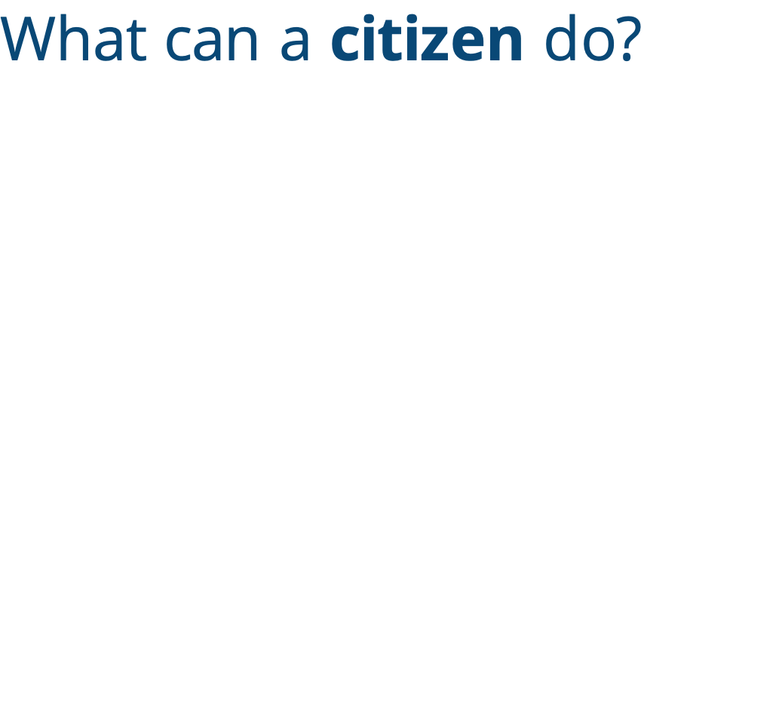
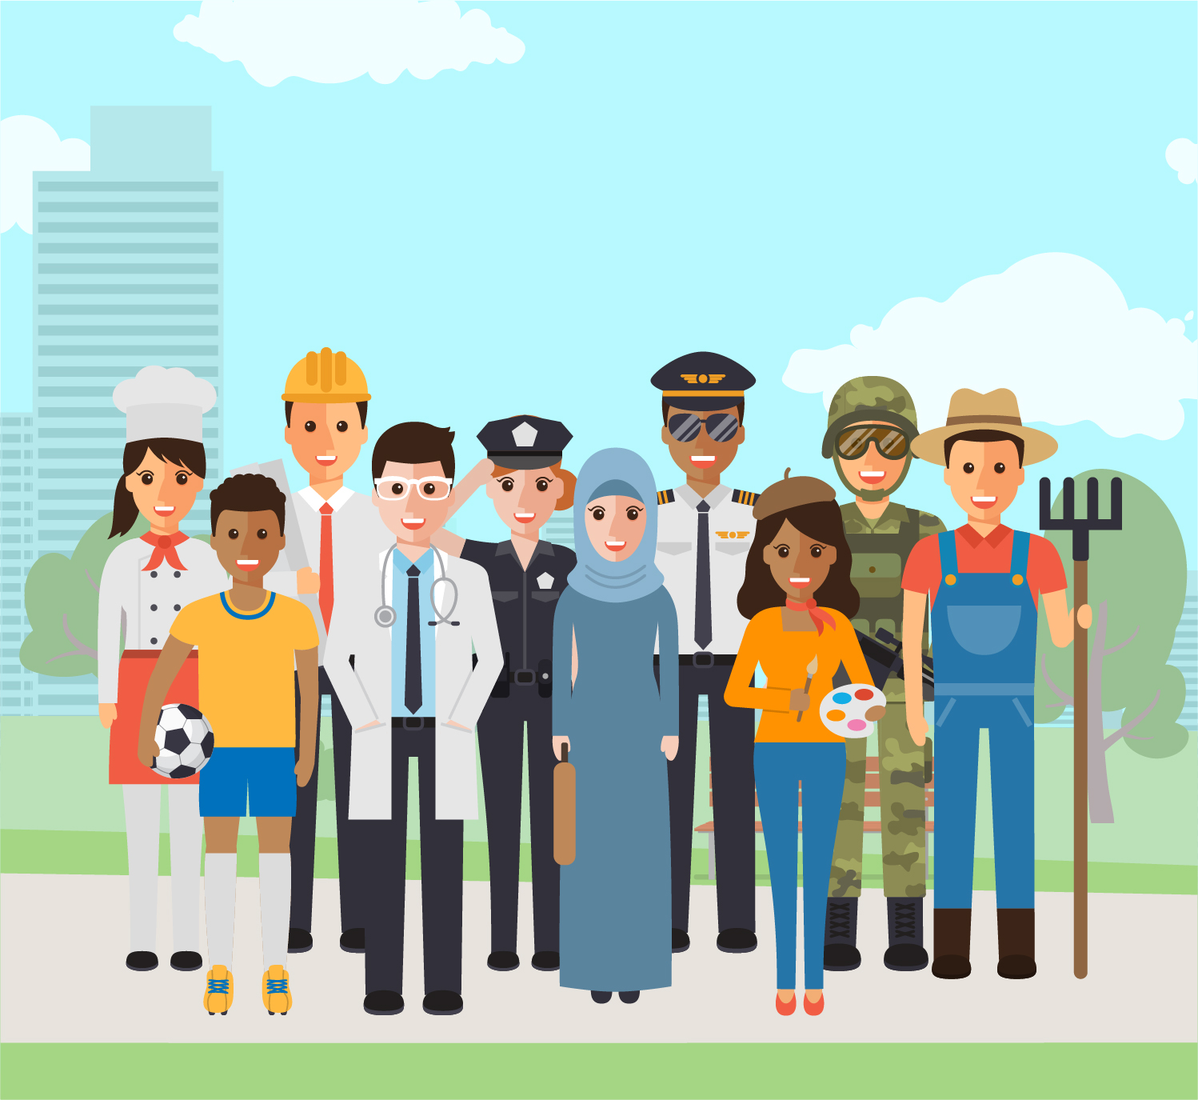
Notes:
Instructor Notes:
Gather students on the floor in a circle or semicircle and join them by sitting at their level.
Bring students’ attention to the slide’s header and ask students what comes to mind when they see the word “citizen.”
Explain that a citizen is a member of a community. All students sitting around the circle are citizens—or members—of the classroom community. They are also citizens and members of the school community.
Introduce the book What Can A Citizen Do? by Dave Eggers or prepare to project a version of the video read aloud.
Click once before you begin reading and ask students to listen for different examples of what a citizen can do.
Then begin to read, pausing occasionally to clarify concepts and vocabulary and ask guiding questions.
For example, after reading “A citizen is what you do,” ask students the following question: Why did the author say that a citizen could be a bear, a citizen could be a kid, or a citizen could wear pink pants?
Be sure students understand that the author said this because a citizen can be anyone (or anything). There is no one type of citizen.
At the end of the story, lead a discussion around the focus question “What can a citizen do?”
Encourage students to share their thoughts and be sure to emphasize that one of the most important things a citizen can choose to do is make the world a better place.

Slide 18
-
+
Notes:
Instruct
Direct students’ attention to the word “Changemaker” on the slide and read it aloud.
Ask: What two words make up “changemaker”?
Then click twice and ask: If changemaker is made up of the words “change” and “maker,” what do you think the word “changemaker” means?
Help the class arrive at the definition that a changemaker is a person (or a citizen) who changes things in order to make the world a better place.
Tape one “-“ sign from Handout 5: Changemaker on one end of the classroom and one “+” sign on the other end of the classroom.
Then click and ask students the following question: If someone is a community changemaker and makes their community a better place, do you think that person probably cares about his or her community (point to the + sign) or do you think that person probably doesn’t care about his or her community (point to the – sign)?
Instruct the students to stand up and move near the sign that shows their answer. Students who aren’t sure may stand in the middle.
Once students have taken a position, ask a few students with different opinions to explain their reasoning.
Then encourage students to rejoin the circle or semicircle and explain that even though it may seem like wanting to change your community means that you don’t care about it, it usually means the reverse. If you try to change your community for the better, it is a sign that you care for, love, and appreciate your community. When you are a changemaker, you try to make your community into a better place for everyone. This is one of the best ways to celebrate your community and show that you care.

Slide 19
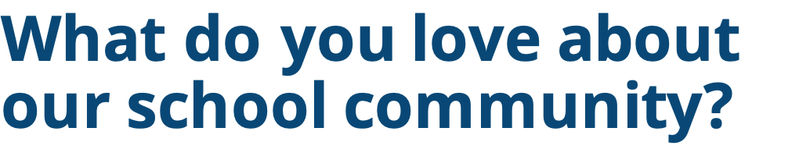
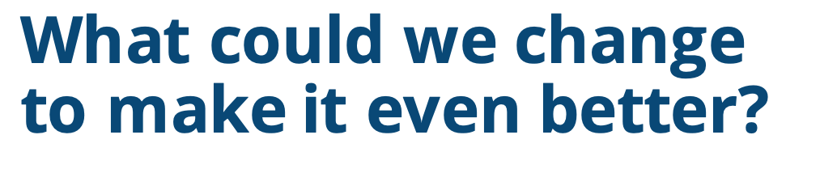
Type here...
Type here...
Notes:
Instructor Notes:
Explain that, next, students will be working together to brainstorm what they love about their school community and what they could change to make it even better!
First, encourage the class to brainstorm what they love about their school community. Record their ideas in the text box on the slide as they share.
Review the list once it is complete and take a moment to reflect on all of the positives and happiness that their community brings to them.
Then pass out one Handout 6: Community Brainstorming to each student.
Explain that the students will now brainstorm how their community can be improved and made even better! They can illustrate or write these changes in the handout’s bubbles.
Lead the class in brainstorming ways to be a changemaker using one of the following strategies:
Encourage students to look at the conflicts they brainstormed on Day 2’s chart paper and discuss what could be changed to make these conflicts less likely to occur.
Provide the following broad categories for students to consider:
How can we help more students feel like they belong to our school community?
How can we help resolve conflict in our school community?
Once all students have one change recorded, they may fill out the rest of the handout in small groups of three or you may continue to brainstorm and complete the handout as a class.

Slide 20

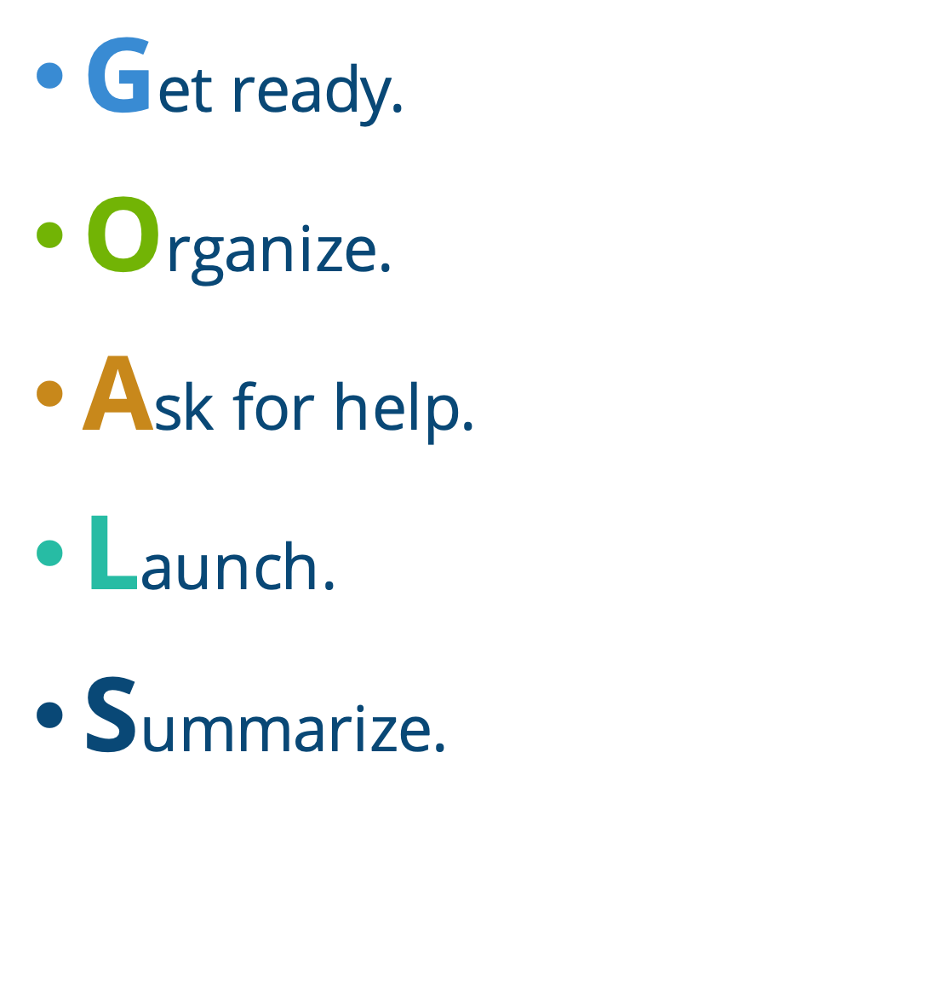
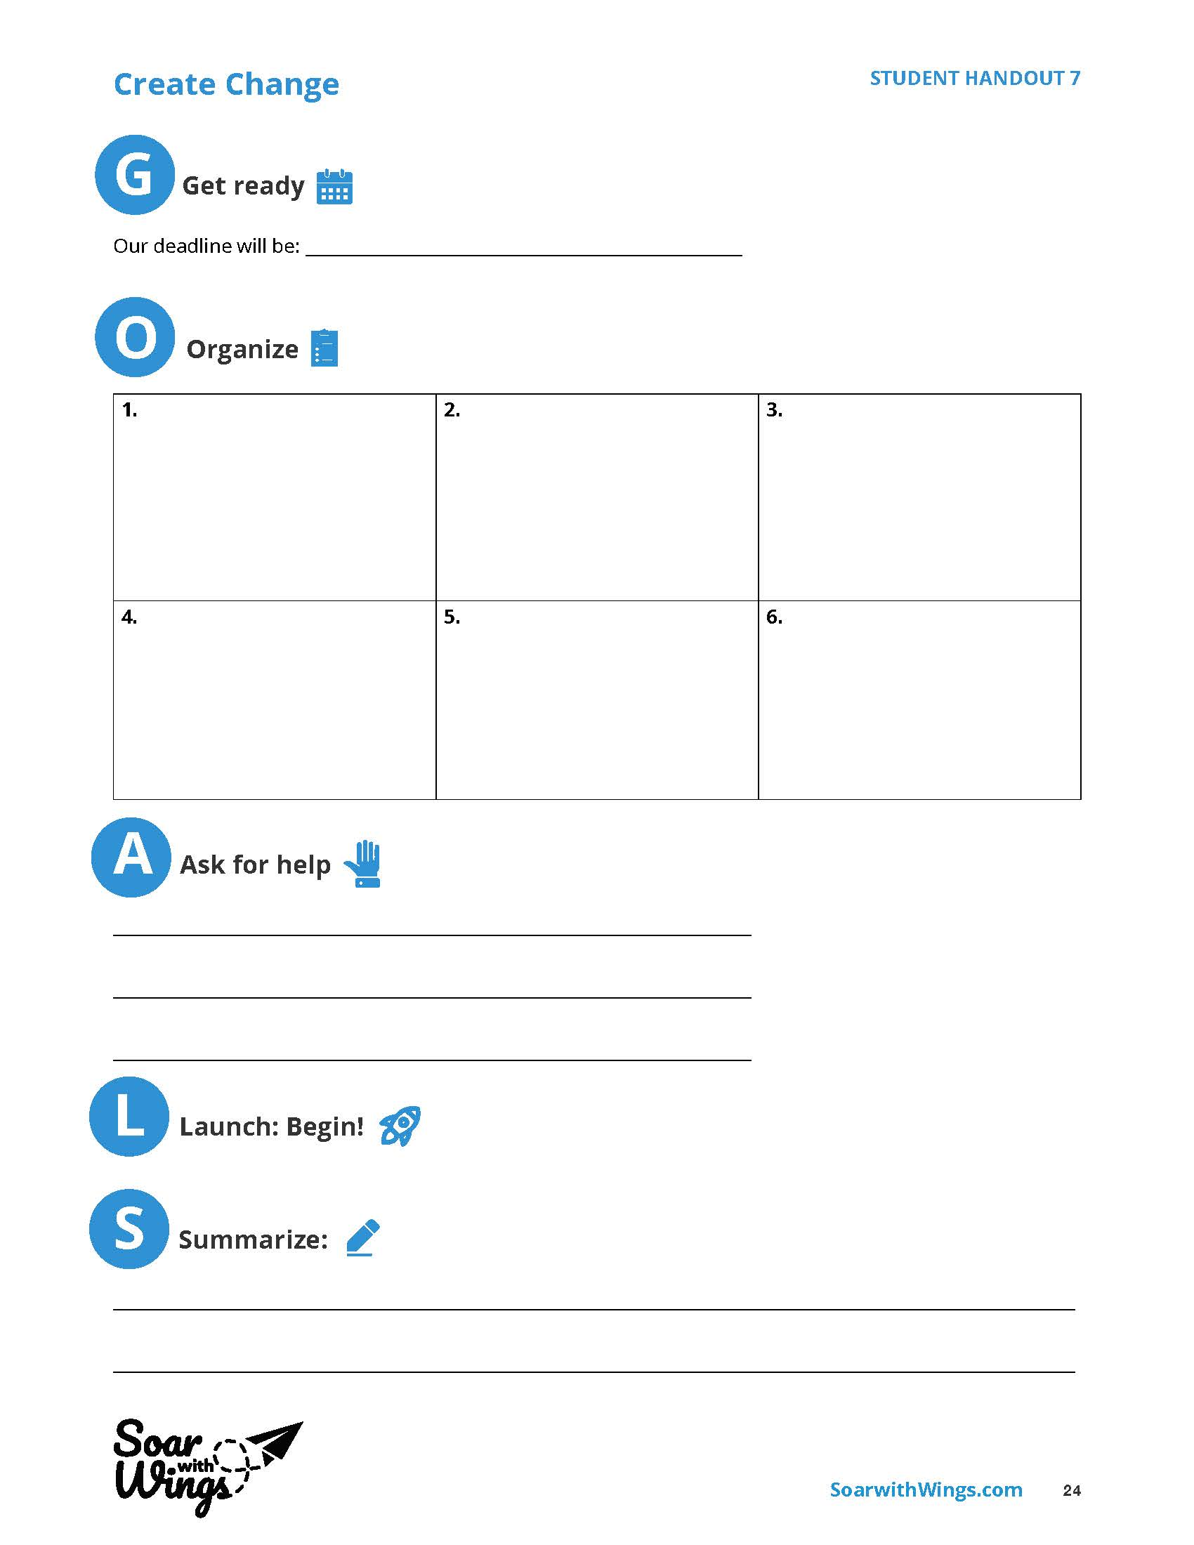
Notes:
Instructor Notes:
Once students have filled out their handouts, explain that they are about to create a plan for making one of these changes happen.
As a whole group, choose one of their change ideas that they think will make their community more beautiful.
*Tip: Before making a selection, explain that you will help share examples for each step they might use in the process.
Pass out one Handout 7: Create Change to each student.
Explain that one way to make change happen is to reach for one’s goals. When students want to be successful and create change, it’s the small steps that count. When these small steps combine, they transform into big changes.
Click once to reveal “Get Ready.”
Explain that before any change can take place, students must be ready for it.
One way to do this is to choose a deadline. When you know you have to accomplish something by a certain date, you are more motivated to achieve it.
Give the following example:
If my goal is to have our class eat lunch outside with other classes so everyone can meet someone new, I think I would be ready to schedule it in two weeks.
Depending on the ability level of your students, you may have them choose a specific date, a month, or a season (e.g., by this winter) for their deadline or you can set a date together by which all goals will be achieved.
Guide students through writing this deadline in the space provided.
Then click to reveal “Organize.”
Explain that there are many smaller things you have to do in order to make a big change.
Ask: What are some of the smaller things that would need to happen in order to make the big change occur?
Then share the following example:
If our goal is to create space and time for our grade level to eat outside to meet other students, I would have to complete the following steps:
Inform parents of the change
Find a good space outside
Find someone to help move tables or sitting area outside
Create ways for students to start talking
Give groups a few minutes to write or draw their own smaller steps in the squares provided.
Then click again and tell students to “Ask for help.”
Explain that no one is expected to create change alone. It always makes sense to ask others for help. Whether it’s a teacher who you know cares about your cause or a community member who has some talent that you could use, you’ll be able to accomplish more together.
Share the following example:
If I am creating a space outside for classes to ear, I might ask the following people for help:
A teacher who can help us organize
An administrator to make sure it is okay to eat outside
A parent who can help us decorate
Encourage students to make a list of all the people they would like to ask for help.
Finally, click once more. Read through the last two categories and explain that these actions won’t happen until all the planning is done.
At this point, they should “Get Moving” and start working on a timeline of smaller steps that they brainstormed. Then, when their project plan and timeline is complete, they should “Summarize” their work by looking back at everything they planned and consider what they could do to make it even better.
It seems to me there should be a reference to the slide here.

Slide 21
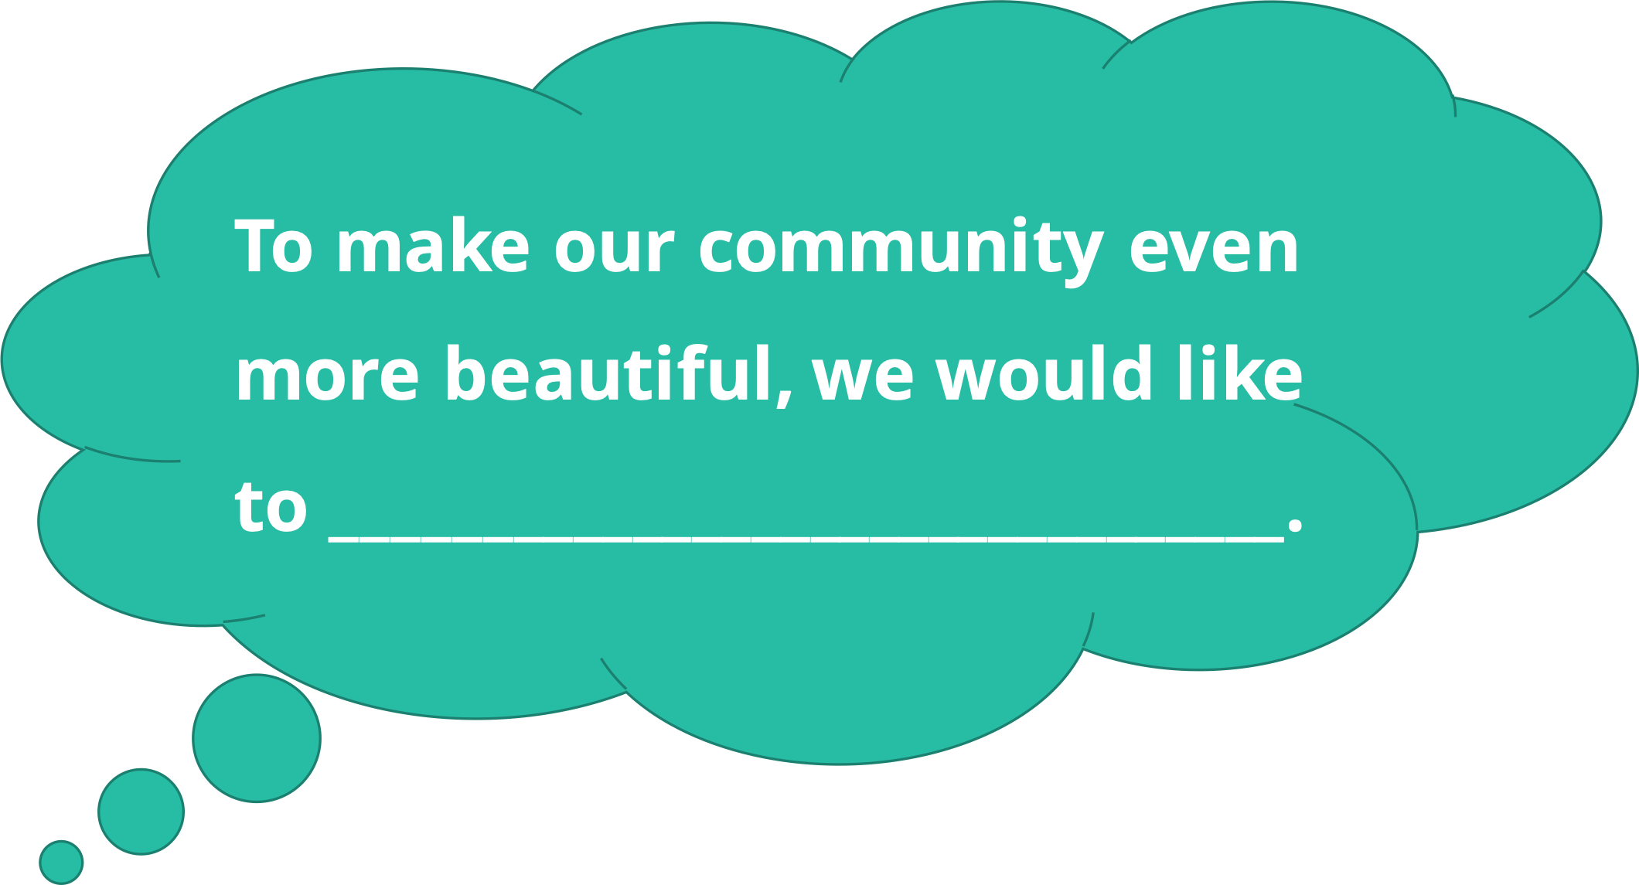
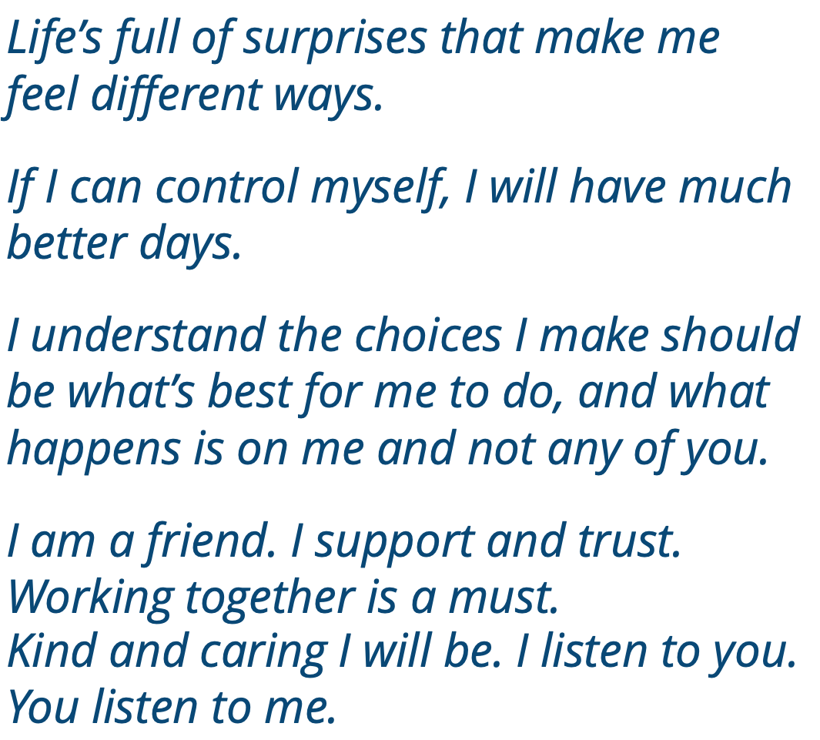
Notes:
Instructor Notes:
Wrap up by asking each group of changemakers to use the following sentence stem to present its ideas as you celebrate your school community together.
To make our community even more beautiful, we would like to _______________.
When the sharing is complete, acknowledge the work students have done to learn how to control their own behavior, make decisions that positively impact those around them, and appreciate and improve the community in which they live.
Conclude by asking the class to join you in reading the following lines from Words to Live By:
Life’s full of surprises that make me feel different ways.
If I can control myself, I will have much better days.
I understand the choices I make should be what’s best for me to do, and what happens is on me and not any of you.
I am a friend. I support and trust. Working together is a must.
Kind and caring I will be. I listen to you. You listen to me

