Slide 1



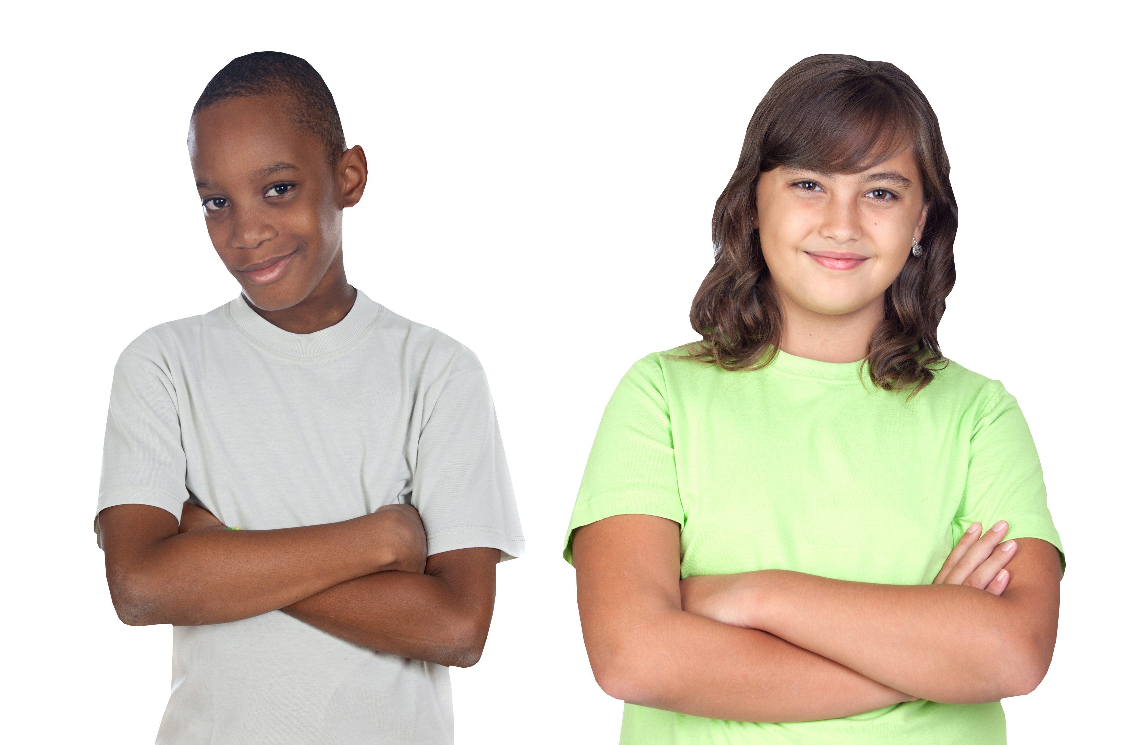

Slide 2
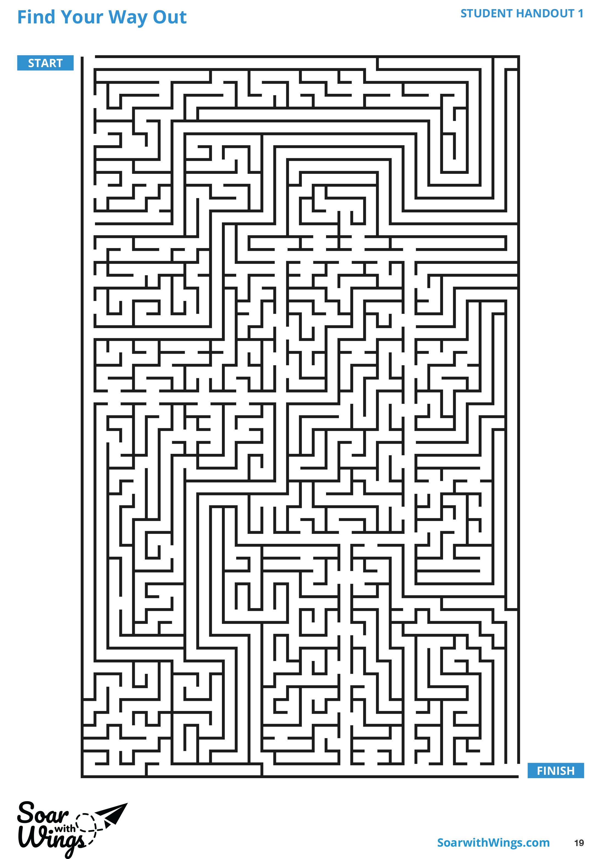
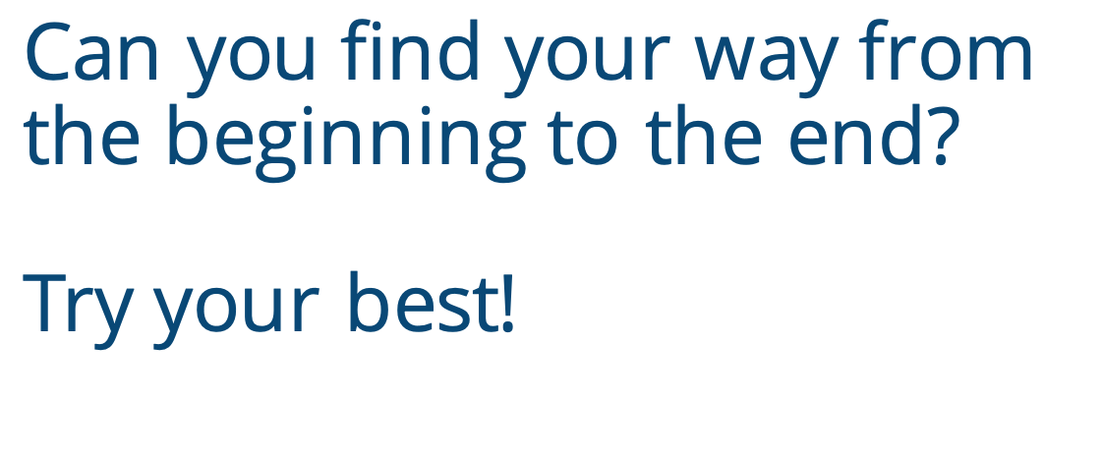
Notes:
Instructor Notes:
Instruct the class to grab a pencil and sit on the floor in a circle or semicircle. Join the students by sitting at their level.
Distribute Handout 1: Find Your Way Out to each student.
Challenge the class to independently find the path from Start to End. Instruct students who finish to first give you a thumbs up and then try to find an alternate route.
Once at least half the class has finished, tell the class to flip their sheets over and put their pencils down.
Ask students to demonstrate through a show of hands: Who reached a dead end while they were trying to find their way out?
Then ask students to demonstrate through a show of fingers: If you had to take a guess, how many times did you have to turn around?

Slide 3
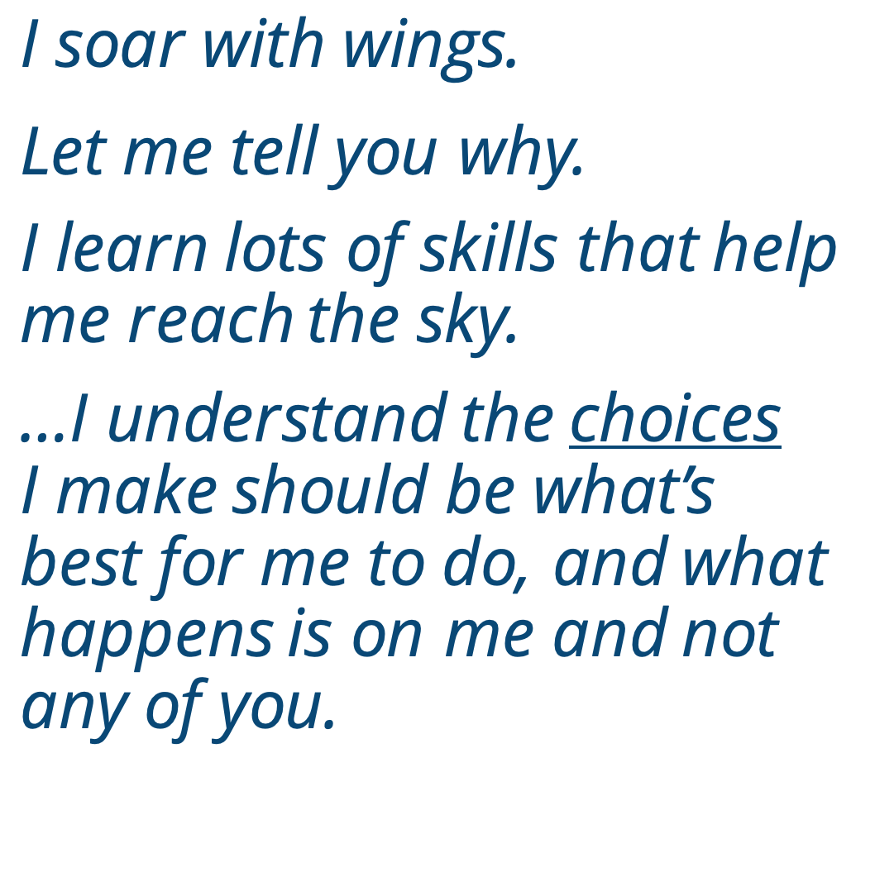
Notes:
Instructor Notes:
Read the following Words to Live By excerpt aloud:
I soar with wings.
Let me tell you why.
I learn lots of skills that help me reach the sky.
…I understand the choices I make
should be what’s best for me to do,
and what happens is on me and not any of you.
Click once and connect the definition of a choice to the maze activity by leading a class discussion around the following questions:
What emotions did you feel when you came to the first dead end? How about the second or third one?
When you reached a dead end, what choices did you have? What choice did you make?
For those who completed the maze: How did you feel when you reached the end?
For those who haven’t finished yet: How do you feel? Do you want to keep trying?

Slide 4
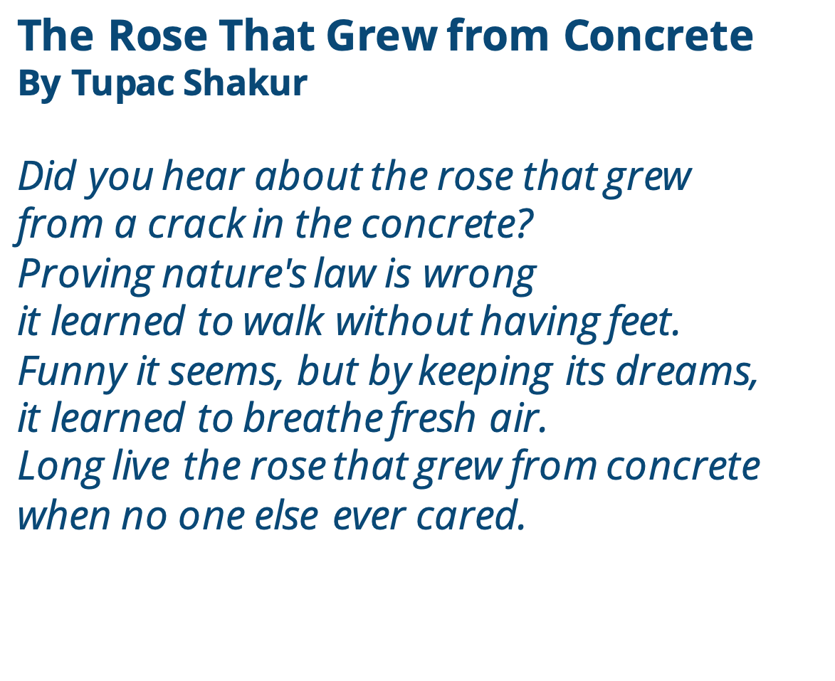
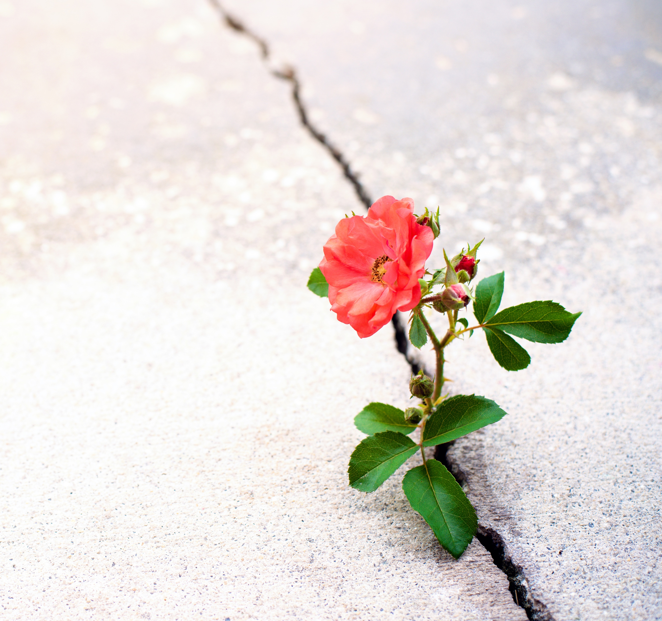
Notes:
Instructor Notes:
Explain that you are about to read a poem together called The Rose That Grew from Concrete by Tupac Shakur. Explain that Tupac was a famous rapper who also wrote a book of poetry.
Ask students to follow along as you read the poem aloud:
Did you hear about the rose that grew
from a crack in the concrete?
Proving nature's law is wrong
it learned to walk without having feet.
Funny it seems, but by keeping its dreams,
it learned to breathe fresh air.
Long live the rose that grew from concrete
when no one else ever cared.
Once you have read it aloud, ask students to read it quietly to themselves one more time.
Then help students deconstruct the poem’s meaning with questions like:
What is meant by “nature’s law?” How did the rose prove it wrong?
How is a rose growing through concrete like walking without having feet?
Why/how was the rose able to grow and breathe fresh air?
Once students seem to understand the gist of the poem, lead the class in understanding the poem’s deeper meaning with questions like:
What connections can you make between the rose’s situation and how you felt when you were working on the maze?
Have you ever been in other situations where you ever felt like you were going to fail? What “concrete” did you have to work through?
What choice did both you and the rose make in order to succeed?
Explain that in order to succeed, they all made a decision to be determined, persevere, and not give up!

Slide 5
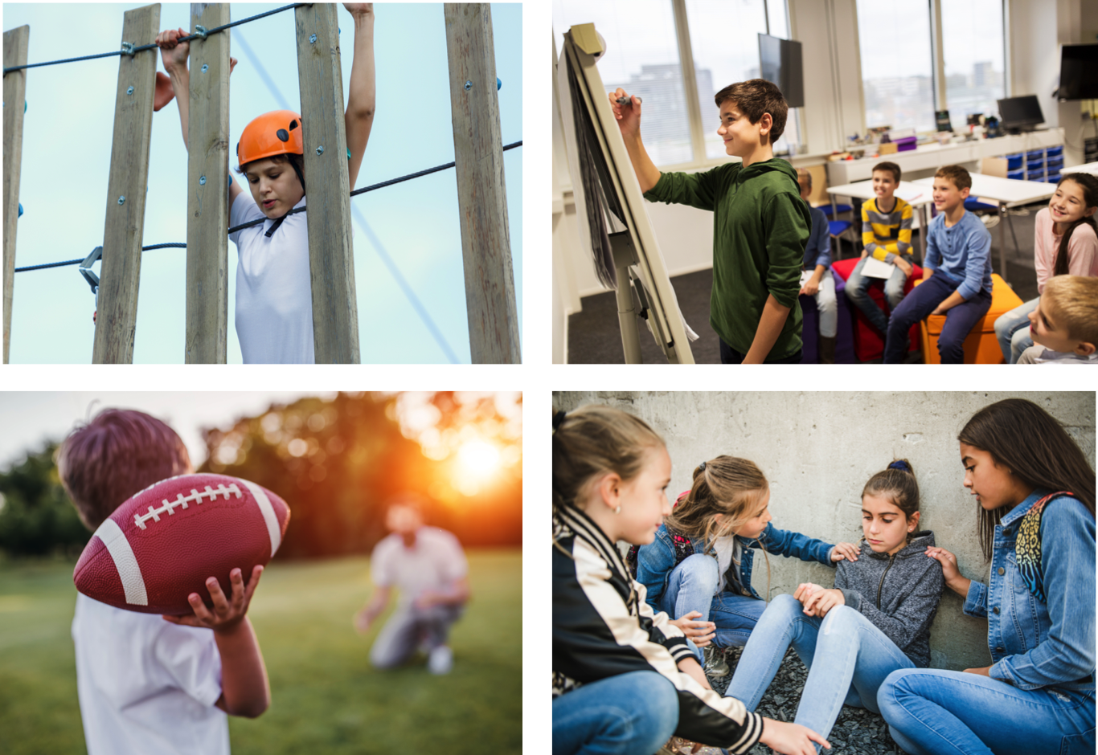
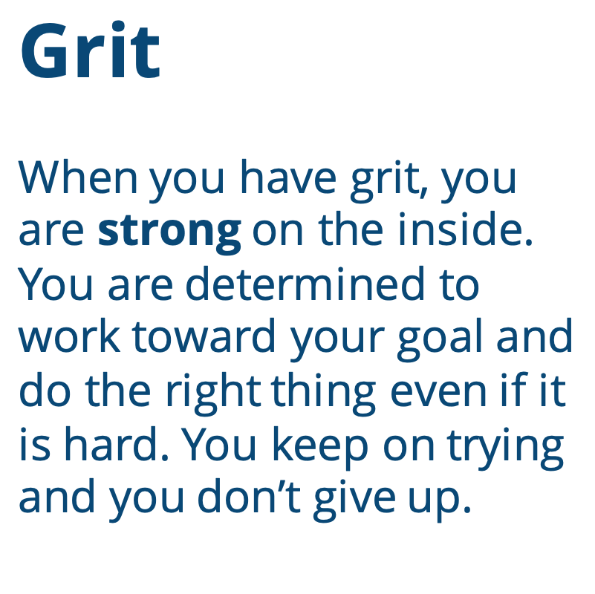
Grit
When you have grit, you are strong on the inside.
You are determined to work toward your goal and do the right thing even if it is hard. You keep on trying and you don’t give up.
Notes:
Instructor Notes:
Point to the word “strong” on the slide and ask students to share with the person next to them: What does it mean to be strong?
Follow up by asking students to share with the class: Was the rose strong? Why or why not?
Be sure students understand that while being physically strong is one way to be strong, being strong on the inside is another important kind of strength.
Tell the class that they and the rose showed they were strong on the inside when they didn’t give up.
Then click twice and introduce students to the word Grit.
Explain that when you have grit, you are strong on the inside. You determined to work toward your goals and do the right thing even if it is hard. You keep on trying and you don’t give up.

Slide 6
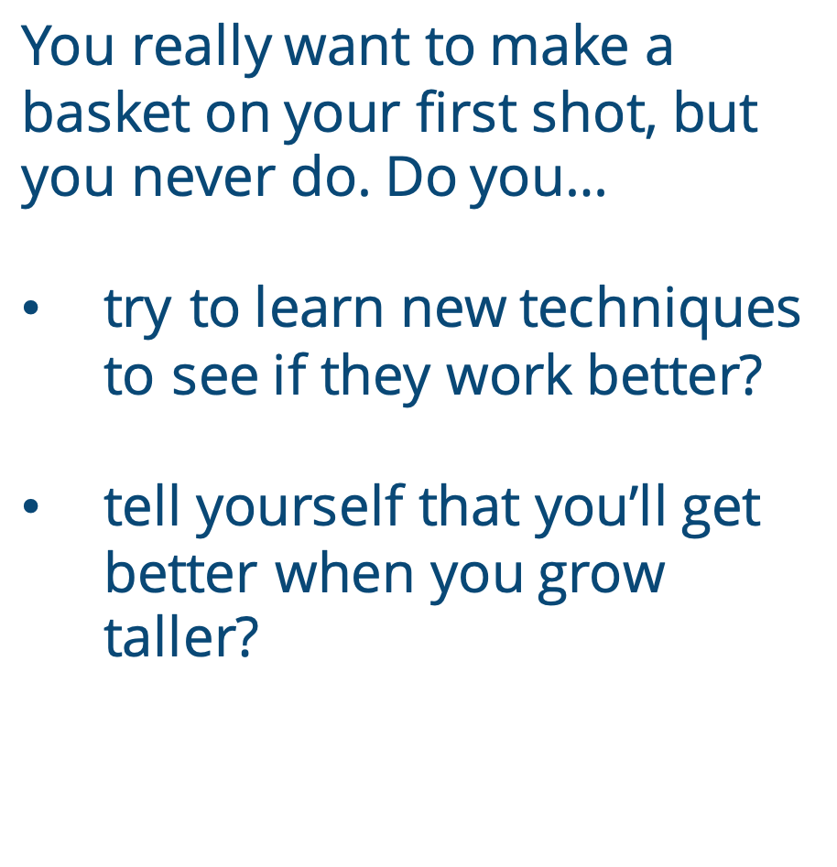
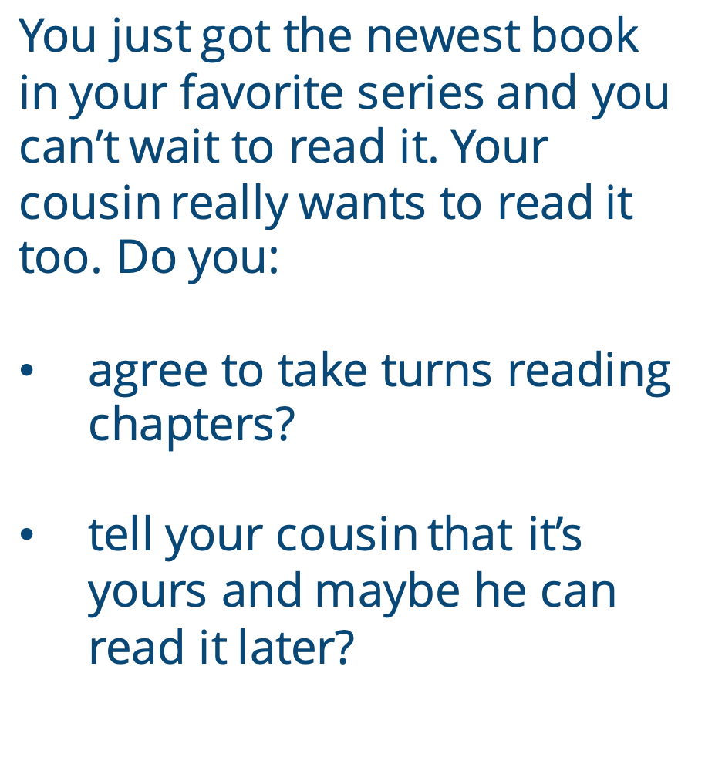
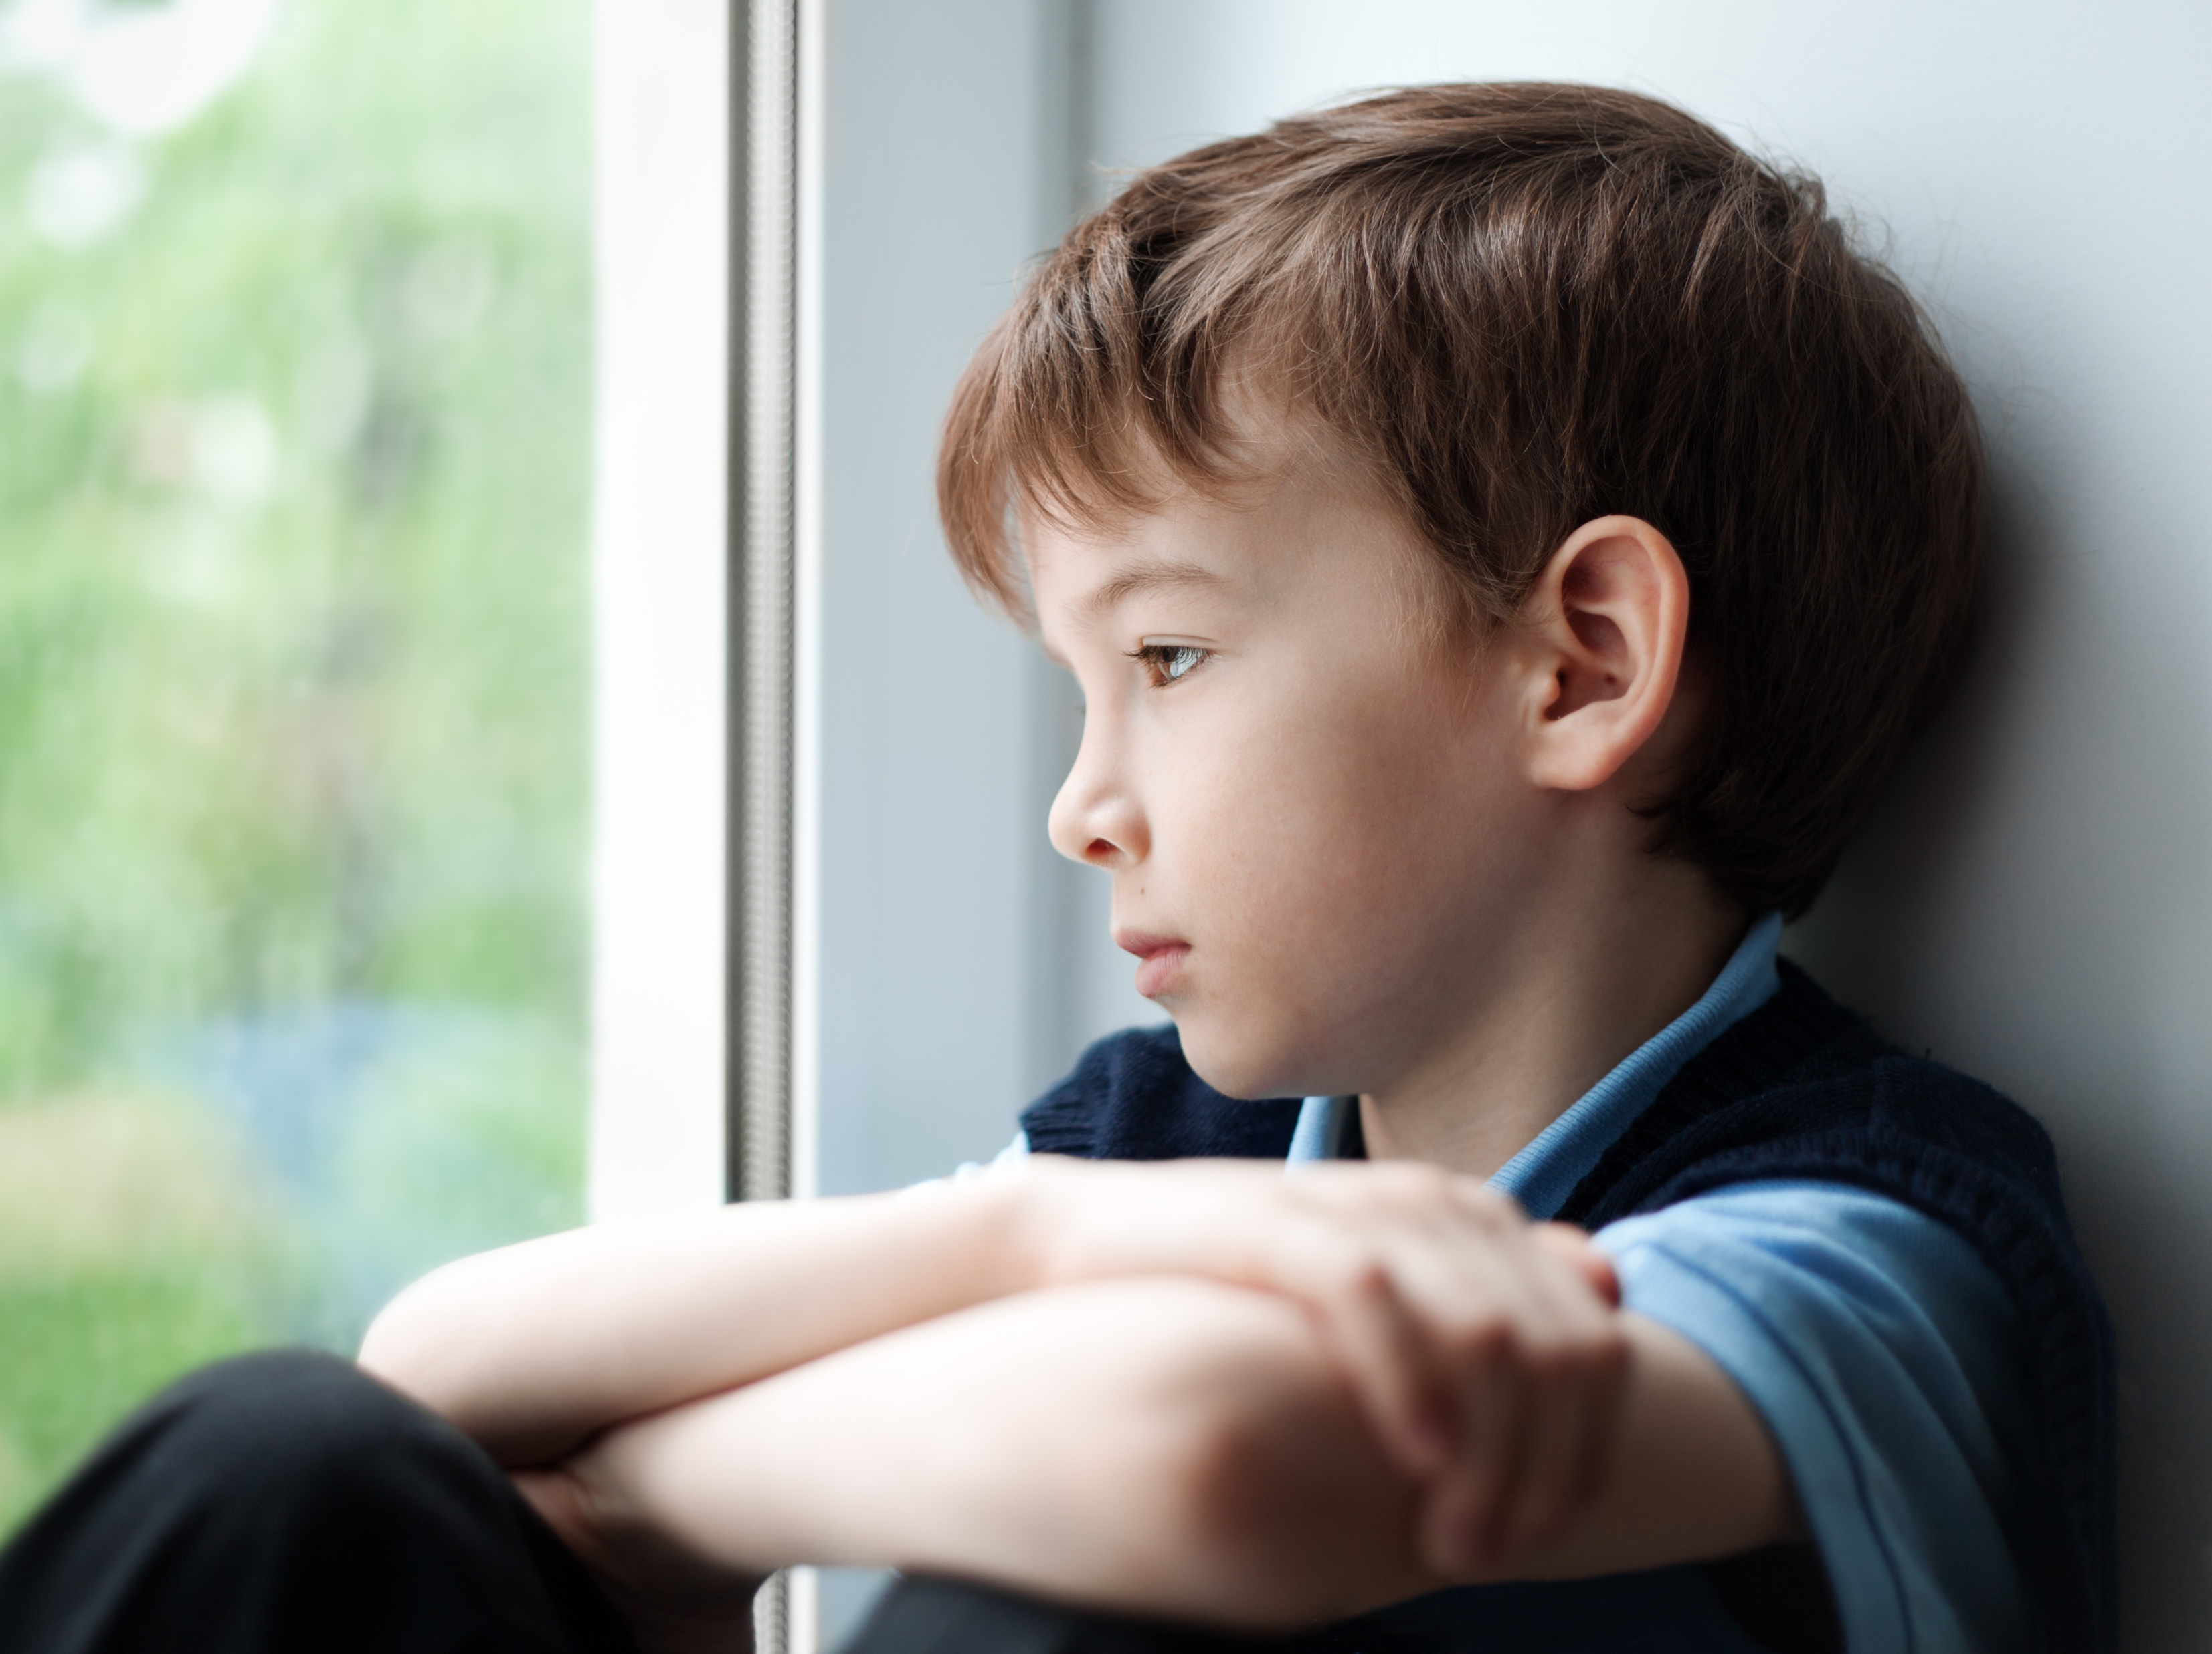
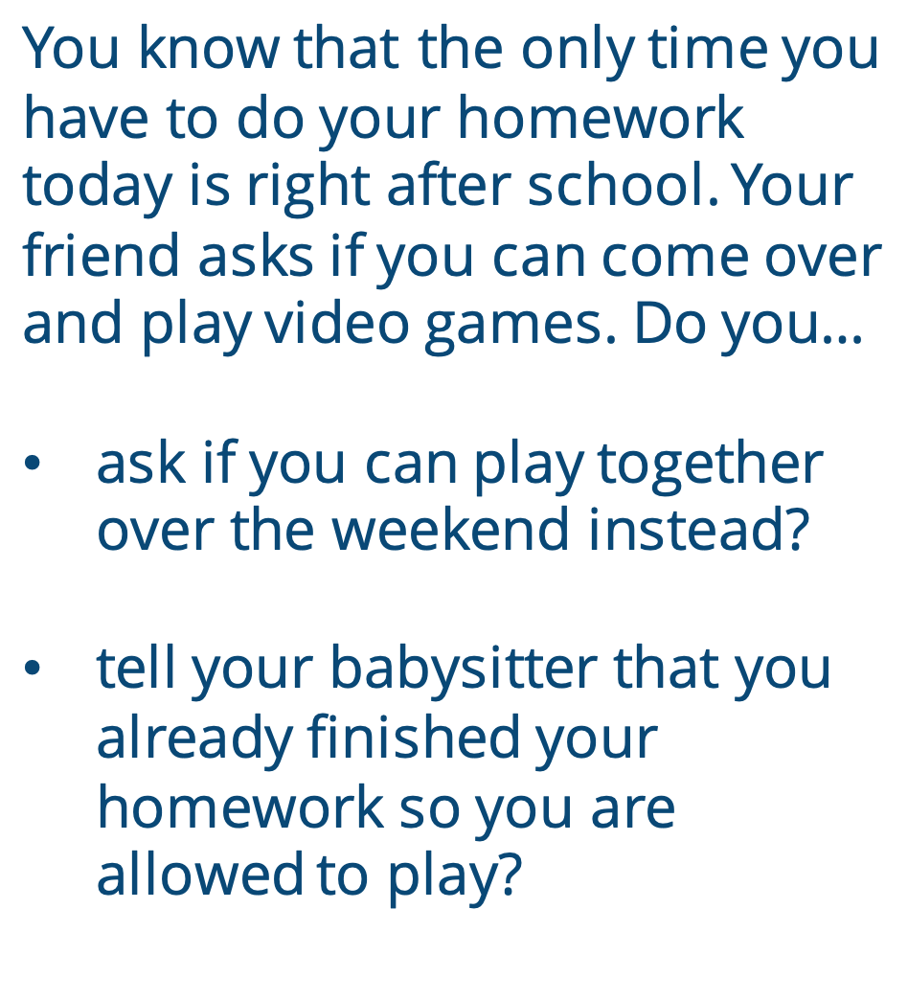


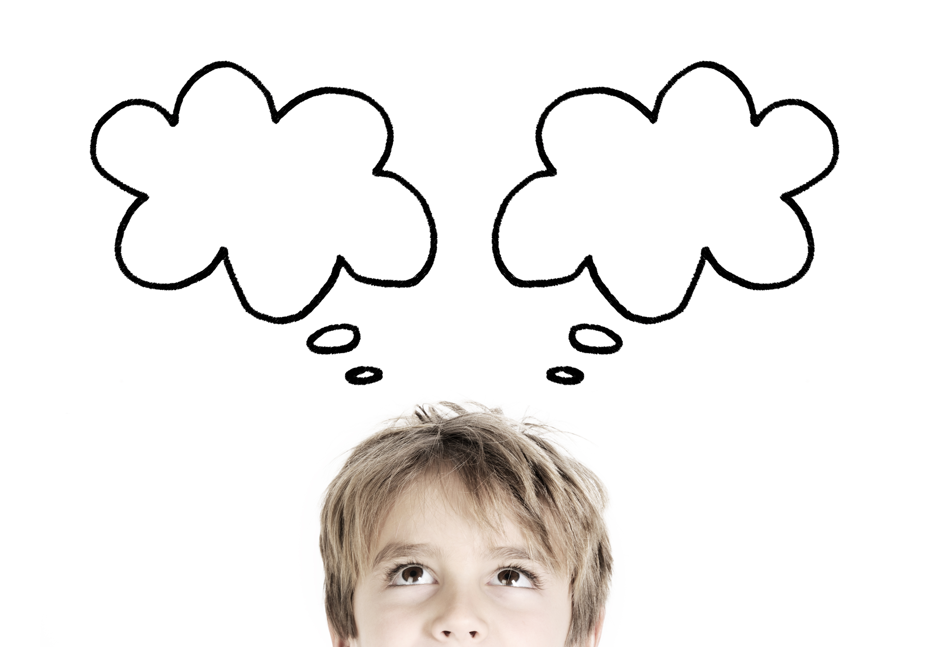
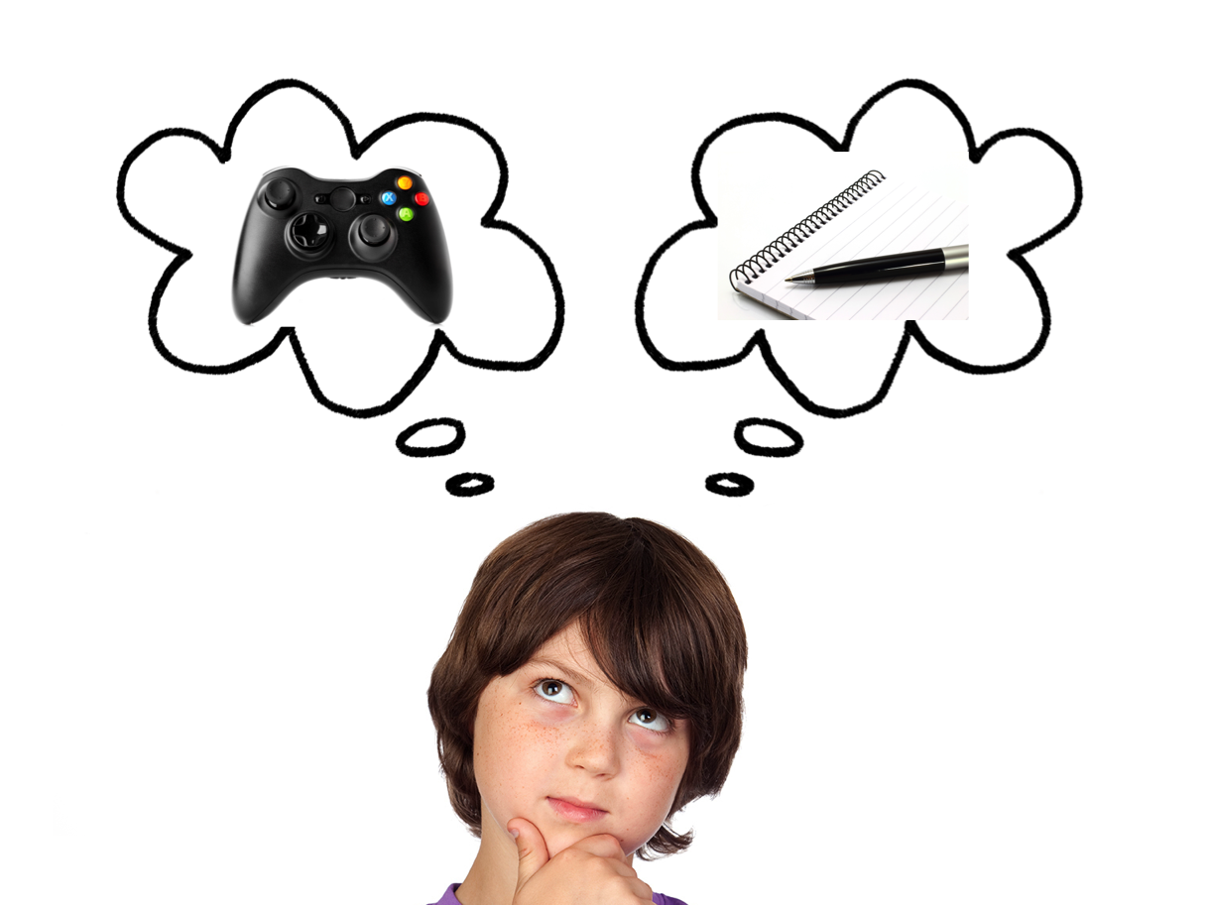


You really want to make a basket on your first shot, but you never do. Do you…
try to learn new techniques to see if they work better?
tell yourself that you’ll get better when you grow taller?
You just got the newest book in your favorite series and you can’t wait to read it. Your cousin really wants to read it too. Do you:
agree to take turns reading chapters?
tell your cousin that it’s yours and maybe he can read it later?
You know that the only time you have to do your homework today is right after school. Your friend asks if you can come over and play video games. Do you…
ask if you can play together over the weekend instead?
tell your babysitter that you already finished your homework so you are allowed to play?
Notes:
Instructor Notes:
Tell the class that when you have to make a choice, one choice may seem easier than the other.
Ask: If you spill your milk, would it be easier to clean it up or just ignore it?
Explain: Even though it may be easier to ignore the spilled milk, it is not the right choice for you or for those around you! If you have grit and are determined to do the right thing, you will help clean up the milk even if it’s not fun.
Next, divide the class into pairs.
Once every student has a partner, split the class in half with an imaginary line. (Be sure to keep all pairs in the same group.)
Tell students:
They are about to hear about a few imaginary situations that each have different choices.
Partners on one side of the line (point to the right half of the class) will be in charge of discussing which choice would be the right choice for them to make.
Partners on the other side of the line (point to the left side of the class) will be in charge of discussing which choice may be the hardest choice and need the most grit and inner strength to actually do.
Click twice to read the first situation and the two choices. Encourage pairs to discuss which choice is right or which choice is harder and requires more inner strength.
Then explain that you are going to read the choices a second time. As you do:
The pair in charge of choosing the right choice should hold two thumbs up above their heads when you read this choice.
The pair in charge of choosing the choice that requires the most inner strength should tap their hearts when you read this choice.
Encourage students to look around and observe their peers’ responses.
Ask at least one pair on each side to describe:
How did you know this was the right choice?
Why would this require the most grit and inner strength?
Then click twice to reveal a new scenario, and repeat the activity for a total of three times.

Slide 7


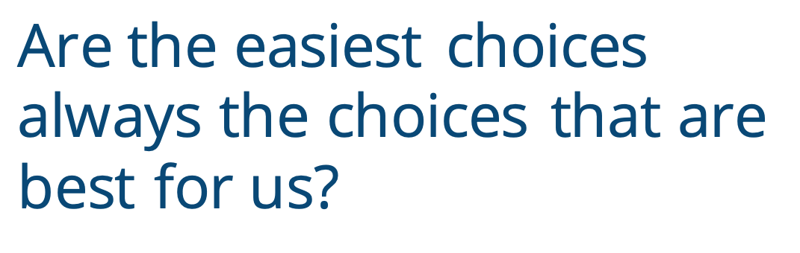
Notes:
Instructor Notes:
Ask students to reflect on the activity and think-pair-share*: Are the easiest choices always the choices that are best for us?
* In a think-pair-share, students think about the question independently, discuss their answers with a partner, and then share their thoughts with the larger class.
Ensure students understand that the choice that is right for us may not always be the easiest. However, when we have grit and are determined to be the best person we can be, we use our inner strength to help us do the right thing!

Slide 8

Notes:
Instructor Notes:
Wrap up the day’s session by bringing students’ attention to the Grit Bulletin Board. Tell the class that this board will be used to recognize when the students exhibit inner strength and make the right choices.
Encourage students to brainstorm some of the ways that they show or have shown they have grit and inner strength.
It may be helpful to kick off the brainstorming by sharing something you are determined to achieve and the hard choices you must make to reach this goal. For instance:
“I want to learn how to speak Spanish. I show I have grit when I choose to study Spanish instead of watching TV.”
“I want to be a good friend. I show I have grit when I choose to stand up for someone who is being teased.”
Pass out Handout 4: Grit Reflections to each student and explain that this handout is designed to look like a mirror because the activity will require self-reflection. Since no one better understands a person’s inner strength than him- or herself, the students will describe on the handout a time when they used their grit and inner strength to make a good decision.
On the handout, show the students where they will describe the choice that required grit and where they will illustrate this decision. Encourage them to explain why the choice was difficult.
Move around the classroom as students work, guiding anyone who needs assistance.
As students finish, instruct them to cut out their mirrors and fasten them to the bulletin board.
Conclude the session showing the students Handout 5: Grit Sighting and reviewing its instructions. Explain that students can use this handout to recognize their peers’ inner strength. Show students where you will keep a stack of the handout’s “I see grit … ” glasses, and encourage students to continue adding to the bulletin board whenever they see someone else make a hard decision that is worthy of a special callout!

Slide 9

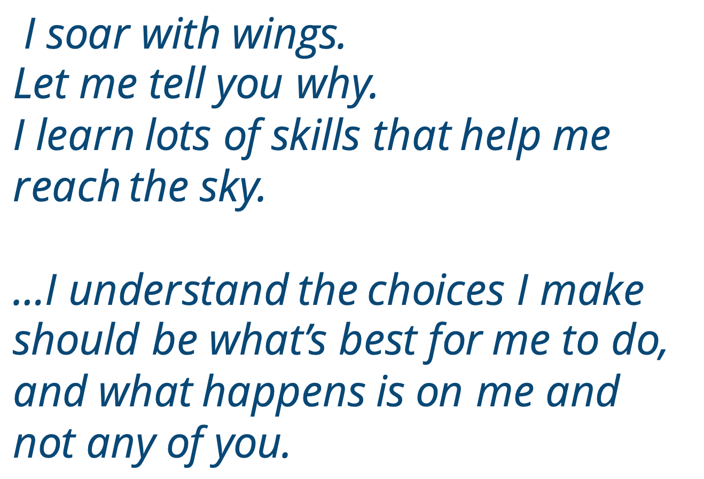
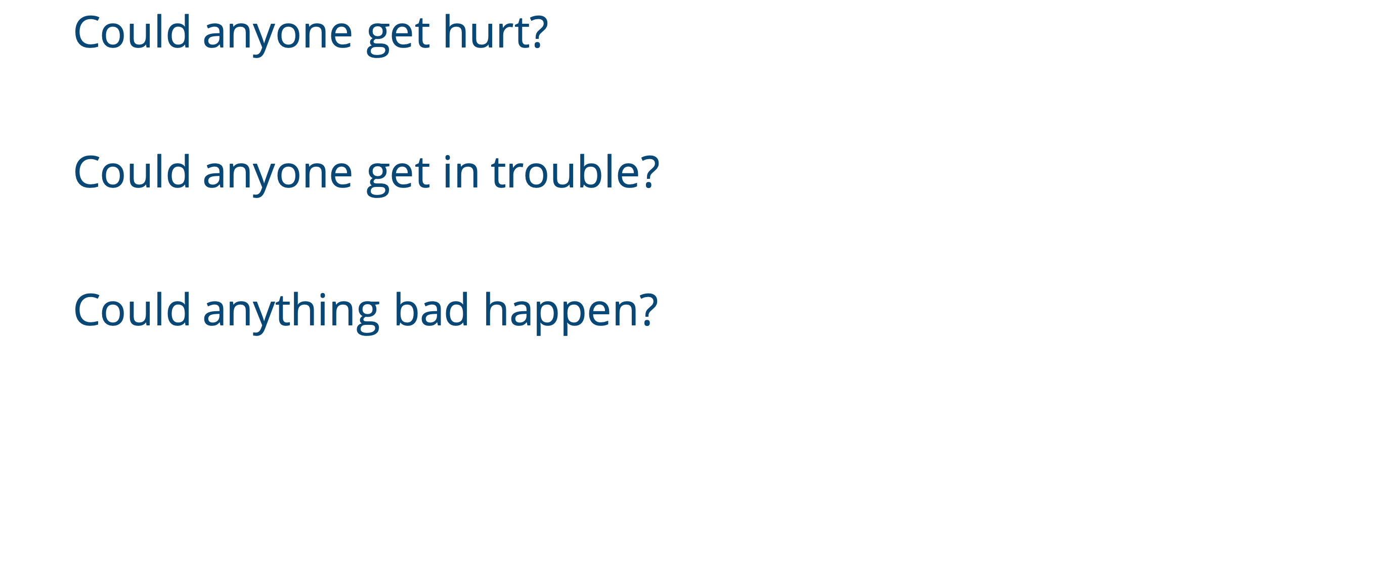
Yes Mess
I soar with wings.
Let me tell you why.
I learn lots of skills that help me reach the sky.
…I understand the choices I make
should be what’s best for me to do,
and what happens is on me and not any of you.
Notes:
Instructor Notes:
Begin by asking the class to sit on the floor in a circle or semicircle and join the students by sitting at their level.
Call on a student volunteer to read the following Words to Live By excerpt aloud:
I soar with wings.
Let me tell you why.
I learn lots of skills that help me reach the sky.
… I understand the choices I make
should be what’s best for me to do,
and what happens is on me and not any of you.
Summarize the last session by explaining that the students learned that making the right decision is not always easy. Sometimes, it takes grit and inner strength to choose the right choice!
Ask the students: How do we know if we are making the right choice?
Click twice and go on to review or explain the idea of a Yes Mess. This strategy was introduced during the 3-5 Time to Play digital lesson bundle.If you have already completed this lesson bundle, click three times.
Then read the Yes Mess questions aloud and invite students to describe to a partner how they can use these questions to make good choices.
If you have not completed this lesson bundle, explain that the Yes Mess questions are three easy questions that people can always ask themselves to help them make the choice that is right for them.
Click three times to display each of the following questions:
Could anyone get hurt?
Could anyone get in trouble?
Could anything bad happen?
Explain that if they can answer “yes” to any of these questions, they have a Yes Mess—which means that it is not the best choice for them!

Slide 10

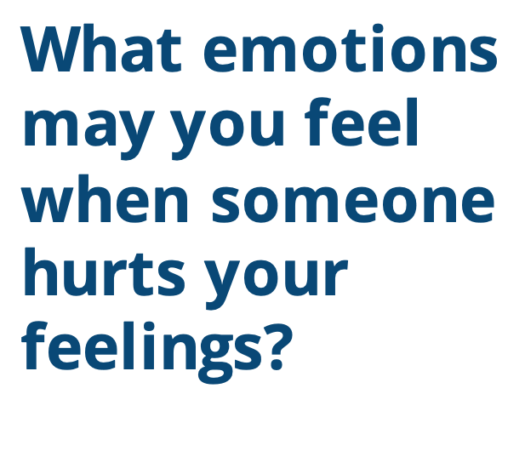
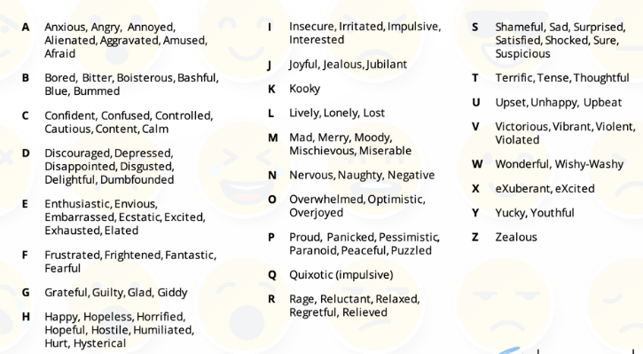
Yes Mess: Can anyone get hurt?
What emotions may you feel when someone hurts your feelings?
Notes:
Instructor Notes:
Elaborate on the Yes Mess question: Can anyone get hurt?
Explain:
“Anyone” refers to both ourselves and others.
“Hurt” refers to all kinds of hurt—both physical and emotional.
When we are hurt physically, our bodies are hurt. Our bodies can get hurt even when we are strong on the outside.
When we are hurt emotionally, our feelings are hurt. Our feelings can get hurt even when we are strong on the inside.
Tell the class that when our feelings are hurt, we may feel many different kinds of emotions.
Click twice and ask students to silently reflect: What emotions might you feel when someone hurts your feelings?
Click again to review the Alphabet Emotion List. Students will be familiar with this list if they have already completed the 3-5 Read All About It digital lesson bundle.
Encourage students to read through the list and pick out at least two emotions that they may feel when their feelings are hurt.
Invite them to share one emotion with someone on one side of them and the other emotion with someone on the other side of them.
Pass out one Handout 6: Emotions that Hurt to each student and read the instructions provided.
Allow students a few minutes to find a comfortable spot and journal about these emotions.
Then bring the class back together and summarize the activity by sharing:
When we are hurt, we can feel all different kinds of negative emotions.
This is one important reason to avoid a Yes Mess. We don’t want to make choices that may cause us or others to feel this way!

Slide 11
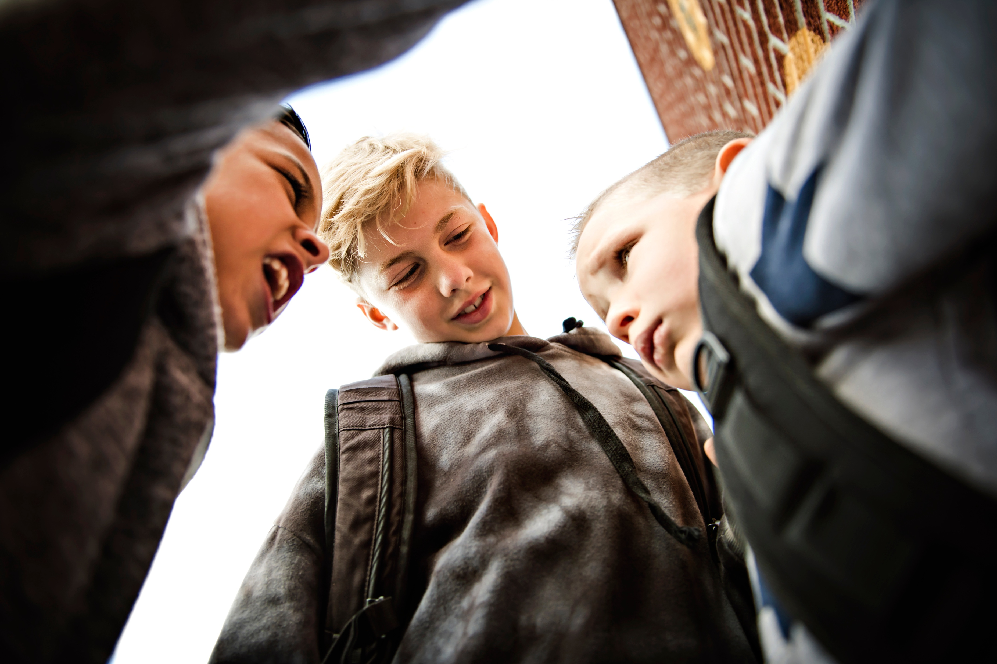
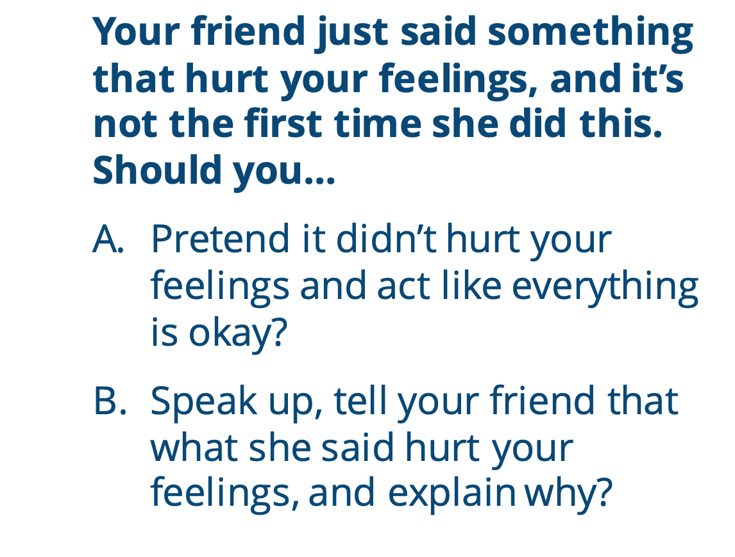
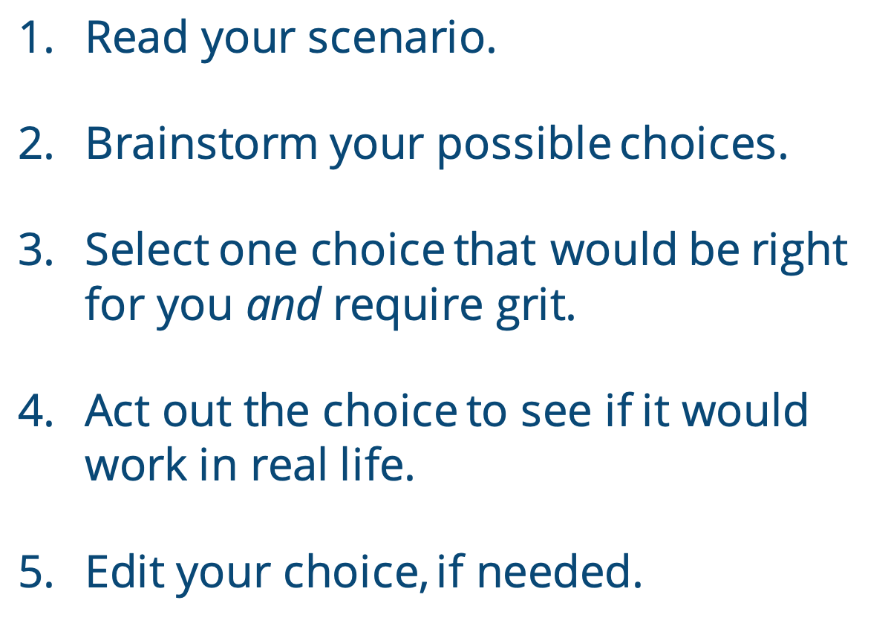
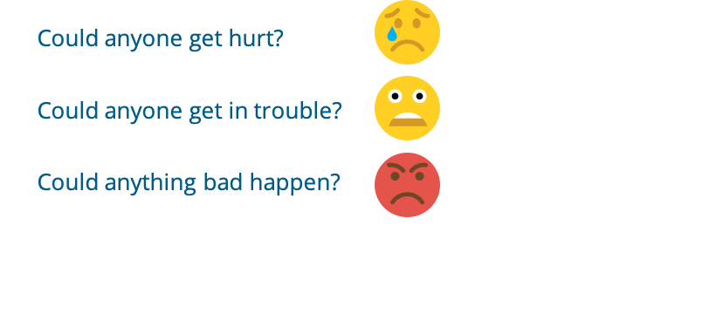
  Your friend just said something that hurt your feelings, and it’s not the first time she did this. Should you…
  Pretend it didn’t hurt your feelings and act like everything is okay?
  Speak up, tell your friend that what she said hurt your feelings, and explain why?
Read your scenario.
Brainstorm your possible choices.
Select one choice that would be right for you and require grit.
Act out the choice to see if it would work in real life.
Edit your choice, if needed.
Notes:
Instructor Notes:
Click to display and read the following scenario: Your friend just said something that hurt your feelings, and it’s not the first time she has done this. Should you
A. Pretend it didn’t hurt your feelings and act like everything is okay?
B. Speak up, telling your friend that what she said hurt your feelings and explaining why?
Click again and bring students’ attention back to Choice A.
Ask students to keep this choice in mind as you read through each of the Yes Mess questions.
Instruct students to jump up as you read the questions and remain standing if they would answer yes.
Ask the class to observe how many students are standing once all three questions are read, and then instruct everyone to sit back down.
Repeat the same activity for Choice B.
Summarize:
Choice A may seem like a good option because it is easier. However, it will hurt you and create a Yes Mess!
Choice B is the best choice because it could prevent you from getting your feelings hurt in the future. It also may help your friend understand how you feel.
However, Choice B may also be the harder choice—because it means you must tell your friend how you feel. Therefore, in order to make this decision, you must have grit!
Next, divide students into pairs and distribute one scenario from Handout 7: Yes Mess Scenarios to each pair.
Click twice and explain that groups should
read their scenario
brainstorm possible choices
select one choice that would be right for them even if it is difficult
act out the choice to see if it would work in real life
edit their choice, if needed
As students are wrapping up, invite a couple groups to role-play their scenarios. As the class watches, ask the students to consider if there are any good choices the student could have made other than the one presented.

Slide 12
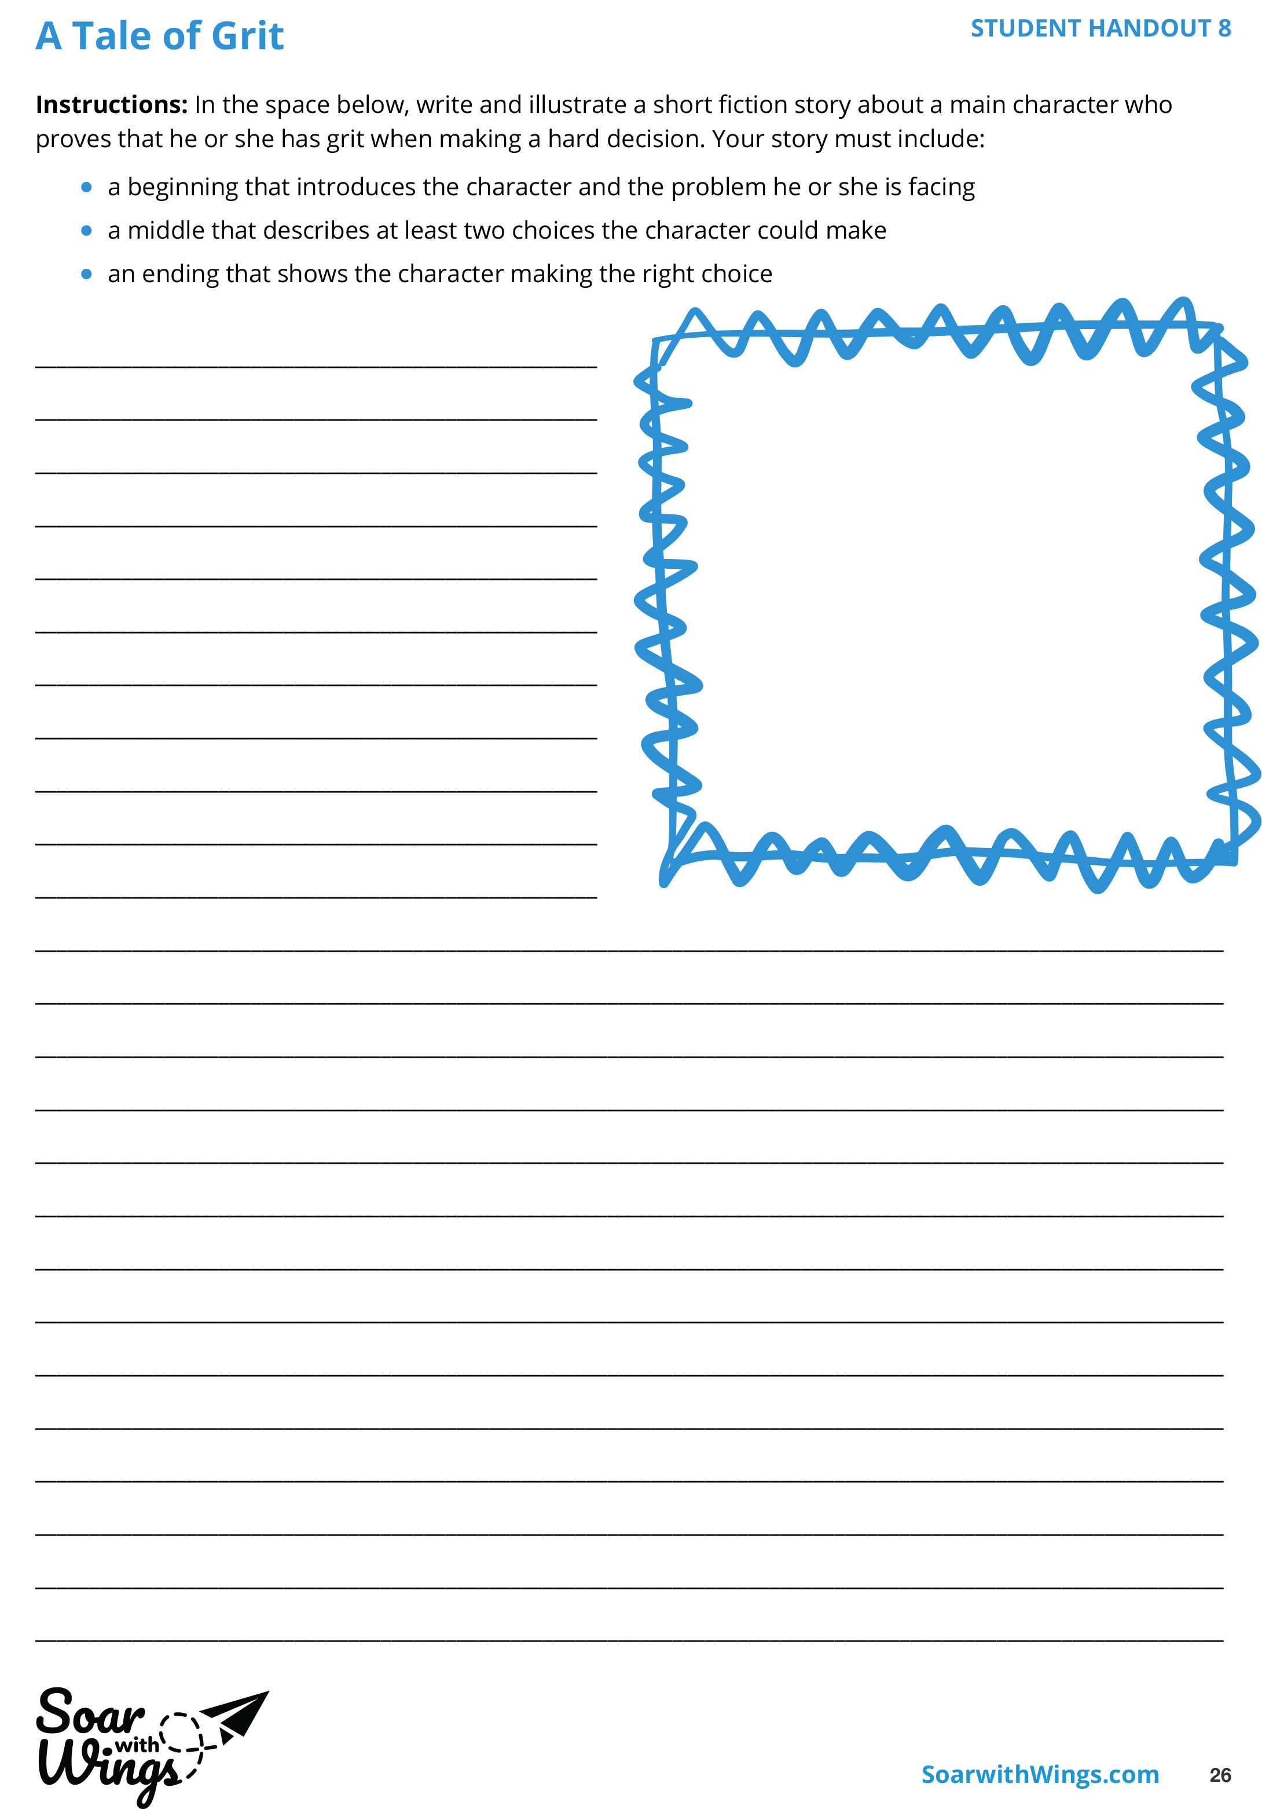

Notes:
Instructor Notes:
Bring students’ attention to the handout image on the screen and explain that they will now apply what they have learned about making good choices to write a short story about someone who exhibits grit and makes the right decision for him- or herself.
Distribute one Handout 8: A Tale of Grit to each student and review the directions. Explain that the story could be realistic fiction or fantasy, as long as it focuses on someone who has grit and makes a good choice.
Then deduct about 15 minutes from the end of the class session, explain that students will have that much time to work on their story, and encourage them to begin! If they don’t finish, they may finish for homework, during writing, or during another time that works well for your classroom.

Slide 13
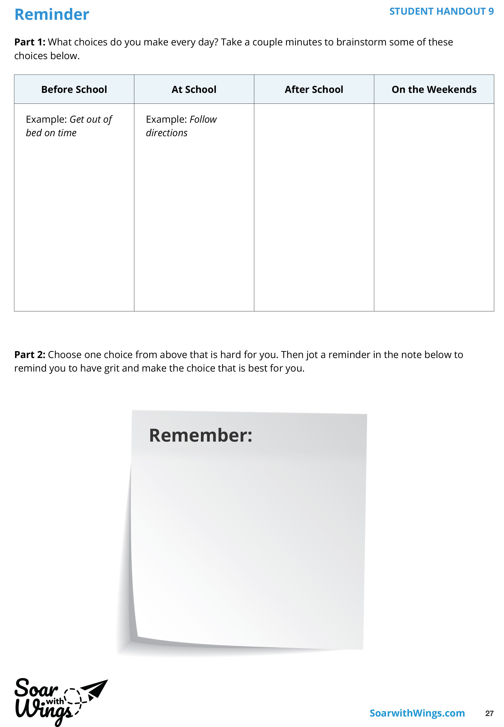
Notes:
Instructor Notes:
Once about 15 minutes are left in the session, tell the students that since they have thought a lot about others’ decisions today, it’s now time for each student to think for him- or herself!
Remind students that we cannot control the choices that others make; we can only control our own choices.
Wrap up the session by distributing one Handout 9: Reminder to each student.
Click once and review the two steps:
Explain that after brainstorming some of the choices they frequently have to make, they will create their own reminder to have grit and make the choice that is best for them.
Explain that the reminder could be anything: a symbol, a picture, a word, or a sentence—as long as it will remind each student to choose the best choice and not just the easiest one.
Tell students that they may brainstorm Part 1 with a partner if it would be helpful and then encourage them to begin.
At the end of the class session, instruct each student to cut out his or her reminder and secure it in a personal location where it will remind him or her to make positive choices in the future.

Slide 14
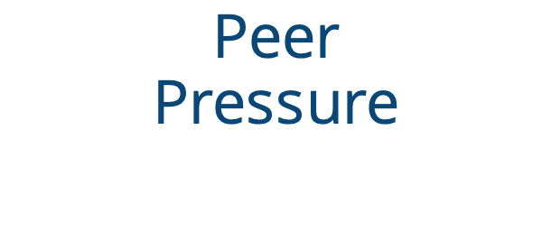
What’s your guess?
Peer
Pressure
Notes:
Instructor Notes:
Begin by asking the class to grab pencils and sit on the floor in a circle or semicircle. Join the students by sitting at their level.
Display the Guesstimate Container and encourage students to silently think about how many items are inside.
Then distribute a Take a Guess Strip (from Handout 10: Take a Guess Strips) to each student and lead students through their guesses:
Guess #1:
Encourage students to independently record their guess in the Guess #1 thought bubble without talking to their classmates.
Guess #2:
Divide students into groups of three or four.
Click once and tell the groups that they will have about two minutes to share their guesses with each other, select one of the guesses for their group guess, and record this number in the Guess #2 bubble. Explain that all members of the group must record the same number.
Next, click to display the term “peer pressure.”
Explain that peer pressure is when your classmates try to convince you to act or think a certain way.
Ask students to demonstrate through a show of hands if they experienced peer pressure when their group selected Guess #2.
Then ask: Are you happy with Guess #2? Encourage students to demonstrate their answer with a thumb up, thumb down, or thumb sideways (for so-so) gesture.
Follow up by asking a few students to explain:
Why do you feel this way about your group’s guess?
How did you feel when your group members tried to persuade you that their guess was best?
Guess #3:
Click twice and give students a moment to think for themselves and come up with their final guess: Guess #3. They should record this in the third thought bubble.
Ask students to explain by a show of fingers (1, 2, or 3) which guess they feel best about. Then ask a few students to explain why.
Explain that Guess #3 may feel like their best guess because everyone had the chance to speak with their peers and make a decision on their own—which is also the best way to deal with peer pressure. It’s good to learn about what your peers think, but you still need to make the choice that is best for you.
Wrap up by encouraging students to share their best guesses and then revealing the actual answer.

Slide 15
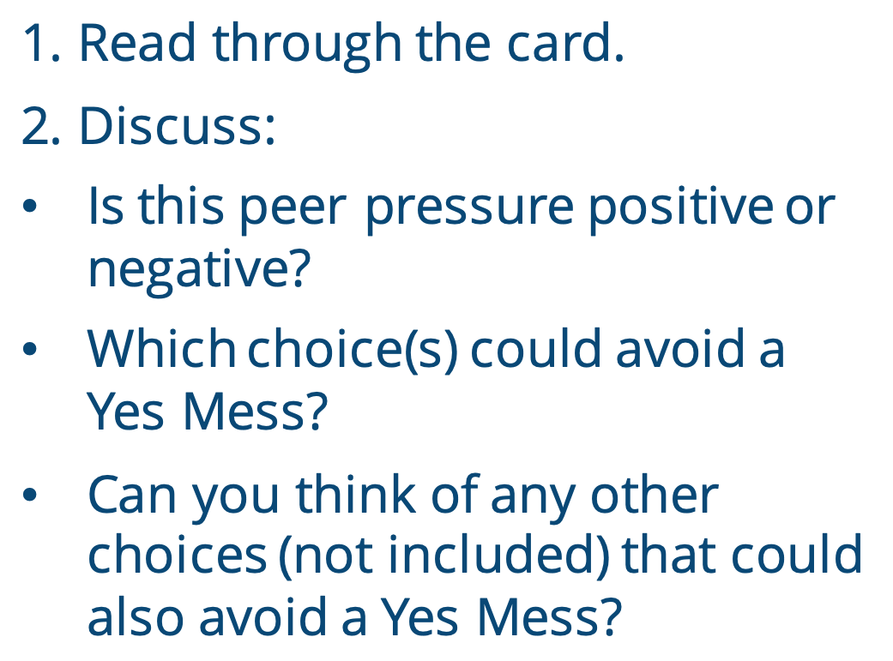
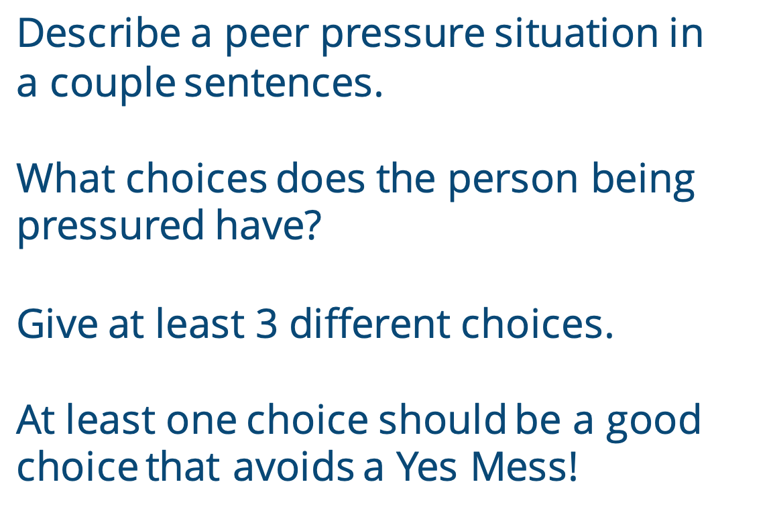
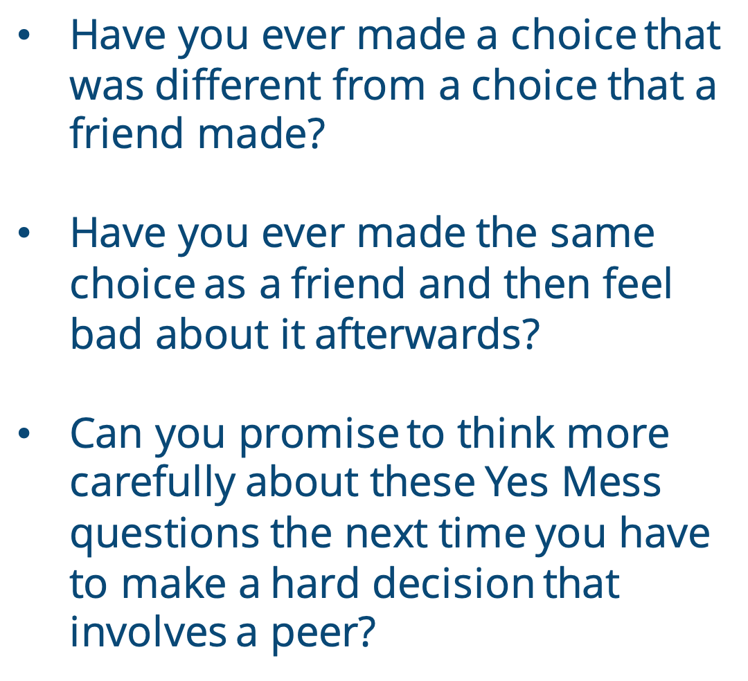
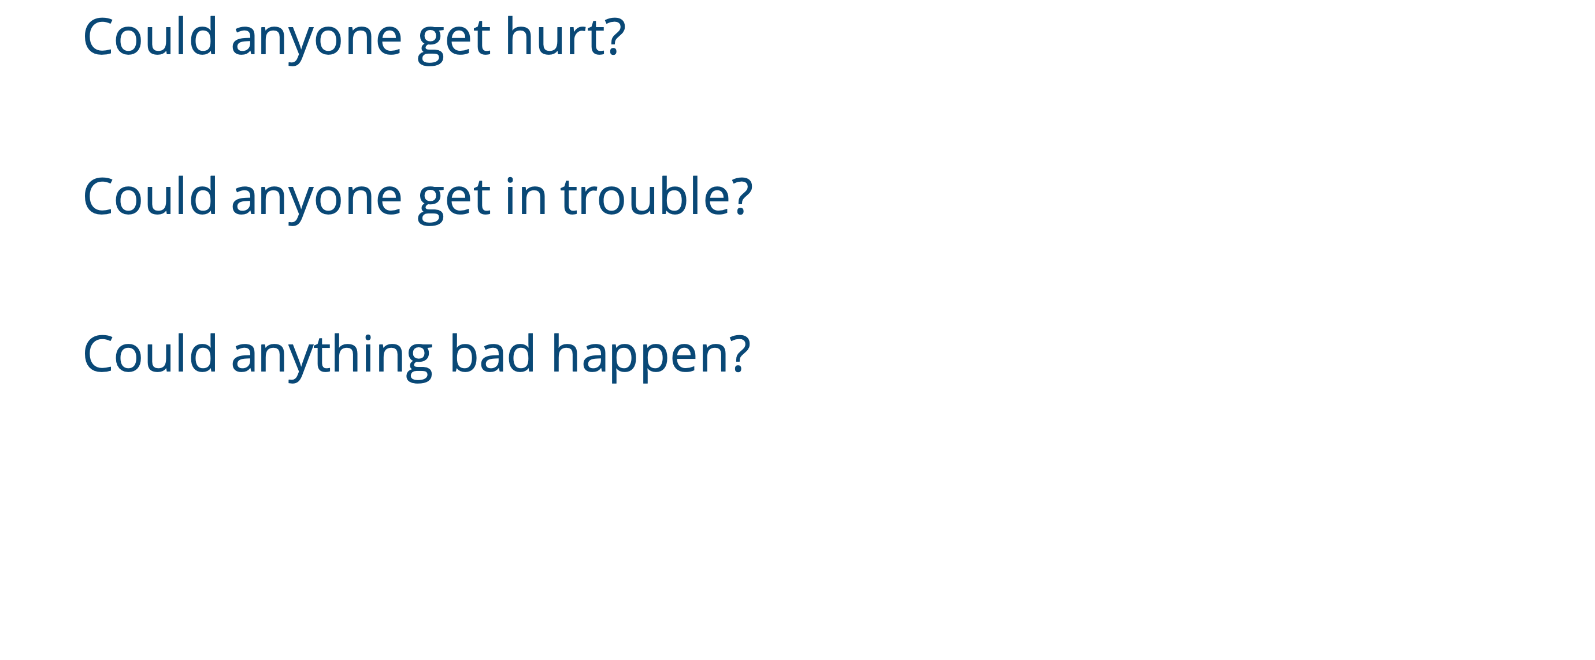
1. Read through the card.
2. Discuss:
Is this peer pressure positive or negative?
Which choice(s) could avoid a Yes Mess?
Can you think of any other choices (not included) that could also avoid a Yes Mess?
Describe a peer pressure situation in
a couple sentences.
What choices does the person being pressured have?
Give at least 3 different choices.
At least one choice should be a good choice that avoids a Yes Mess!
Have you ever made a choice that was different from a choice that a friend made?
Have you ever made the same choice as a friend and then feel bad about it afterwards?
Can you promise to think more carefully about these Yes Mess questions the next time you have to make a hard decision that involves a peer?
  Could anyone get hurt?
  Could anyone get in trouble?
  Could anything bad happen?
Notes:
Instructor Notes:
Bring students’ attention to the Yes Mess questions on the slide and ask students to think-pair-share: Do you think these Yes Mess questions could also help with choices related to peer pressure? Why or why not?
Explain that the Yes Mess questions work with any kind of decision, so they would be helpful in choices that involve peer pressure.
Divide the students into pairs and distribute an index card to each pair. Explain that the class is about to further explore using Yes Mess questions to help with choices related to peer pressure.
Click twice and ask the pairs to think about a peer-pressure situation that could happen to someone their age. Explain that the situation could be positive (i.e., someone is persuaded to do something good) or negative (i.e., someone is to persuade someone to do something bad).
On their index cards, the pairs should work together to
describe the peer pressure situation in a couple sentences
provide three ways that the person being pressured could choose to act. At least one choice should avoid a Yes Mess
*Remind students that, no matter what, they should not mention other people’s names.
Give the students a few minutes to work with their partners.
Then collect the cards, quickly scanning through them as you do to make sure all situations are appropriate.
Shuffle them and redistribute them so that each student pair has a card prepared by a different pair.
Click twice and instruct pairs to
Read through their new card
Discuss:
Is this peer pressure positive or negative?
Which choice(s) could prevent a Yes Mess?
Can you think of any other choices (not included) that could also prevent a Yes Mess?
Once students have discussed their cards, click twice and wrap up by asking students to silently reflect on and nod or shake their heads in response to the following questions:
Have you ever made a choice that was different from a choice that a friend made?
Have you ever made the same choice as a friend and then feel bad about it afterwards?
Can you promise to think more carefully about these Yes Mess questions the next time you have to make a hard decision that involves a peer?

Slide 16
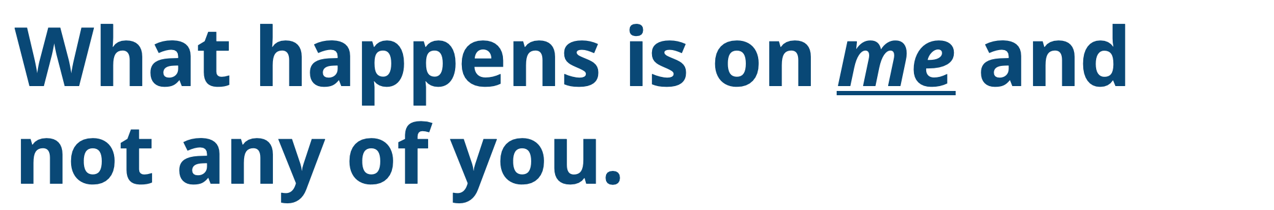



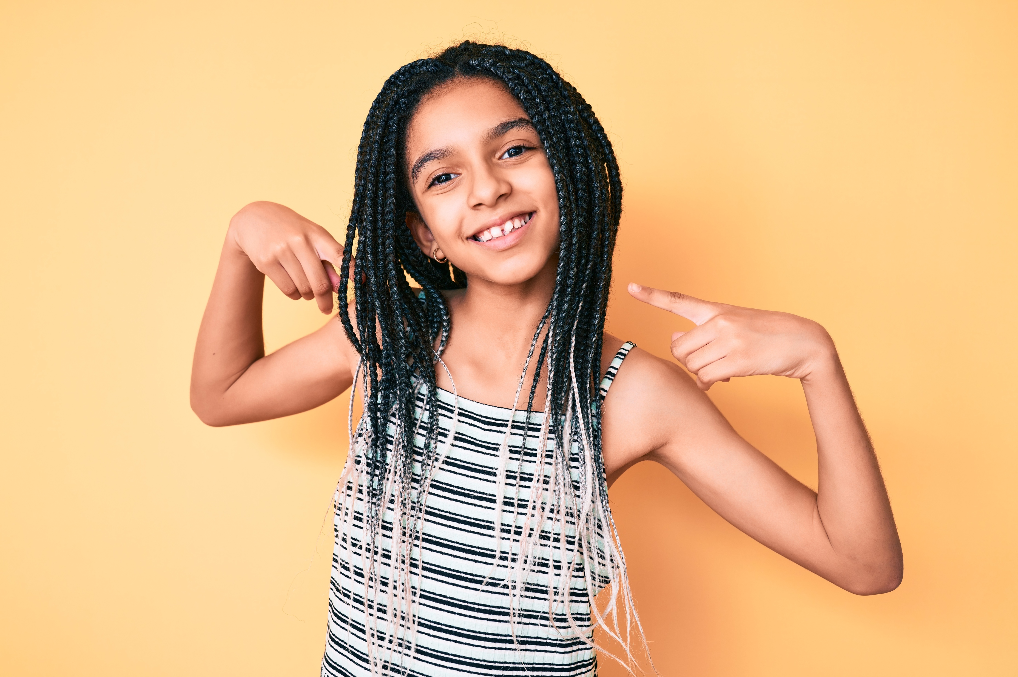
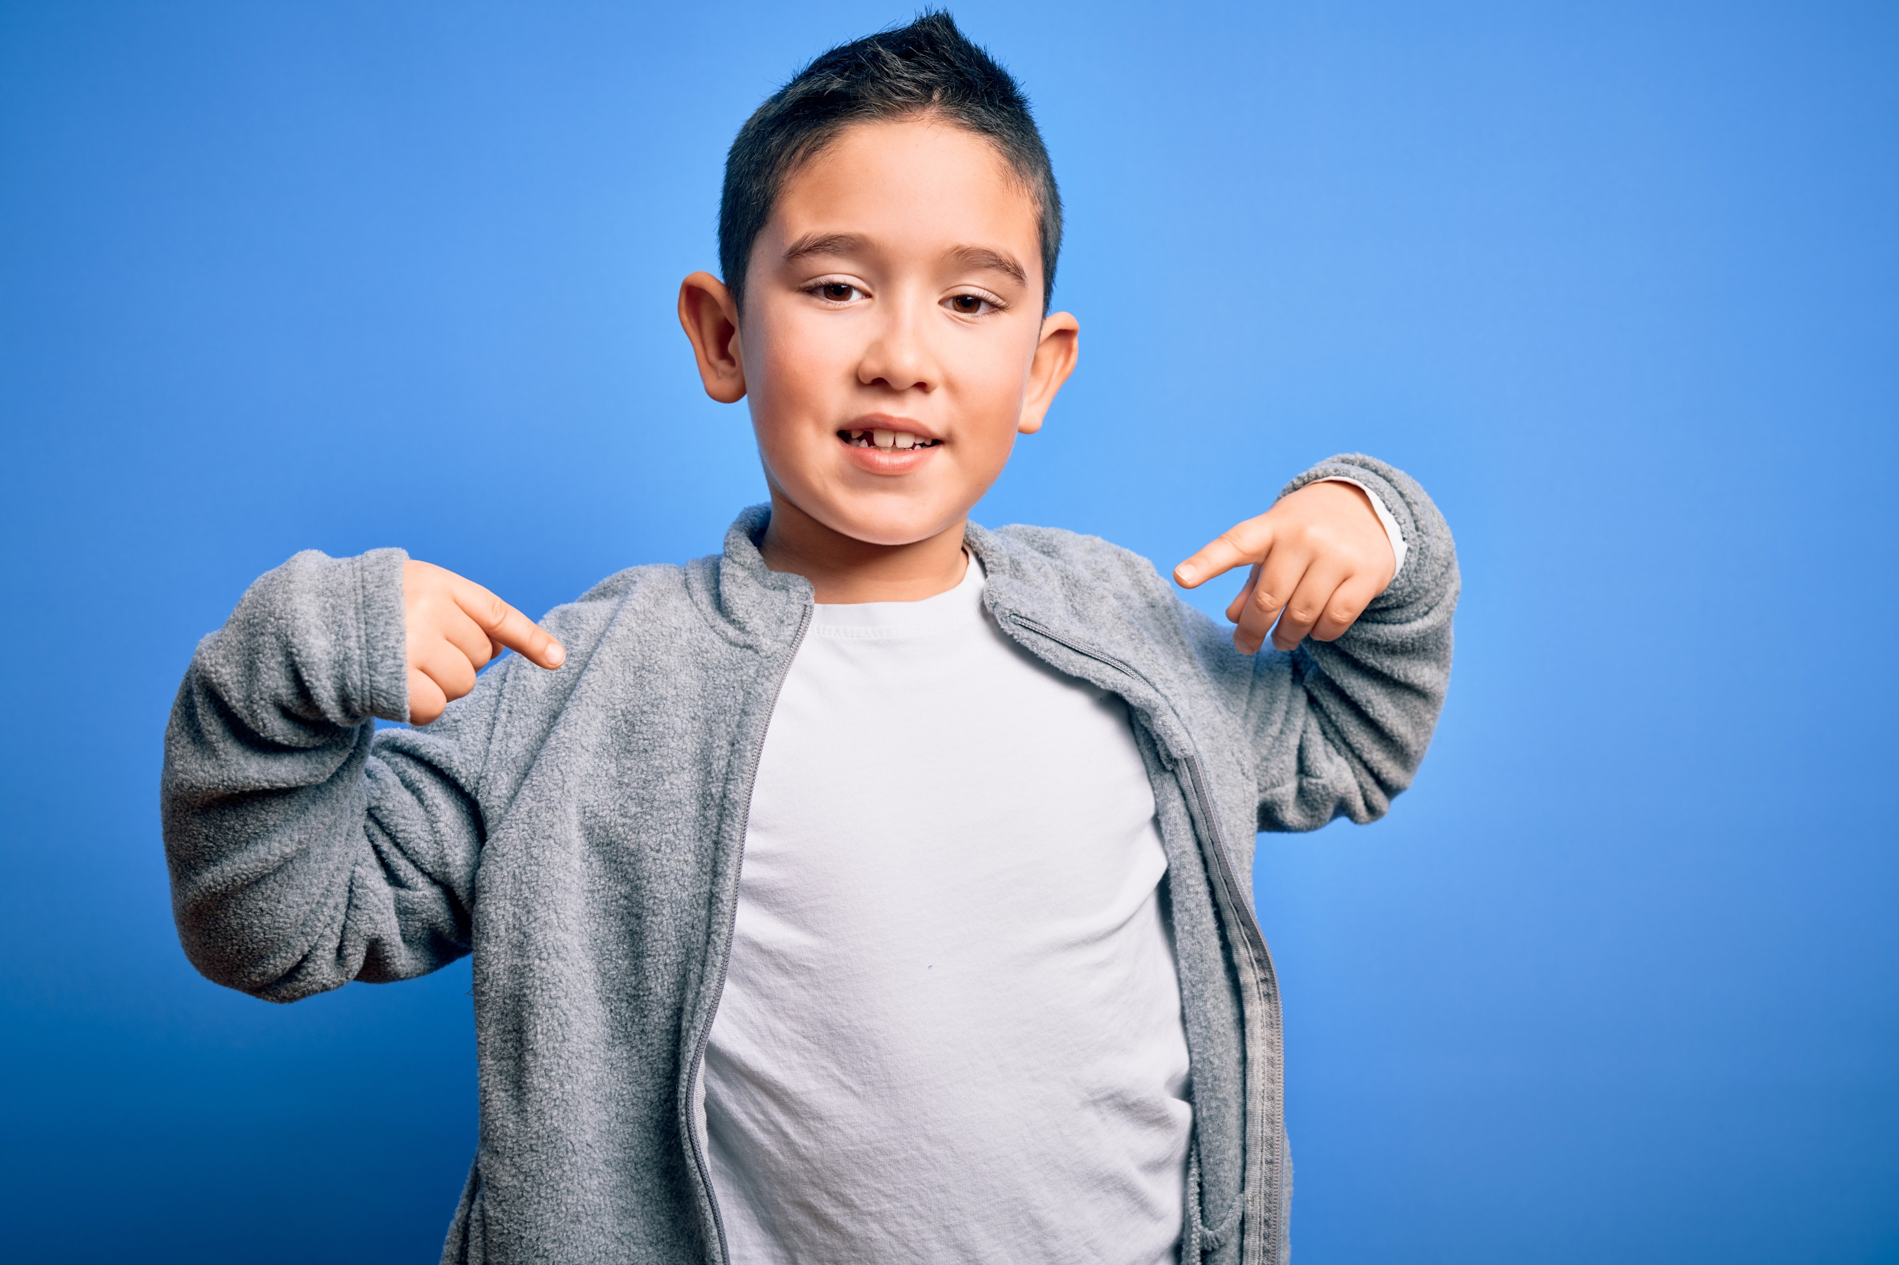
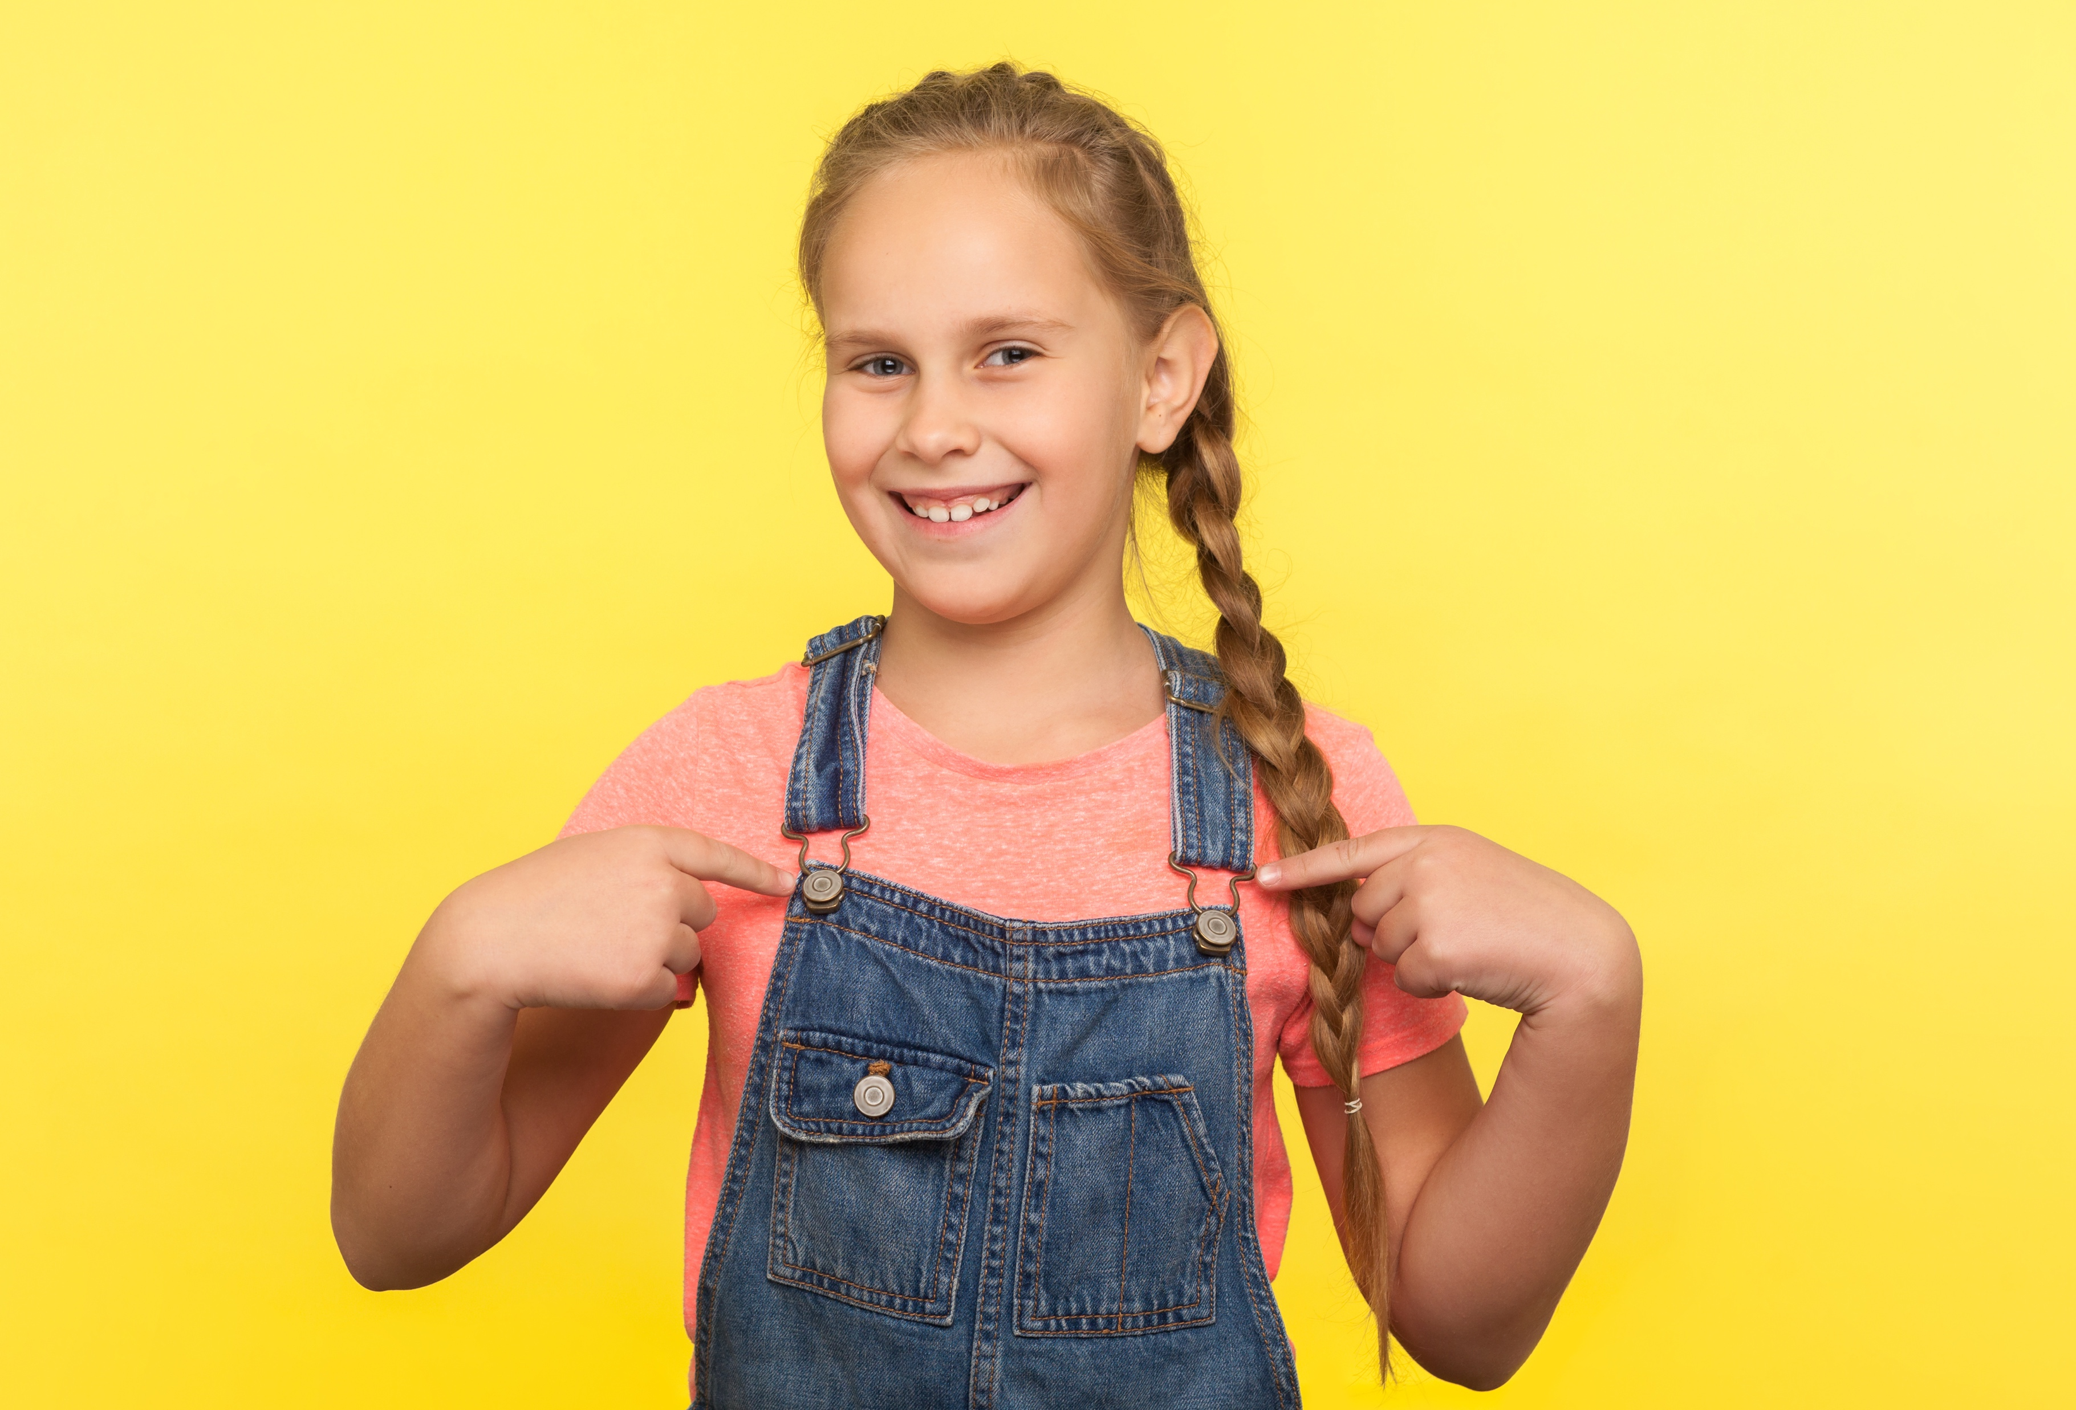
I...
I...
I...
Notes:
Instructor Notes:
Review and/or explain that because we are all in charge of making decisions that are best for us, “what happens is on me and not any of you.”
In other words, we must own up to our choices and not blame anyone else for our decisions. When we own up to our choices, we take responsibility for our actions even if we make mistakes.
Click once and review and/or explain that one way students can do this is by Showing Their ID:
When you Show Your ID, you simply say: “I …” and then explain what you did.
Instead of blaming others for our negative choices or not admitting our positive actions, we should always Show Our ID—and take responsibility for our actions, say what we did, and not blame anyone else!

Slide 17


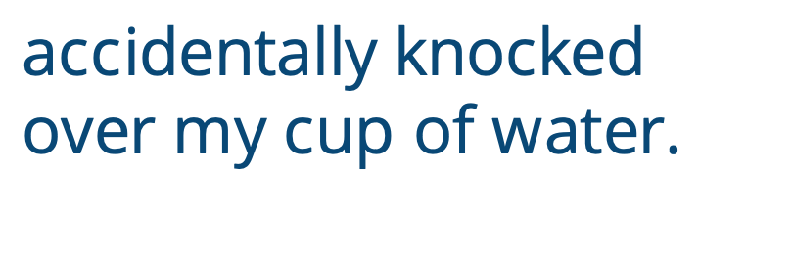
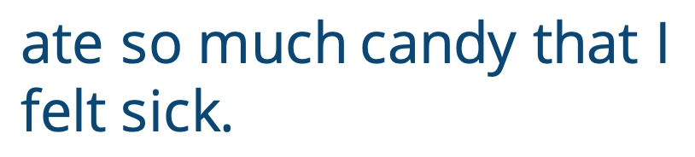
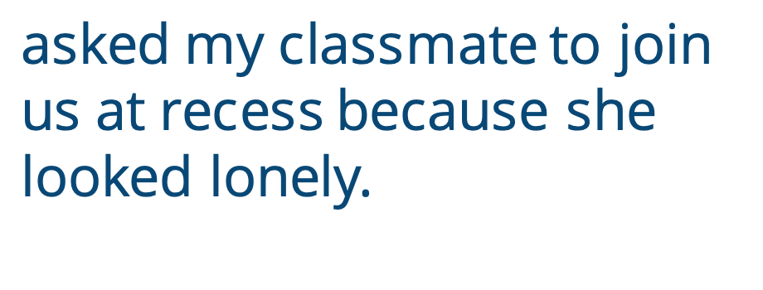
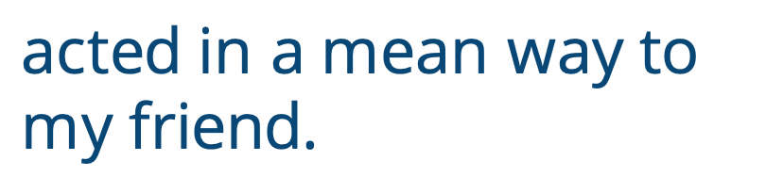


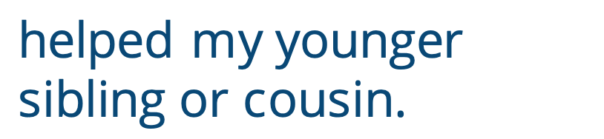
I...
accidentally knocked over my cup of water.
ate so much candy that I felt sick.
asked my classmate to join us at recess because she looked lonely.
acted in a mean way to my friend.
stayed up past my bedtime.
cheated on my test.
helped my younger sibling or cousin.
Notes:
Instructor Notes
Tell the class that they are about to think about some of the different times when they may Show Their ID.
Designate one side of the classroom as “easy” and one side of the classroom as “hard.” Explain that the middle area represents a continuum line (or scale) between the two.
Click to display each of the following instances in which students may Show Their ID. Encourage students to imagine whether each situation would be easy, hard, or somewhere in between to own up to. They should then silently move toward that part of the continuum line to demonstrate their answer.
Remind students that they may not all have the same opinion, and that’s okay.
Click twice to reveal each of the following scenarios. Between each one, ask students to turn to someone nearby and explain why the action would be hard, easy, or somewhere in between to own up to.
Scenarios:
I … accidentally knocked over my cup of water.
I … acted in a mean way to my friend.
I … ate so much candy that I felt sick.
I … asked my classmate to join us at recess because she looked lonely.
I … stayed up past my bedtime.
I … cheated on my test.
I … helped my younger sibling or cousin.
Instruct the class to come back to the circle or semicircle.
Ask: What kind of behaviors were the hardest to Show Your ID for? Why?
Acknowledge:
It can be hard to Show Your ID if you are ashamed of your actions.
It can also be hard to Show Your ID if you are embarrassed or don’t want it to seem like you’re bragging.
However, it is important to have grit and Show Your ID for everything you do. When you take ownership for your behavior, it will not only make you feel better about your actions, but it will help others trust and believe you!

Slide 18
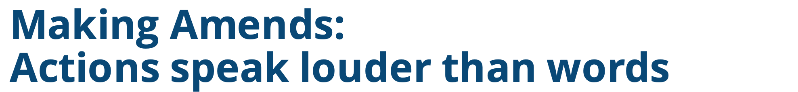
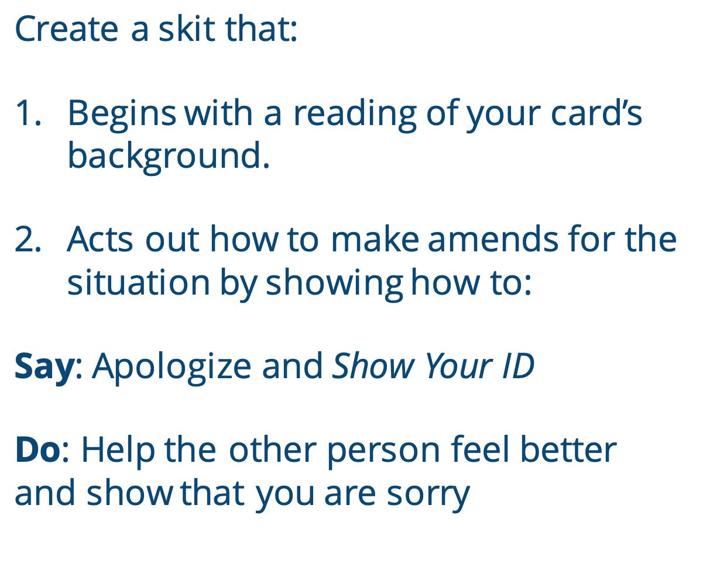

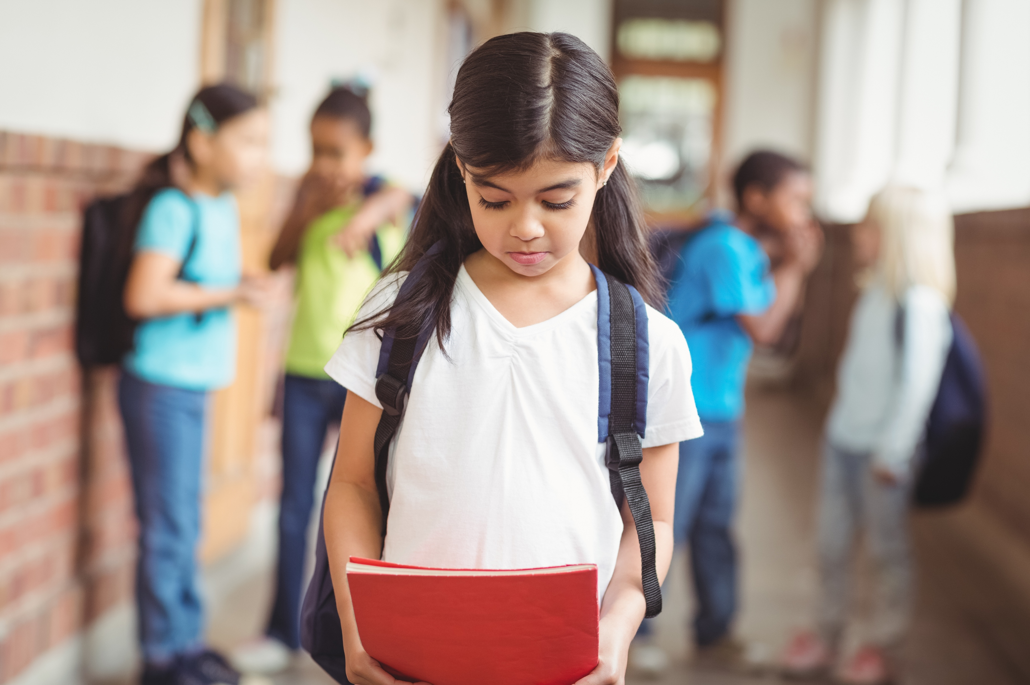
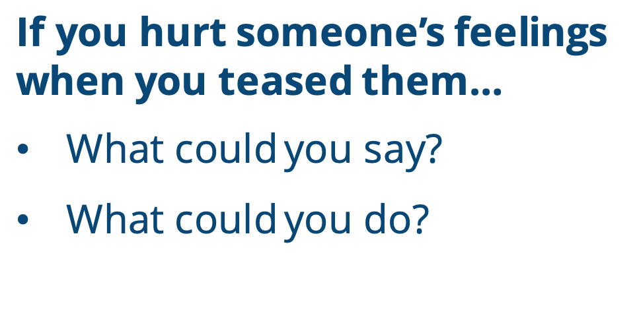
Create a skit that:
Begins with a reading of your card’s background.
Acts out how to make amends for the situation by showing how to:
Say: Apologize and Show Your ID
Do: Help the other person feel better and show that you are sorry
Say: Apologize and Show Your ID
Do: Help the other person feel better and show that you are sorry
If you hurt someone’s feelings when you teased them…
What could you say?
What could you do?
Notes:
Instructional Notes:
Click once and encourage students to raise their hand if they have heard the expression Actions speak louder than words.
Ask: What does it mean?
Explain that while it is important for our words to be kind, we need to make sure our actions are kind too. It’s sometimes easier to choose to say something kind than to do something kind, because doing something requires more work. To show people that we really mean what we say, we must make sure our actions are kind too.
Click once more. Explain that, for this reason, when we make a mistake that hurts someone else, we should Show Our ID and apologize and we should also make amends.
Tell the class that when you make amends, you do something to right the wrong and help the other person feel better.
Click again to provide the following example: If you hurt someone’s feelings when you teased them…
Then click once for each bullet below and brainstorm possible answers as a class:
What could you say to apologize and Show Your ID?
Sample Answer: I’m sorry that I teased you and hurt your feelings…
What could you do to make amends?
Sample Answer: You may make amends by doing anything that shows that you care about this person and their feelings, such as: Ask them if they would like to play a game with you, offer to help them with something, try your best to be aware of their feelings in the future, etc.
Explain that when you make amends, the most important thing is to think about the person or people you hurt and how you can make it up to them.
Then divide the class into groups of two or three, and give each group one scenario square from Handout 11: Making Amends Cards. Be sure two different groups are given the same scenario before you distribute the next one.
Click twice and explain that each group will develop a skit that acts out how to make amends for their card’s situation. They will do this by acting out what they could:
Say: Apologize and Show your ID
Do: Help the other person feel better and show that you are sorry
Note: Students do not have to act out the actual scenario; they should focus on showing how they would make amends!

Slide 19






Scene 1:
You excluded someone from a game at recess and their feelings are hurt.
Scene 5:
Someone is teasing another student about their new haircut and you join in.
Scene 6:
You persuade your classmate
to let you copy their math homework.
Scene 4:
You see someone making fun of someone’s lunch in the cafeteria and you just watch it happen.
Scene 3:
You weren’t nice to a classmate when they asked for your help with an assignment.
Scene 2:
You upset an adult at home because you didn’t speak kindly.
Notes:
Instructional Notes:
Bring the class back together and encourage each group to share their skit. In order to lead the class through this:
Click to project and read the scenario.
Call up one group to act out how they would make amends.
As students watch, encourage them to think of additional ways to make amends.
Call up the second group to present how they would make amends.
Then invite the rest of the class to share additional ways to make amends.
Click twice to begin again with a new scenario.
At the end of the presentations, discuss as a full class:
Is there one specific way to make amends?
What is most important?
Be sure students understand that after we apologize and Show Our ID, the most important part of making amends is choosing a kind action that shows the person we care and are truly sorry. Doing this can also help us begin to forgive ourselves!

Slide 20
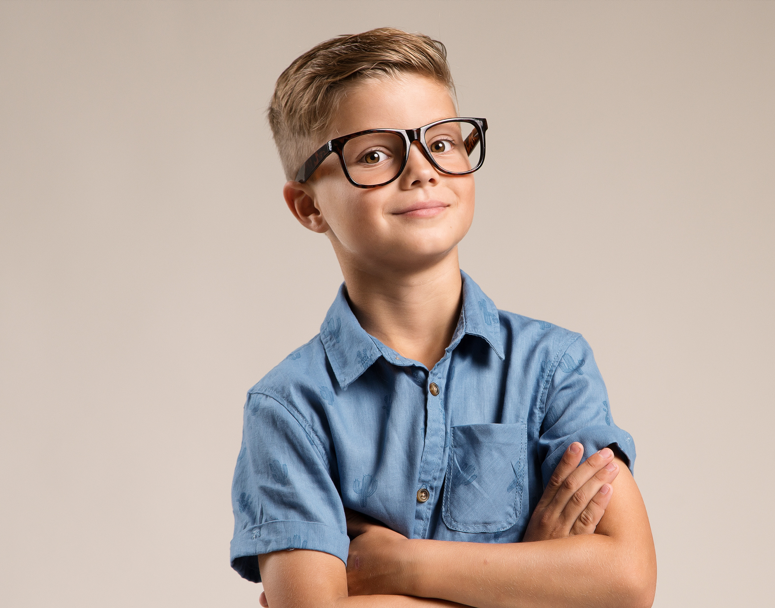
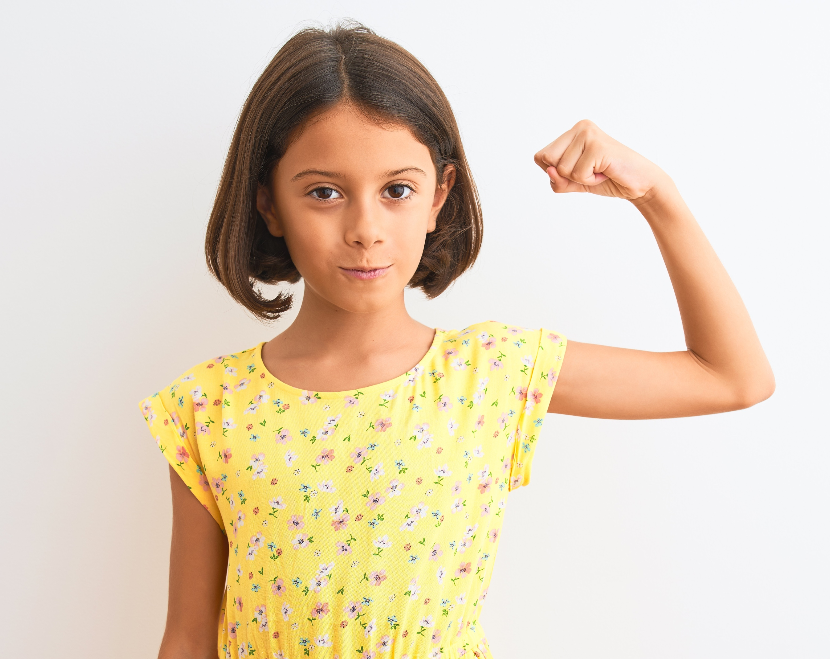
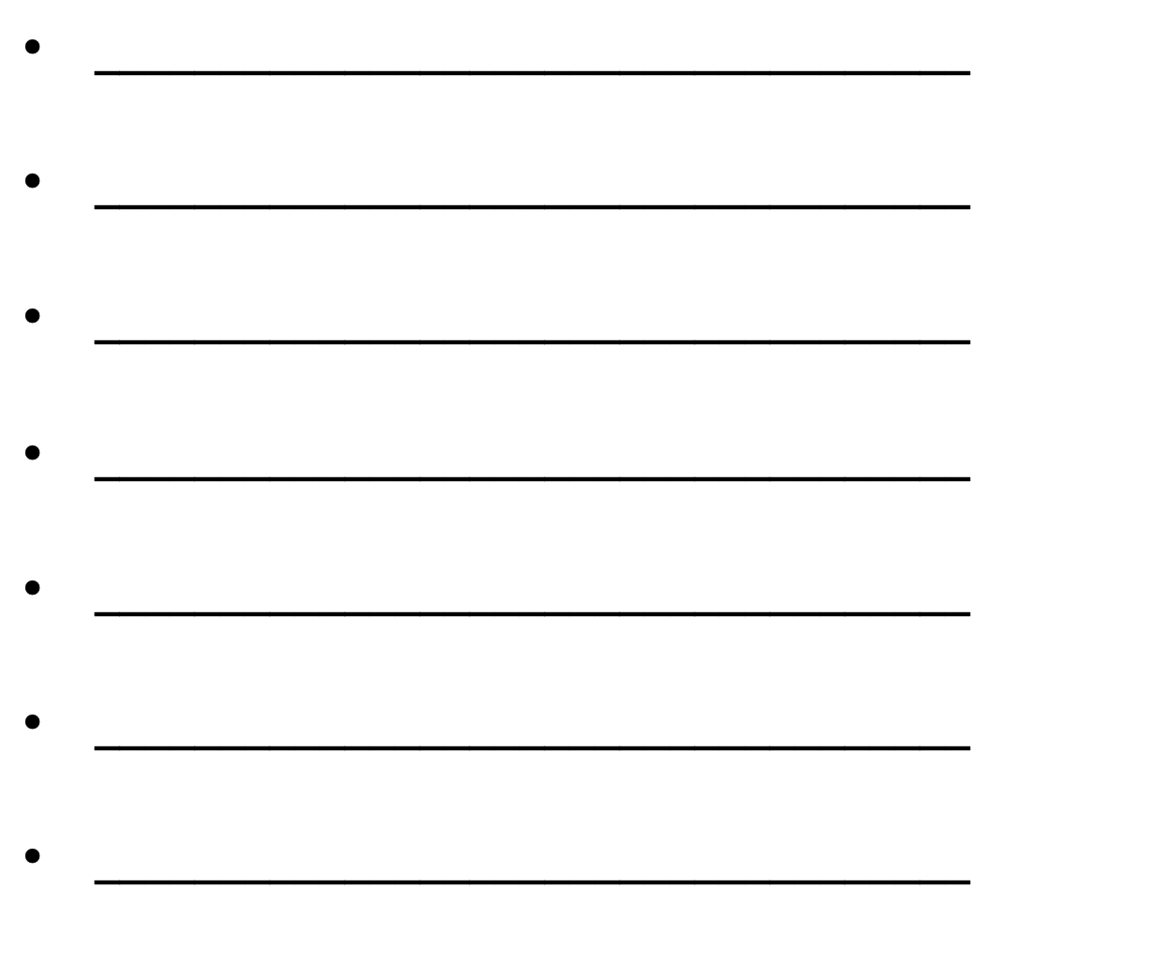


Notes:
Instructional Notes:
Repeat the idea that Showing Your ID is also important for matters you are proud of.
Some people may find it easy to Show Their ID for actions they are proud of while others may find it embarrassing.
However, it is always important to be proud of yourself if you accomplish something that required inner strength and grit!
Explain that what may require inner strength is different for everyone. For instance:
Climbing a tree might look easy to some of you, but what if you were afraid of heights?
Being patient with your brother may seem like no big deal, but what if he is usually bothering you?
Ask each student to turn to the person next to him or her and brainstorm positive actions for which people may Show Their IDs both at school and at home. Explain that these could be actions that the students have personally completed or actions they have seen others complete.
Invite students to share some of their ideas, recording their actions on the board as they share.

Slide 21
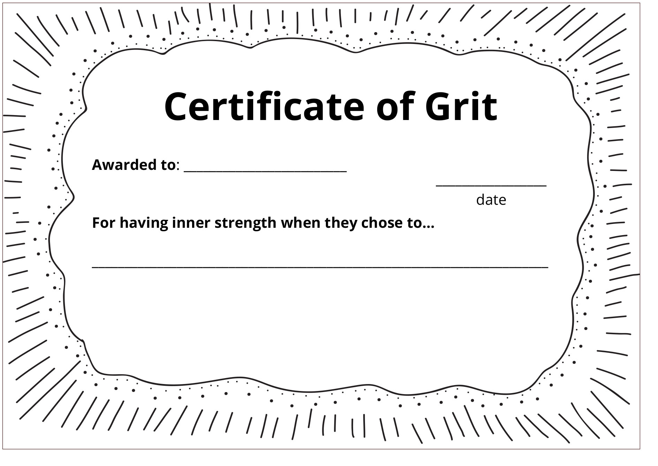
Notes:
Instructional Notes:
Distribute Handout 12: Inner Strength Award to each student and explain that the session will end by recognizing how each student uses his or her inner strength to make positive decisions.
Encourage students to select a personal choice they have made that they are proud of and that required grit to achieve.
Point to the blank certificate on the slide and explain that students should summarize this choice on the lines provided and draw a picture that illustrates the choice they described.
It may be helpful to give an example of an award you could make for yourself. For instance:
You could explain that you had grit when you were studying to be a teacher. You had to make decisions that prioritized school above having fun with your friends. So your certificate might say: “Certificate of Grit, awarded to Ms./Mr. _____ for having inner strength when she or he chose to always study for their teacher classes, even when it meant saying no to fun things.”
You might then draw a picture of yourself teaching a class because it shows what you accomplished as a result of making this choice.
Once students understand the instructions, encourage them to begin their own.
Move around the classroom as students work, assisting anyone who may need help recognizing his or her own accomplishments.
As students finish, collect their awards for the final activity.

Slide 22
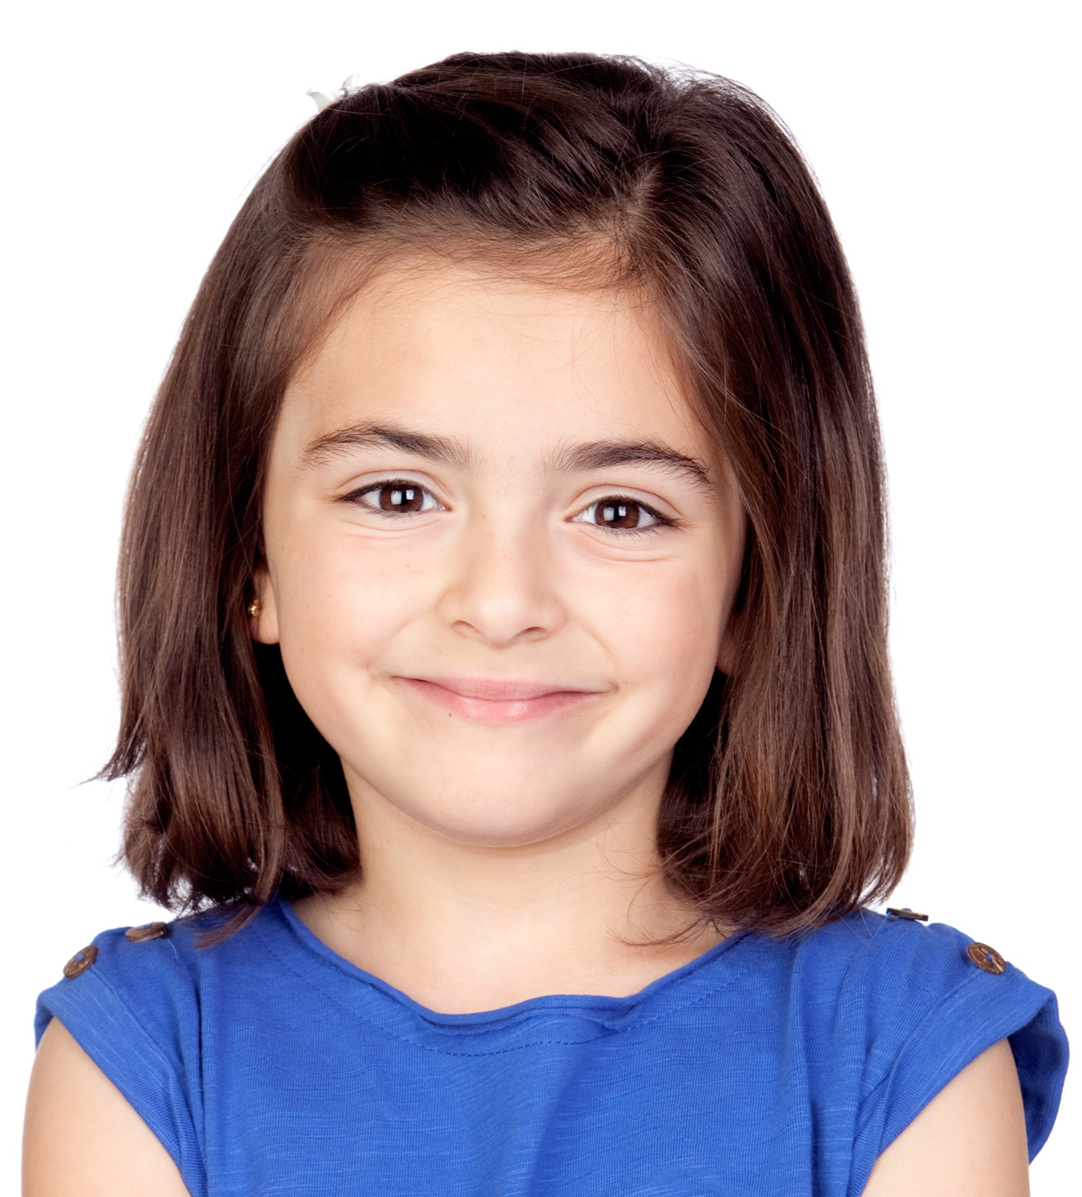
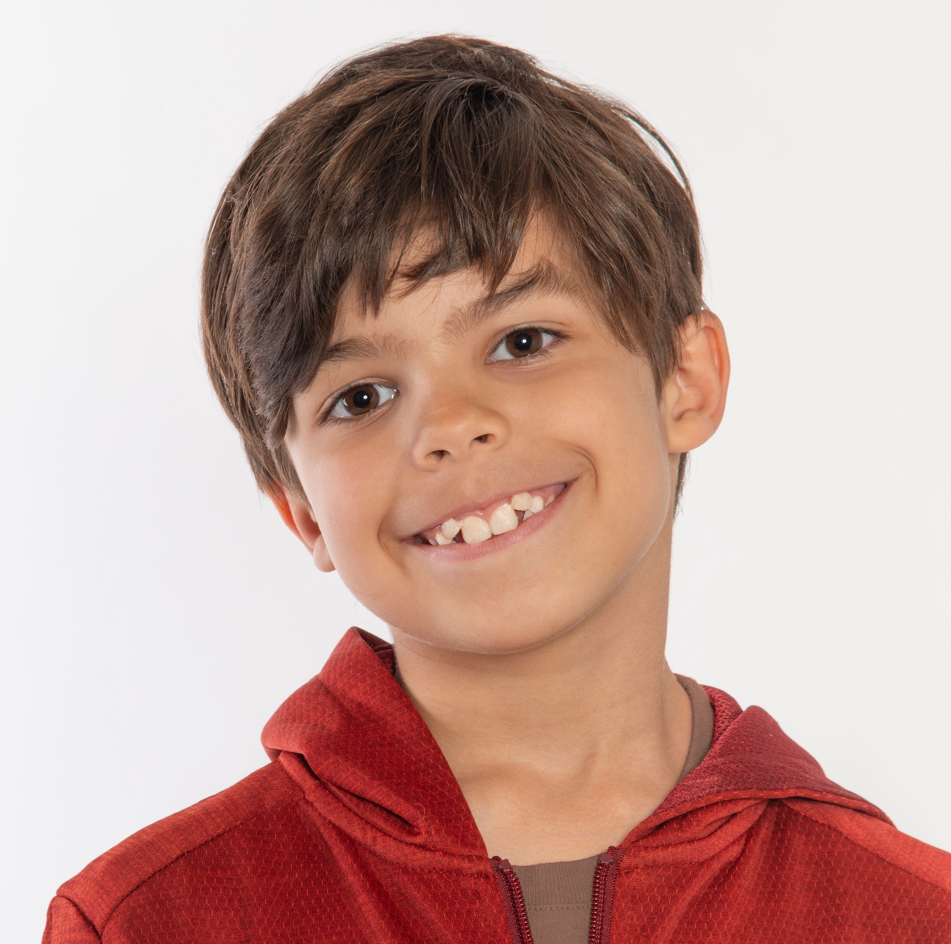
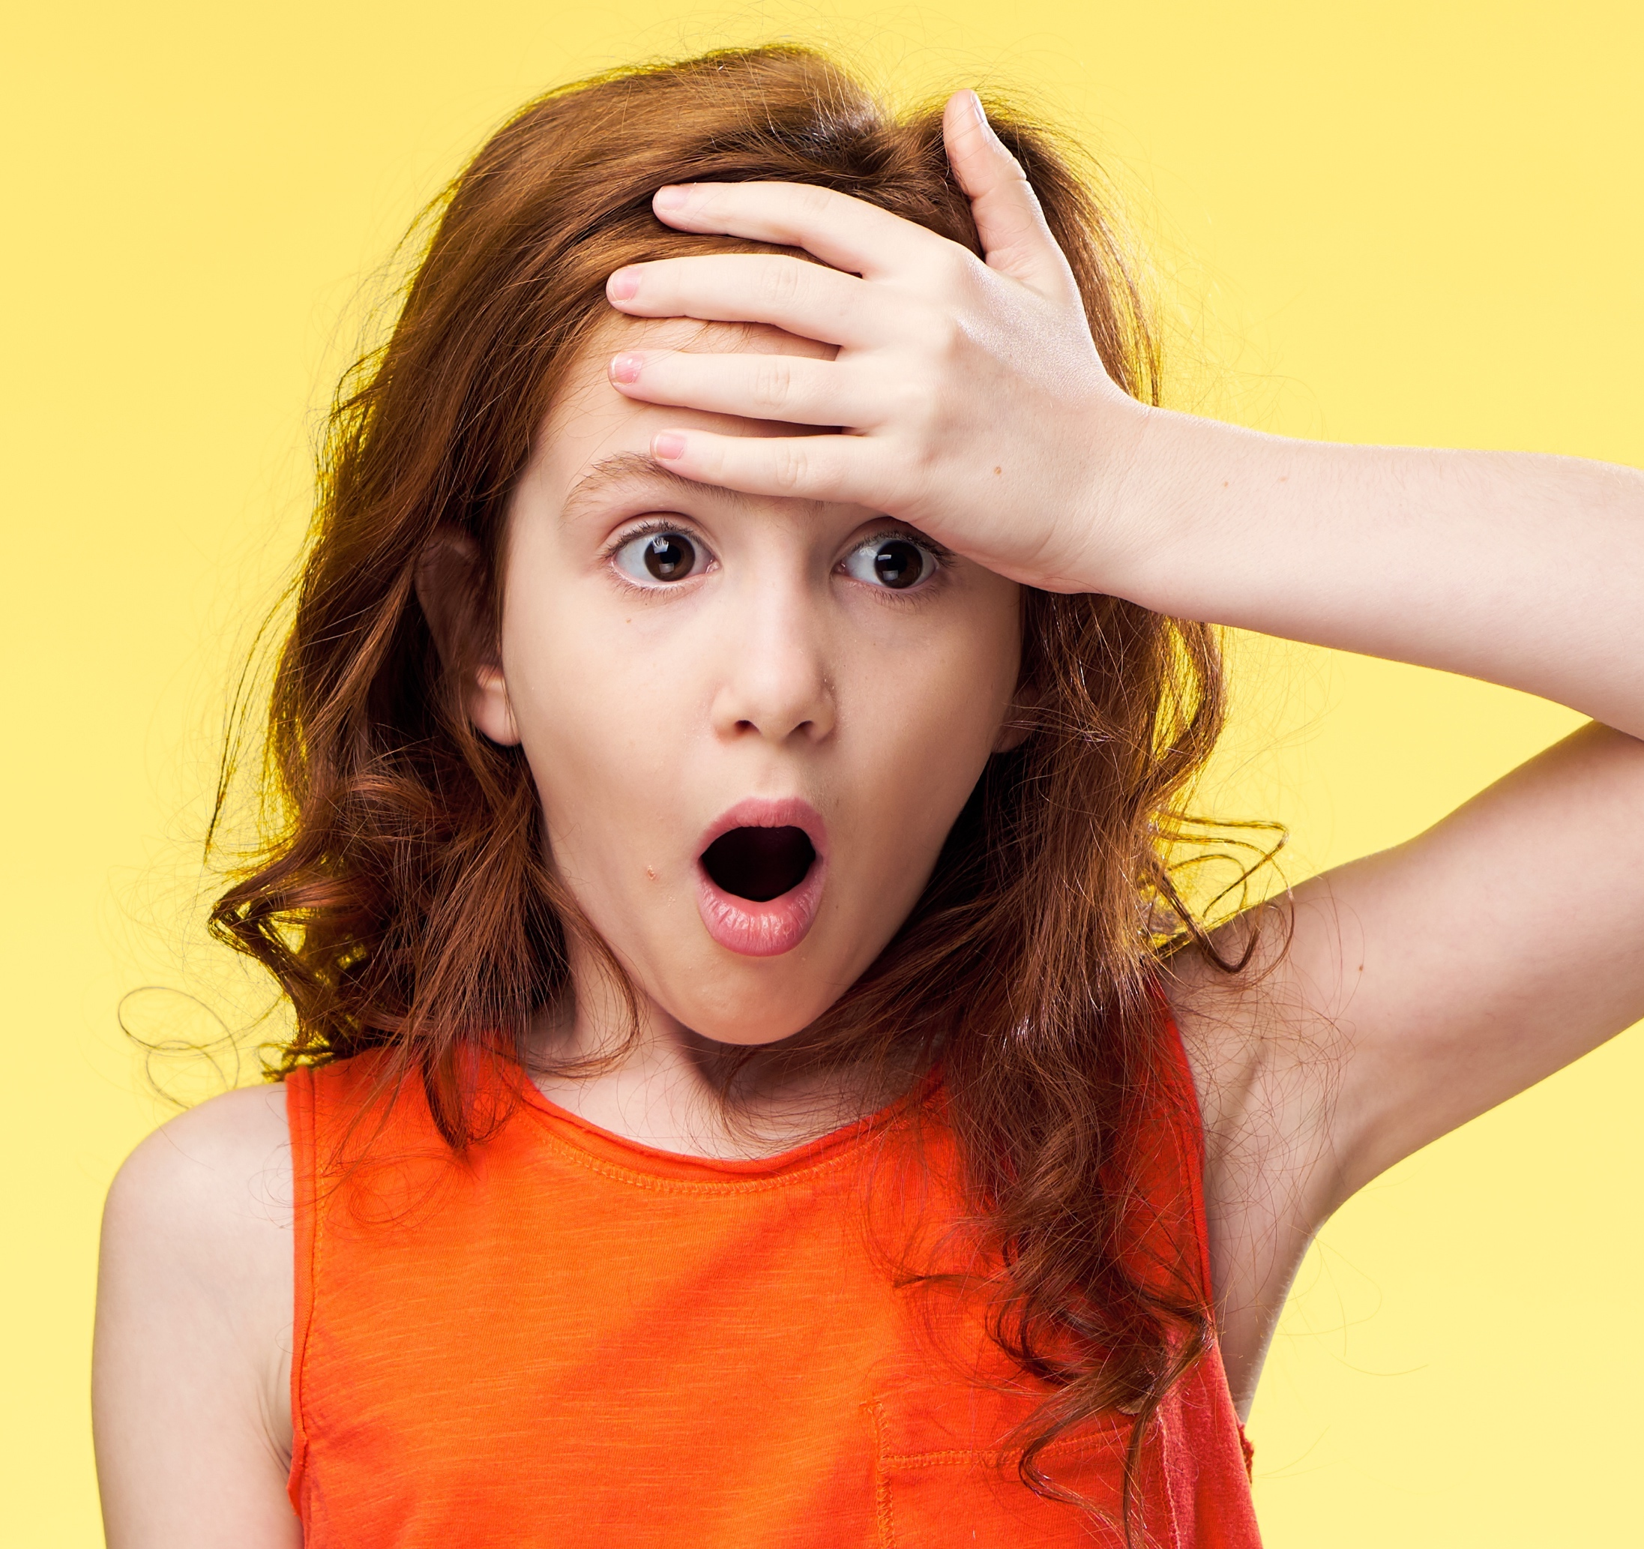





Notes:
Instructor Notes:
Conclude with a Grit Award Ceremony.
Bring the class back to a circle or semicircle and kick off the award ceremony by asking the class to join you in reading this Words to Live By excerpt one more time:
I soar with wings.
Let me tell you why.
I learn lots of skills that help me reach the sky.
… I understand the choices I make
should be what’s best for me to do,
and what happens is on me and not any of you.
Tell the class that you are proud of what they have learned about decision making and that you trust that each student has what it takes to make the best possible choices for him or her.
Explain that you are going to wrap up with an award ceremony in which you recognize each student’s grit and inner strength.
With the certificates in hand, call up the students one by one. As you present the certificates to the students, summarize each award by saying:
I present ________ with this certificate of inner strength. ________ showed us he or she had grit when he or she ________________.
Once all of the certificates have been presented, encourage students to keep their certificate somewhere they will see it often.
Explain that you hope these certificates will serve as a reminder of the positive decisions they have made in the past so they will continue to have grit and make positive, strong choices in the future!

