Slide 1

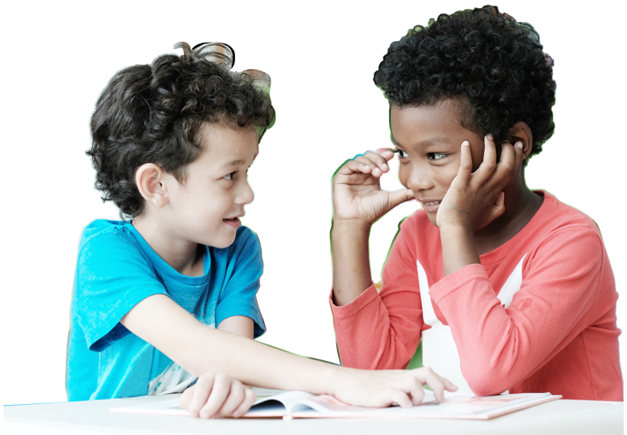
Time to Play!
Grades 3–5
Digital Lesson

Slide 2

My Choices
I soar with wings.
Let me tell you why.
I learn lots of skills that help me reach the sky…
I understand the choices I make should be what’s best for me to do, and what happens is on me and not any of you.
What choices did you have to make during the game?

Slide 3

Right or Wrong?
  You see that your classmate doesn’t have anyone to play
  with at recess. Should you:
    Ask him or her to join you?
    or
    Keep playing with your friends and pretend you don’t notice?
What are the consequences?
Notes:
Instructor Notes:
Reiterate that some decisions don’t have a right or a wrong option. Sometimes, decisions are based entirely on our personal preferences and how we feel or think.
Move on to explain that other choices, like whether or not we cheat during a game, are different: They do involve right and wrong.
Click once to display the following scenario and ask for a volunteer to read it aloud:
You see that your classmate doesn’t have anyone to play with at recess. Should you:
Ask him or her to join you, or
Keep playing with your friends and pretend you don’t notice?
Click once to reveal the word “consequence” and explain that a consequence is something that happens as a result of a choice that you make. There can be positive consequences and negative consequences to our choices!
Explain that sometimes one choice may have both a positive and negative consequence.
Ask students to turn to a peer and try to brainstorm a positive and negative consequence for each of the choices on the slide.
Once students have brainstormed consequences with a partner, discuss them as a whole class. Possible answers include:
Choice: Ask him or her to join you
Positive consequence: Your classmate is happy and no longer feels lonely.
Negative consequence: You may have to change what you are playing or how you are playing.
Choice: Keep playing with your friends and pretend you don’t notice
Positive consequence: Your game doesn’t change.
Negative consequence: Your classmate feels hurt and lonely, and you may feel guilty.
Explain that if you really think about the possible consequences, it becomes easier to figure out the right choice!

Slide 4
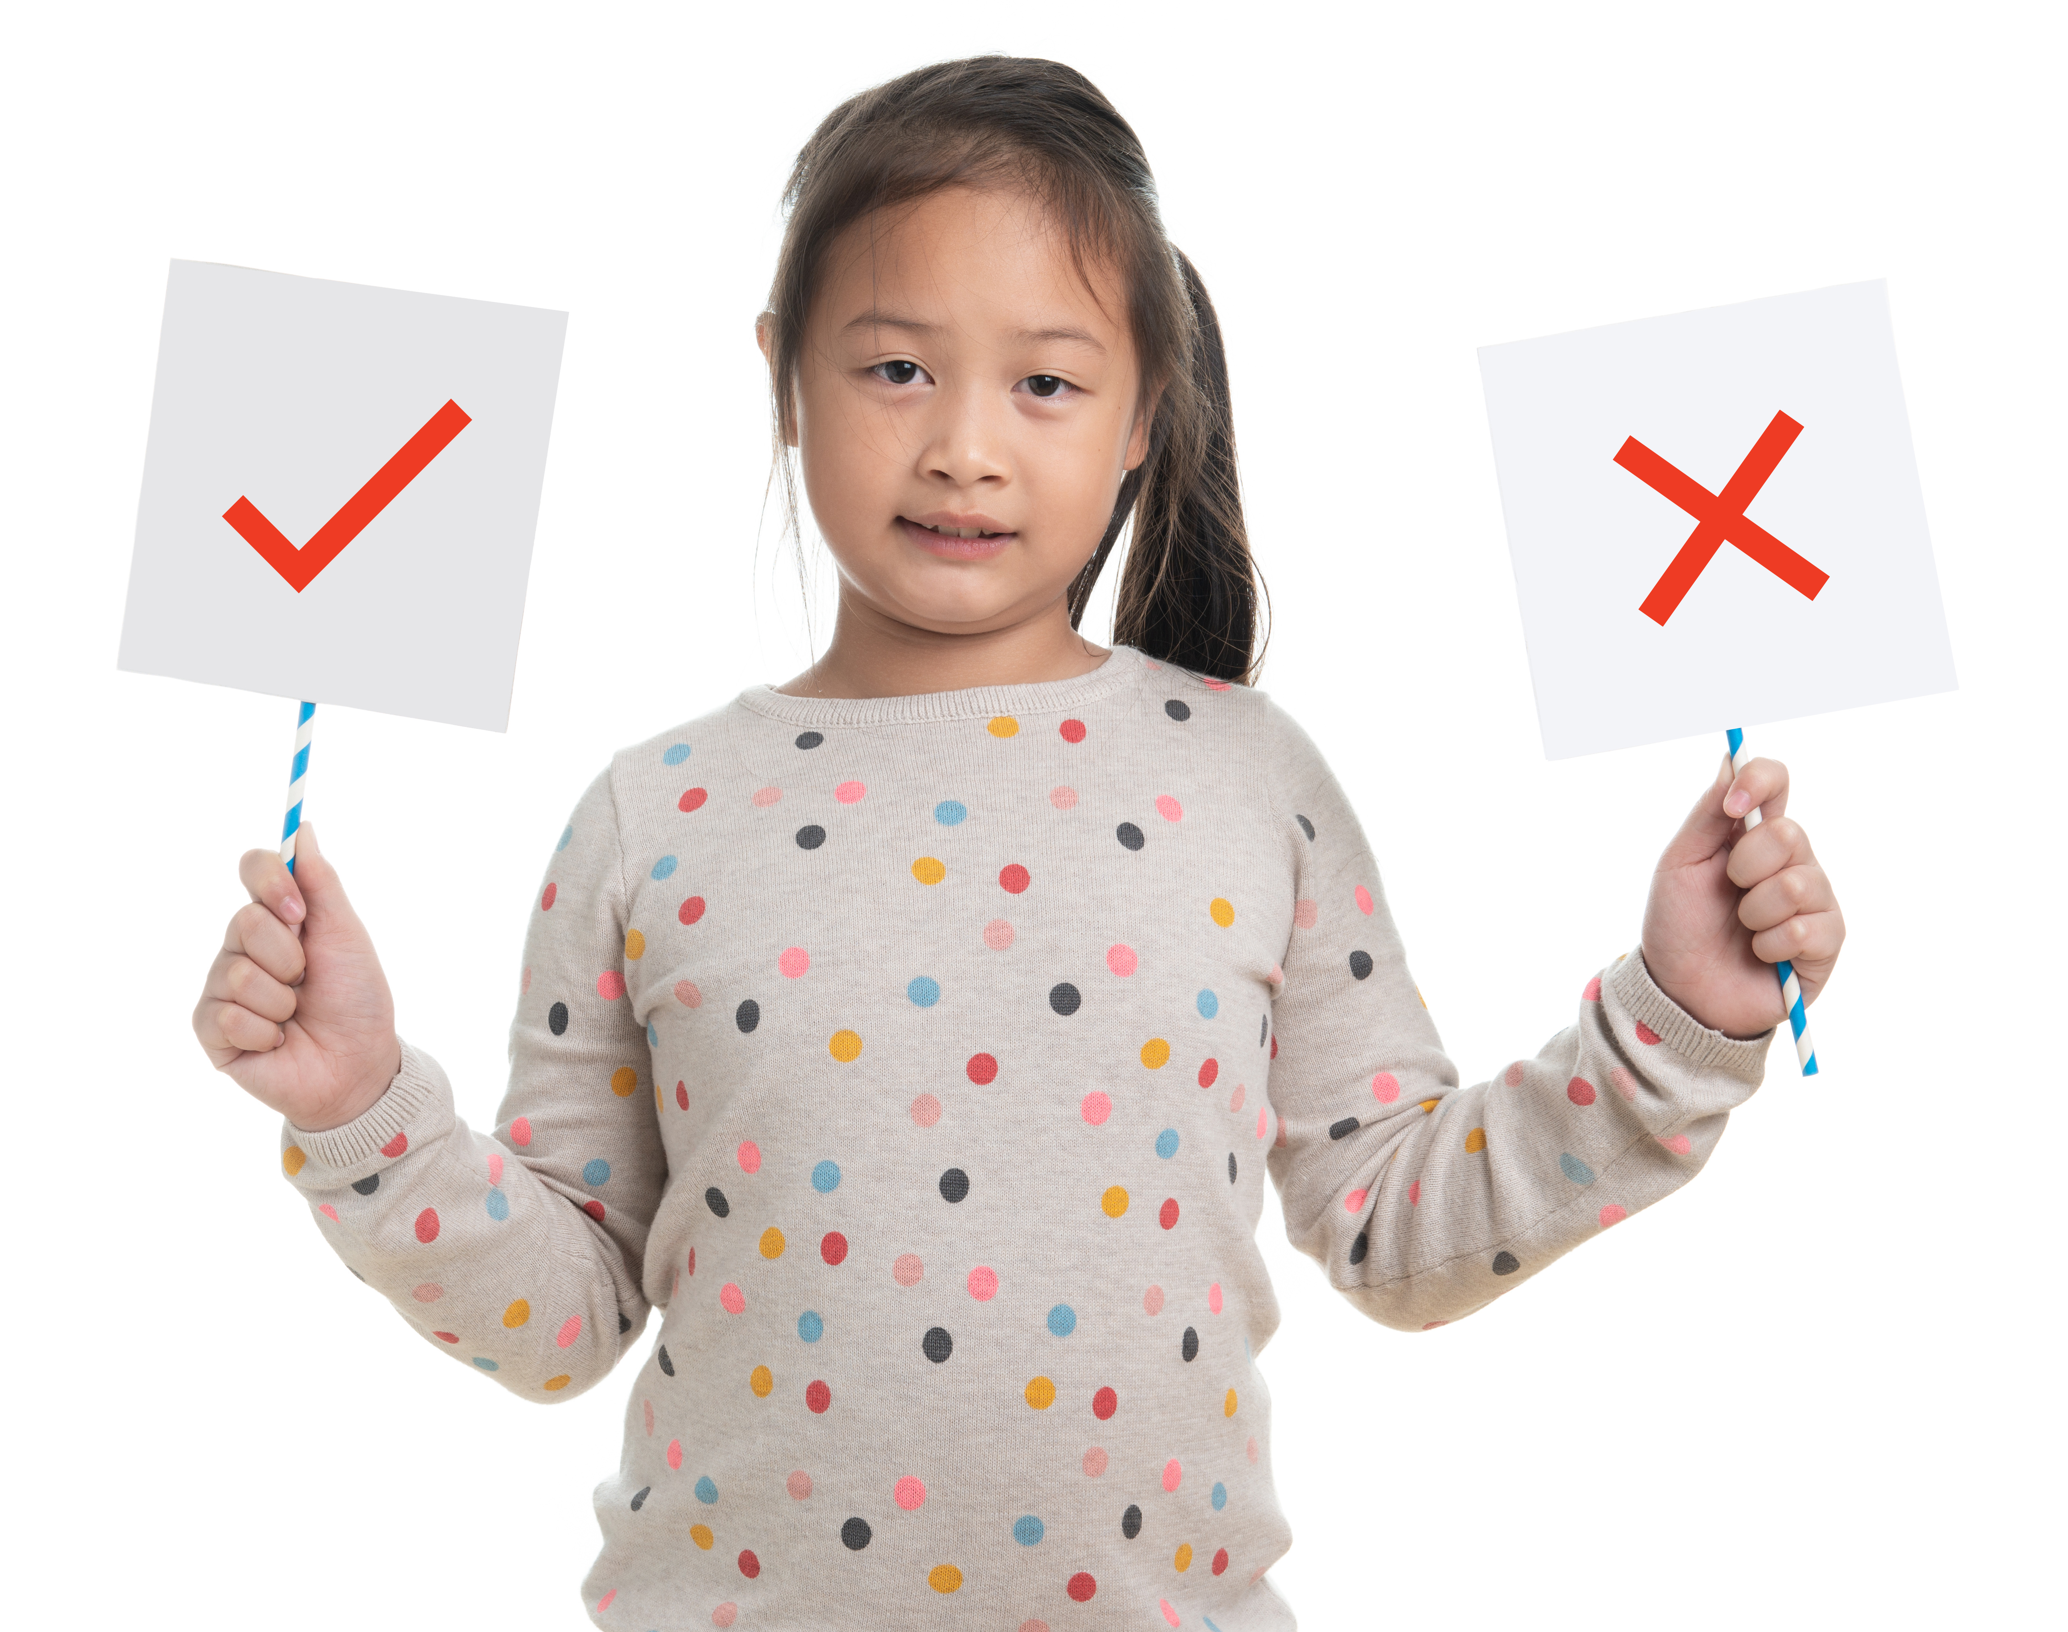
Right or Wrong?
  Game Goal: Match a choice with whether it is
  right or wrong.
  Rules:
  All cards need to be spread out and face down.
  To begin, one student turns over two cards.
  If you turn over a choice card and correctly match it with a right or wrong card, then you may keep the cards.
  If it is not a match, turn the cards back over.
  The other student then turns two cards over.
  Continue taking turns until there are no
  cards left.

Slide 5
Yes Mess
What other Yes Mess questions could help
YOU
make good choices?
  Could anyone get hurt?
  Could anyone get in trouble?
  Could anything bad happen?
Remember: If your answer is…
YES = Mess
NO = Go!
Notes:
Instructor Notes:
Once students are done playing, explain that you have a trick to make it even easier to make positive decisions.
Click once and introduce students to the idea of a Yes Mess by explaining that there are three easy questions that you can ask yourself to help you make choices that are right for you.
Click three times to reveal and read each of the following questions:
Could anyone get hurt? (Be sure students understand that this refers to all kinds of “hurt” – emotional and physical!)
Could anyone get in trouble?
Could anything bad happen?
Explain that if you think about a choice and answer yes to any of these questions, you’ll have a mess…which means the choice is not right for them!
Pass out one Handout 2: Yes Mess Dice to each student and explain that they will be making this handout into a dice that they can roll to help them make decisions.
Instruct students to first copy each of the Yes Mess questions on the board onto three different squares of their dice.
After a couple moments have passed, click again and ask: What other questions could help YOU make good choices?
Click once more and remind students that Yes Mess questions must have a “yes” answer if it is a bad choice, and a “no” answer if it is a good choice!
For instance:
“Would this decision make me proud?” would not work because the answer is yes, which means it is likely a good choice!
“Would this decision make me sad?” would work because the answer is yes, which means it is likely a bad choice!
If you think students are up for the challenge of creating more Yes Mess questions, encourage them to work with a partner and develop three more questions for their dice. If this is too challenging, distribute Handout 3: More Yes Mess Questions and encourage students to select three questions and add them to their dice.

Slide 6

Yes Mess
My uncle forgot his cell phone at my apartment, so I choose to bring it to school so I can play with it.
No one is watching, so I choose to take it home for a snack.
I see my favorite candy bar on my teacher’s desk.
I forgot to do my homework, so I choose to quickly copy my friend’s answers before school.
YES
MESS
Notes:
Instructor Notes:
Once students have finished writing their Yes Mess questions, explain and model how to make their dice:
Cut out the dice along the outside border.
Keep your scrap paper…you’ll soon see why!
Fold along the interior lines and form a cube.
Use a small piece of tape to attach the sides to each other.
When the dice are complete, assemble students back around you on the floor with their dice and scrap paper in hand.
Then explain that they are going to use their dice to help them make choices that are right for them. Any choice that leads to a Yes Mess is not the right choice and it means there is another better choice for them!
Click once and display:
I see my favorite candy bar on my teacher’s desk.
Click again to display:
No one is watching, so I choose to take it home for a snack.
Then instruct all students to roll their dice near themselves and read the question.
Ask: Would we have a Yes Mess if we made this choice?
Instruct students who answered yes to their question to tear off a small piece of their scrap paper, crumple it, and throw it at the Yes Mess target on the board.
Ask:
Why did you answer “yes” to this question?
This Yes Mess shows us that this is not the right choice. What would be a better choice for you?
Click twice to repeat the procedure above with each of the following two scenarios:
I forgot to do my homework, so I choose to quickly copy my friend’s answers before school.
My uncle forgot his cell phone at my apartment, so I choose to bring it to school so I can play with it.
*Note: If students answer “no” to any of the dice questions, remind them that only one of the questions needs a “yes” in order for a Yes Mess to occur, and encourage them to roll again and continue to consider each question.

Slide 7
  I choose to make the choices that I know are best for me.
  Could anyone get hurt?
  Could anyone get in trouble?
  Could anything bad happen?
YES
MESS
Notes:
Instructor Notes:
Ask for a few volunteers to pick up and recycle the mess from the Yes Mess activity.
Then click once to reveal one more choice:
I choose to make the choices that I know are best for me.
Remind students of the Yes Mess questions by pointing to them on the slide as you read them.
Then click twice and instruct each student to roll their dice and answer the question in their heads.
If students would answer “yes” to their Yes Mess question, instruct them to throw their piece of scrap paper at the Yes Mess target.
*Note: Students should answer no to each of their Yes Mess questions, so probe any students who throw their papers to walk you through their thought process and help them understand why yes may not be the best response.
Instruct students to roll one more time, think about the answer, and throw their piece of scrap paper at the target if they would answer yes.
Summarize what the class has learned by saying, “It looks like this choice is not a Yes Mess…which you can see because there is no mess to clean up! Since we answered no to each of the Yes Mess questions, making the choices that you know are best for you is a smart decision.”

Slide 8
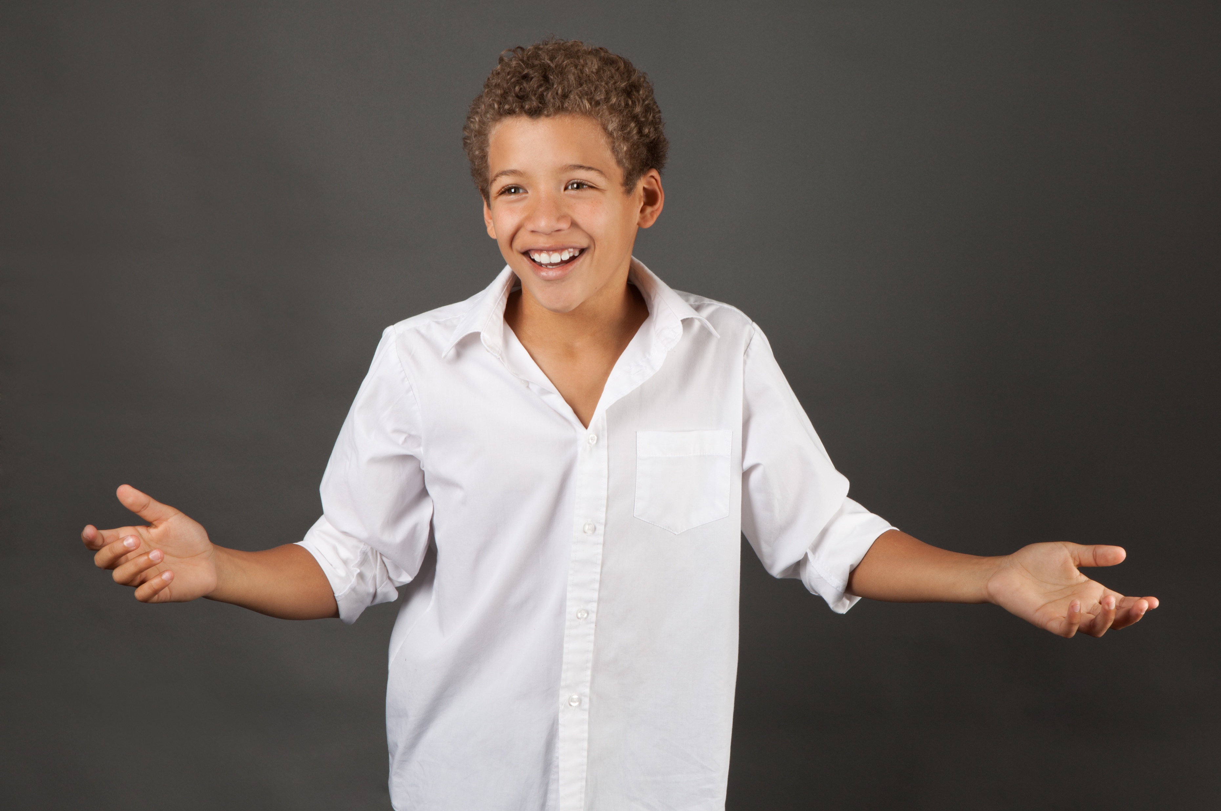
I soar with wings.
Let me tell you why.
I learn lots of skills that help me reach the sky…
I understand the choices I make should be what’s best for me to do,
and what happens is on me and not any of you.
Notes:
Instructor Notes:
Invite students to join you in reading the Wings Words to Live By section aloud.
Then conclude by saying, “Before you make choices in the future, think about your Yes Mess dice. And if you would answer yes to any of the questions, remember the mess you made here today, and try to think of a better choice for yourself!”

Slide 9
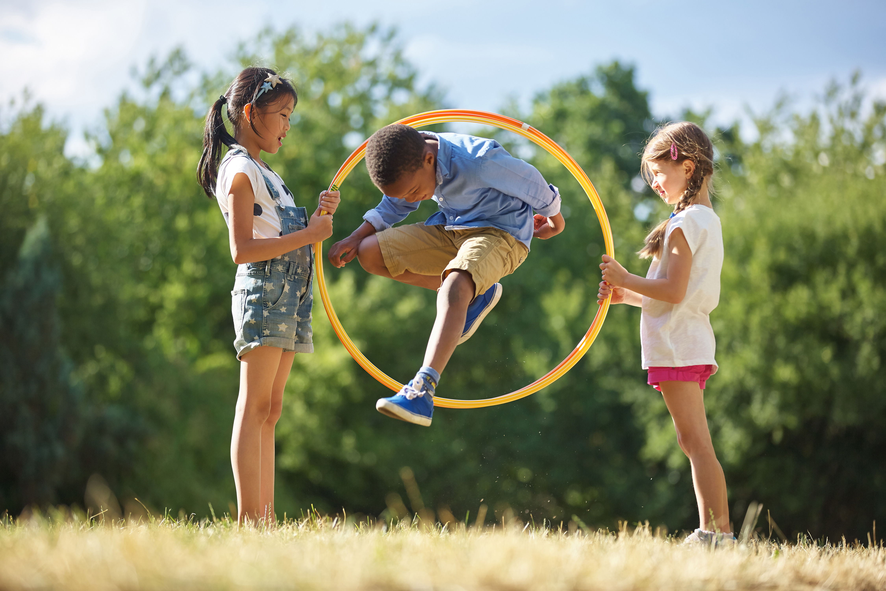
Challenge Time!
Notes:
Instructor Notes:
* Note: For this activity, the class will be standing in a circle as they pass through a hula hoop. If you don’t think this will be possible in the classroom, try to scout out another location in advance!
Begin Day 2 by instructing the class to sit on the floor in a circle or semi-circle and join the students by sitting at their level.
Explain that today will begin with a hula hoop challenge, where students will have to work both individually and as a team.
Preview the directions with the class before you begin:
Students will stand in a large circle, and hold on to the hand (or wrist, if more comfortable) of the people on either side of them.
You will choose a starting point in the circle for the hula hoop. (Students will have to break hands temporarily so it can go around them.)
You will then start a timer and you will time how long it takes for the class to pass the hula hoop around the circle and back to the starting point.
If students break hands, the hula hoop must go back to the beginning.
Take any questions that students may have. Then instruct students to stand and follow the directions above.
Once the hula hoop has passed around the circle once, record the class’s time on the board. Then encourage students to think about how they may be able to get through the hula hoop more quickly and challenge the class to complete the activity one more time in an effort to beat their time.

Slide 10
YOUR actions matter
  Could you control the actions or choices of others?
  What job did every person have in this challenge?
  Why were YOUR actions important?
  What choices did YOU have to make?
Notes:
Instructor Notes:
Reassemble the class on the floor in a circle or semi-circle and again join the students by sitting at their level.
Click once to display the first question below and then double-click to display each of the following questions. Discuss each one as a full class:
What job did every person have in this challenge?
What choices did YOU have to make?
Could you control the actions or choices of others?
Why were YOUR actions important?

Slide 11
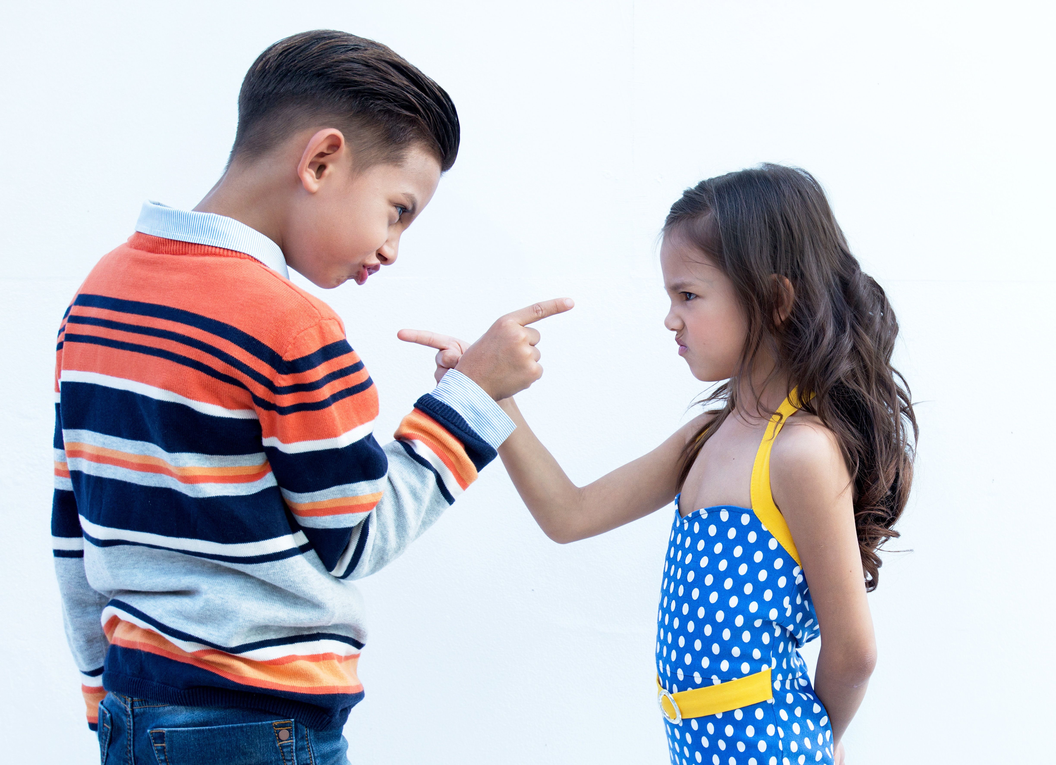
Personal Responsibility
When you take personal responsibility for something, you don’t blame other people for your choices.
You accept whatever happens as a result of your choice…whether it’s good
or bad!
Notes:
Instructor Notes:
Point to the header: “Personal Responsibility” and ask students to think-pair-share* what they think this means.
*In a think-pair-share, students think about the question independently, discuss their answer with a partner, and then share their thoughts with the class.
Click again to display: When you take personal responsibility for something, it means that you don’t blame other people for your choices. You accept whatever happens as a result of your choice…whether it’s good or bad!
Follow up by asking, “How did you take personal responsibility in the hula hoop challenge?”

Slide 12
Hand Up, Pair Up, Own Up!
You left your math homework on the kitchen counter and your Grandma accidentally threw it away.
You talked to your classmate so much during lunch that you didn’t have a chance to eat.
Your friend convinced you to skip taking the bus and walk home from school instead. You were late getting home, and your babysitter was worried.
I could blame _____ but I will own up!
This is my fault because ______.
Notes:
Instructor Notes:
Students will now practice taking responsibility for their actions and not blaming others with a game of Hand Up, Pair Up, Own Up.
Lead students, step by step, through the first round of this activity by following these directions:
Say, “Hand up,” and instruct students to put one hand up in the air, stand up, and walk silently around the room.
Say, “Pair up,” and instruct students to gently fist bump the person closest to them and sit down next to them.
Then click once and read a scenario aloud: You left your math homework on the kitchen counter and your grandma accidentally threw it away.
Click again and instruct the student pairs to own up by thinking about this situation and filling in the blanks: I could blame ________ but I will own up! This is my fault because _________.
After a minute has passed, ask a volunteer or two to share how they filled in the blanks and owned up.
Then say, “Hand up,” and continue the procedure two more times, clicking twice to reveal each of the following scenarios:
You talked to your classmate so much during lunch that you didn’t have a chance to eat.
Your friend convinced you to skip taking the bus and walk home from school instead. You were late getting home and your babysitter was worried.
Bring the students back to their circle or semi-circle and congratulate the class on taking ownership for “their” actions. They took personal responsibility for their pretend choices and didn’t blame anyone else for their decisions!

Slide 13
Tic Tac Toe!
Directions:
Own up to a choice you have made and share it with your partner.
Draw an X or an O.
Try to get three-in-a-row!
Category:
Playing with classmates,
friends, or family
Category:
Doing schoolwork
or homework
Category:
Being kind
Category:
Walking through our school
Category:
Being helpful
Category:
Notes:
Instructor Notes:
Tell students that they are going to wrap up today by owning up to some of their own decisions.
Divide students into pairs and instruct them to sit next to each other.
Pass out one copy of Handout 4: Tic Tac Toe to each pair.
Explain that students will be playing a game of Tic Tac Toe…But they will only be able to take a turn if they can take ownership for one of their own decisions!
Click once and, if needed, quickly review how to play Tic Tac Toe:
Game Goal: Get three Xs or Os in a row!
One player will only draw Xs and the other player will only draw Os.
Take turns placing Xs and Os on the game board until someone has three in a row.
Click again and explain that in this version of the game, you are going to call out categories every round, before pairs can mark an X or an O. For each category that you call out, each student should take ownership of a positive or negative decision they made and share it with each other. Once students have taken ownership of a decision related to that category, they may mark their X or O on the board.
Before students begin, ask for a student volunteer to help you model an example:
State the category of “Being Helpful.”
Share a personal example of a time when you chose to be or not be helpful. If you have a hard time thinking of an example, you could say, “When I was your age, I used to sometimes pretend that I didn’t hear my aunt when she asked for my help with something.”
Once you have shared your example, demonstrate where you would mark your X on the board.
Then ask your student volunteer for an example of a decision they made related to being helpful. Once they share, they can make an O on the board.
Once both partners have gone, they need to wait for the next category before they can go again.
Then click once and instruct students to begin playing by owning up to their own positive or negative decision related to “Being Helpful” and drawing an X or an O.
After a moment has passed, click twice to reveal each of the following categories, each time giving students a minute to share and play:
Doing schoolwork or homework
Walking through our school
Playing with classmates, friends or family
*Tips:
- Remind students to own up to both positive and negative choices.
- If a student wins, the pair may continue playing to try to get another three-in-a- row!
Next, tell students that there is one category left. Once they own up to the following category, their board will be full (if no one has won yet)!
Click to reveal and read: Being kind. Allow students a moment to share and play.
Conclude by praising students for owning up to their actions. It’s not always easy to take responsibility for your choices and they proved today that they could do it!

Slide 14
I soar with wings.
Let me tell you why.
I learn lots of skills that help me reach the sky…
I understand the choices I make
should be what’s best for me to do,
and what happens is on me and not any of you.
ID
(I did…)
Notes:
Instructor Notes:
Begin this session with students sitting in a large circle or semi-circle. Join them at their level and then read the underlined portion of the Wings Words to Live By (what happens is on me and not any of you) aloud.
Click once to display “ID” and ask for student volunteers to explain what an ID is.
Help students arrive at the answer that an ID card is a document that shows your identification…In other words, it shows who you are!
Click again and explain that your actions are a big part of who you are too. So “ID” can also stand for “I did…”
Tell students that when you Show Your ID, you take responsibility for your actions, say what YOU did, and don’t blame anyone else!

Slide 15
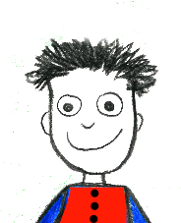
Create your ID
  Fold your game piece in half, so it can stand up by itself.
  On the bottom, write “I Did…”
  Draw a self-portrait.
I did…
Notes:
Instructor Notes:
Explain that today students will be making their own decision-making board game. They have already made their dice, so the second step is to make their own ID Game Piece.
Pass out one ID Game Piece (see the Materials list) to each student, and click once to display the directions:
Fold your game piece in half, so it can stand up by itself.
On the bottom, write “I Did…”
Draw a self-portrait.
Explain that students will have about 5 minutes to draw their self-portrait and create their game piece.

Slide 16
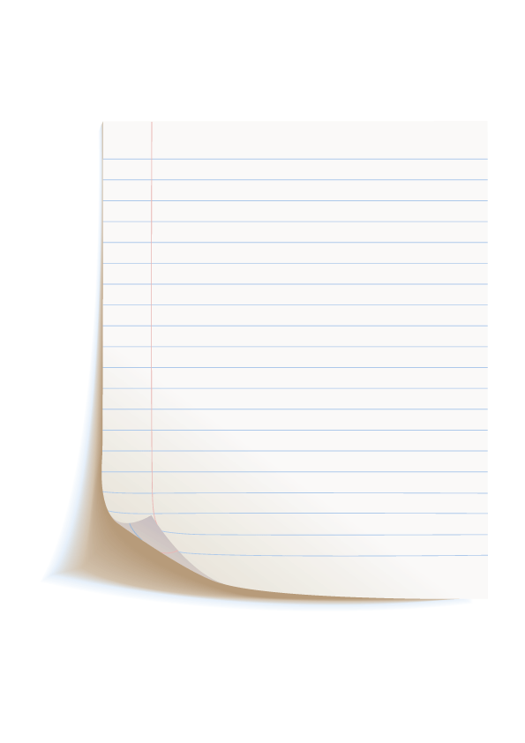
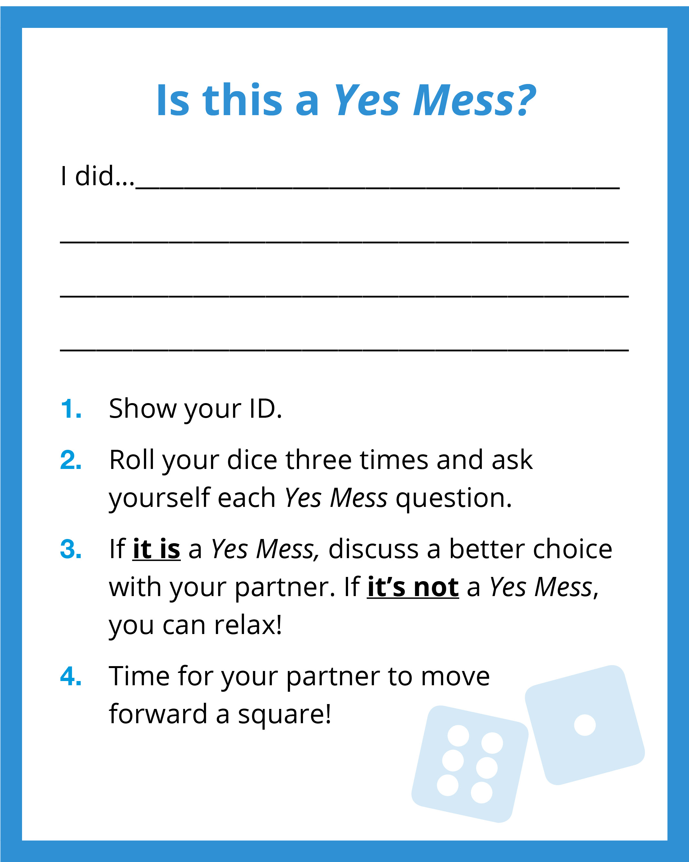
Yes Mess Cards
Yes Mess Cards
Stuck? Think about decisions
you make:
Before school
On the school bus
In the classroom
At recess
At specials
At lunch
During clubs, sports, or after school activities
When you do homework
At night
Show your ID for:
- 2 positive choices
- 2 negative choices
Notes:
Instructor Notes:
Distribute one Handout 5: Yes Mess Cards to each student
Explain that these cards will be used during the game that the students play…but they first need a few finishing touches!
Click once to display a model Yes Mess card. Explain that on the blank lines, students will Show Their ID and take responsibility for a choice they have made.
Click again and explain that, since they have four cards in all, they will Show Their ID for positive choices on two cards and Show Their ID for negative choices on two cards.
Click a third time and reveal some of the categories/idea starters that students could consider when Showing Their ID.
Help kick off the brainstorming by sharing one positive and negative ID statement about yourself. For instance:
Positive: I did…make the choice to get out of bed on time this morning!
Negative: I did… make the choice to watch TV and not clean last night.
As students finish, encourage them to help another student brainstorm ID statements.

Slide 17
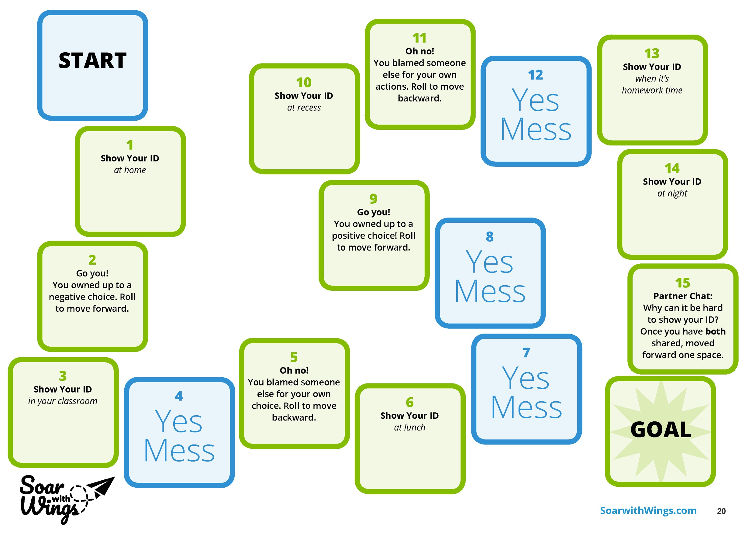
Game Prep!
  Cut out your Yes Mess cards, shuffle them with your partner’s cards, and place them face down.
  Brainstorm a name for your game (related to making positive choices!) and write it on your gameboard.
  Add color and drawings to your gameboard and/or cards.
Notes:
Instructor Notes:
Place students with new partners. If they worked with someone to create their Yes Mess cards, they should not work again with this person.
Distribute one Handout 6: Board Game and a pair of scissors to each pair.
Click once and explain that pairs will have about 5 minutes to complete the following steps and prepare their board game to be played:
Cut out your Yes Mess cards, shuffle them with your partner’s cards, and place them face down.
Brainstorm a name for your game (related to making positive choices!) and write it on your gameboard.
Add color and drawings to your gameboard and/or cards if you have time.

Slide 18

Time to Play!
Notes:
Instructor Notes:
It’s game time!
Every pair will need their game pieces, their Yes Mess cards, their Yes Mess dice from Day 1, and their game boards.
In addition, distribute one copy of Handout 7: Game Rules to each pair.
Read through the rules together and answer questions as needed.
Reiterate that students need to raise their hand when they are done playing, and then encourage them to begin!
When students raise their hands to indicate they have played their game once, provide them with a goal sheet. As you do, encourage them to think about what they have learned about making responsible decisions and then fill in the blanks to set goals that will help them make the very best decisions in the future.
Pairs who finish their goal sheets while there is still time left in the class period may play their game again!
When there are 10 minutes left in the class period, distribute goal sheets to any pairs who have not yet started them.

Slide 19

I understand the choices I make
should be what's best for me to do,
and what happens is on me and not any of you.
  When is it easy to Show Your ID?
  When can it be hard to Show Your ID?
  Why is it important to Show Your ID?
Notes:
Instructor Notes:
Bring the students back to a semi-circle or circle for a few moments of reflection.
Click once to display each of the following questions, and discuss:
When is it easy to Show Your ID?
Acknowledge that it may be easy to Show Your ID if it is something you are really proud of doing.
When can it be hard to Show Your ID?
Acknowledge that other times it can be hard to Show Your ID if you are embarrassed, made a mistake, or don’t want to feel like you’re bragging.
Why is it important to Show Your ID?
Ensure students understand it is important to Show Your ID for all of your choices because it means you take ownership for everything you do. This will help others trust you and believe you!
Explain that by setting a goal for a time when Showing Your ID is difficult, students are making sure that they use their new personal responsibility skills when it is most important!
If there is time for a couple student volunteers to share their goals, encourage them to do so. It may be helpful to talk about how it can be difficult to Show Your ID for something positive if you don’t want others to know. Collect students’ goal sheets and display them in the classroom or have students share at a later date.
Click two times and conclude by reading the Responsible Decision-Making portion of the Wings Words to Live By, as displayed on the slide, together as a class.

