Slide 1



Time to Play!

Slide 2

My Choices
I soar with wings.
Let me tell you why.
I learn lots of skills that help me reach the sky…
I understand the choices I make should be what’s best for me to do, and what happens is on me and not any of you.
What is a choice?
Notes:
Instructor Notes:
Instruct the class to sit on the floor in a circle or semi-circle and join the students by sitting at their level. Then begin the first session by reading the Words to Live By excerpt aloud.
Repeat “I understand the choices I make should be what’s best for me to do” and ask students to raise their hand if they have ever made a choice before.
Then click once and ask: What is a choice?
Call on a few volunteers to share their thoughts.
Then click once more and ensure students understand that a choice involves picking between two or more possibilities.
Tell students that they are going to play a game to learn a little more about choices!

Slide 3

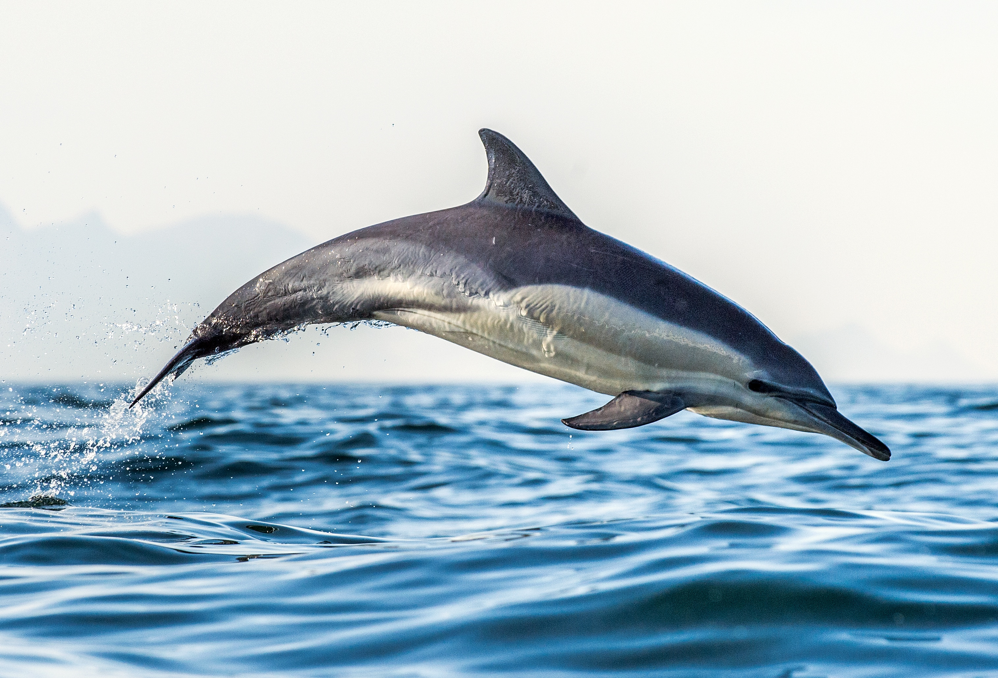

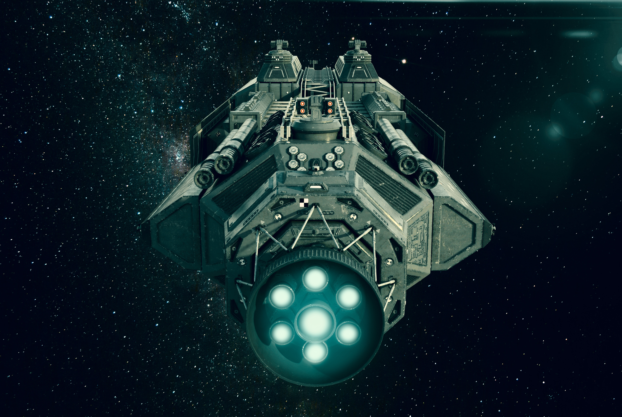
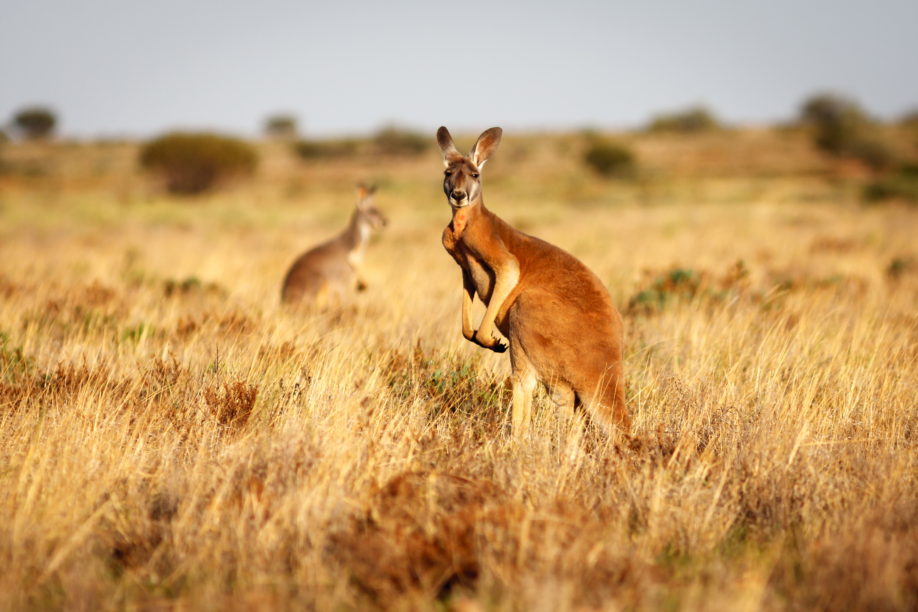



Would you rather…
live in a castle or on a spaceship?
live on Mars or the Moon?
be 3 years older or 3 years younger than you are right now?
be a kangaroo or a dolphin?
be able to fly or become invisible?
did any of these choices have right or wrong answers?
Yes
No
Notes:
Instructor Notes:
Explain that students are going to play a game called “Would You Rather?”
Lead students through the first round of the game by following these directions:
Click once to display the question “Would you rather live on Mars or the Moon?” and read it aloud.
Instruct students to think silently about their answer. They must choose one!
Then designate one area of the classroom for Mars and one area of the classroom for the Moon. Instruct students to silently get up and stand in the area that represents their choice.
*Note: If needed, discuss the importance of staying true to your own decision, even if many people made a different choice.
Ask at least one student on each side to share the reasoning behind their choice.
Then click twice to remove the question and replace it with the next question.
Repeat the procedure above for the following questions:
Would you rather be three years older or three years younger than you are right now? (Provide ages for students so they do not have to add or subtract to understand the question.)
Would you rather be a kangaroo or a dolphin?
Would you rather live in a castle or on a spaceship?
Would you rather be able to fly or become invisible?
Finally, click twice more to reveal one last question: Did any of these choices have right or wrong answers? Designate one area of the classroom for “yes” and one area of the classroom for “no.”
Before moving on to the next slide, make sure students understand that some decisions don’t have a right or a wrong option. Sometimes, decisions are based entirely on how we feel and think. It’s not “more” right or “more” wrong to rather be a kangaroo or a dolphin…It’s entirely up to our own feelings, likes, and dislikes!

Slide 4
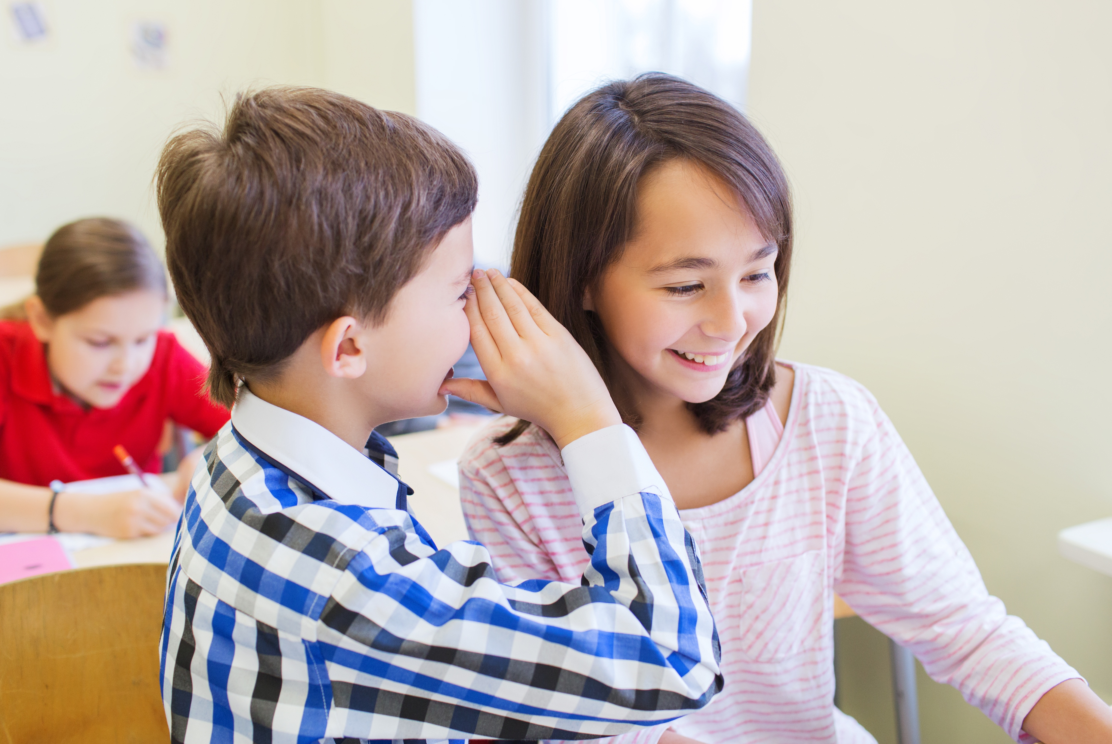
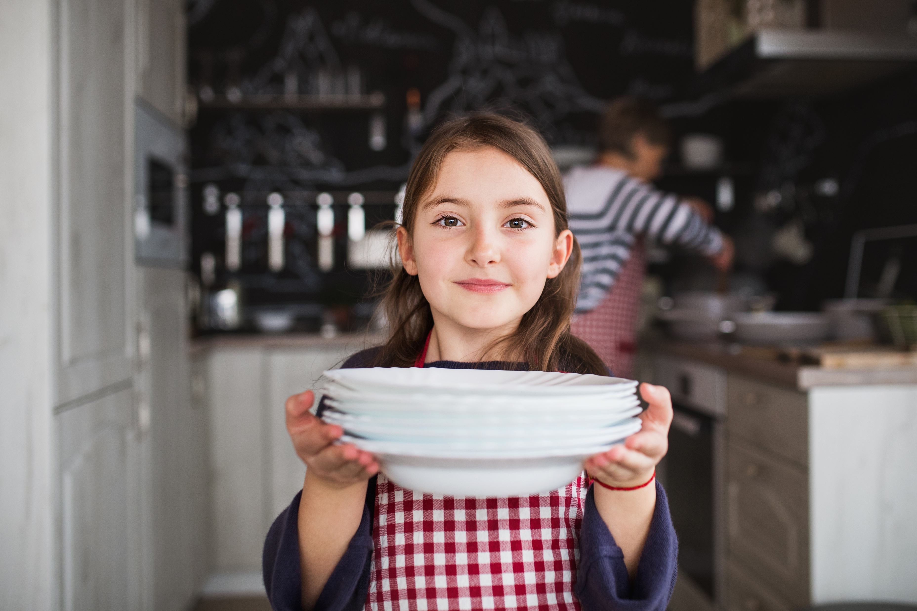
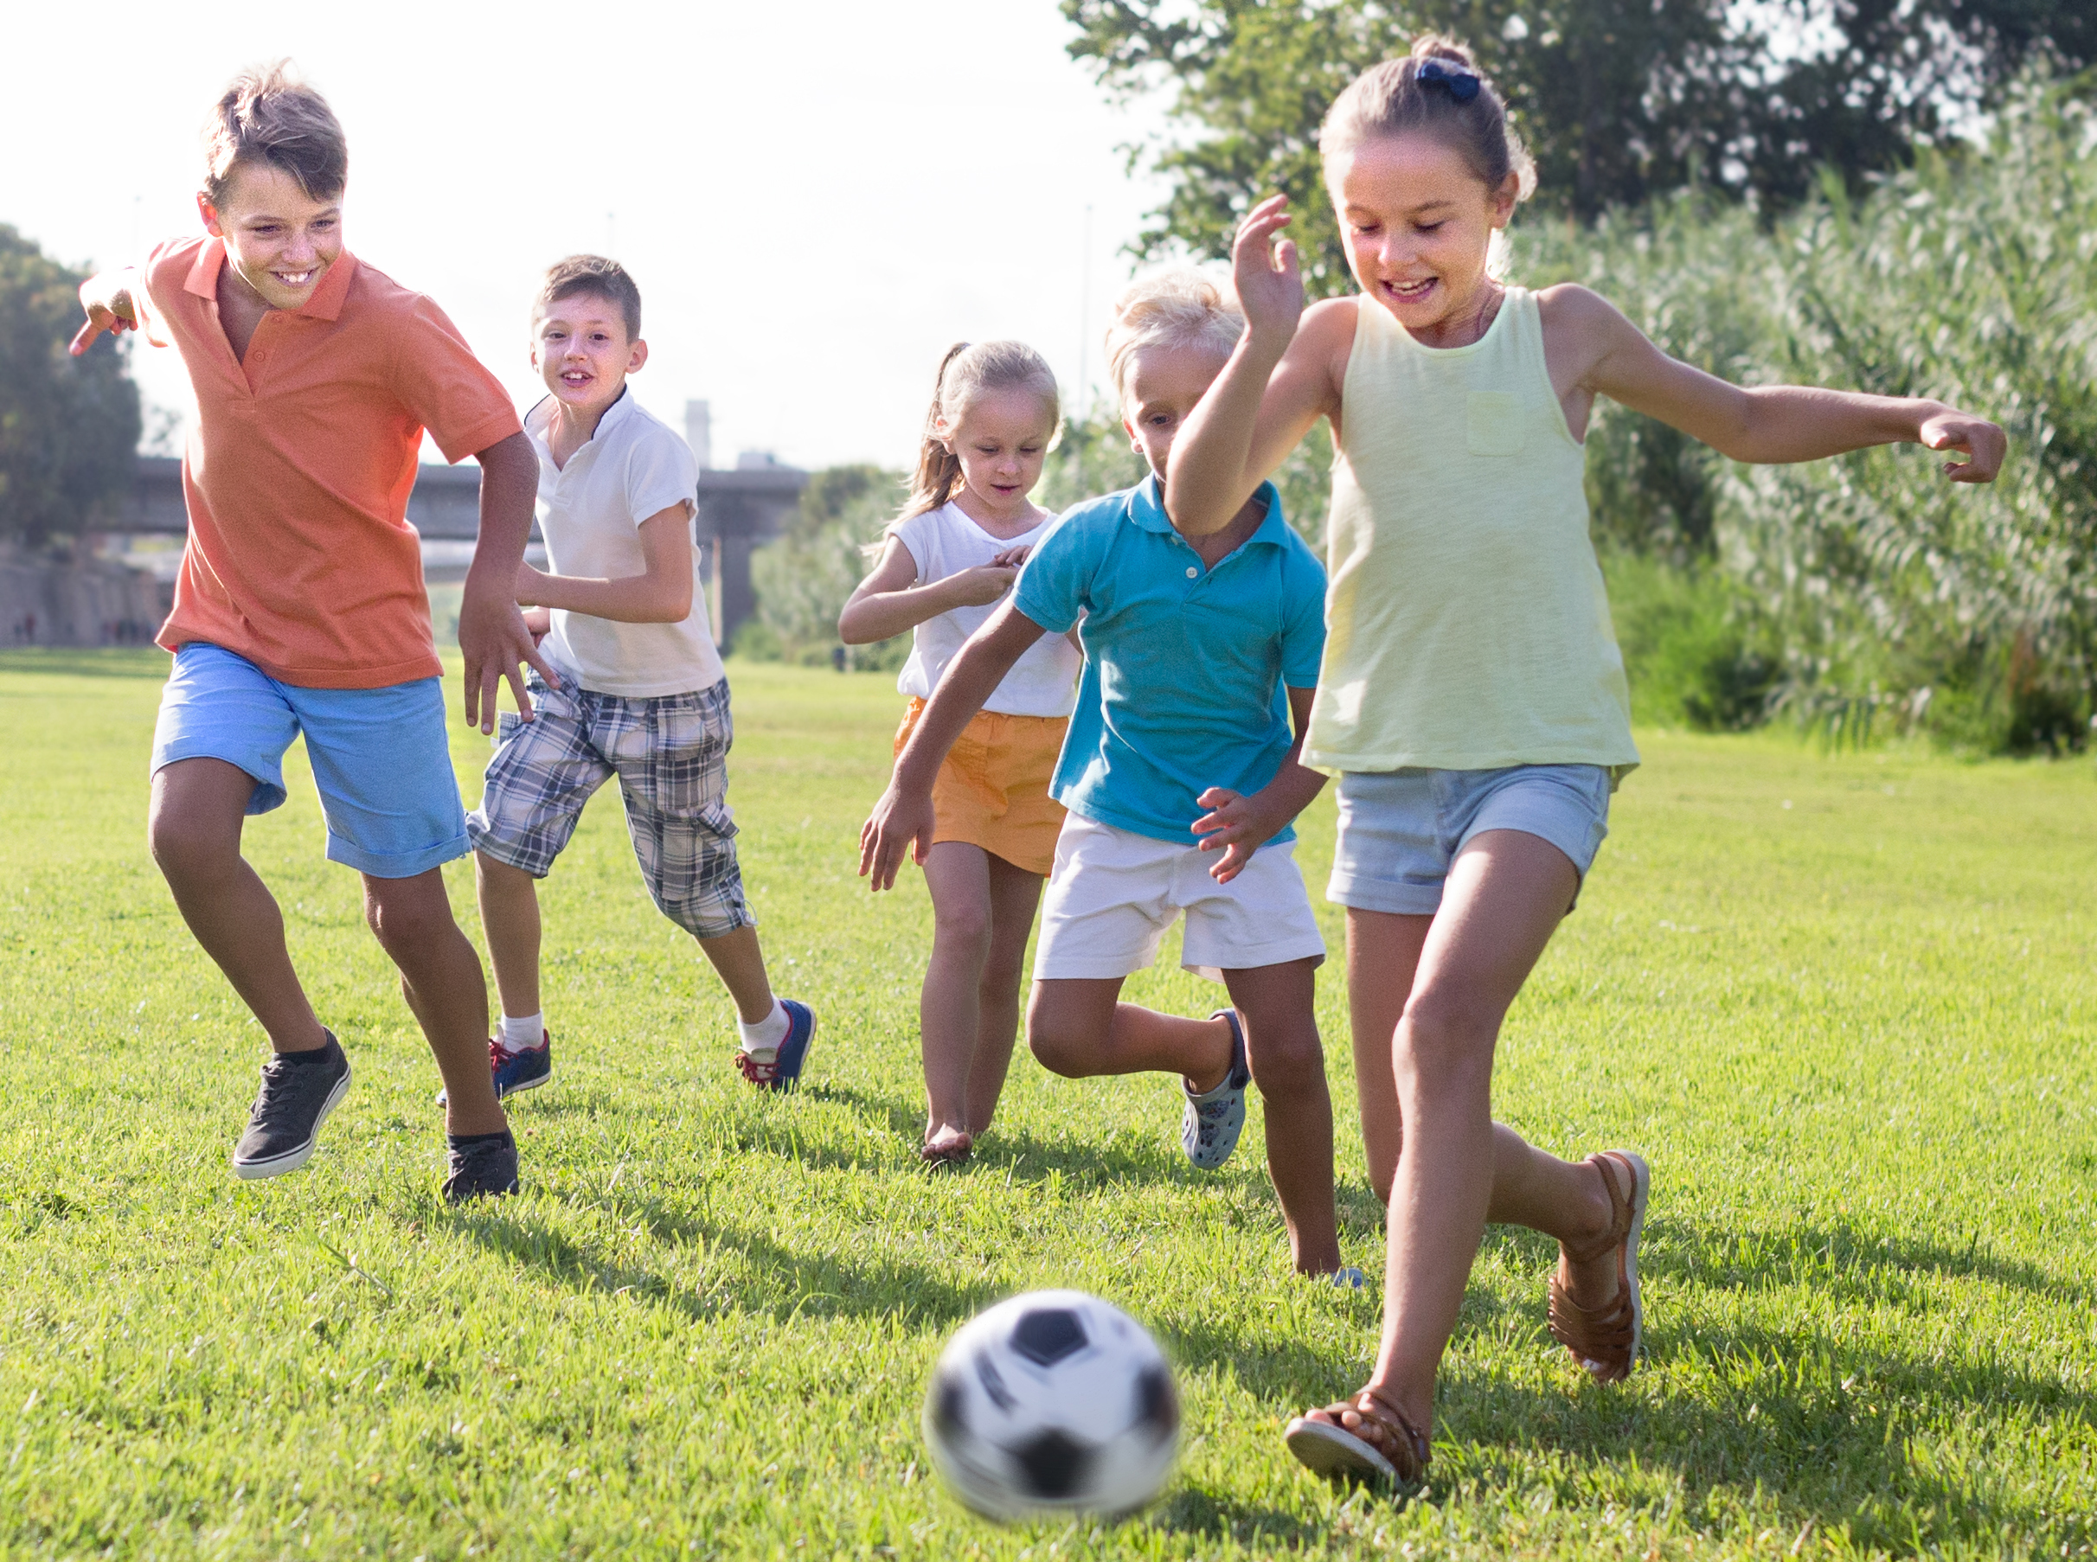
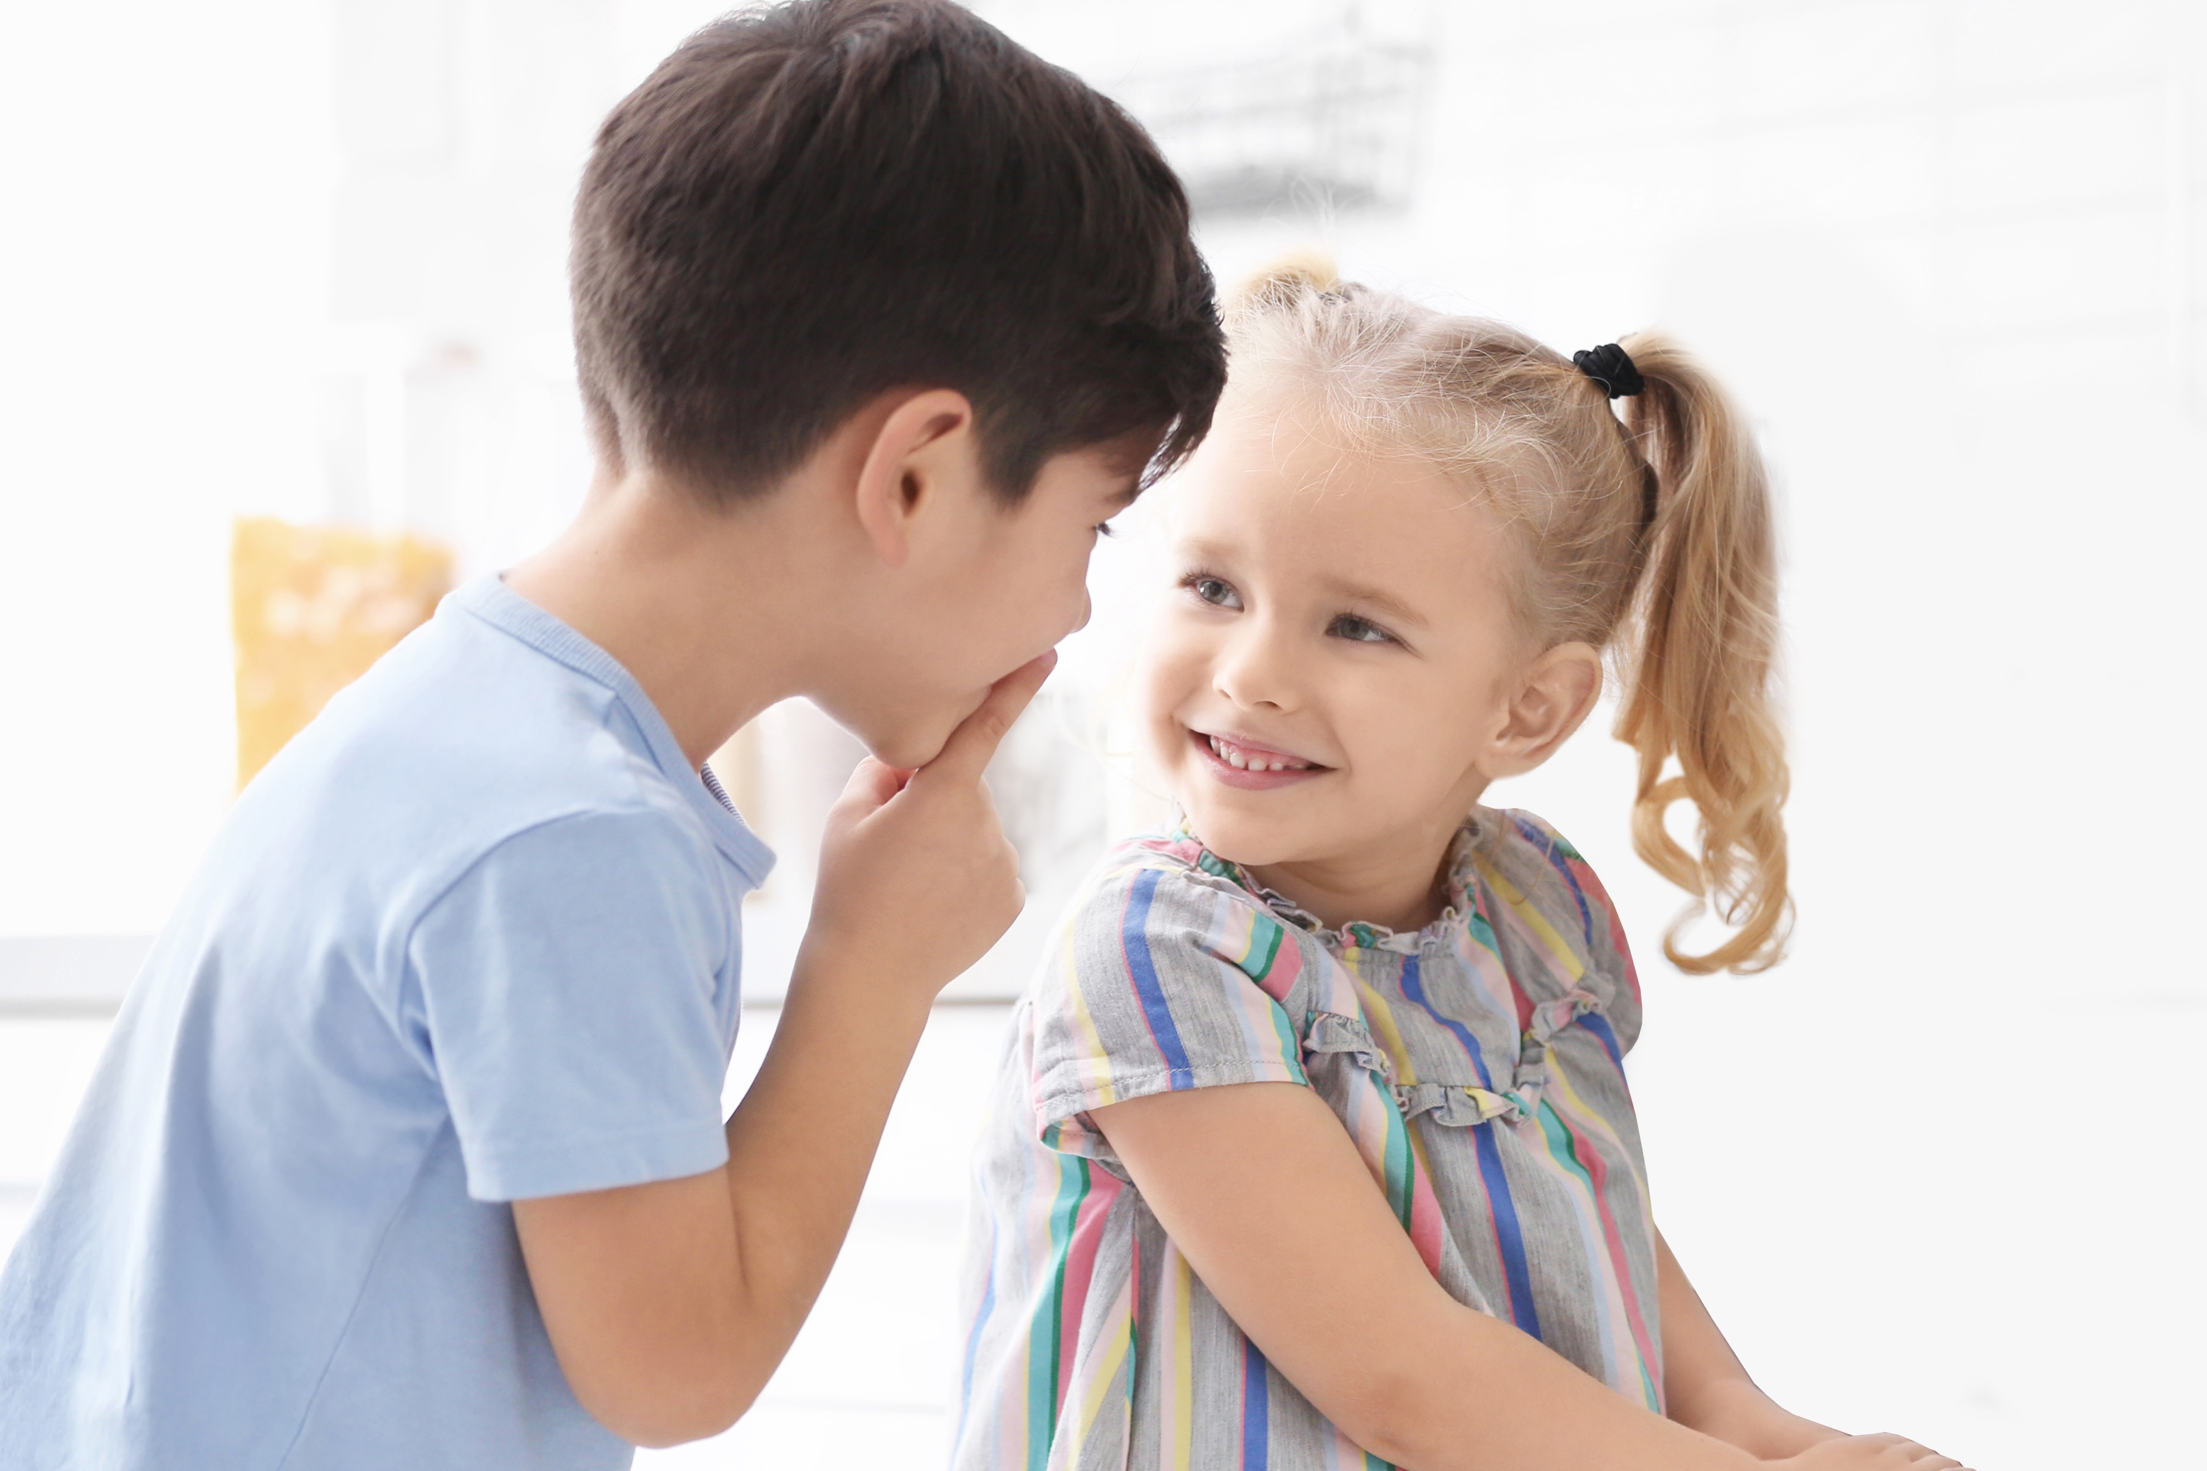

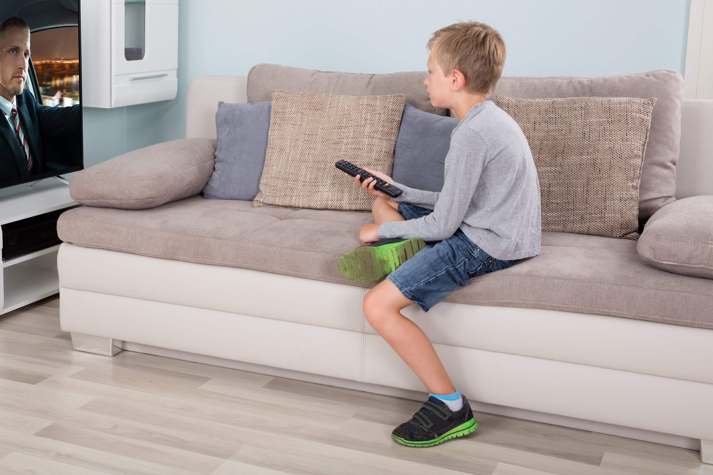
Right or Wrong?
Your mom has asked you to stop watching TV and help her get ready for dinner. Do you:
You see that your classmate looks lonely
at recess. Do you:
Your friend is in the middle of telling you a funny story, but the teacher just asked you to be quiet. Do you:
  Turn the TV off and help her?
  Ask him or her to join you?
  Keep listening to your friend so you can hear the story’s ending?
  Ask your friend to finish telling you later?
  Keep watching TV because it’s your favorite show?
  Keep playing with your friends and pretend you don’t notice?
Notes:
Instructor Notes:
Explain that other choices are different: Some choices do involve right and wrong!
Help students form groups of three or four and pass out both parts of Handout 1: Right or Wrong to each group.
Tell students that you are going to read a few different choices. Each group should talk together and decide which is the “right” choice and which is the “wrong” choice. Once they have decided, one group member should come up and put the “wrong” red light handout on the floor under the wrong choice and another group member should put the “right” green light handout on the floor under the right decision.
Click once to display one of the scenarios:
Your mom asks you to stop watching TV and help her make dinner. Do you: Turn the TV off and help her or Keep watching TV because it’s your favorite show?
Instruct students to discuss the choices with their group. Every group should then have two students come up and distribute their traffic lights.
Once each group has made their decision, discuss: How did you know which choice was right and which choice was wrong?
Redistribute the traffic lights to each group and then click twice to repeat the same procedure with the following two scenarios:
You see that your classmate looks lonely at recess. Do you: Ask him or her to join you or Keep playing with your friends and pretend you don’t notice?
Your friend is in the middle of telling you a funny story, but your teacher just asked you to be quiet. Do you: Keep listening to your friend so you can hear the story’s ending or Ask your friend to finish telling you later?

Slide 5
Yes Mess
  Could anyone get hurt?
  Could anyone get in trouble?
  Could anything bad happen?
Notes:
Instructor Notes:
Introduce students to the idea of a Yes Mess by explaining that there are three easy questions that you can ask yourself to help you make choices that are right for you.
Click three times to read and display each of the following questions:
Could anyone get hurt?
Take a moment to explain that this question refers to all kinds of hurt, including our feelings!
Could anyone get in trouble?
Could anything bad happen?
Pass out Handout 2: Yes Mess to each student and explain that they will be making a game spinner with these questions, which they can use to help them make decisions!
Instruct students to use the coloring supplies to decorate their spinner with colors and pictures that will help them remember each of the questions. They can use the emojis on the slide as a starting point, but encourage them to come up with their own image too!
*Tip: As part of this step, older students may also use scissors to cut out their spinner. However, it’s also fine to keep the spinner on the larger handout.
As students are designing their spinners, walk around the classroom with a pair of scissors, paper clips, and paper fasteners. Work with small groups of students and help them construct their spinners by following these directions:
Use the scissors to create a small hole in the center of each spinner.
Help (and/or show students how to) place the paper fastener through the paper clip and then through the hole in the spinner, so it looks similar to this.
Secure the paper fastener by folding its arms over on the back of the spinner. Make sure not to secure the arms all the way against the spinner: It will need to be a little loose in order for the paper clip to spin.

Slide 6

  I choose to jump off the swings or playground at recess.
  I choose to tell my cousin she or he cannot play with me.
  I choose to run around the cafeteria during lunch time.
YES
MESS
Notes:
Instructor Notes:
Tell students that you are going to go back to a couple of the surprises that you discussed at the beginning of this session.
Click to re-display a picture of the first surprise, and say: Surprise! Your little brother or sister breaks your new toy.
Click to redisplay one more surprise picture, and say: Surprise! Your mom was supposed to take you to the movies but she has to work.
Instruct partners to discuss the same Control Check question: If you stopped and did a Control Check, how could you react to this surprise in a calm and kind way?

Slide 7
  I choose to think about my choices before I make a decision.
  Could anyone get hurt?
  Could anyone get in trouble?
  Could anything bad happen?
YES
MESS
Notes:
Instructor Notes:
Ask for a few volunteers to pick up and recycle the mess from the Yes Mess activity.
Then click once to reveal one more choice:
I choose to think about my choices before I make a decision.
Remind students of the Yes Mess questions by rereading them and pointing to them on the slide as you read.
Then click twice to remove the questions and display the Yes Mess target.
Instruct each student to spin their own spinner and think about this choice.
If students would answer “yes” to their spinner question, instruct them to throw their last piece of scrap paper at the Yes Mess target.
*Note: Students should answer no to each of the questions, so probe any students who throw their papers to walk you through their thought process and help them understand why yes may not be the best response.
Instruct students to spin two more times, think about the answer in regards to this choice and throw their piece of scrap paper at the target if they would answer yes.
Conclude by saying, “It looks like this choice is not a Yes Mess…which you can see because there is no mess to clean up! Since we answered no to each of the Yes Mess questions, this is a good choice for you!”

Slide 8

I soar with wings.
Let me tell you why.
I learn lots of skills that help me reach the sky…
I understand the choices I make should be what’s best for me to do,
and what happens is on me and not any of you.
Notes:
Instructor Notes:
Wrap up the session by inviting student to join you in reading the Wings Words to Live By segment aloud, as it is displayed on the slide.
Then conclude by saying, “When you make choices in the future, think about your Yes Mess spinner. And if you would answer “yes” to any of the questions, remember the mess you made here today, and try to think of a better choice for yourself!”

Slide 9
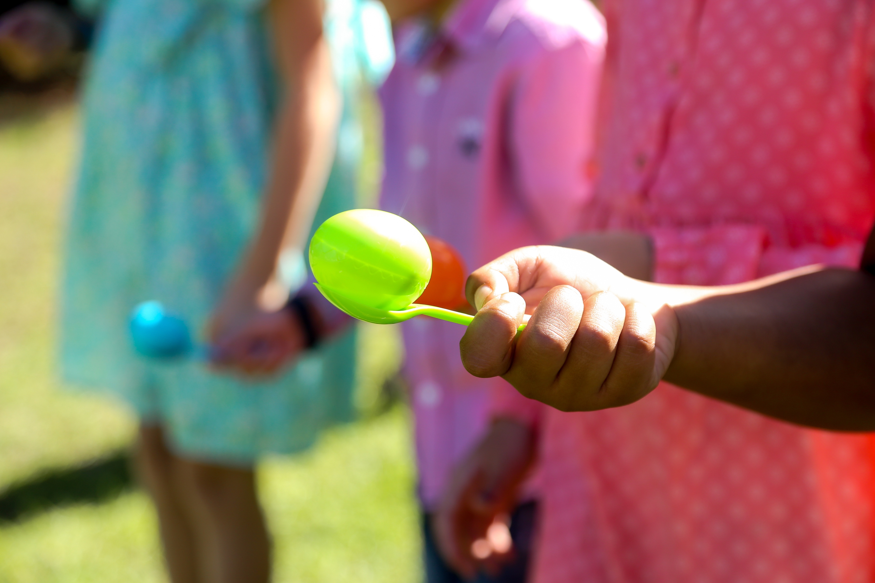
Time to Play!
Notes:
Instructor Notes:
Instructor Prep: Before this session begins, select an area where the class can participate in a relay race. Ideally, you will find an area where the class can stand divided by at least 20-30 feet. (Students will be walking back and forth between these two spots.) Once you have found a space, use masking tape or chalk to mark the two sides.
Begin Day 2 by instructing the class to sit on the floor in a circle or semi-circle and join the students by sitting at their level.
Explain that today will begin with a fun relay race where students will have to work both individually and as a team.
Break the class into groups of four.
*Tip: If the class is not easily divisible by four, it will be better to have a group of three than a group of five.
Bring the class to the area you have prepared for the relay race, along with the rest of the relay race materials.
Instruct each group to stand in a line behind one of the lines of tape or chalk.
Hold up a spoon and the material that the class will have to balance on their spoon. Explain that when you say, “Go!” the first person in each group will balance this material on their spoon and move quickly to the opposite line. They must touch the line with both feet, and then turn around and return to their group. They will then pass their spoon to their next group member and sit down at the end of their group’s line.
This will continue until all four group members have gone and are sitting down. The first group to have all members sitting wins!
*Notes:
It may be helpful to have a couple students help you model this before you begin!
If the material comes off the spoon, students should place it back on, and then begin again at the location where it fell off.
If any groups have only three members, the first person in line should go twice so there are still four participants.
Then answer any student questions, distribute the materials, and count down to the race start with a “Ready, Set, Go!”
When the race is complete, congratulate all teams for finishing rather than making a winners’ announcement and then bring students back to the classroom.When the race is complete, congratulate all teams for finishing rather than making a winners’ announcement, and then bring students back to the classroom.

Slide 10

YOU matter
  Could you control the actions or choices of others?
  Why were YOUR actions important?
  What choices did YOU have to make?
  What job did every person have in the relay race?
Notes:
Instructor Notes:
Reassemble the class on the floor in a circle or semi-circle and again join the students by sitting at their level.
Click once to display the first question below and then click twice to display each of the following questions. Discuss each one as a whole class before moving to the next one:
What job did every person have in the relay race?
What choices did YOU have to make?
Could you control the actions or choices of others?
Why were YOUR actions important?

Slide 11
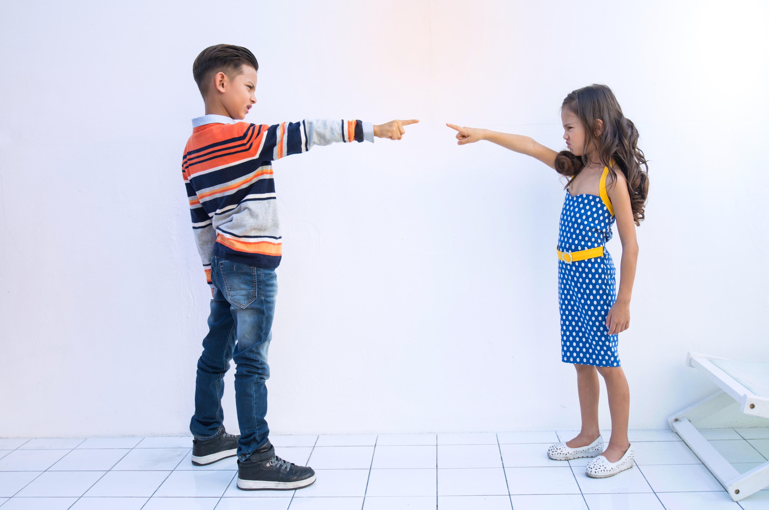
Is it my fault?
Notes:
Instructor Notes:
It’s read-aloud time! Explain that the class is about to read a book that will help them think even more about their own actions and choices.
As you read, ask students to listen for examples of the choices that the main character Noodle makes and think about what we can learn from his actions.
Then either read But It’s Not My Fault by Julia Cook aloud or project the video-aloud.
When the read-aloud is complete, discuss:
Noodle used to blame others all the time. Was this a good choice? Why or why not?
Is it better to say, “It’s not my fault” or is it better to own up to our choices? Why?
*Tip: If needed, explain that when you “own up to your choices,” you admit the choice that you made!

Slide 12
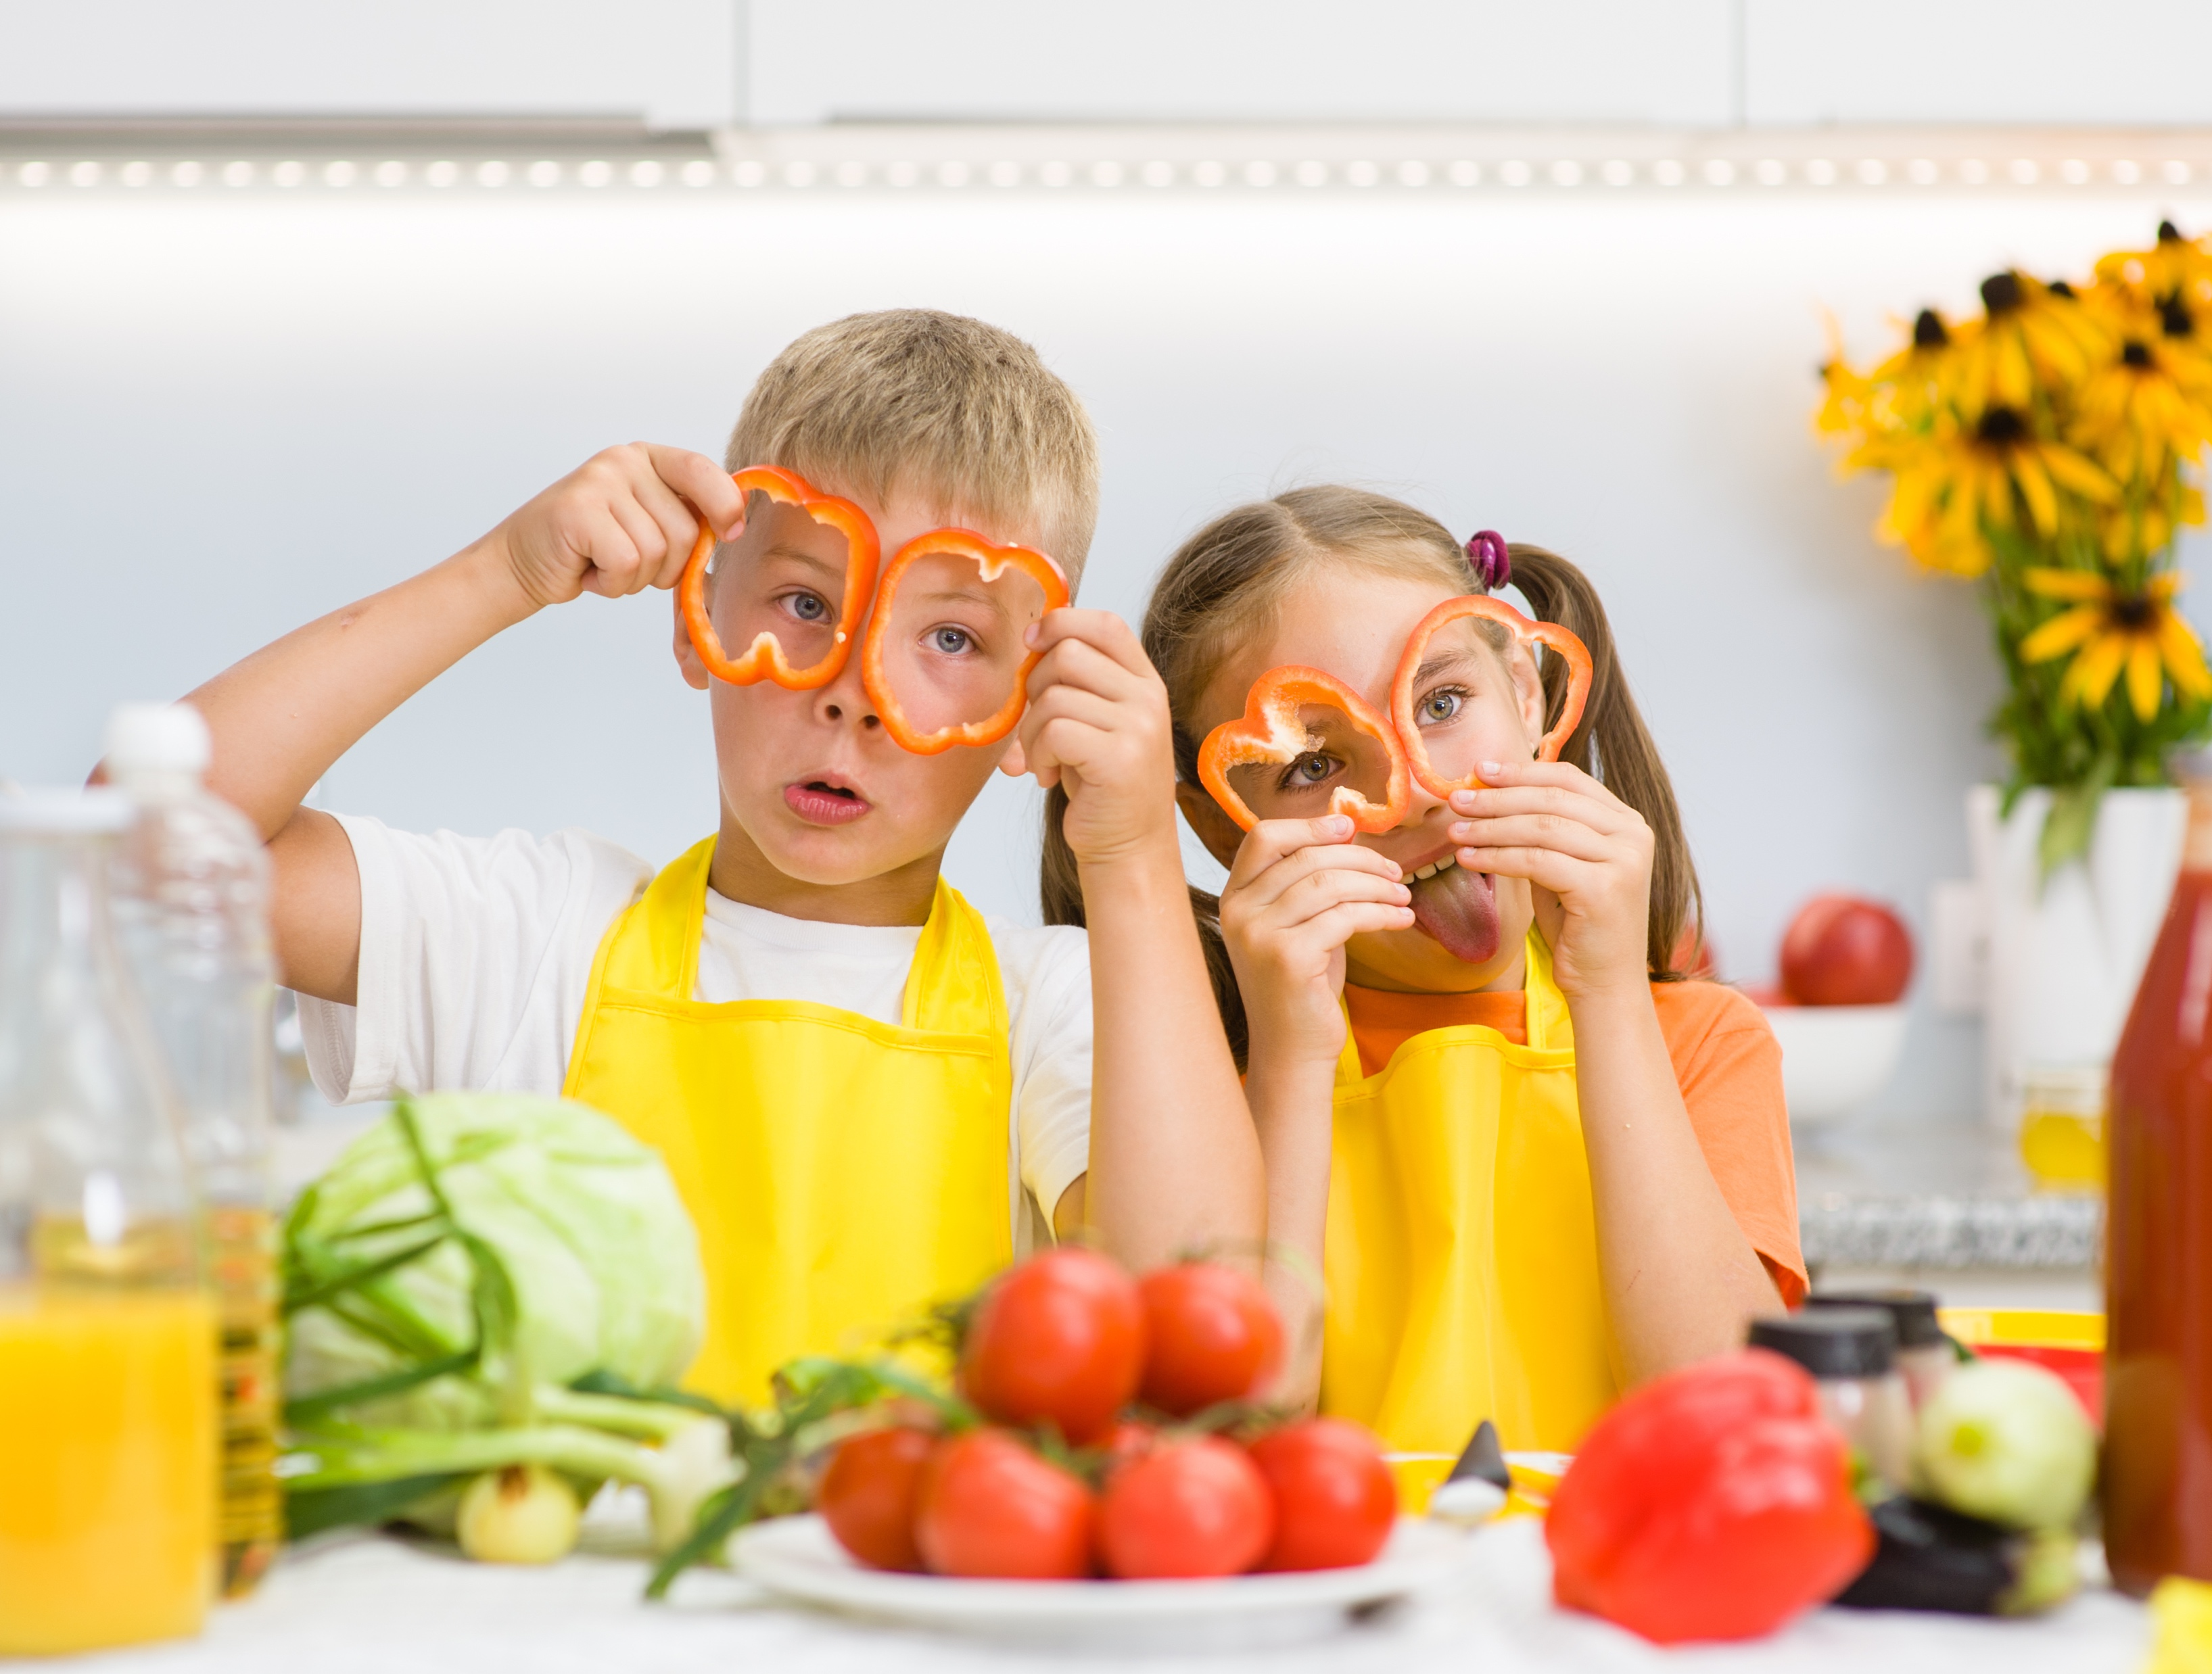
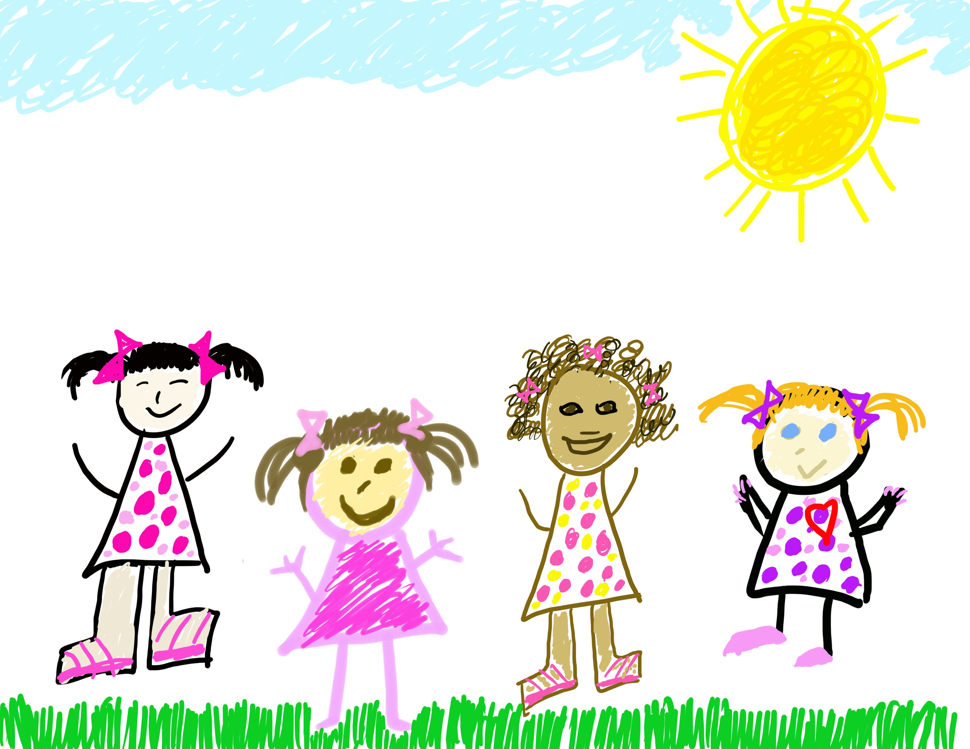
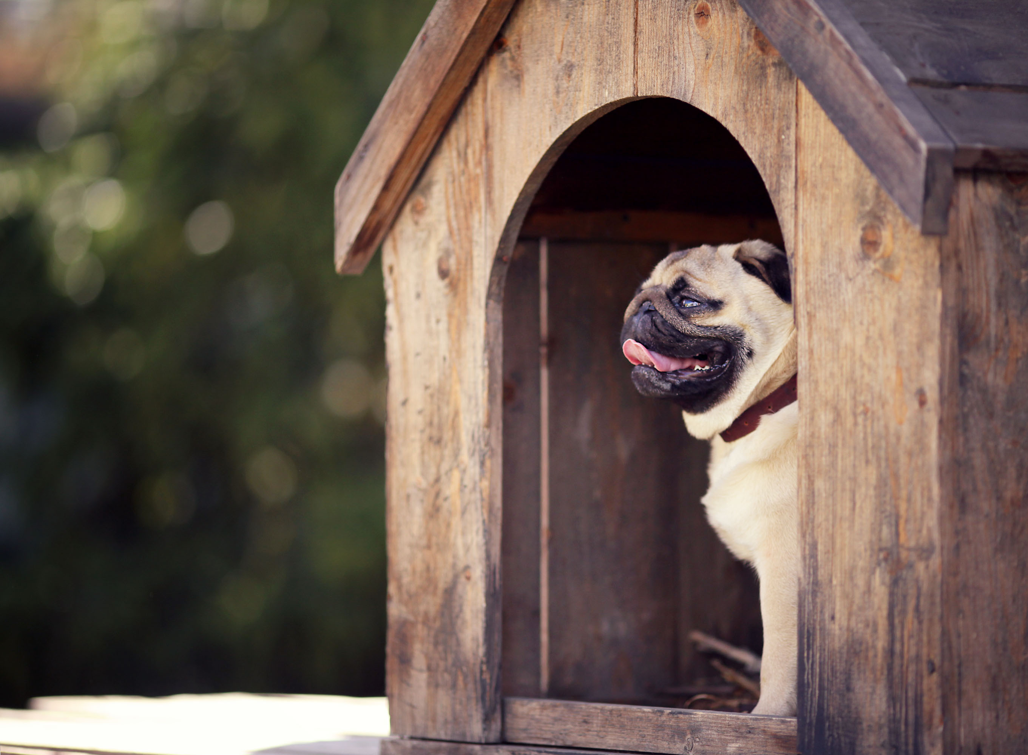
Hand Up, Pair Up, Own Up!
I could blame _____ but I will own up!
This is my fault because ______.
Notes:
Instructor Notes:
Explain that students will now practice not blaming others with a game of Hand Up, Pair Up, Own Up.
Lead students, step by step, through the first round of this activity:
Say, “Hand up,” and instruct students to put one hand up in the air, stand up, and walk silently around the room.
Say, “Pair up,” and instruct students to gently fist bump the person closest to them and sit down next to them.
Then click once and share a scenario aloud: You left a drawing you made on the kitchen counter and your grandma accidentally threw it away.
Click again and instruct the student pairs to “Own up!” by thinking about this situation and filling in the blanks: I could blame ________ but I will own up! This is my fault because _________.
After a minute has passed, ask a student or two to share how they filled in the blanks and owned up.
Then say, “Hand up,” and continue the procedure two more times, clicking twice to reveal new pictures as you read each of the following scenarios:
You goofed around with your friend so much during snack-time that you didn’t have a chance to eat.
You didn’t put the top on your water bottle, and your dog spilled your water all over your library book.
Then bring the students back to their circle or semi-circle and congratulate them for taking ownership of their actions. They admitted their pretend choices and didn’t blame anyone else for their decisions!

Slide 13

Own Up and Inch Up!
Category:
Playing
with friends
or family
members
Category:
Being helpful
Category:
Doing
schoolwork
Category:
Following
directions
Category:
Being kind
Category:
Moving
throughout
the school
building
Notes:
Instructor Notes:
Tell students that they are going to wrap up today by owning up to some of their own decisions.
Divide students into pairs and explain the activity:
Students will sit on the floor and listen as you call out a category.
Each student should own up to a choice they have made related to that category and share it with their partner.
Explain that the choice they share could be good or bad: The important thing is that they own up and don’t blame others.
Once they have owned up to a decision related to that category, they may “inch up.”
Before students play the game, model how to “inch up”: Sit on the floor. State the category of “Being Helpful” and give an example of a time when you chose to be (or chose not to be helpful. If you have a hard time thinking of an example, you could say, “When I was your age, I used to sometimes pretend that I didn’t hear my aunt when she asked for my help with something.”
Once you have shared your example, “inch up” by getting off the floor and crouching just above the ground.
Then encourage student pairs to also own up to a positive or negative decision related to “Being Helpful” and inch up.
Once students have inched up a little bit, click twice to reveal each of the following new categories. As you read each one, instruct students to own up and inch up:
Doing schoolwork
Moving throughout the school building
Following directions
Playing with friends or family members
*Tips:
Remind students to own up to both positive and negative choices.
If students are inching up too quickly, remind them that there are still categories to come so they shouldn’t yet be at their full height.
Finally, share that there is one category left. Click twice to reveal and read: Being kind.
After students own up to this category, they may inch up to their full height and jump into the air.
Conclude by inviting students to high-five each other for owning up to their actions. It’s not always easy to take responsibility for our choices, and they proved today that they could do it!

Slide 14
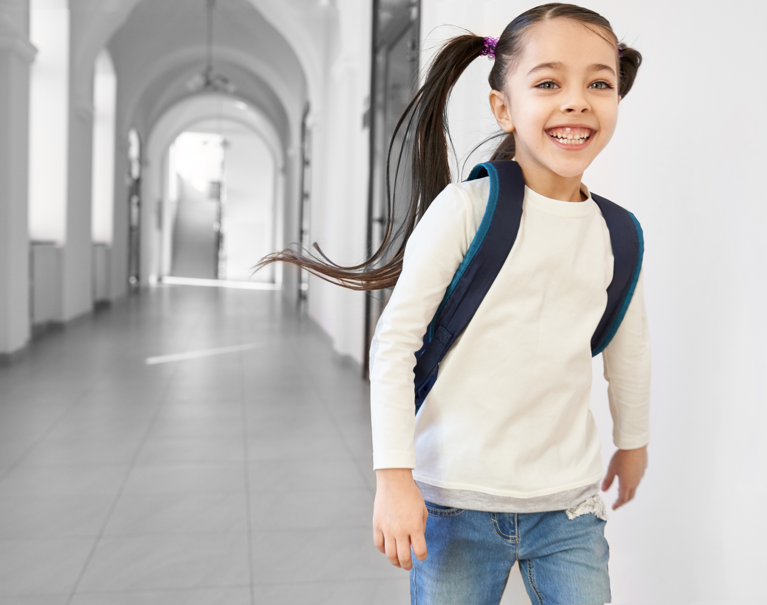
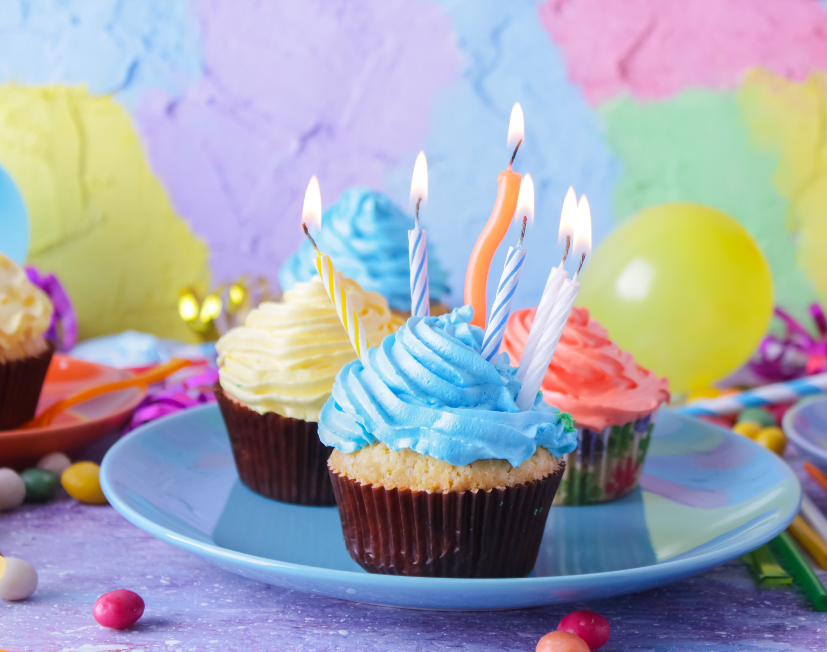

I soar with wings.
Let me tell you why.
I learn lots of skills that help me reach the sky…
I understand the choices I make
should be what’s best for me to do,
and what happens is on me and not any of you.
Notes:
Instructor Notes:
Instructor Prep: Before this session begins, select an area where the class can participate in the game of freeze tag that is included on Slide 16. If needed, this can take place in the classroom, but it will be easier if there is a bigger space available!
Begin this session with students sitting in a large circle or semi-circle. Join them at their level and review what you discussed last session by reading the underlined portion of the Words to Live By aloud: What happens is on me and not any of you. As you read this portion, point your thumbs inward toward yourself when you read “me” and point to the class when you read “you.”
Then review what students learned last session with a silent gesture game.
Click once and tell students to pretend: I ate so many sweets at my friend’s birthday party that I got a stomachache!
Then ask students to decide who needs to own up and take responsibility for getting a stomachache. They should show their decision by quietly pointing to those around them (to indicate it was someone else’s fault) or pointing their thumbs inward toward themselves.
Once students have participated, continue with the following two scenarios, each time clicking twice to display a corresponding picture:
I decided to go to bed before my bedtime and woke up with lots of energy!
I ran in the hallway, and a teacher made me miss part of recess.
For each example, reiterate the concept of personal responsibility by explaining that whatever happens as a result of your choice is on YOU and no one else! For this reason, all scenarios should have students’ thumbs pointing inward.

Slide 15
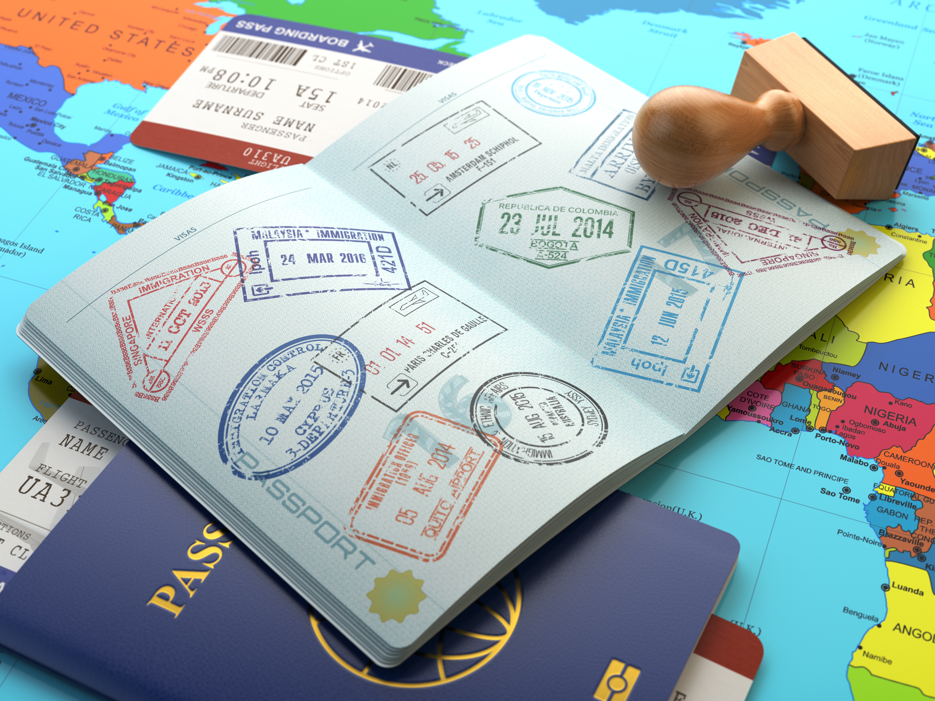
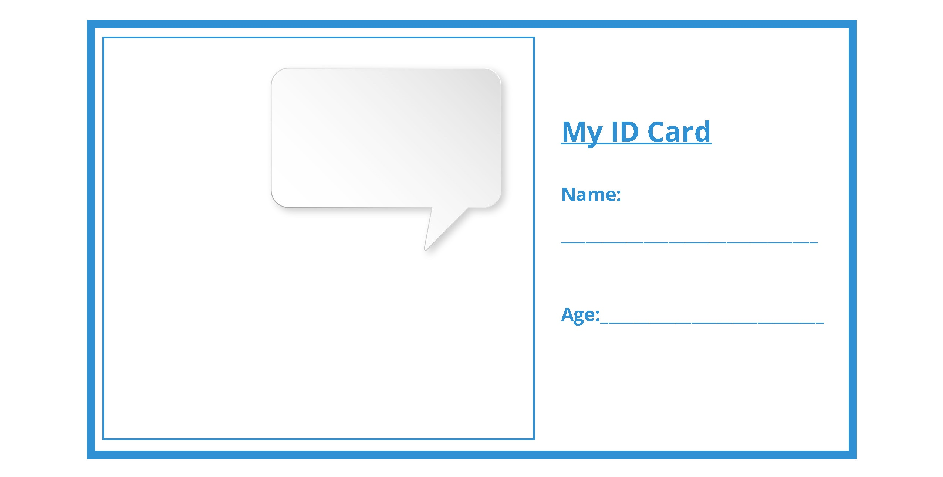
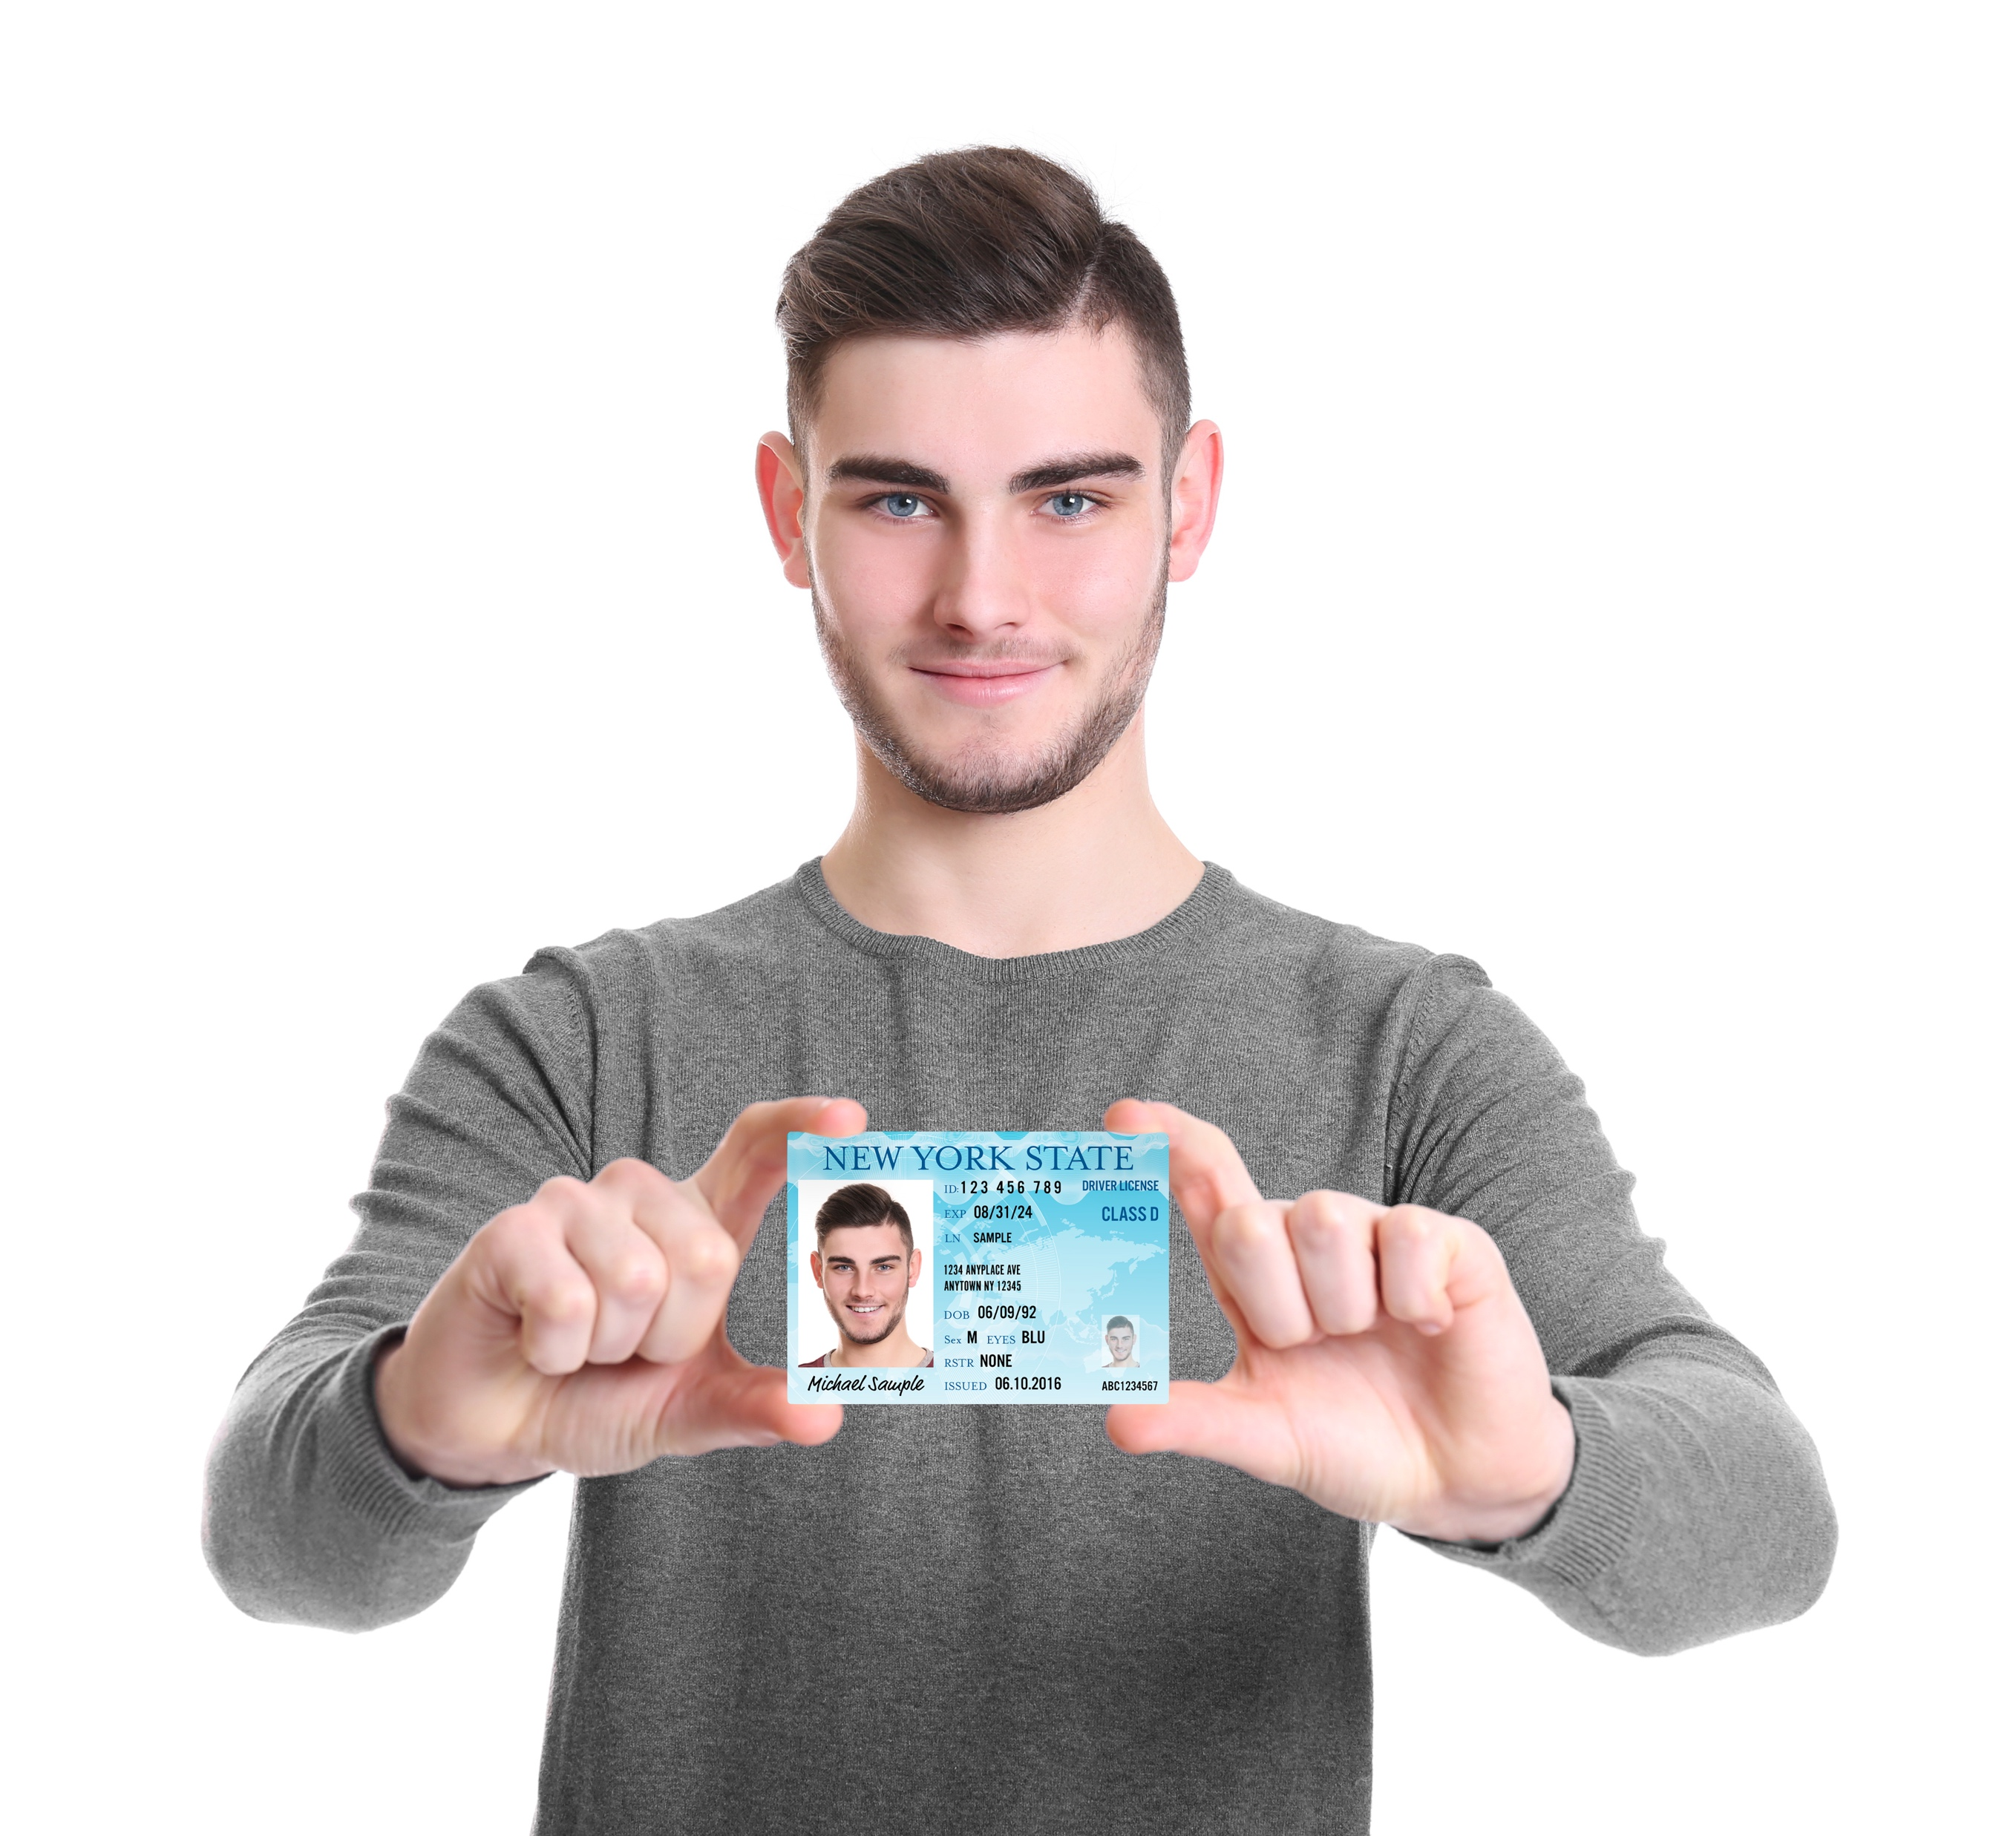
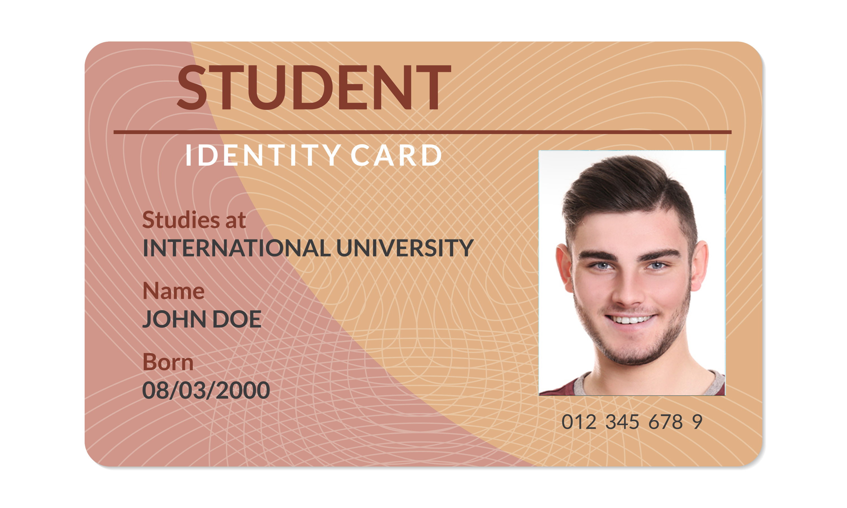
Show your ID
Notes:
Instructor Notes:
Tell students that their choices and actions make up a big part of who they are.
Click once and ask students if they know what an ID card is. Encourage them to look at the pictures on the slide to get an idea!
Help students arrive at the answer that an ID card is a document that uses pictures and words to show your identification…In other words, it shows who you are!
Pass out one ID card (from Handout 3) to each student and explain that they will be making their own ID cards.
Click twice to display the student ID card and read through the words on the card.
Instruct students to first fill in their name and age. They should then use the coloring materials to create a self-portrait of themselves in the circle.
Instruct students to leave the speech bubble blank!

Slide 16
Show your ID
I did …
Notes:
Instructor Notes:
As students are wrapping up, instruct them to put their coloring materials down for a moment.
Click once and explain that they will also be using the letters “ID” to stand for “I did…” which will help everyone own up to their choices and actions.
Explain that when you Show Your ID, you say what YOU did, and you don’t blame anyone else!
Guide students in copying “I did…” into the speech bubble on their ID cards, like the model on the slide.

Slide 17

1,2,3…Show your ID!
Notes:
Instructor Notes:
Tell students that they are about to practice Showing Their ID.
Distribute a Positive Personal Responsibility Patch (from Handout 4) to each student.
Instruct students to think about a way they took personal responsibility for themselves. For example, choosing their own outfit for the day, cleaning their room without being asked, getting their own snack, helping a younger sibling, and so on.
Have students draw or write about their example on the back of their patch. Give students about 15 minutes to work on their patches.
Once students are ready, they should get up with their patches. Explain that when you say, “Go!” students will walk around the classroom. When you say, “Partner!” students find a partner close to them and Show Their IDs to each other. Each student Shows Their ID and describes how they demonstrated personal responsibility.
If necessary, model the activity with a student volunteer.
Instruct the class to begin walking around the room and repeat these directions for three or four rounds.

Slide 18

1,2,3…Show your ID for:
A or choice
that you made this week!
A choice
you made that you
are proud of.
A choice
that you made
during school.
A choice
that you made
at home.
Notes:
Instructor Notes:
Reassemble students into a large circle or semi-circle and collect the Positive Personal Responsibility Patches.
Explain that while it’s important to be able to talk about the positive choices we make, it’s also important to Show Our ID for our bad or negative choices. When we Show Our ID for a negative choice, it’s our chance to admit that what we did was wrong and that the choice was on “me” and no one else. It is also a chance for us to think about how we would act differently the next time.
Explain that students are now going to do a similar activity, but will talk about some negative choices they have made instead. They will then work with their partners to identify positive alternatives for their negative choices.
Explain the procedure:
At the beginning of each round, I will share a Show Your ID category, such as, “Show Your ID for a bad choice you made at home,” or “Show Your ID for a choice that you’re proud of!”
Once I share the category, you will have a minute to think about a choice you made. You’ll need to share this choice with a partner.
When I say, “Go!” start to move around.
When I say, “Partner!” find a partner near you and Show Your ID.
Once both of you have shared your negative choices, help each other figure out a positive choice for next time. For example, if your bad choice was to make a mess in the kitchen, your positive choice for next time could be to clean up your mess before leaving the kitchen.
After about 30 seconds, I will give you the signal to move again and find a new partner. Your new partner will give you their positive choice suggestion.
If necessary, model the activity using a student volunteer.
Begin playing. Click once to reveal the first round’s Show Your ID Category: Show Your ID for a negative choice you made at home.
Give students a moment to think about this choice, then say, “Go!” Students will move to find partners, share their negative choices, and suggest positive alternatives.
Repeat for the following categories:
Show Your ID for a positive choice you made that you are proud of.
Show Your ID for a negative choice you made during school.
Show Your ID for a negative or positive choice that you made this week!
Just in this instance. They’ve shared a positive example. Now they’re sharing a negative choice and a positive alternative.

Slide 19
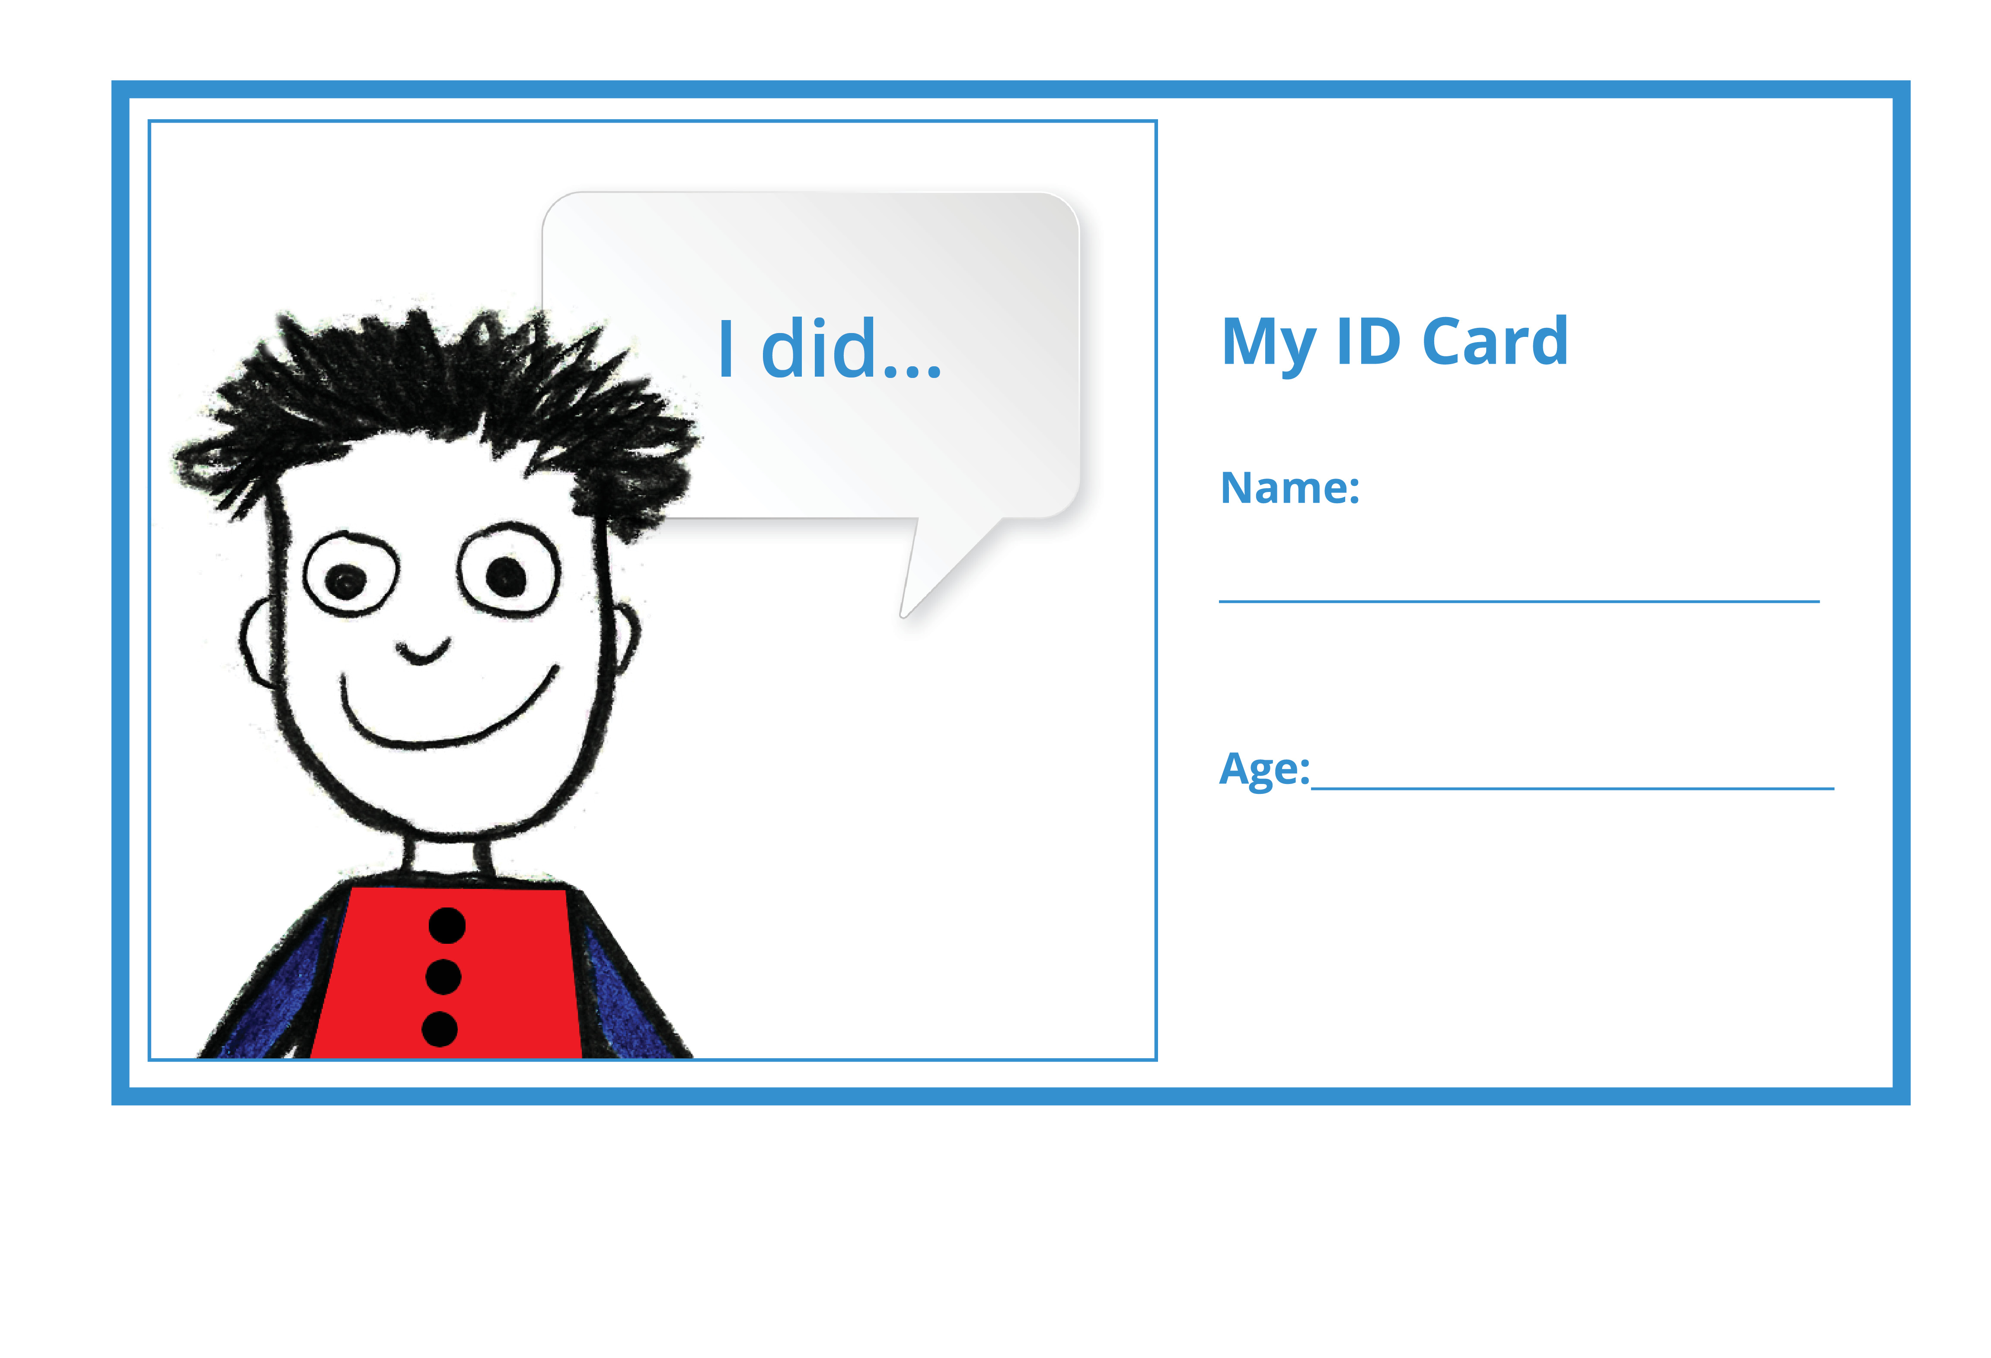
Notes:
Instructor Notes
Bring the students back to a semi-circle or circle and debrief on the activity. Ask:
When is it easy to Show Your ID?
Acknowledge that it many people find it easy to show their ID if they are proud of their actions, but some people find it embarrassing to bring attention to themselves (even for positive things).
When can it be hard to Show Your ID?
Acknowledge that other times it can be hard to Show Your ID if you are embarrassed, made a mistake, or don’t want to feel like you’re bragging.
Is it important to Show Your ID? Why or why not?

Slide 20
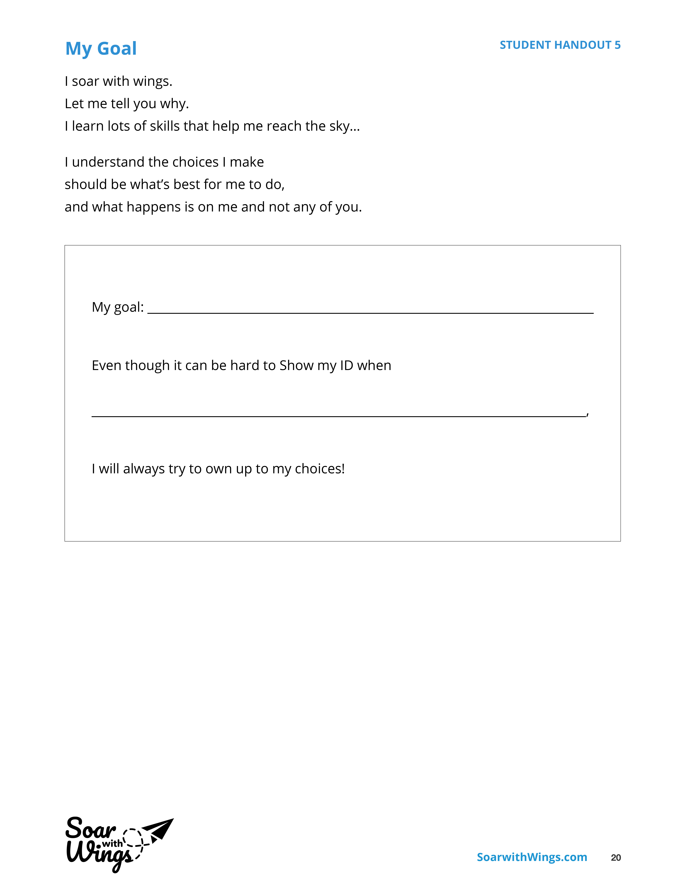

My Goal
Notes:
Instructor Notes:
Conclude this session by passing out a copy of Handout 6: My Goal to each student.
Read through the Words to Live By segment on the top half of the handout together as a class.
Then read the fill-in-the-blanks portion and explain that every student will set a goal to help them with a time in the future when it might be hard for them to Show Their ID. They will then illustrate their goal in the space provided.
Provide the example:
It is hard for me to Show my ID when I feel embarrassed. So, I may write: “Even though it can be hard to Show my ID when I am embarrassed about the choice I made, I will always try to own up to my choices!” Then I could draw a picture of me apologizing to my sister for making the choice to be unkind.
Answer any questions and then encourage students to begin their goal-setting. If you think it will be helpful for students to discuss their goal with a peer before working individually, encourage them to do so.
Once students’ work is complete, collect their goal sheets and display them in the classroom. Or, if this is not possible, try to incorporate time for goal-sharing into the next several sessions!

